Slide 1
NOTE TO TEACHERS:
This poem is about Boston. Either use this poem or replace it with a poem of your choice.

Slide 2
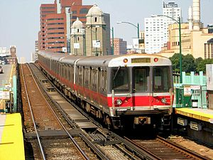
Boston Day
Shared Reading Week 3

Slide 3
Good morning!
Get on the T,
Sit by the sea,
Eat a snack with me!

Slide 4
Good afternoon!
Watch players at bat,
Have a good chat,
Don’t forget your “B” hat!

Slide 5
Good evening!
Go home with a map,
It’s time for a nap!

Slide 6
Photo citation:
https://en.wikipedia.org/wiki/Red_Line_(MBTA)

