Slide 1
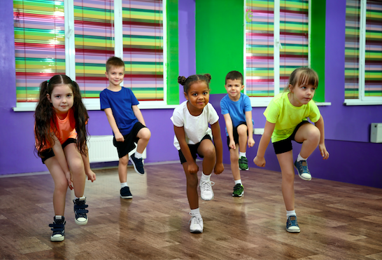
Way Down in the Music
by Eloise Greenfield
Shared Reading Week 3

Slide 2
I get way down in the music
Down inside the music
I let it wake me
take me
Spin me around and make me
Uh- get down

Slide 3
Inside the sound of the Jackson Five
Into the tune of Earth, Wind and Fire
Down in the bass where the beat comes from
Down in the horn and down in the drum
I get down
I get down

Slide 4
I get way down in the music
Down inside the music
I let it wake me
take me
Spin me around and shake me
I get down, down
I get down

