Slide 1
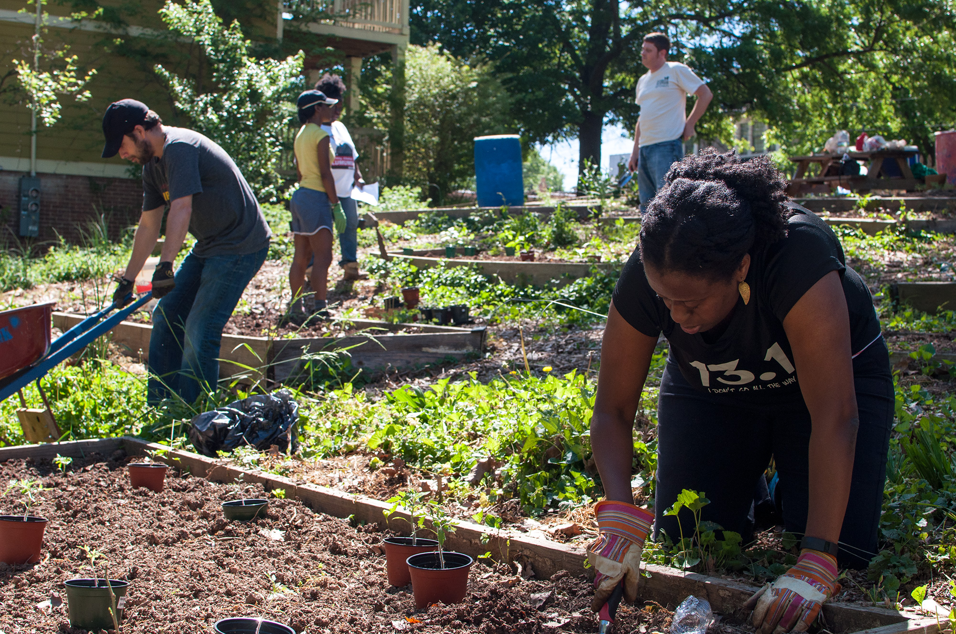
Garden Song
By David Mallet
http://www.madison-park.org/news/what-is-roxbury-in-motion
Shared Reading Week 3

Slide 2
Inch by inch, row by row,
Gonna make this garden grow.
All it takes is a rake and a hoe
And a piece of fertile ground.

Slide 3
Pulling weeds and picking stones,
We are made of dreams and bones.
Feel the need to grow my own
'Cause the time is close at hand.

Slide 4
Grain for grain, sun and rain,
Find my way in Nature's chain,
Tune my body and my brain
To the music from the land.

Slide 5
Plant your rows straight and long,
Tend them with work and song.
Mother Earth will make you strong
If you give her loving care.

