Slide 1
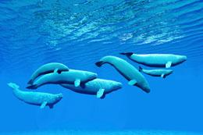
Down by the Bay
https://animalsake.com/beluga-whale-adaptations
Shared Reading Week 3

Slide 2
Down by the bay
where the watermelons grow
back to my home
I dare not go.
For if I do, my mother will say,
“Did you ever see a whale swim backward with its tail?”
Down by the bay!

Slide 3
Down by the bay
where the watermelons grow
back to my home
I dare not go.
For if I do, my mother will say,
“Did you ever see llamas nuzzling their mamas?”
Down by the bay!

Slide 4
Down by the bay
where the watermelons grow
back to my home
I dare not go.
For if I do, my mother will say,
“Did you ever see cats stalking some rats?”
Down by the bay!

Slide 5
Down by the bay
where the watermelons grow
back to my home
I dare not go.
For if I do, my mother will say,
“Did you ever see a fox hiding behind a box?”
Down by the bay!

Slide 6
Down by the bay
where the watermelons grow
back to my home
I dare not go.
For if I do, my mother will say,
“Did you ever see rams butting horns with other rams?”
Down by the bay!

