Slide 1
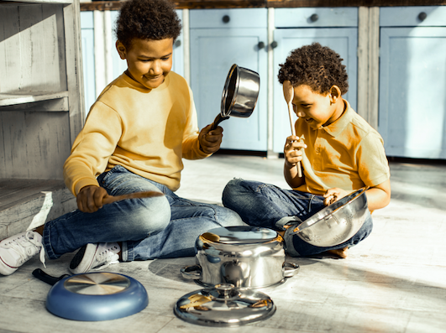
Noise Day
by Shel Silverstein
Shared Reading Week 2

Slide 2
Let’s have one day for girls and boyses
When you can make the grandest noises.
Screech, scream, holler, and yell,
Buzz a buzzer, clang a bell, Sneeze—hiccup—whistle—shout,
Laugh until your lungs wear out.

Slide 3
Toot a whistle, kick a can,
Bang a spoon against a pan,
Sing, yodel, bellow, hum,
Blow a horn, beat a drum,
Rattle a window, slam a door,
Scrape a rake across the floor.

Slide 4
Use a drill, drive a nail,
Turn the hose on the garbage pail,
Shout Yahoo-Hurrah-Hurray,
Turn up the music all the way,
Try and bounce your bowling ball,
Ride a skateboard up the wall.

Slide 5
Chomp your food with a smack and a slurp, Chew—chomp—hiccup—burp.
One day a year do all of these,
The rest of the days—be quiet please.

