Slide 1
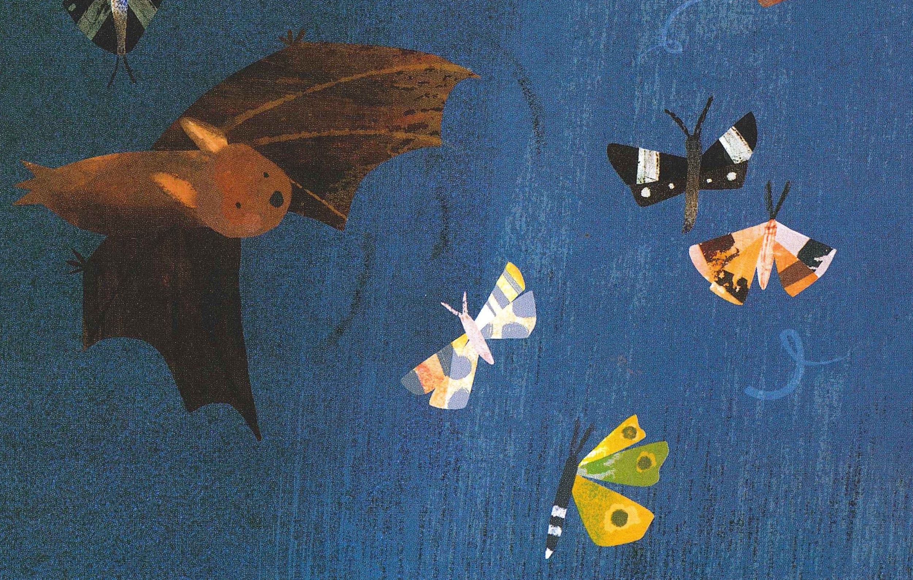
Bat Breakfast
From Hidden City, Sarah Grace Tuttle
Illustration: Amy Schimler-Safford
Shared Reading Week 2

Slide 2
By a glowing street lamp
little brown bats
hunt
with a
dart!
and a
swoop!
and a hasty
wing-scoop!
for moths
drawn by the light.

