Slide 1
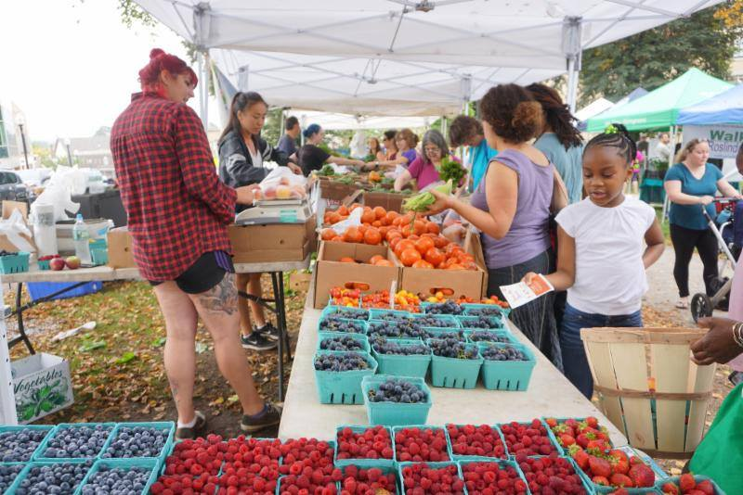
To Market, To Market
Shared Reading Week 1

Slide 2
To market, to market to buy a fat pig.
Home again, home again, jiggety-jig.
To market, to market, to buy a fat hog.
Home again, home again, jiggety-jog.

Slide 3
To market, to market to buy some fresh clams.
Home again, home again, bippity-bam.
To market, to market, to buy a corn tortilla.
Home again, home again, bippity-bia.

Slide 4
To market, to market to buy a fat pig.
Home again, home again, jiggety-jig.
To market, to market, to buy a fat hog.
Home again, home again, jiggety-jog.
To market, to market to buy some fresh clams.
Home again, home again, bippity-bam.
To market, to market, to buy a corn tortilla.
Home again, home again, bippity-bia.
original version
new version

Slide 5
To market, to market to buy ___________________.
Home again, home again, bippity- ______.
To market, to market, to buy _________________.
Home again, home again, bippity- ______.

