Slide 1
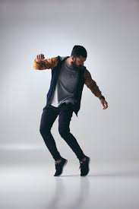
Tapping Tate
Shared Reading Week 1

Slide 2
Tate loves to make music with his feet.
He puts on tap shoes,
Makes a sweet, neat, beat.
He taps his heel, he taps his toe
He stomps his whole foot
Creates different sounds on the go.

Slide 3
He makes a rat-a-tat-tat sound
and a clickety-click-click sound
Strikes his feet on the ground.
Can you dance a rhythm
Just like him?

Slide 4
