Slide 1
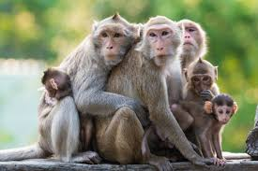
Three Small Monkeys
Shared Reading Week 1

Slide 2
Three small monkeys jumping on the bed,
One fell off and bumped her head.
“Mama, call the doctor!” And the doctor said,
“No more monkeys jumping on the bed!”

Slide 3
Two small monkeys jumping on the bed,
One fell off and bumped his head.
“Mama, call the doctor!” And the doctor said,
“No more monkeys jumping on the bed!”

Slide 4
One small monkey jumping on the bed,
She fell off and bumped her head.
“Mama, call the doctor!” And the doctor said,
“Put those monkeys all to bed!”

