Slide 1
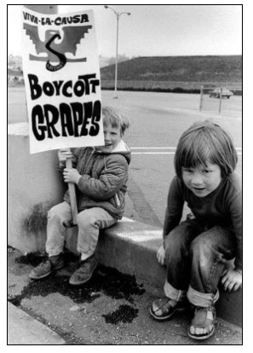

Slide 2
The Role of Consumers in the
Delano Grape Boycott 1965-1970
Text Talk Week 8, Day 3

Slide 3
Slide 1
In California, the summer is warm and dry, and the winter is rainy. This makes it a perfect place for growing grapes. Many people go to California to find work on farms.

Slide 4
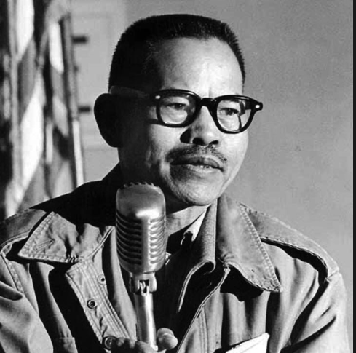
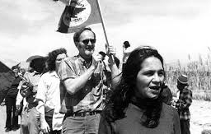
Slide 2
Delano Grape Boycott Timeline
1965
Larry Itliong starts the farmworkers strike.
Dolores Huerta and Cesar Chavez join the strike and organize more farm workers.

Slide 5
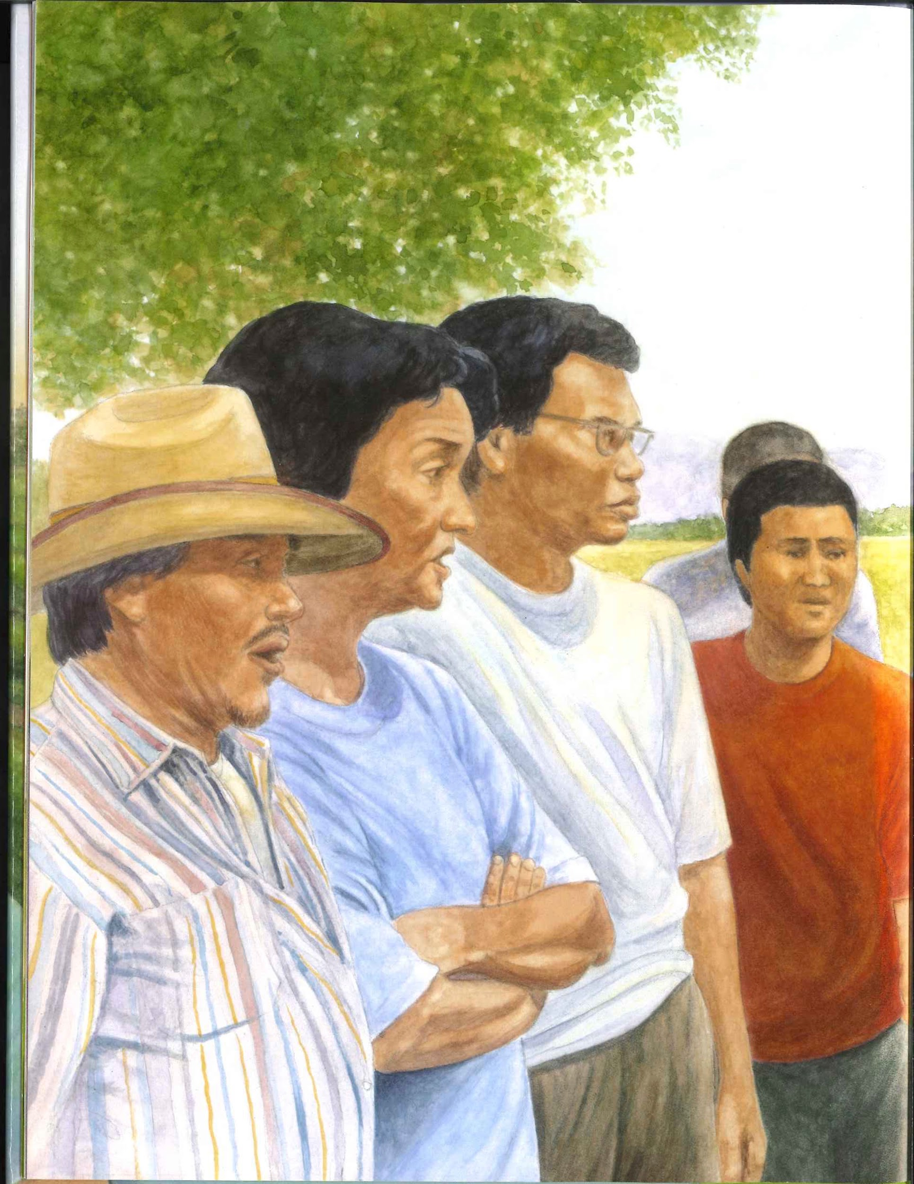
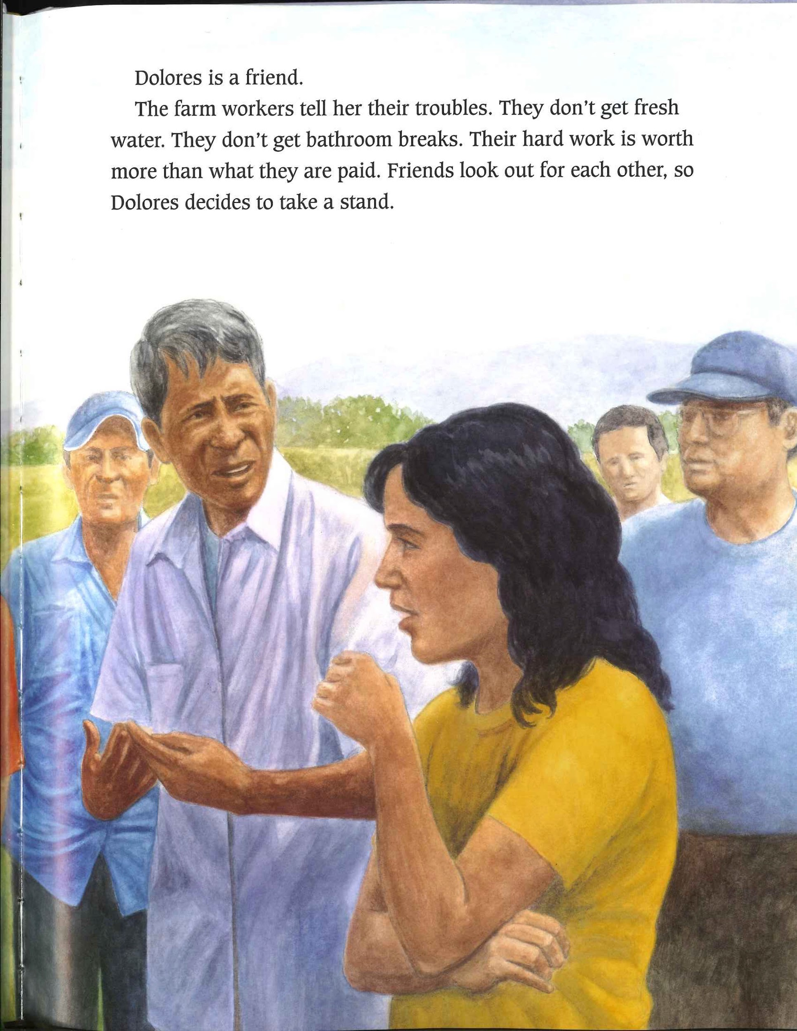
Slide 3

Slide 6
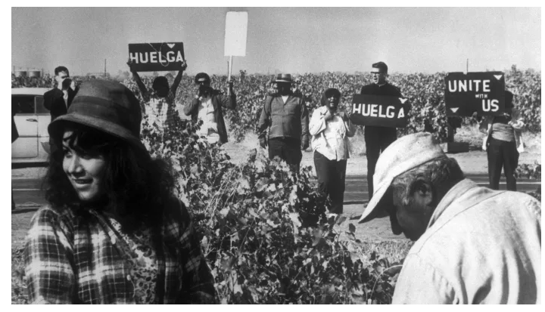
Slide 4
Filipino and Mexican farmworkers and their allies joined together to picket at the farms. They held signs and chanted their message.

Slide 7
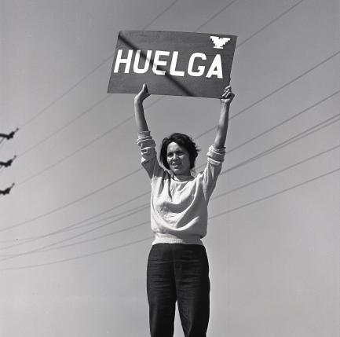
Slide 5
Larry Itliong, Cesar Chavez, and Dolores Huerta were three of the leaders who worked together to improve the lives of farmworkers and their families.

Slide 8
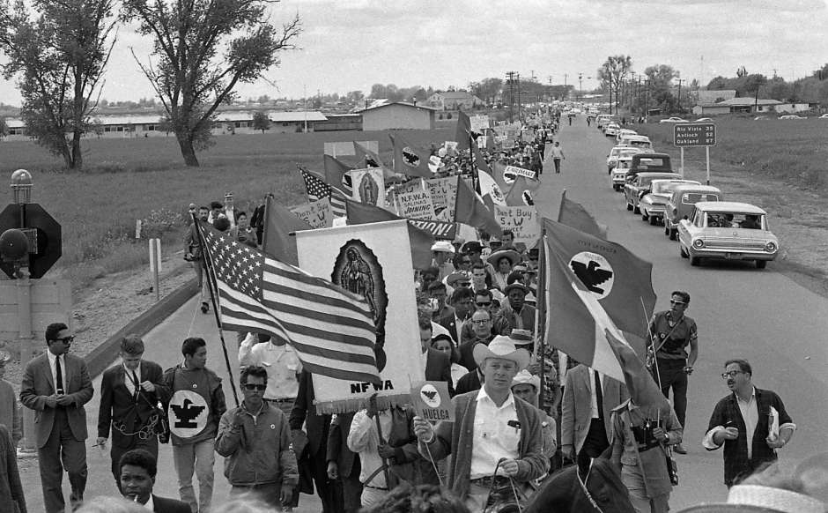
Slide 6
Farmworkers and their allies marched from farms to the government offices many miles away. They wanted state leaders to make laws that would protect workers.

Slide 9
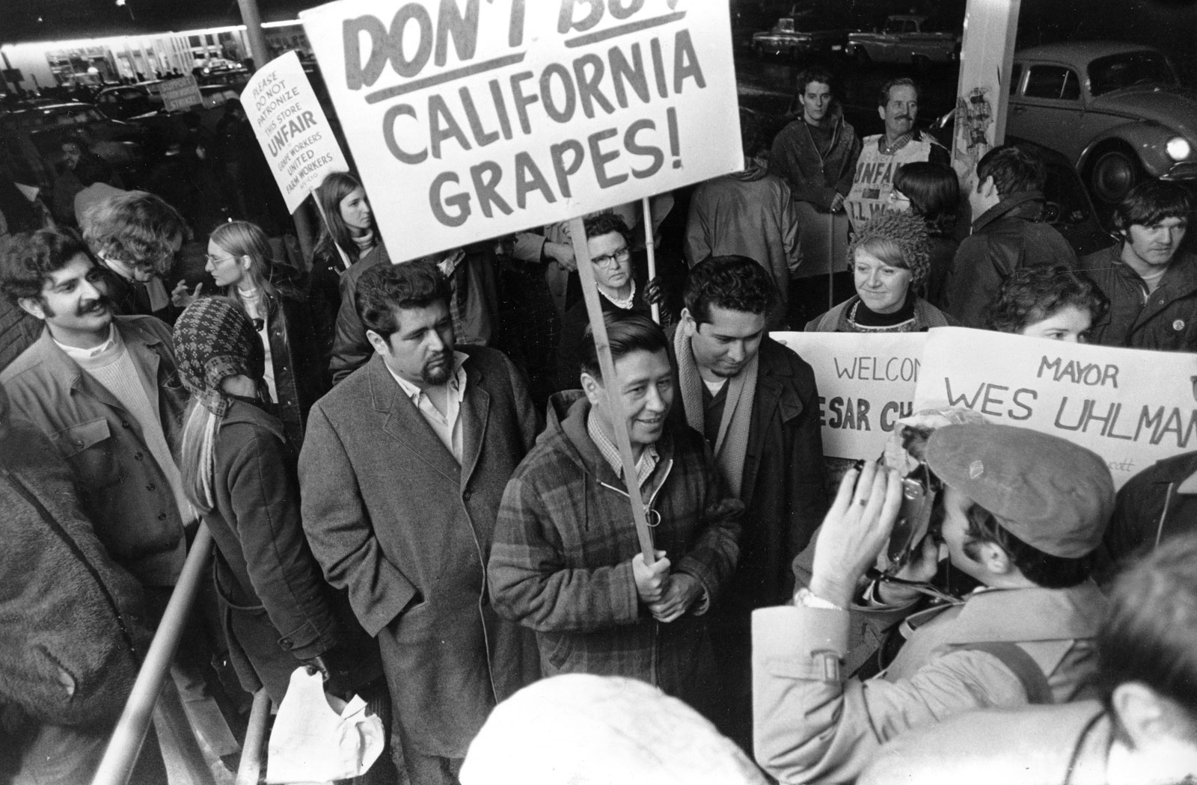
Slide 7
1968
The consumer boycott of grapes begins.
Delano Grape Boycott Timeline
1965
Larry Itliong starts the farmworkers strike.
Dolores Huerta and Cesar Chavez join the strike and organize more farm workers.

Slide 10
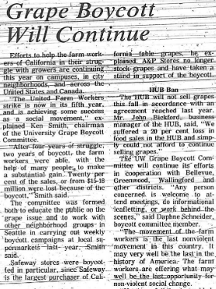
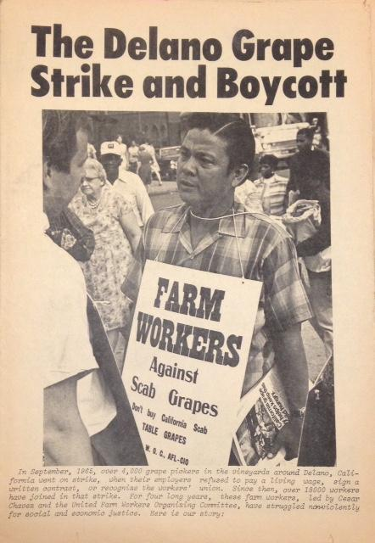
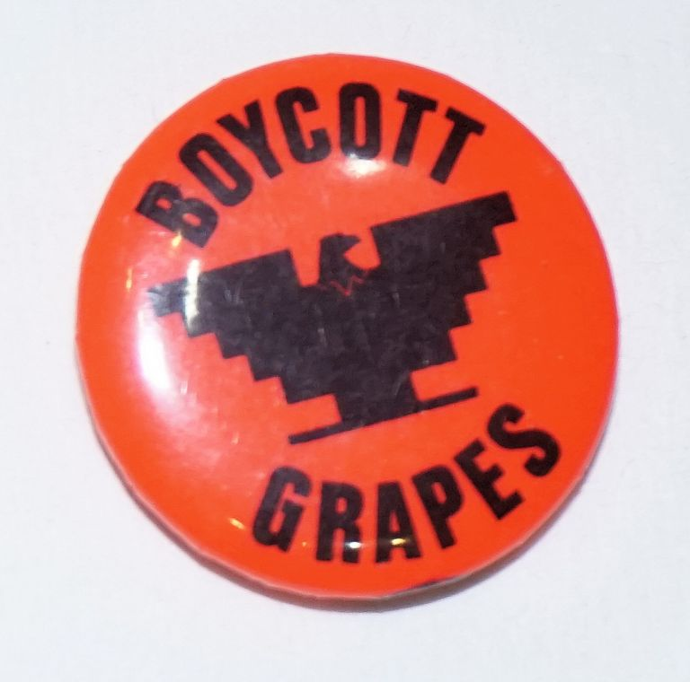
Slide 8
Farmworkers and their allies asked consumers not to buy grapes from grocery stores so that the grape farm owners would not get any money. They used many different strategies to communicate their message.
Notes:
https://depts.washington.edu/civilr/images/mecha/news/1969/Crop%20Daily%20Sep_30_1969%20p13.jpg, https://www.sutori.com/story/the-civil-rights-movement--xqrwPbjoSVZJ9zy5KcrgTCL2

Slide 11
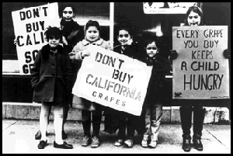
Slide 9
Notes:
,

Slide 12
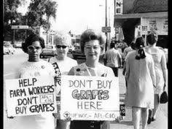
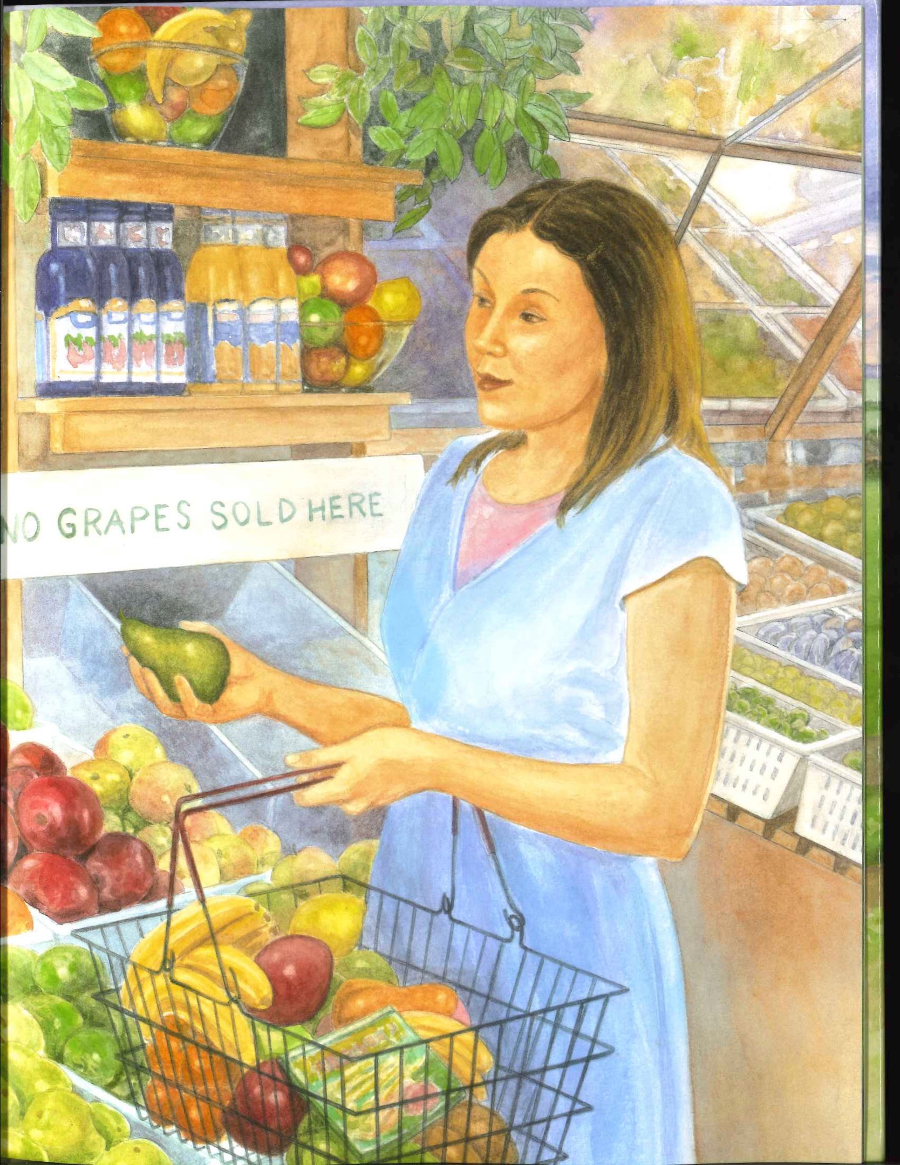
Slide 10
Consumers were persuaded. They joined the effort to change wages and working conditions for farmworkers.

Slide 13
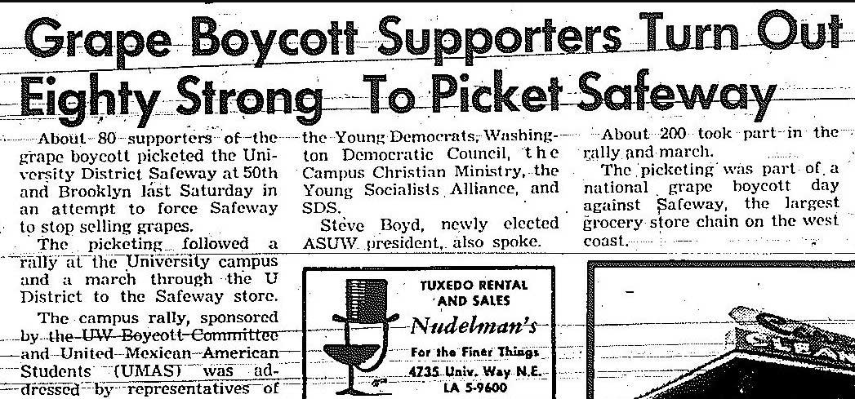
Slide 11
“About 80 supporters of the grape boycott picketed the University District Safeway ... last Saturday in an attempt to force Safeway to stop selling grapes.
The picketing was part of a national grape boycott day against Safeway, the largest grocery store chain on the west coast.”

Slide 14
Slide 12
1968
The consumer boycott of grapes begins.
Delano Grape Boycott Timeline
2020
1965
1970
Farm owners agree to fairer wages and better working conditions for farmers.
Consumers continue to think about the wages and working conditions of workers and to think about their choices to buy or not to buy certain goods.
The boycott ends and consumers begin buying grapes again.
Larry Itliong starts the farmworkers strike.
Dolores Huerta and Cesar Chavez join the strike and organize more farm workers.

Slide 15
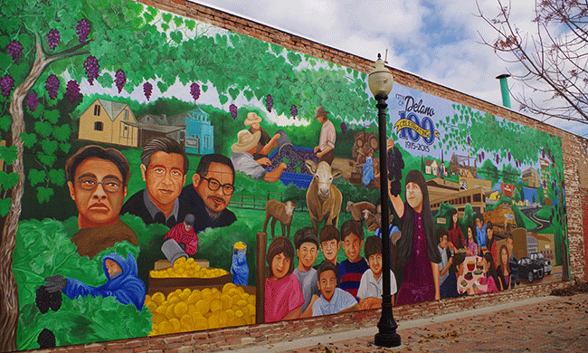
Slide 13
A mural in Delano, California remembers the strike and boycott for fair wages and better working conditions for grape farmworkers.

Slide 16
Citations
Written and compiled by Brooke Childs and Melissa Tonachel, Focus on First, 2019.
VTS image: https://libraries.ucsd.edu/farmworkermovement/gallery/displayimage.php?album=611&pid=12127#top_display_media
Slide 1: Map of the U.S. State of California
Slides 2, 7, 12: https://www.npr.org/sections/thesalt/2015/09/16/440861458/grapes-of-wrath-the-forgotten-filipinos-who-led-a-farmworker-revolution, http://www.delanograpestrike.org/
Slide 3: Sarah Warren and Robert Casilla, Dolores Huerta: A Hero to Migrant Farmers
Slide 4: https://www.history.com/news/delano-grape-strike-united-farm-workers-filipinos
Slide 5: https://www.si.edu/newsdesk/photos/dolores-huerta-huelga-during-grape-strike-delano-california-sept-24-1965, https://www.theatlantic.com/magazine/archive/2011/07/the-madness-of-cesar-chavez/308557/, https://www.npr.org/sections/thesalt/2015/09/16/440861458/grapes-of-wrath-the-forgotten-filipinos-who-led-a-farmworker-revolution, Farmworker Movement Documentation Project/University of California San Diego Library
Slide 6: https://www.sfchronicle.com/opinion/article/50-years-after-the-Delano-grape-strike-6508846.php
Slide 8: https://depts.washington.edu/civilr/images/mecha/news/1969/Crop%20Daily%20Sep_30_1969%20p13.jpg, https://www.bolerium.com/pages/books/99334/el-malcriado-the-delano-grape-strike-and-boycott-vol-3-19-january-15-1970-special-edition, Social Movements | Hispanic American | Hispanic American
Slide 9: https://www.sutori.com/story/the-civil-rights-movement--xqrwPbjoSVZJ9zy5KcrgTCL2, https://libraries.ucsd.edu/farmworkermovement/gallery/displayimage.php?album=611&pid=12127#top_display_media
Slide 10: https://ufw.org/1965-1970-delano-grape-strike-boycott/
Slide 11: https://depts.washington.edu/civilr/mecha_news_grapes.htm,
https://depts.washington.edu/civilr/images/mecha/news/1969/Crop%20Daily%20May_13_1969%20p3.jpg
Slide 12: https://www.yesmagazine.org/democracy/2016/05/01/the-little-known-farmworkers-who-sparked-the-biggest-labor-movement-in-us-history/, photo by Alexa Straybuk

