Slide 1
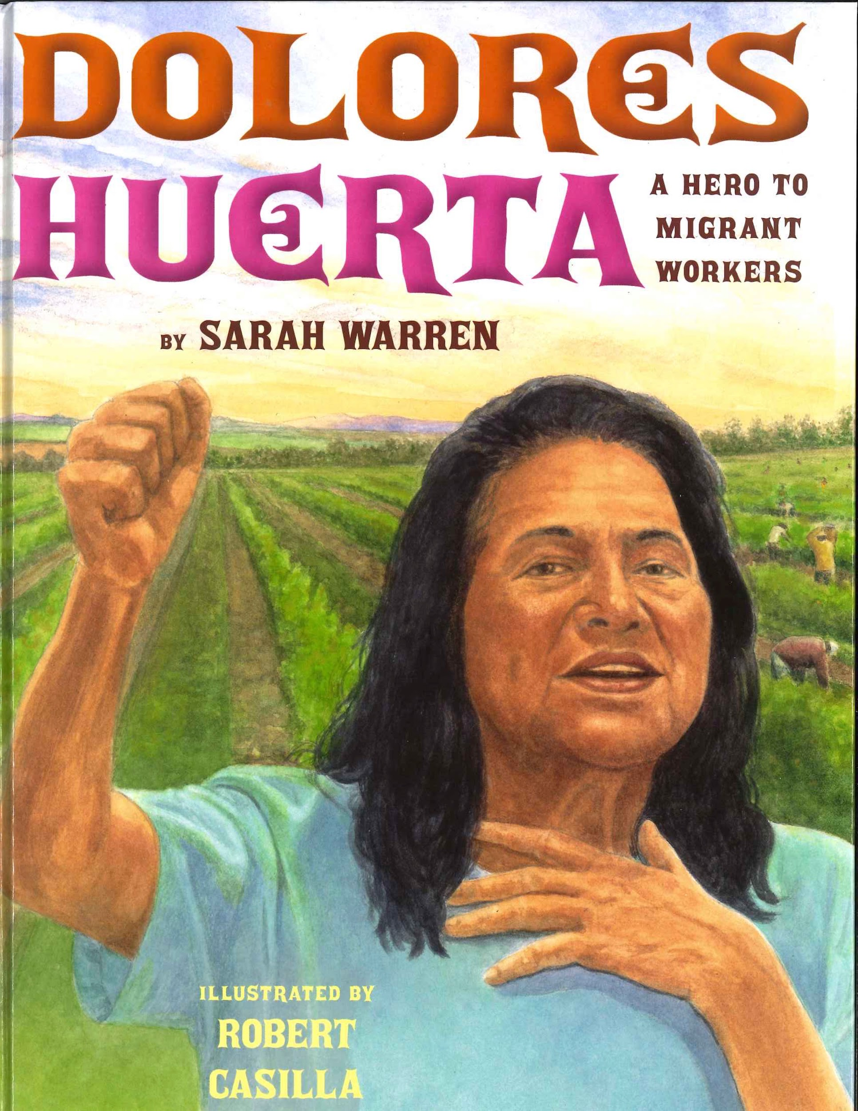
Dolores Huerta:
A Hero to Migrant Workers
Text Talk Week 8, Day 2

Slide 2
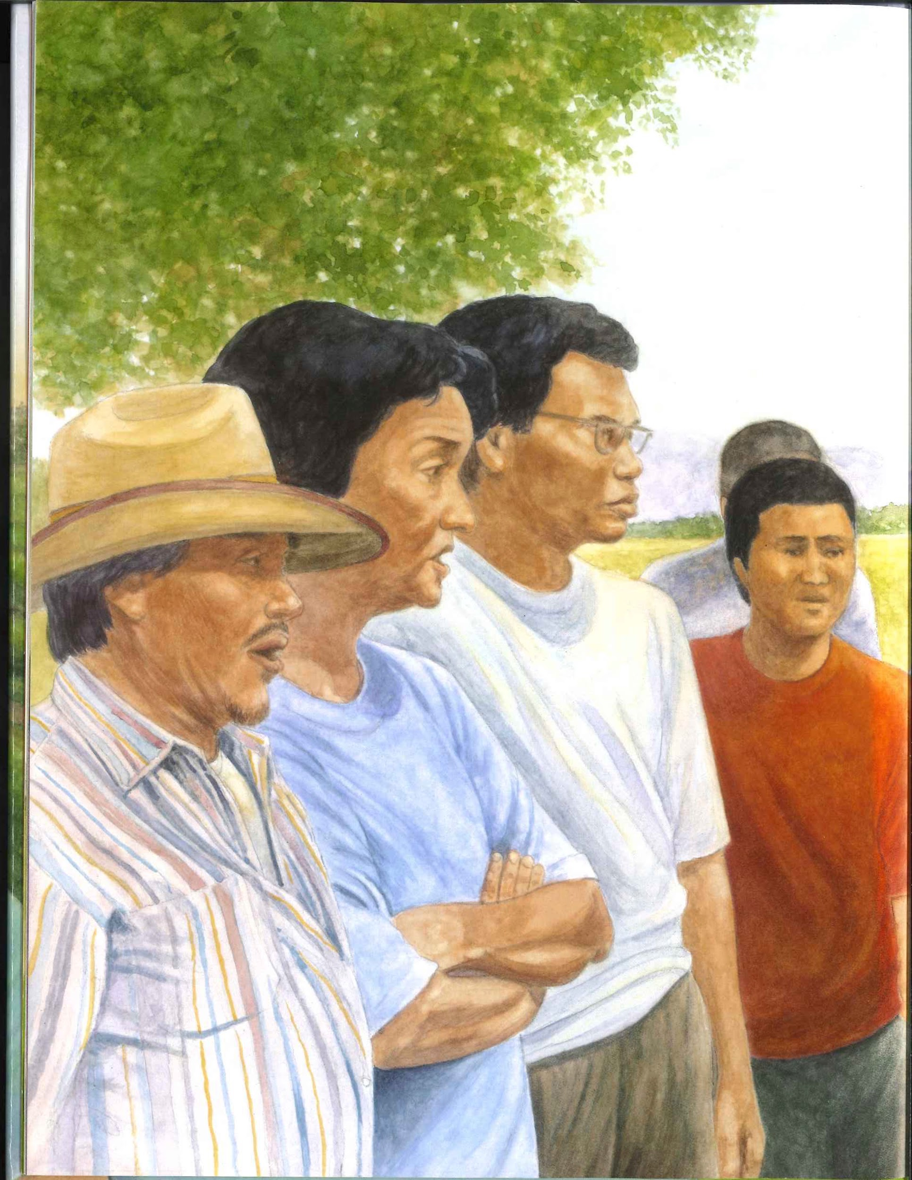
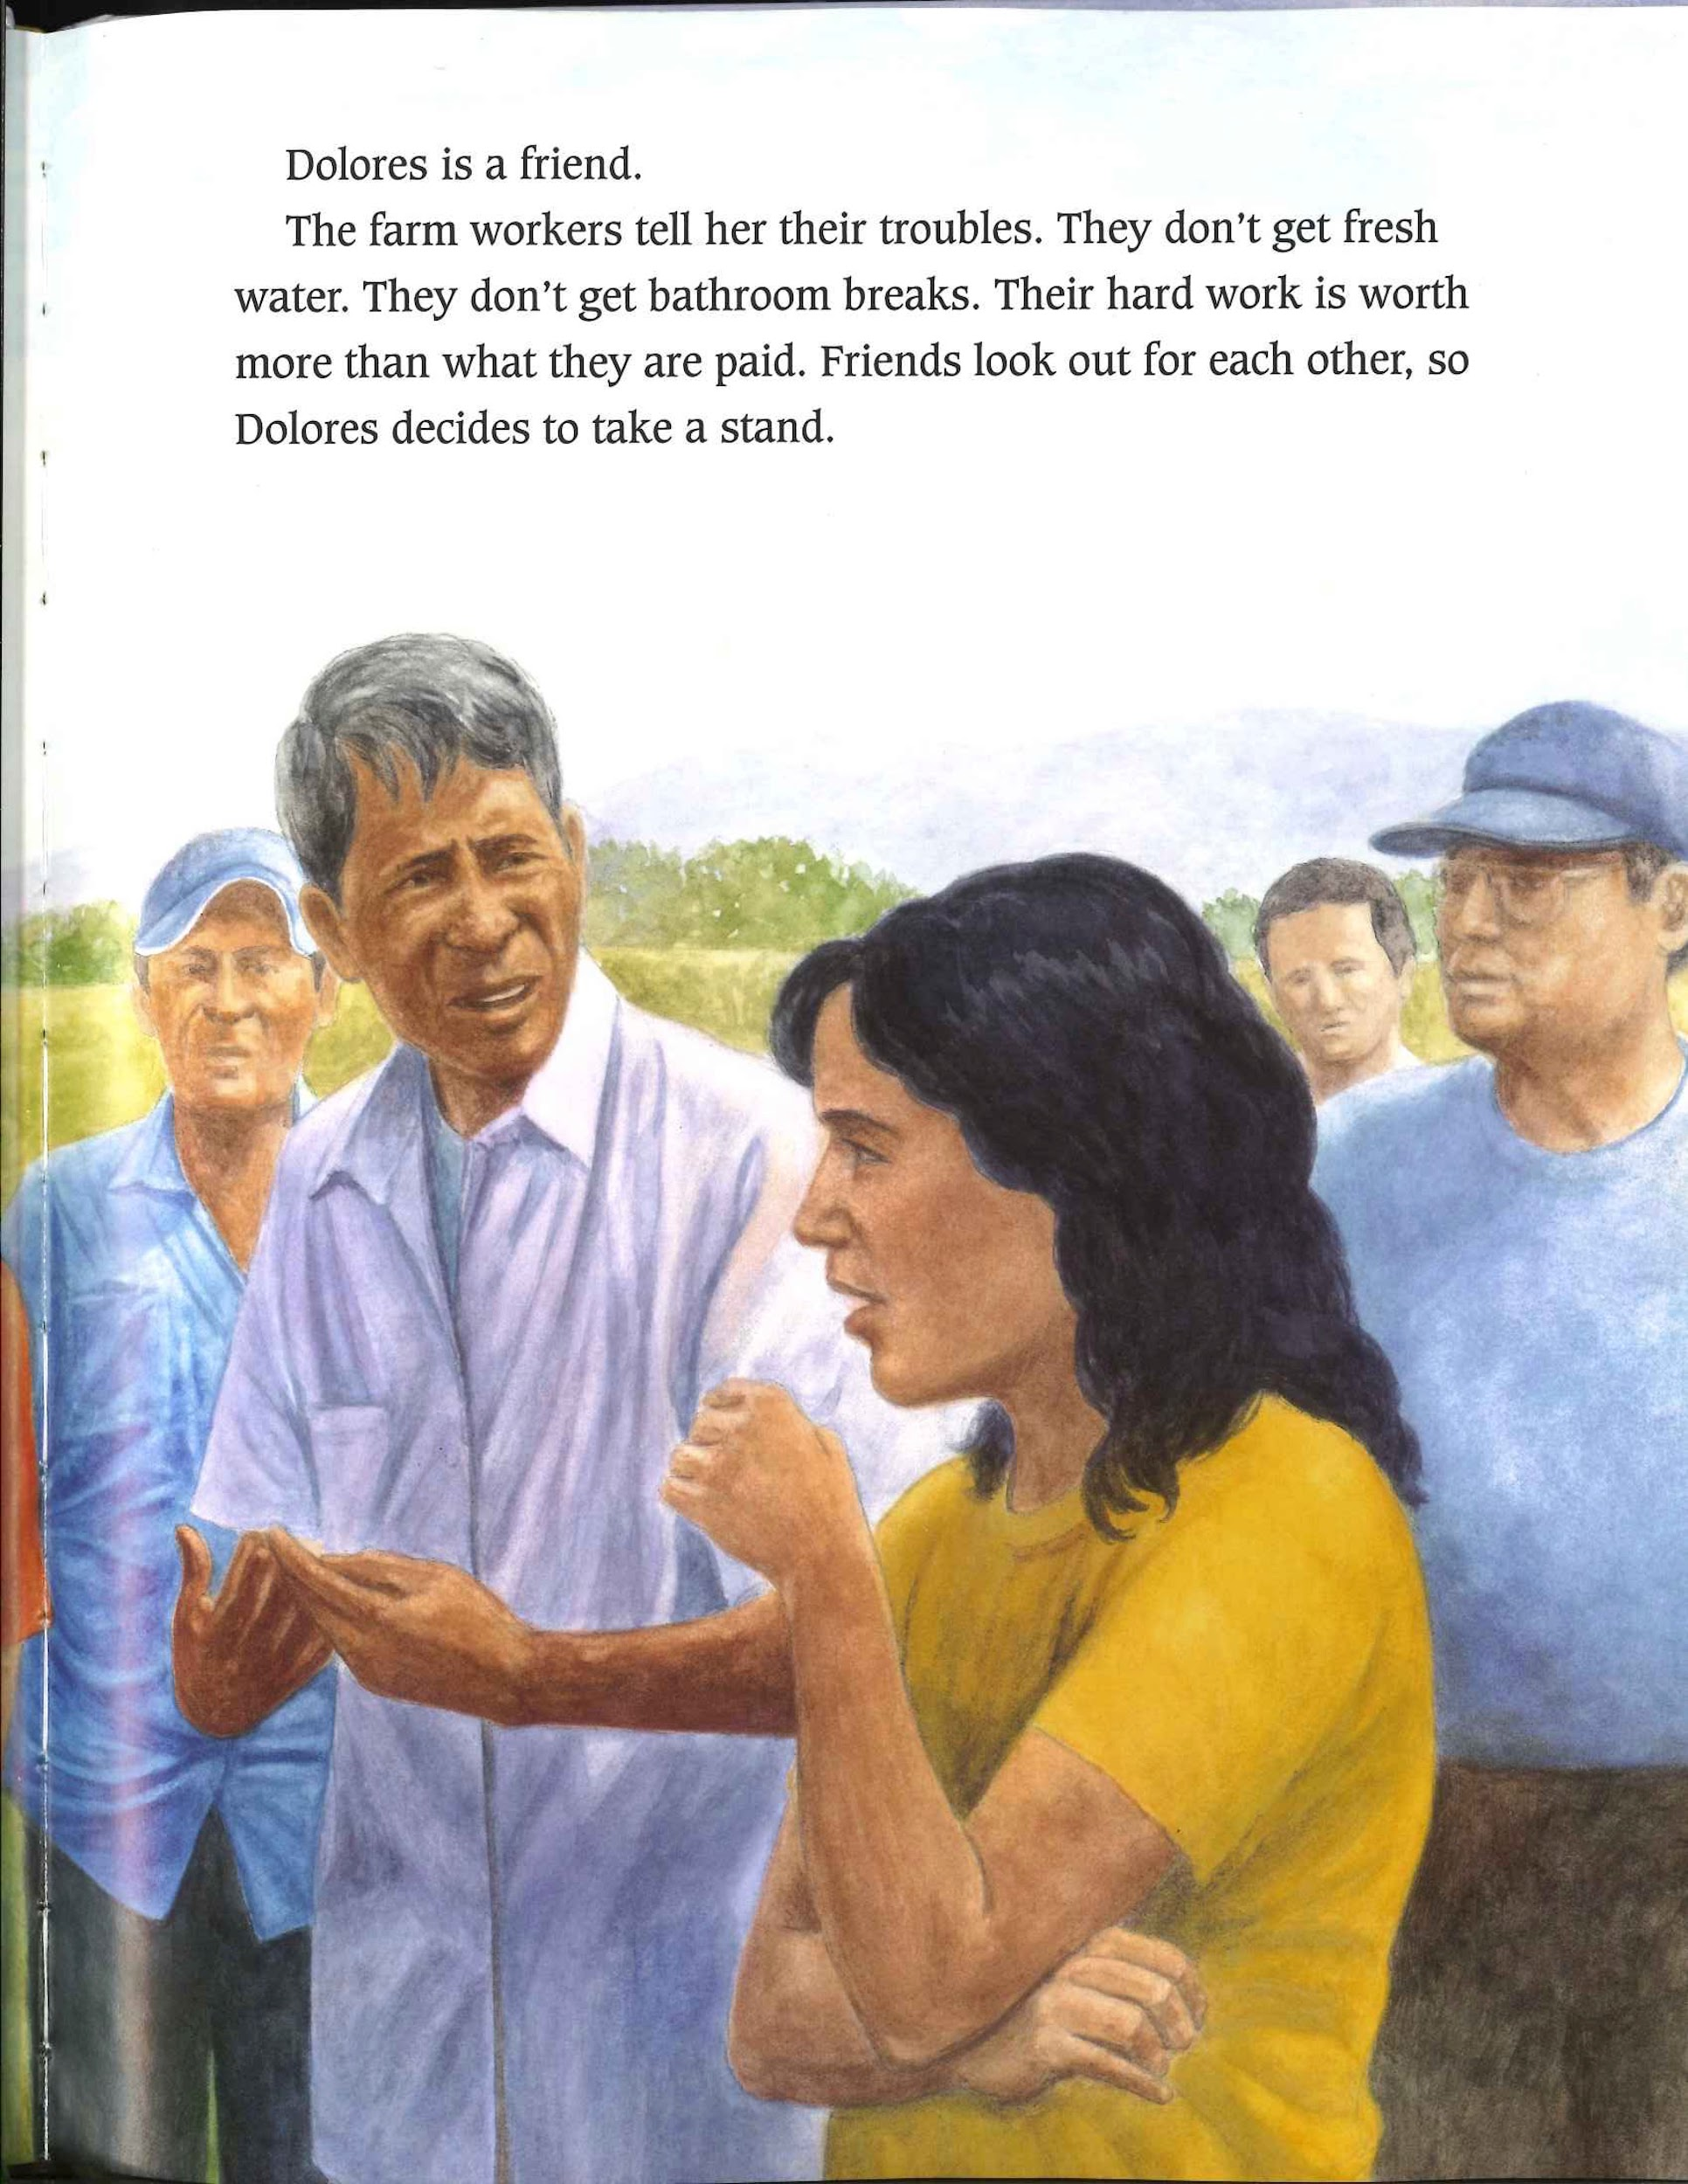
Slide 1

Slide 3
Slide 2
Dolores is a friend.
The farm workers tell her their troubles. They don’t get fresh water. THey don’t get bathroom breaks. Their hard work is worth more than what they are paid. Friends look for each other, so Dolores decides to take a stand.

Slide 4
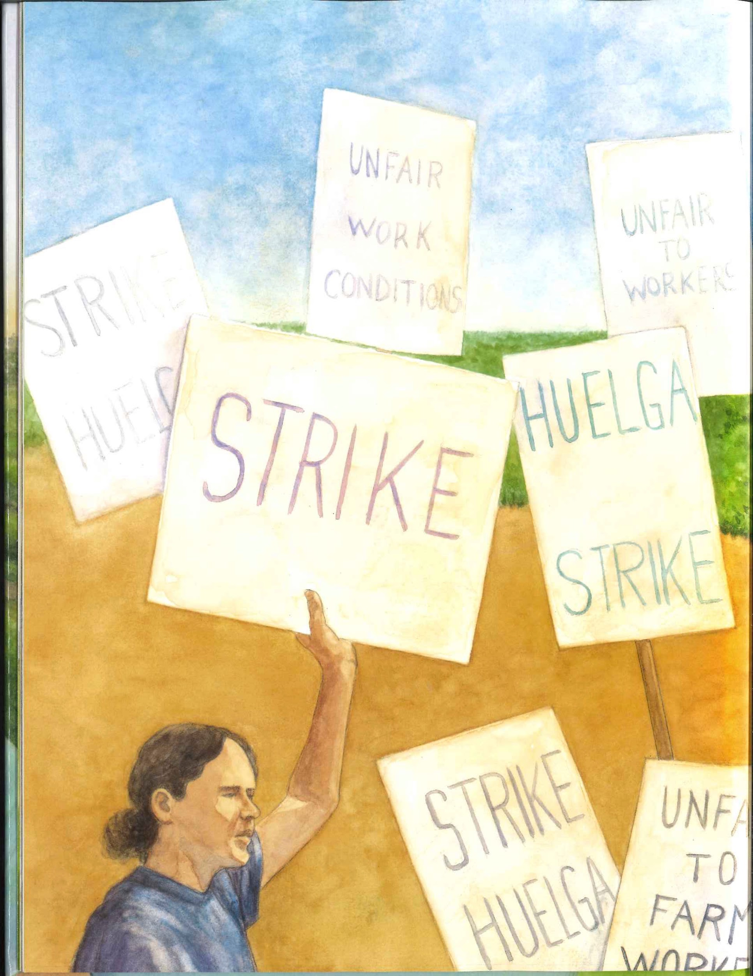
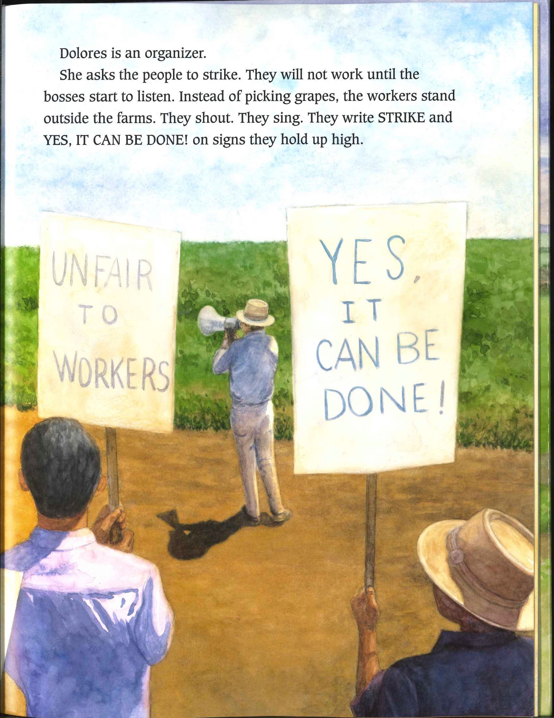
Slide 3

Slide 5
Slide 4
Dolores is an organizer.
She asks the people to strike. They will not work until the bosses start to listen. Instead of picking grapes, the workers stand outside the farms. They shout. They sing. They write STRIKE and YES, IT CAN BE DONE! On signs they hold up high.

Slide 6
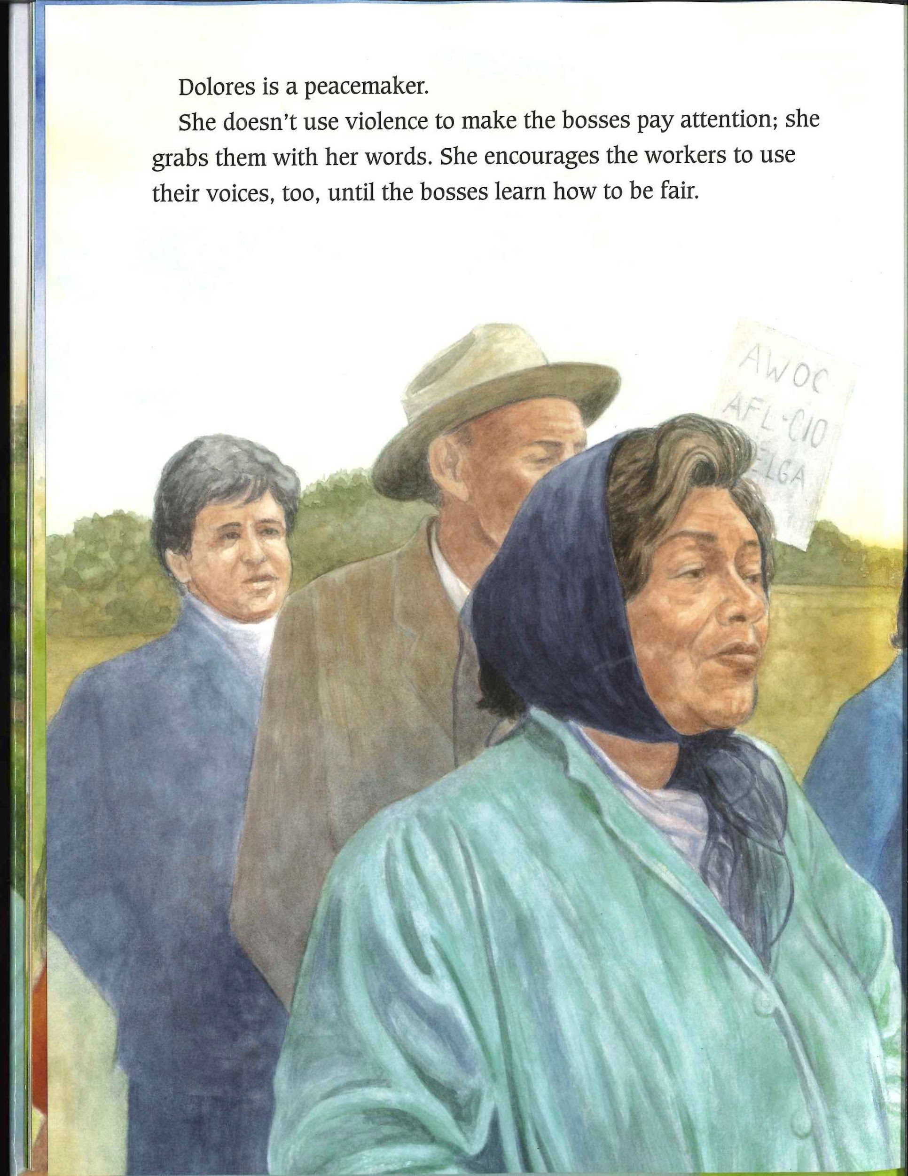
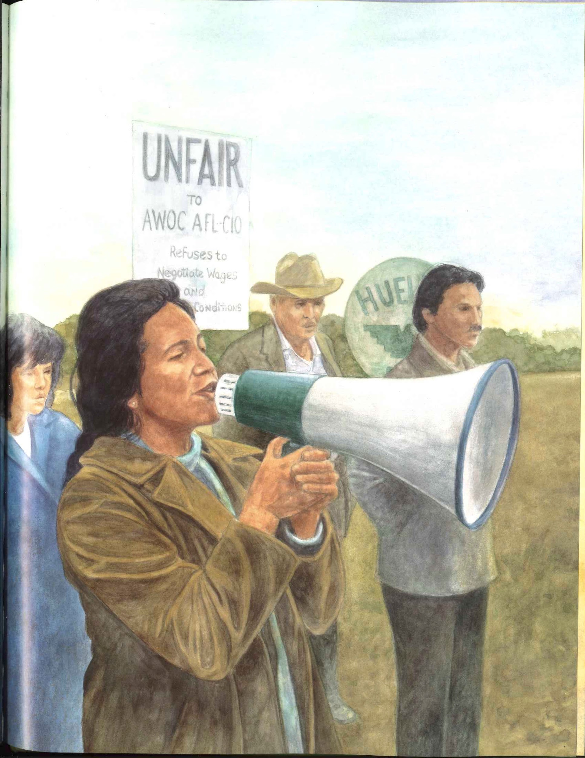
Slide 5

Slide 7
Slide 6
Dolores is a peacemaker.
She doesn’t use violence to make the bosses pay attention; she grabs them with her words. She encourages the workers to use their voices, too, until the bosses learn how to be fair.

