Slide 1
Helping Animals
Text Talk Week 8, Day 2

Slide 2
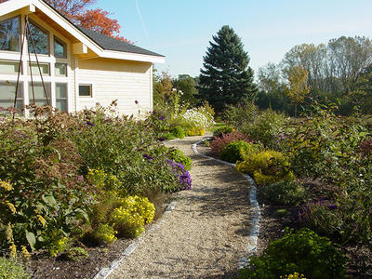
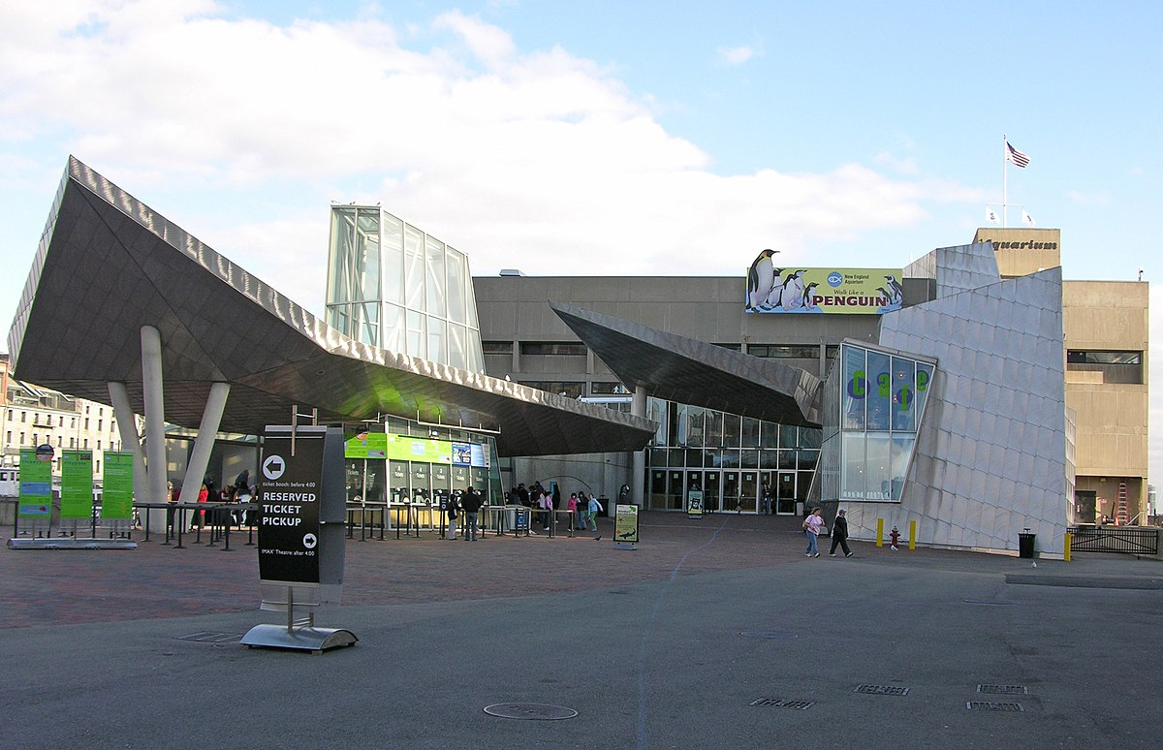
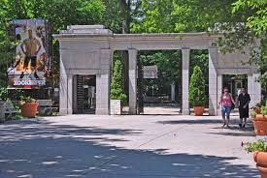
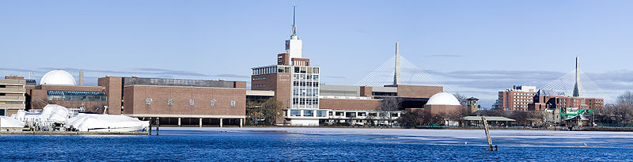
Slide 1
In a city called Boston, there are many people working to help animals.

Slide 3
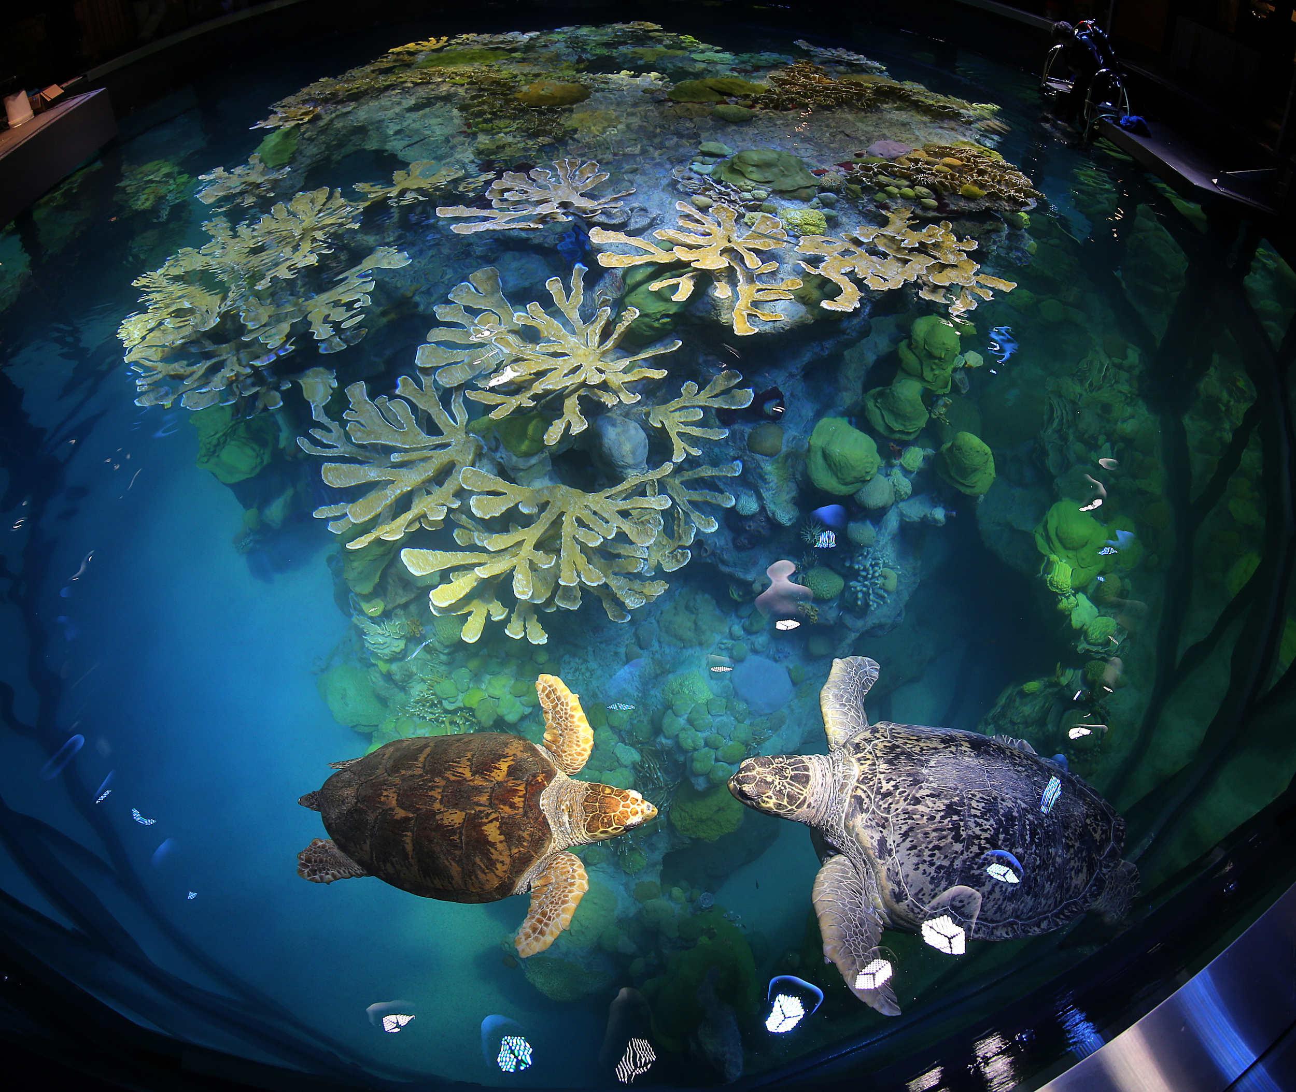
Slide 2
The New England Aquarium is an important place in Boston. The Aquarium’s motto is “protecting the blue planet.” Blue refers to water habitats and the plants and animals that live in them.

Slide 4
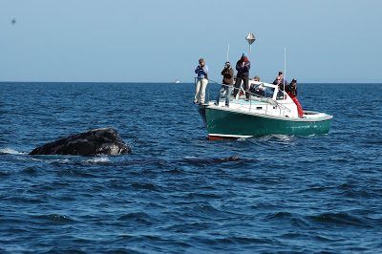
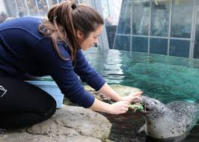
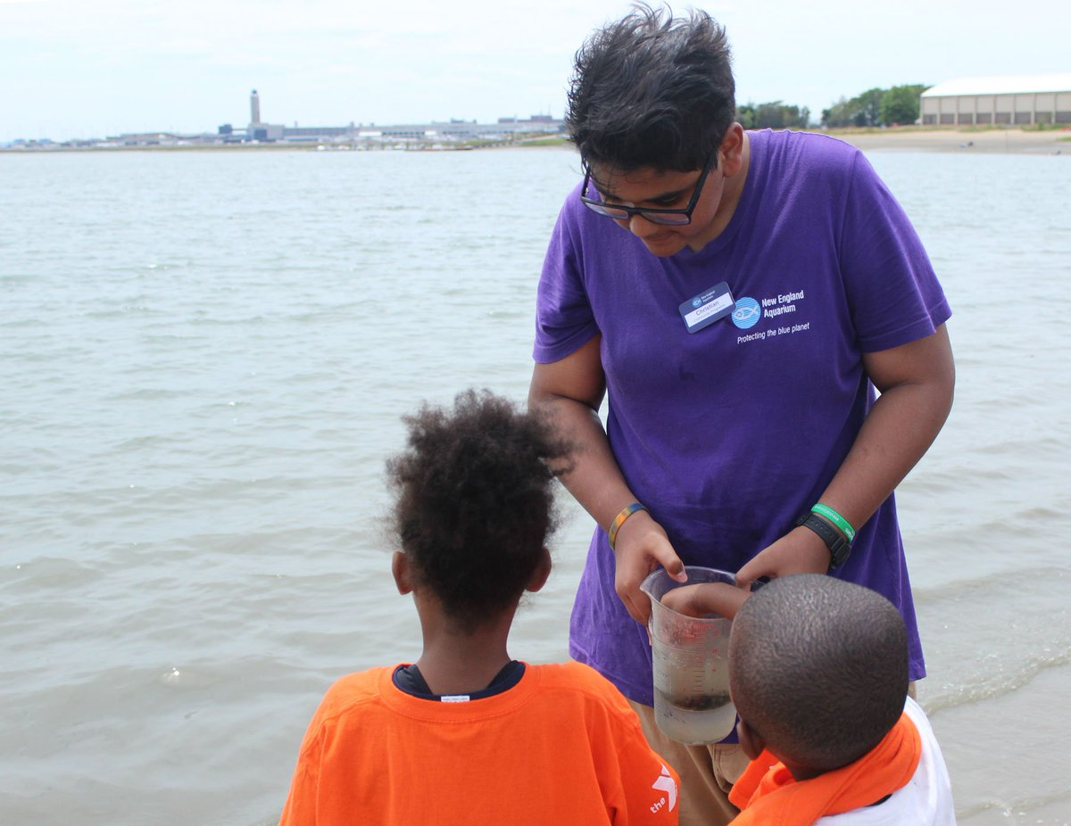
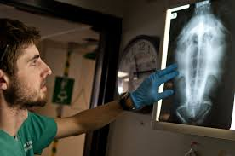
Slide 3
At the Aquarium, visitors learn about animals and plants that live in the ocean. People who work at the Aquarium help ocean animals thrive. They feed and provide health care for animals, take care of plants, conduct research, move animals, clean tanks, teach people about aquatic animals and plants, raise money, and welcome visitors.

Slide 5
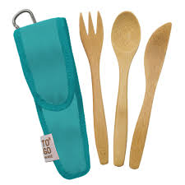
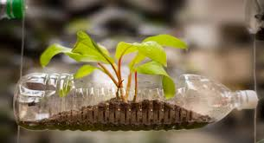

Slide 4
The New England Aquarium hopes that children and other people in our community protect our oceans by creating less garbage. We can do this by using less plastic and by re-using things instead of throwing them away.

Slide 6
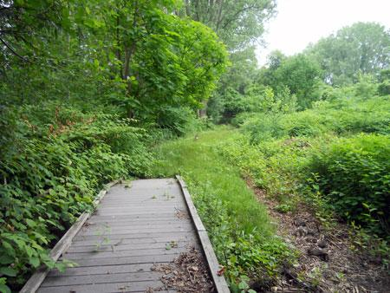
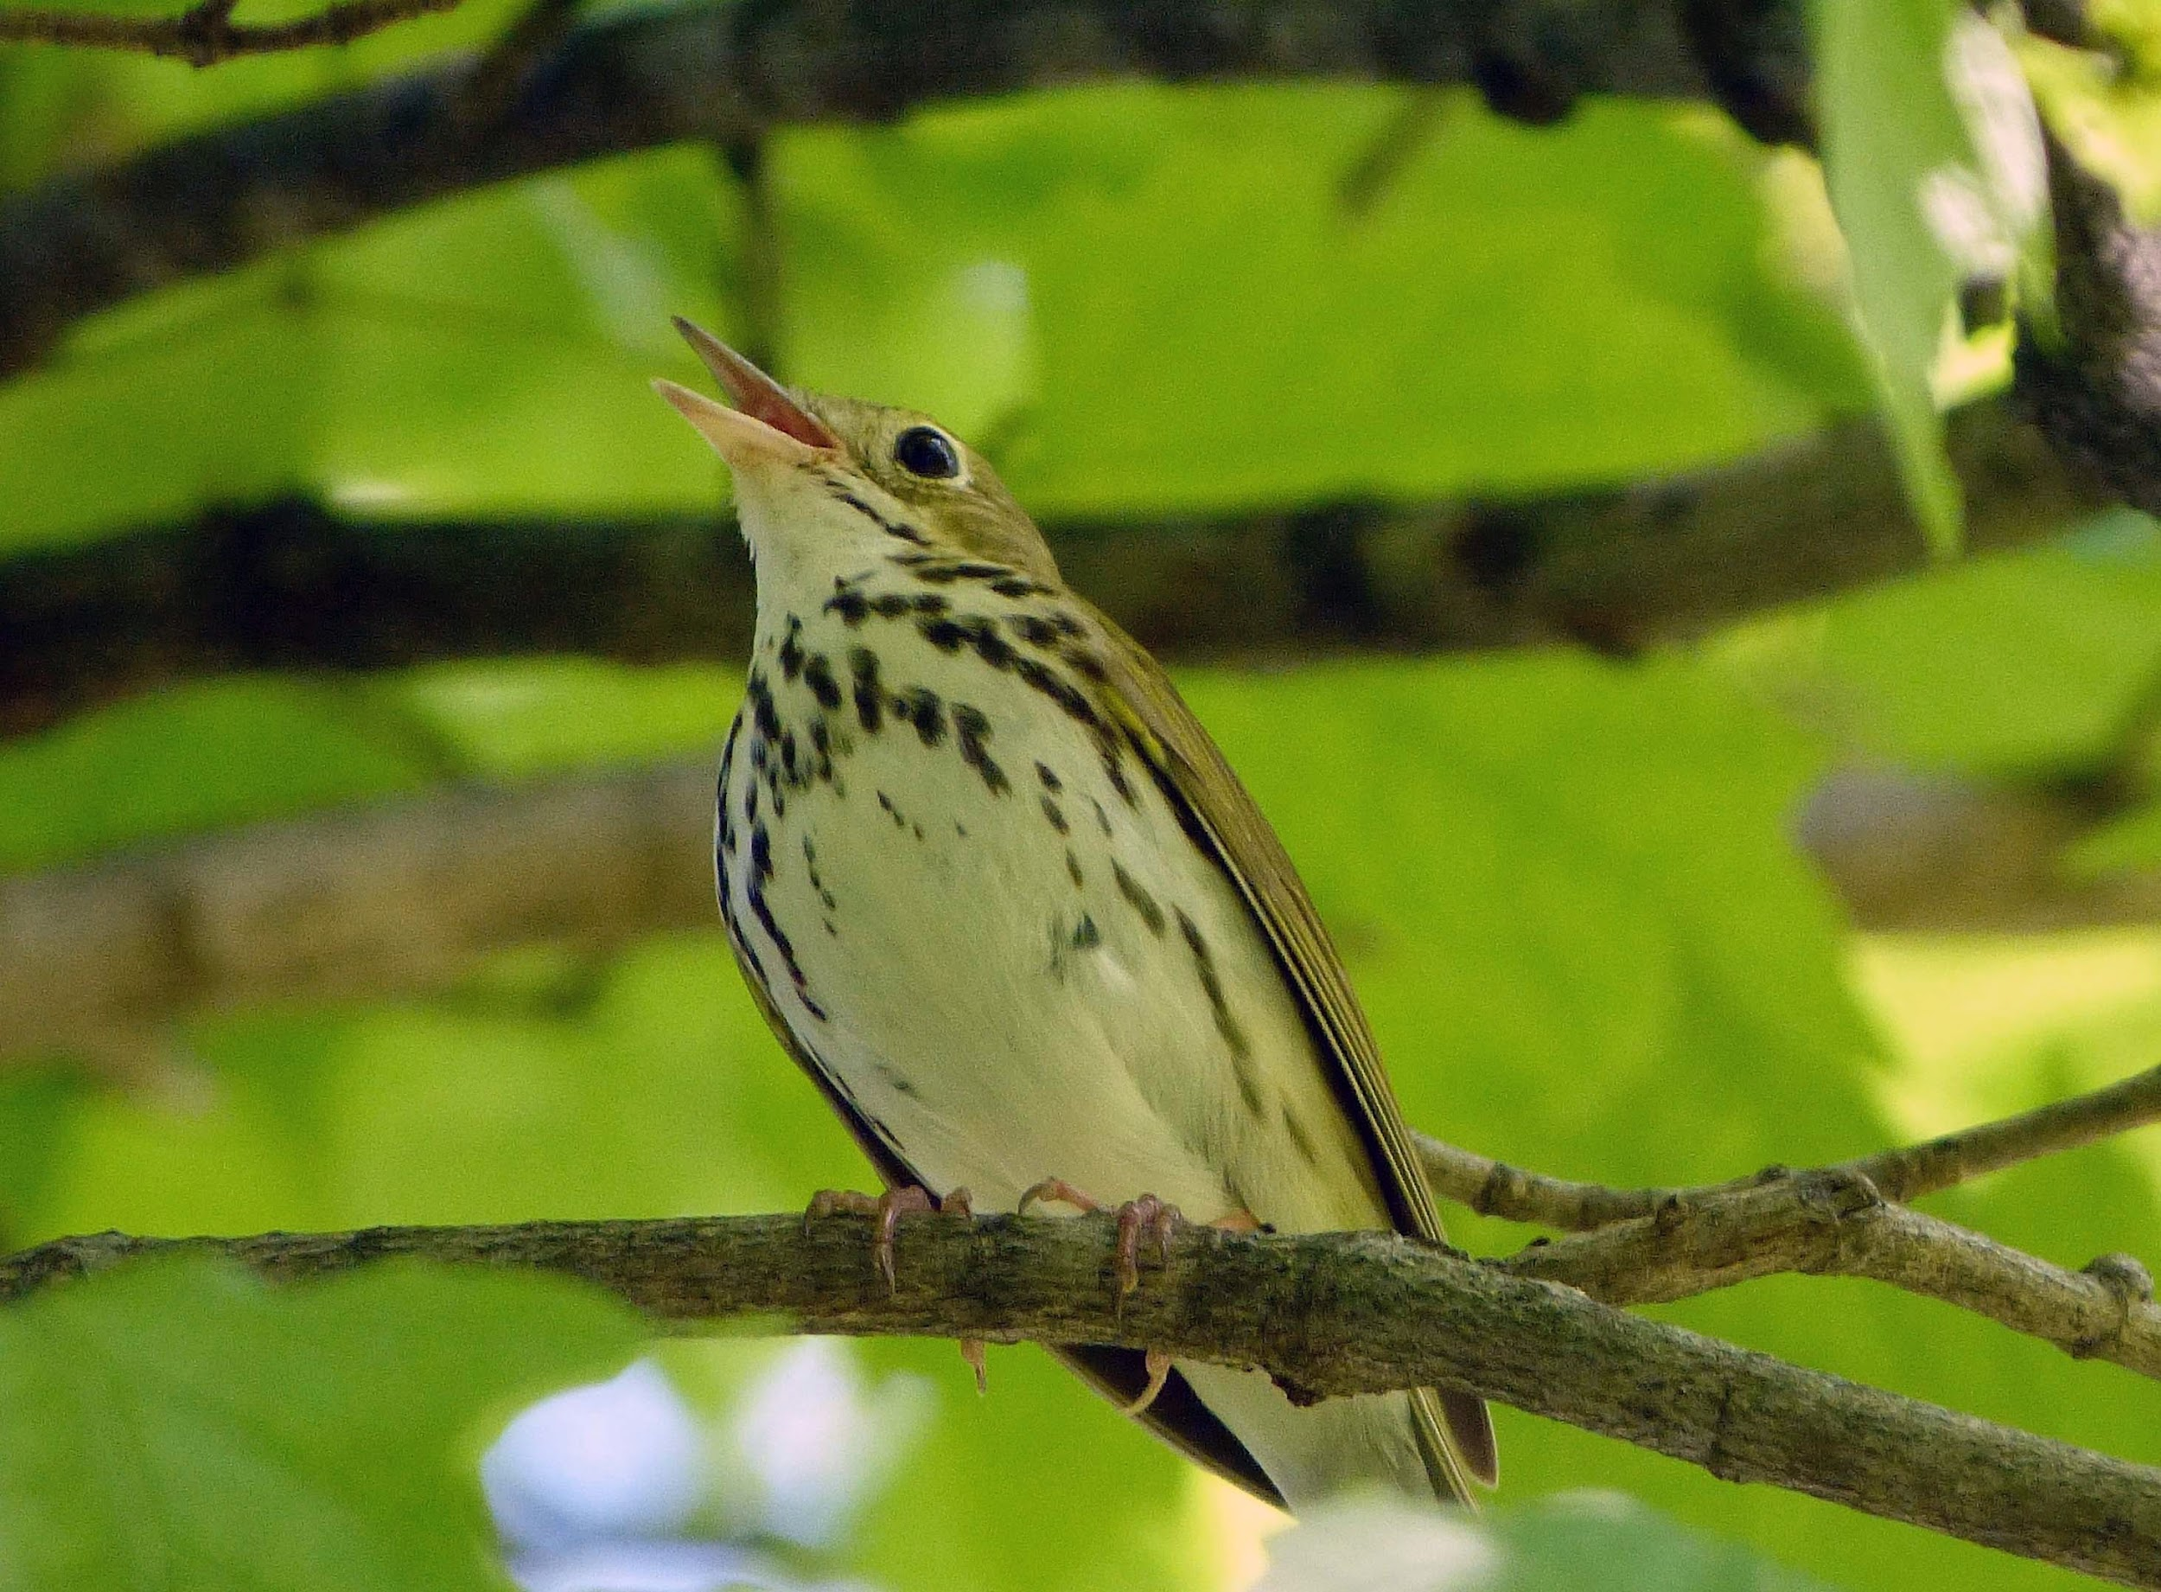
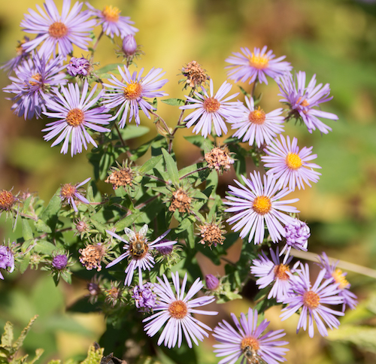
Slide 5
The ovenbird can be hard to see, but we can often hear its call: it sounds like “teacher, teacher, teacher!”
The Boston Nature Center is an urban sanctuary in the neighborhood of Mattapan. A sanctuary is a place where all animals and plants are safe. Trails and boardwalks allow people to walk across meadows and wetlands. In these habitats, over 150 species of birds, 40 species of butterflies, and 350 species of plants live.

Slide 7
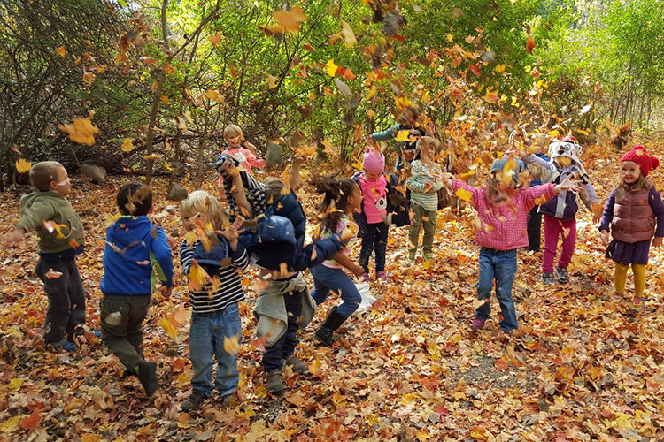
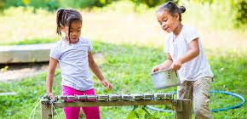
Slide 6
The Boston Nature Center helps animals by keeping their habitats safe.
At the Boston Nature Center children can attend preschool or summer camp. The Nature Play area is made for gardening, building, climbing, and relaxing. At these programs, children learn about keeping habitats safe for all animals and plants.

Slide 8
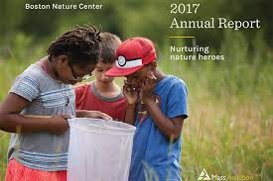
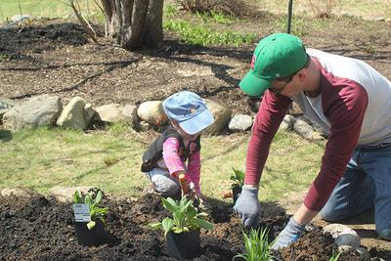
Slide 7
The Boston Nature Center hopes that people will take time to visit the sanctuary, observe closely, and appreciate the natural environment.
People in the community, including children, can volunteer to work at the Boston Nature Center!

Slide 9
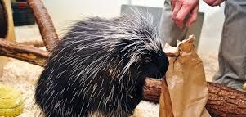
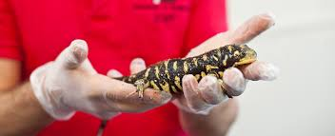
Slide 8
The Museum of Science is an important place in Boston. Natural science—the study of animals and plants in our environment—is one kind of science people come to learn about.
People at the Museum of Science introduce visitors to the body structures, behaviors, and habitats of different kinds of animals. They teach about the impacts of humans and other animals on each other and how animals struggle to survive.

Slide 10
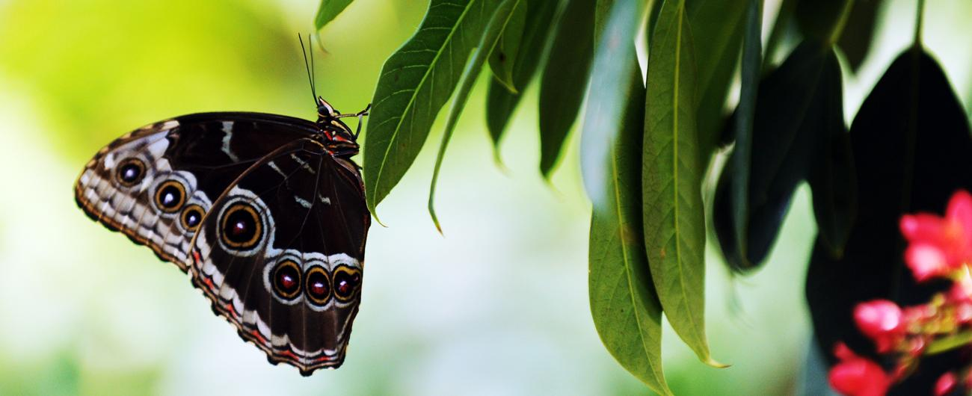
Slide 9
In the Butterfly Garden visitors can walk right through the butterflies’ habitat and see what kinds of plants butterflies need to thrive. They can see how butterflies’ wing patterns help them survive in their habitats. They might even see a caterpillar with legs change into a butterfly with wings!

Slide 11
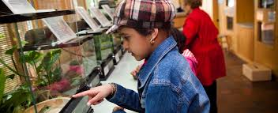
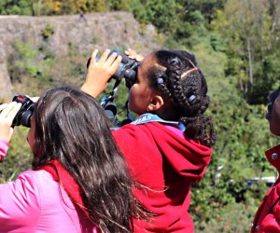
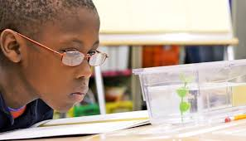
Slide 10
The Museum of Science hopes that children and other people in our community continue to ask questions and learn about as much as we can about science, including our natural world.

Slide 12
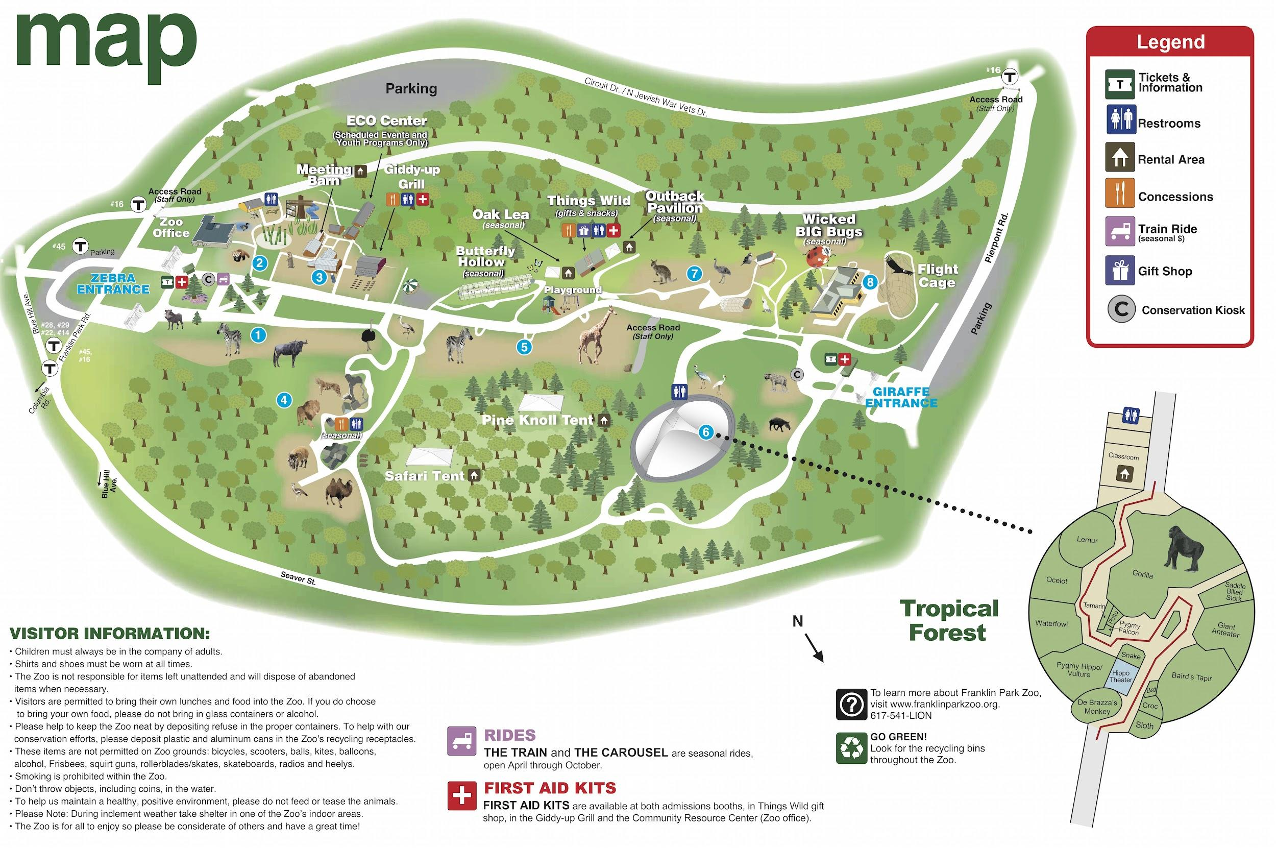
Slide 11
The Franklin Park Zoo is a place to see animals that live in different habitats all around the world.

Slide 13
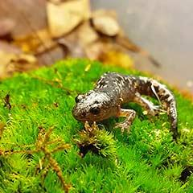
Slide 12
The people who work at the Franklin Park Zoo take care of these animals.
They also do other important work. They care for the plants in the environments where the animals live. They keep spaces for animals and people clean.
Marbled salamanders used to thrive in and around Boston, but their numbers have decreased. Scientists and volunteers now raise salamander hatchlings and release them into healthy habitats. Then they keep track of them to make sure they are surviving and thriving.

Slide 14
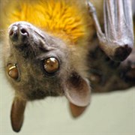
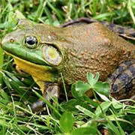
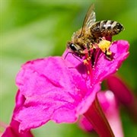
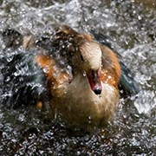

Slide 13
The Franklin Park Zoo hopes that children and adults will become citizen scientists, people in the community who collect data about the natural world to help scientists with their projects. We can all use our observation skills and share our findings with people who work at the zoo. They are especially interested in learning from community members about bees, bats, leaves, birds and birds’ nests, weather, and how much trash is in our environment.

Slide 15
Slide 14
These organizations help animals in Boston. What can you do to help animals?

Slide 16
Citations
Written and compiled by Melissa Tonachel and Fay Ferency, Focus on First, 2019.
Slides 1 and 14: wheretowheel.us; Massaudobon.org; https://en.wikipedia.org/wiki/Museum_of_Science_(Boston); Aroundustyroads.com
Slide 2: https://www.bostonglobe.com/magazine/2013/06/15/new-england-aquarium-puts-finishing-touches-giant-ocean-tank/1QvxUaeOr0JtpCp8ifPvVK/story.html
Slide 3: https://www.neaq.org/get-involved/careers-at-the-aquarium/, https://www.wbur.org/news/2018/04/03/climate-change-new-england-aquarium, http://news.neaq.org/2010/08/right-whale-researchers-migrate-north.html, https://twitter.com/NEAQ/status/993588077305221127
Slide 4: https://www.thebermudian.com/home-a-garden/home/10-ways-to-reduce-your-plastic-use/; https://www.to-goware.com/product-kids-utensil-set-142?color=berry; https://blog.cuyahogarecycles.org/top-5-ways-reuse-recycle-home/
Slide 5: http://kids.outdoors.org/index.cfm?trip=27D988F4-EF9B-B050-8EB9B7A3E8BC082C&name=Boston-Nature-Center-and-Wildlife-Sanctuary-; https://blogs.massaudubon.org/yourgreatoutdoors/what-to-do-this-weekend-sept-14-15/
Slide 6: https://www.massaudubon.org/get-outdoors/wildlife-sanctuaries/boston-nature-center
Slide 7: https://www.massaudubon.org/get-involved/volunteer/statewide-volunteer-day; https://www.massaudubon.org/get-outdoors/wildlife-sanctuaries/boston-nature-center/about/publications/annual-report
Slide 8: https://www.mos.org/live-presentations/live-animal
Slide 9: https://www.mos.org/exhibits/
Slide 10: https://www.mos.org/exhibits/butterfly-garden; https://mommypoppins.com/boston-kids/indoor-activities/indoor-gardens-in-boston-and-beyond; https://www.futurity.org/fish-in-class-biology-1295262-2/
Slide 11: https://www.zoonewengland.org/map
Slide 12: https://www.zoonewengland.org/protect/here-in-new-england/amphibian-conservation/marbled-salamanders/
Slide 13: https://www.zoonewengland.org/protect/what-you-can-do/become-a-citizen-scientist/; https://www.almanac.com/content/weather-sayings-and-their-meanings

