Slide 1
Being Part of a Green Economy
Text Talk Week 7, Day 5

Slide 2
Slide 1
A green economy is a system that makes sure that people can get what they need and want, while also protecting the environment and building strong communities.

Slide 3
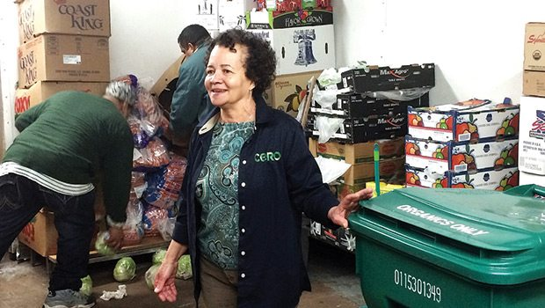
Slide 2
One company that is part of the green economy is called CERO.
Workers at CERO pick up food waste from businesses like grocery stores, restaurants, colleges, and hospitals.
Businesses pay for this service.
Notes:
CERO worker and owner Josefina Luna during a pickup at America’s Food Basket. Workers in background are America’s Food Basket employees. (Photo: Photo courtesy Chris Helms/jamaicaplainnews.com)

Slide 4
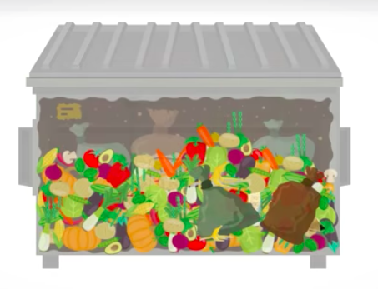
Slide 3
Dumpsters are full of food that people don’t eat!
Some businesses are not allowed to throw away that much food. They have to pay a fine if they throw away too much. It’s also not good for the earth to create so much trash.
The food waste can be used for compost instead—it can be turned into soil to grow more food.

Slide 5
Slide 4
How it works
CERO does an assessment to see how much food waste a business creates.
The business has less trash to get rid of. This saves them money. It’s also less smelly!
CERO drops off bins to the business.

Slide 6
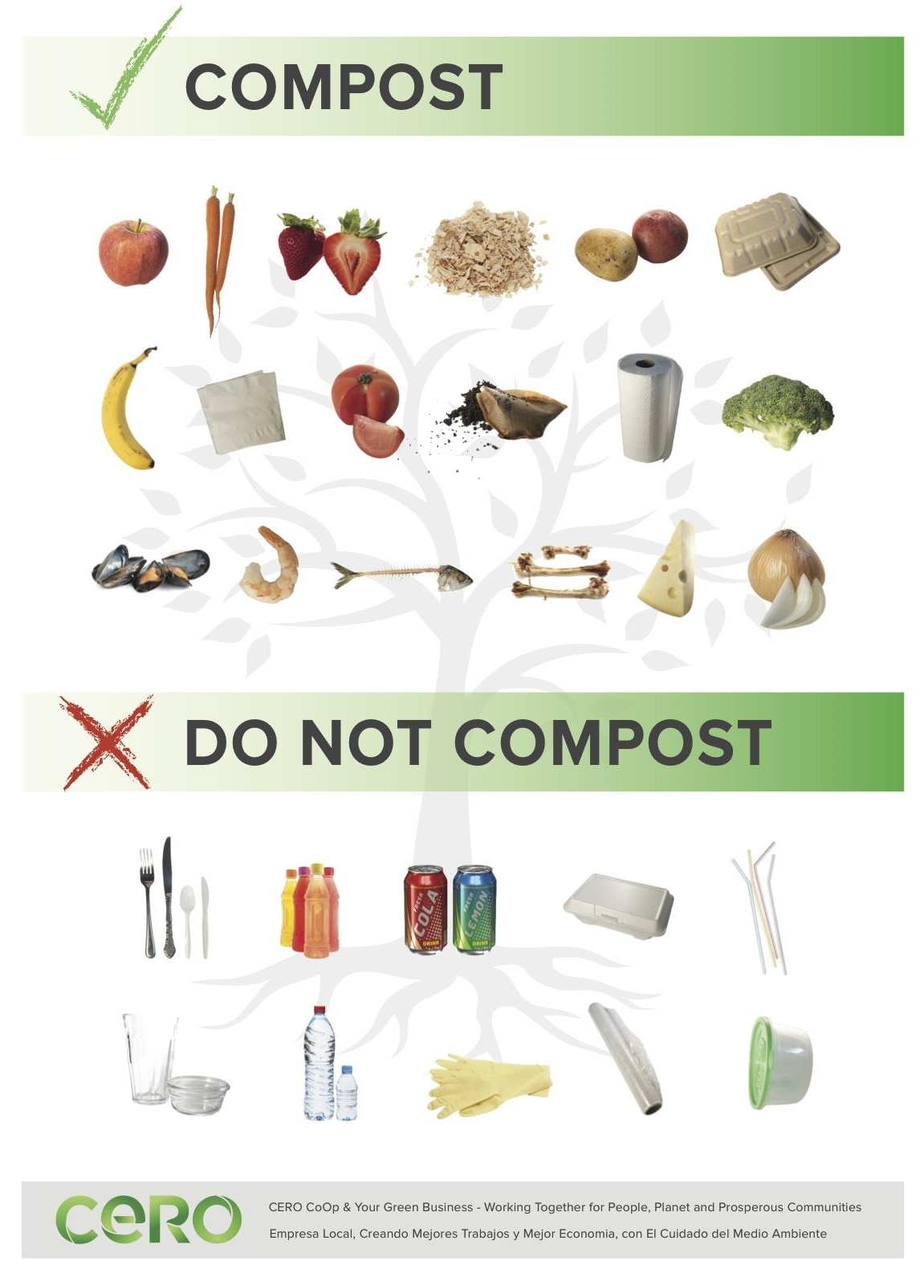
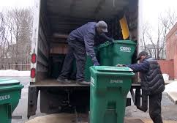
Slide 5
Only food waste goes into the bins.
The CERO workers pick up the full bins and deliver fresh ones.

Slide 7
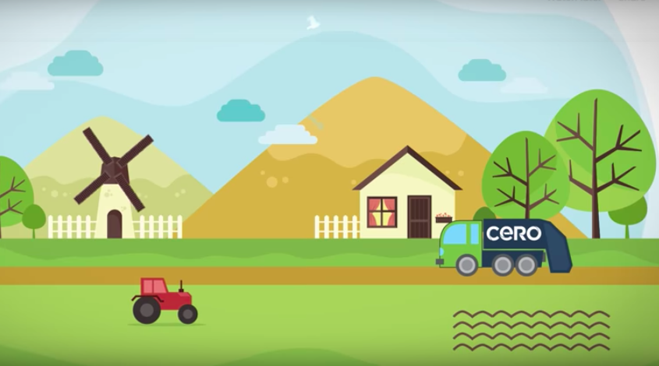
Slide 6
CERO transports the food waste from the bins to local farms.
This is where the food waste breaks down and becomes compost. The compost makes the soil healthier for growing new plants.

Slide 8
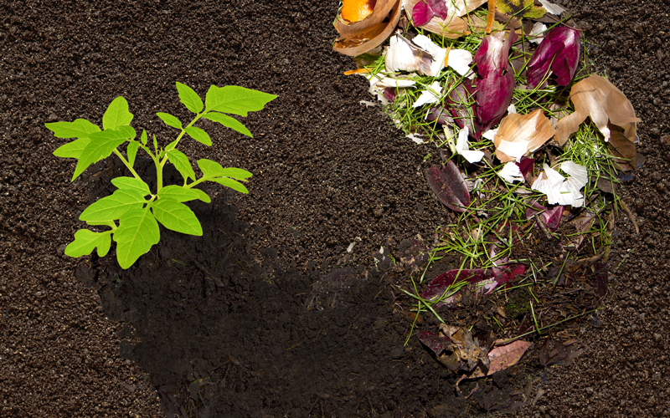
Slide 7
The compost turns into rich soil.
The soil is used to grow more food for people to eat.
Notes:
Cero website

Slide 9
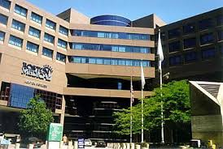
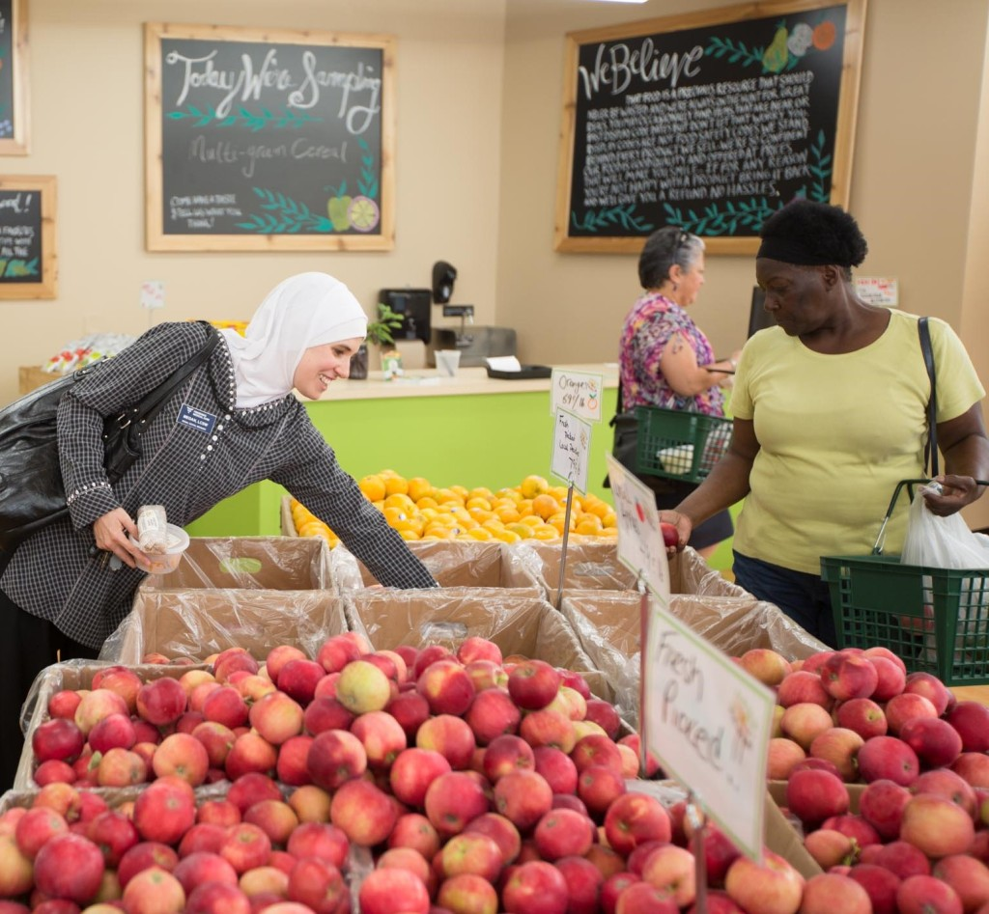
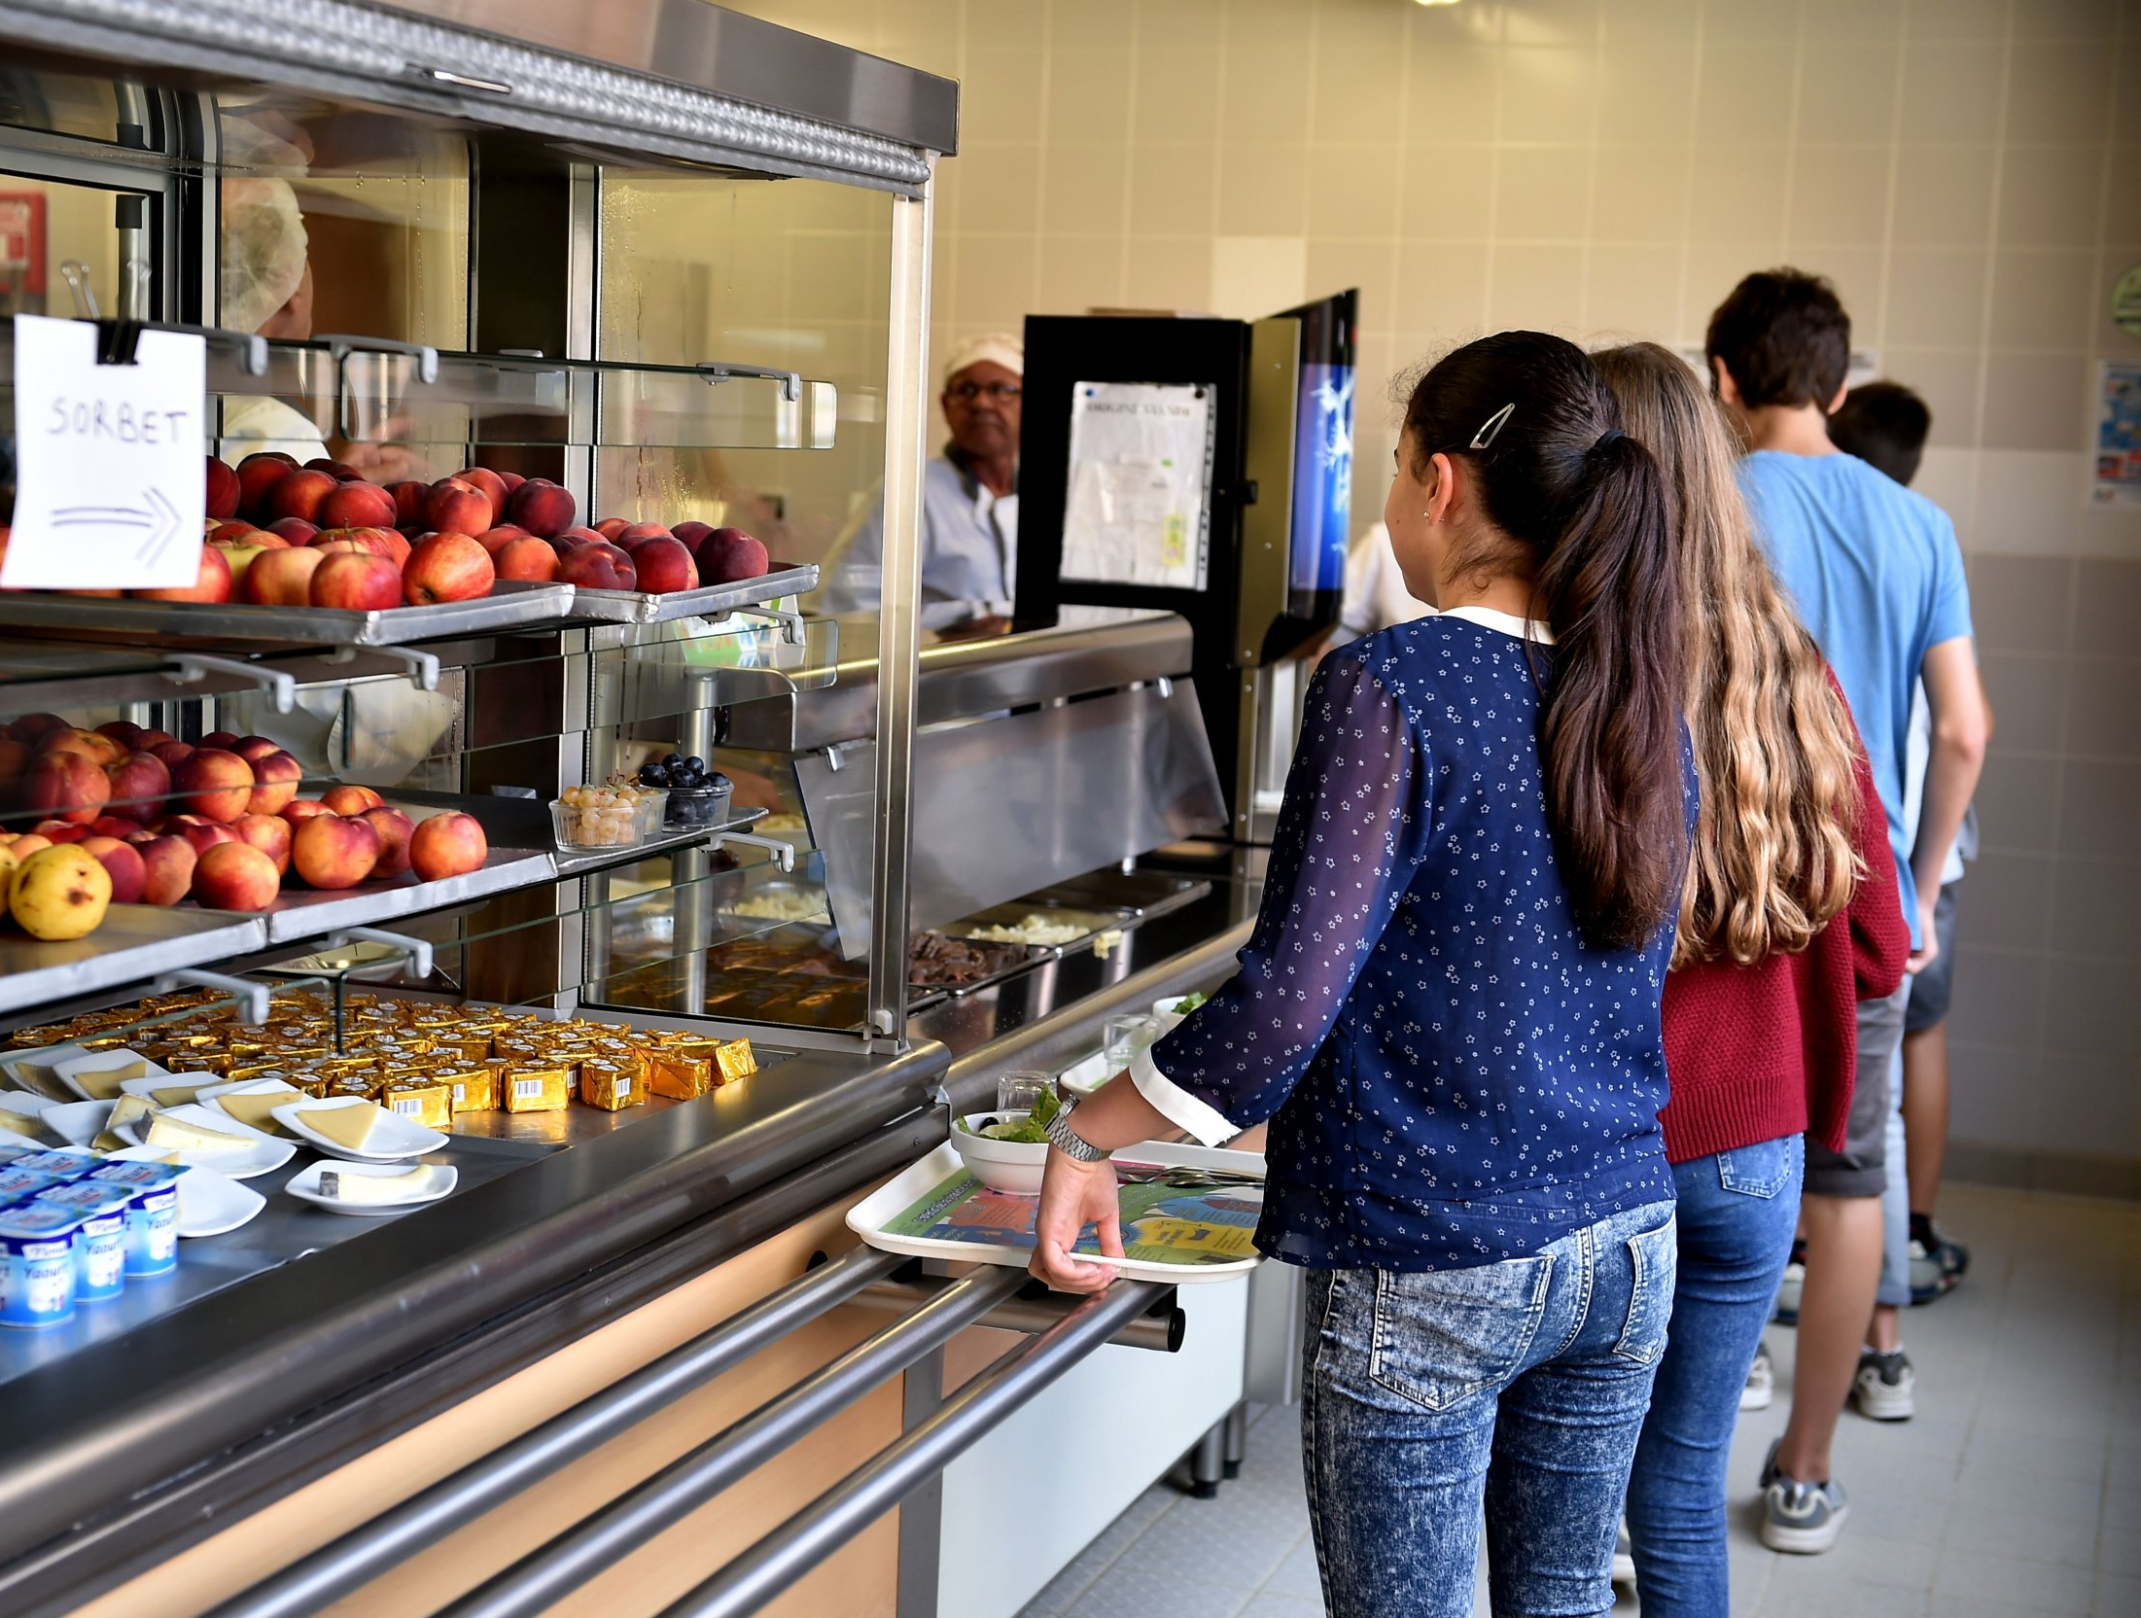
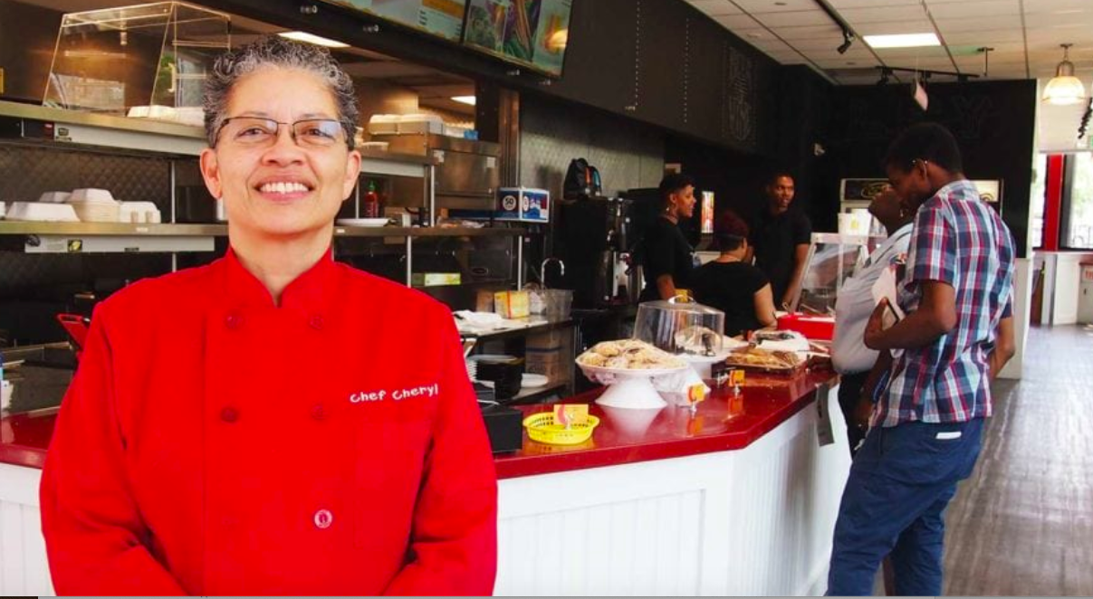
Slide 8
That food from the farms goes to stores and restaurants, hospitals and schools.

Slide 10
Slide 9
A green economy supply chain

Slide 11
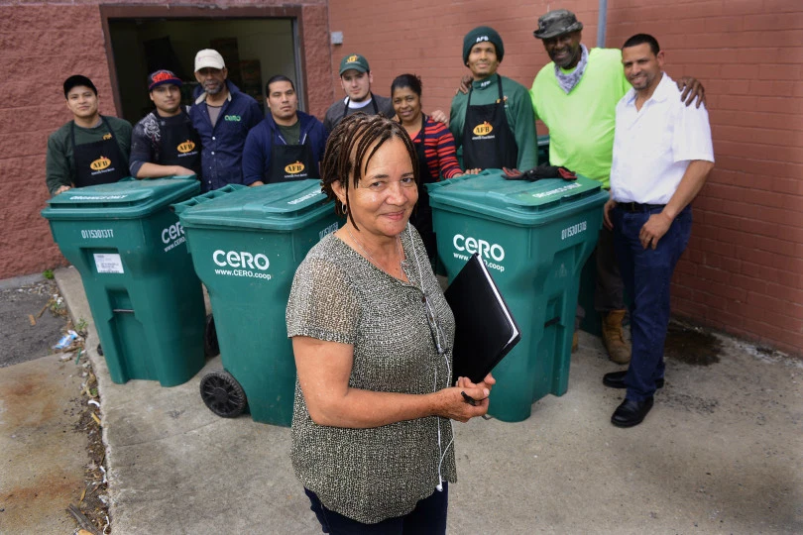
Slide 10
Each part of this supply chain requires people who do the work.
Josefina Luna is one of the founders of CERA. She is an owner and a worker.
Josefina was born in the Dominican Republic and now lives in Boston, Massachusetts. She was a teacher for 15 years. Her mother taught her to plant trees, and she learned to grow a garden to provide food for her family.

Slide 12
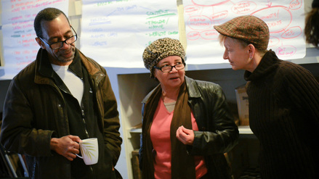
Slide 11
“When I heard about the green economy for the first time, a light bulb went off in my head. We can create businesses and jobs for ourselves.”
- Tim Hall
Founder, Owner, Worker
CERO is a worker cooperative.
In a worker cooperative, the workers are the bosses. Together, they make decisions about their business, their goods and services, and how they work, and they share the money the business makes.
In a worker cooperative, workers do many different jobs.
Notes:
https://www.yesmagazine.org/issue/poverty/2014/08/15/how-america-s-largest-worker-owned-co-op-lifts-people-out-of-poverty/

Slide 13
Written and compiled by Melissa Tonachel Focus on First, 2019.
Citations
Slide 1: https://www.switchmed.eu/fr/news/actualites/take-the-green-economy-survey-now
Slide 2: Chris Helms/jamaicaplainnews.com
Slide 8: https://dailytable.org/about-us/our-story/, https://www.glassdoor.com/Photos/Boston-Medical-Center-Office-Photos-IMG10774.htm, https://www.newsweek.com/mascoma-valley-regional-high-school-cafe-services-employee-fired-student-meal-1427473
Slide 10: https://www.bostonherald.com/2015/06/21/boston-recycling-co-succeeds-with-funds-raised-from-public/, Staff photo by Ted Fitzgerald
All other images and information courtesy of CERO, http://www.cero.coop

