Slide 1
How People Help Animals Survive and Thrive
Text Talk Week 7, Day 4 | Packet 2
Citations:
Slide 13: https://www.neaq.org/blog/an-ocean-of-progress-in-2018/
Slide 14: https://allyouneedisbiology.wordpress.com/2019/01/20/jane-goodall-conferences/; https://businesschicks.com/dr-jane-goodall-interview/
Slide 15: https://www.nationalgeographic.org/education/crittercam-education/; https://www.youtube.com/watch?v=A9mbCNs47FI
Slide 16: https://www.worldwildlife.org/species/directory

Slide 2
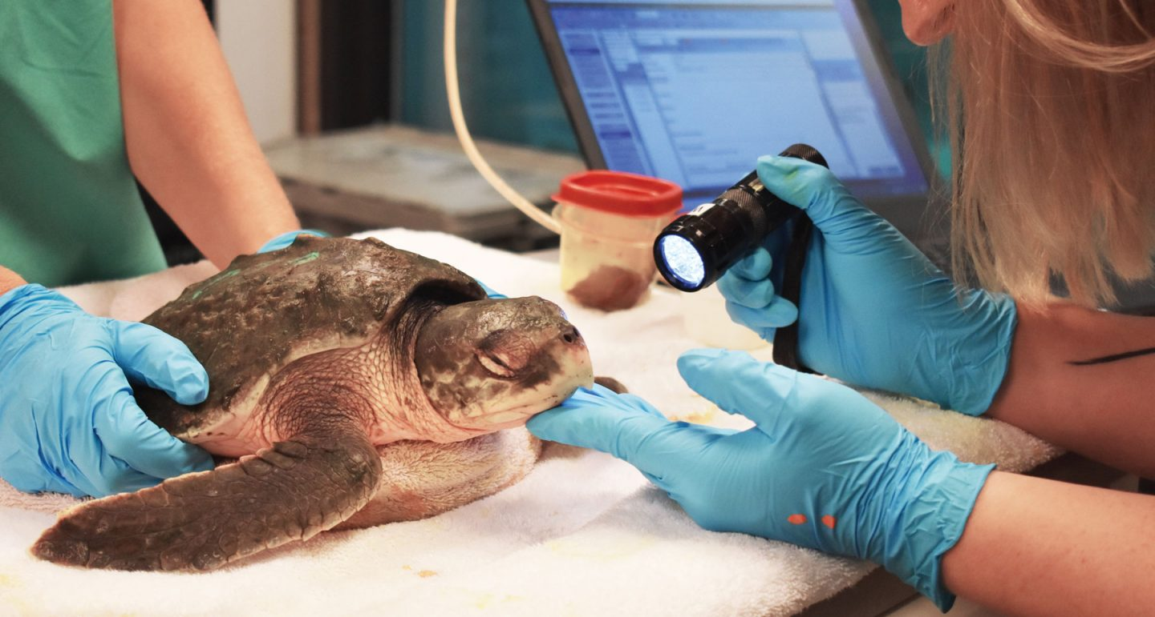
Slide 13
Studying Animals
Another way to impact animals’ survival in a positive way is to study animals in order to help them.

Slide 3
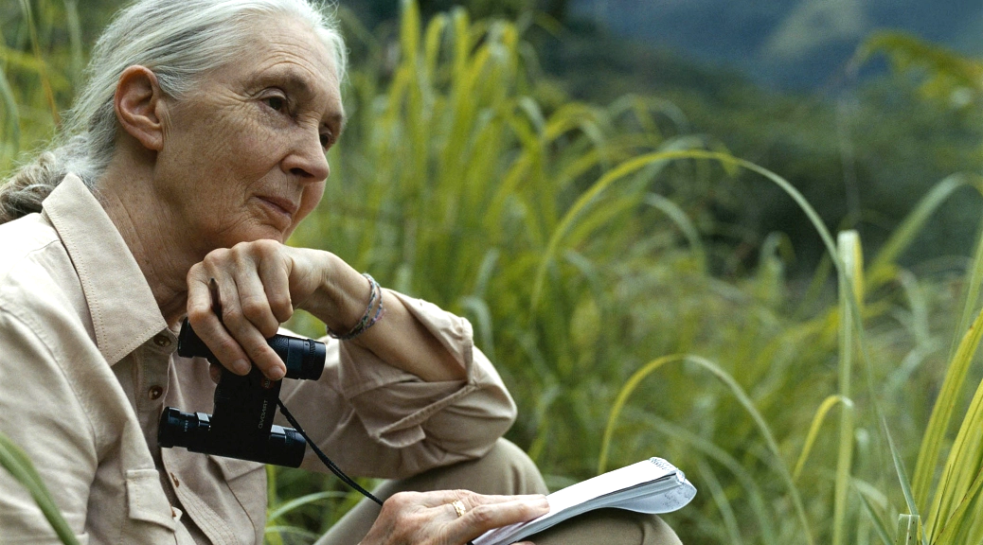
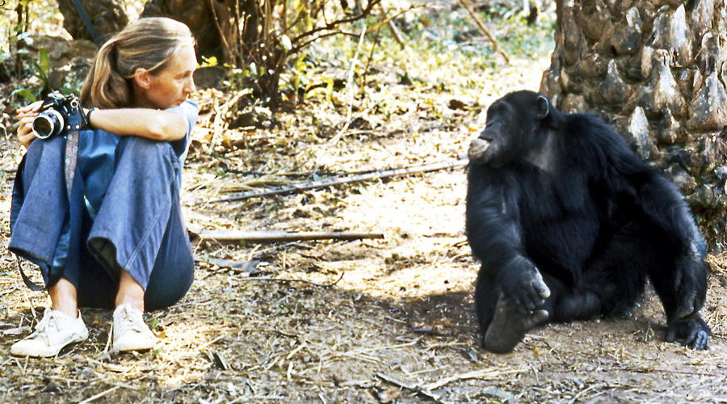
Slide 14
Scientists observe and record information about animals. This can help them understand animal behaviors, what animals need, and how best to help animals survive and thrive.

Slide 4
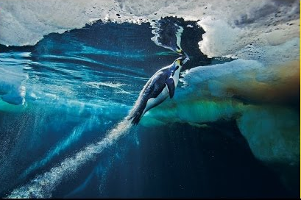
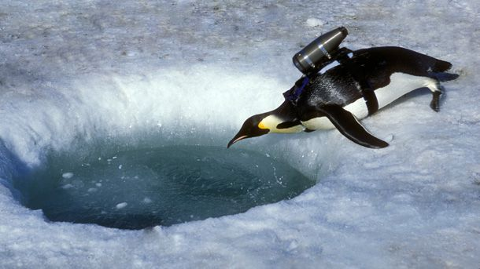
Slide 15
Some scientists use crittercams to find out more about what the life of an animal is like. They can put a camera on a whale to see how it eats and swims. They can film a penguin’s behaviors under the ice!

Slide 5
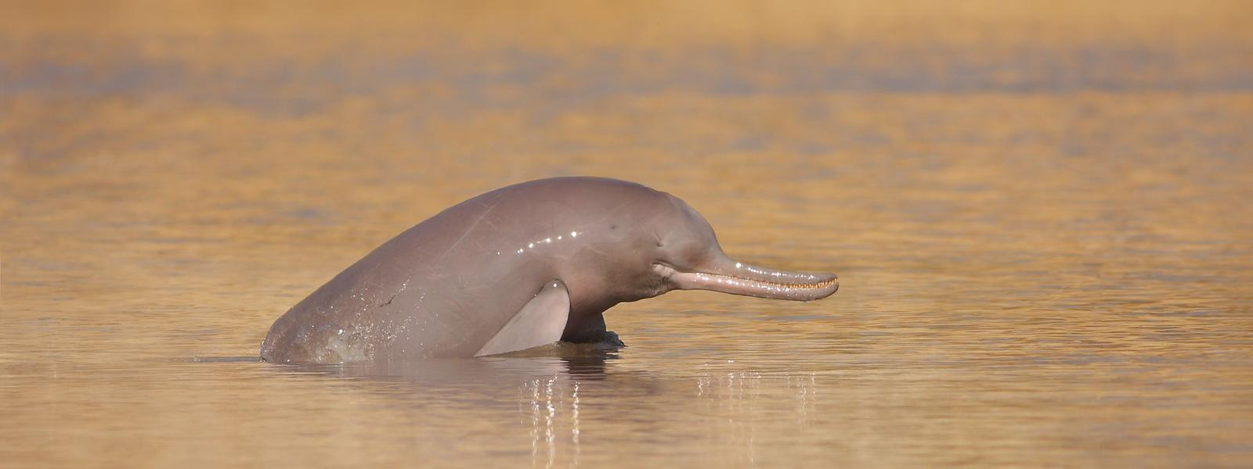
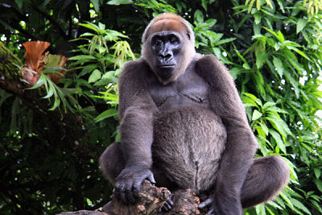
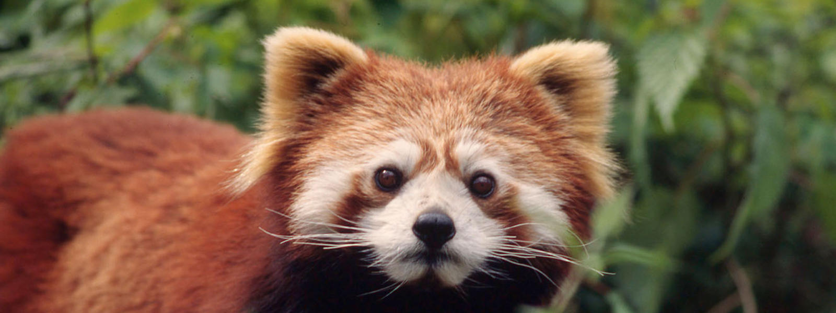
Slide 16
There are many ways people can help animals survive and thrive.
When many different kinds of animals live well, the whole Earth is healthier.

