Slide 1
How People Help Animals Survive and Thrive
Text Talk Week 7, Day 3 | Packet 1
Notes:
global, map

Slide 2
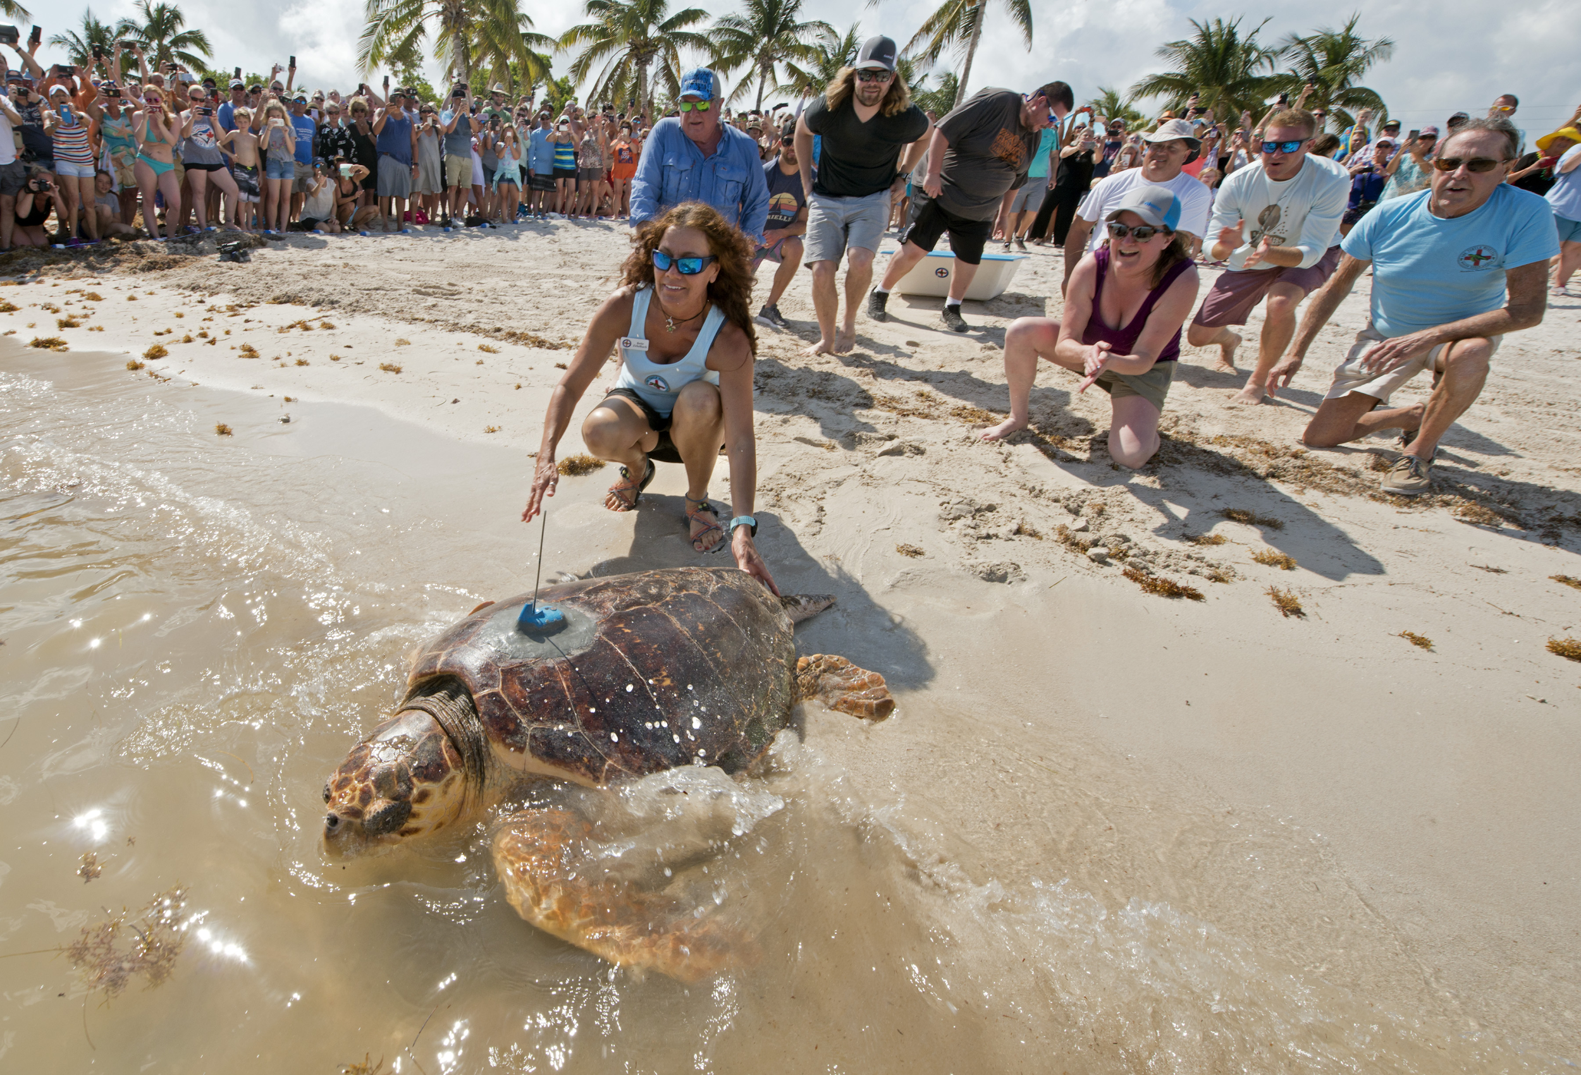
Slide 1
People and animals are interconnected. People can have a positive impact on how animals survive and thrive.

Slide 3
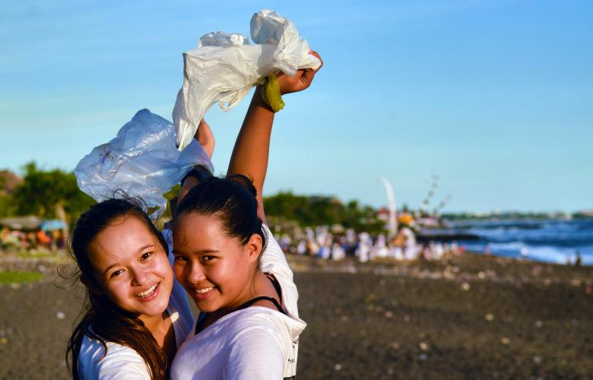
Slide 2
Reducing Trash
One way to impact animals’ survival in a positive way is to reduce the amount of trash we make.

Slide 4
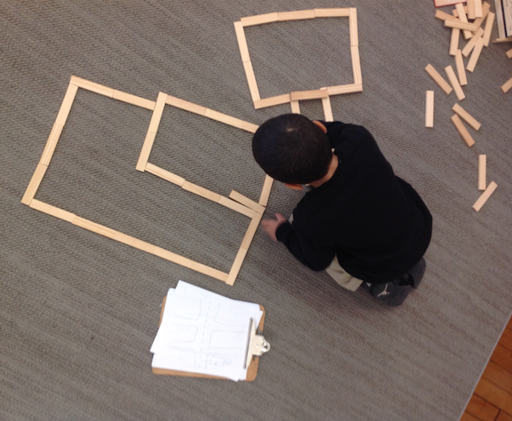
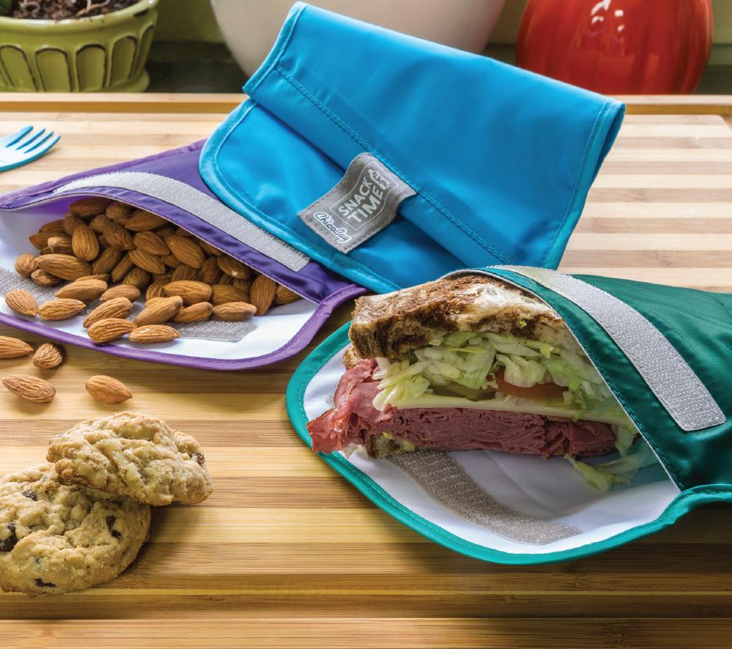
Slide 4
Plastic trash is particularly harmful. We can reduce plastic trash by buying and using less of it. For example, we can use non-plastic toys. We can use reusable cloth bags for our lunches and snacks.

Slide 5
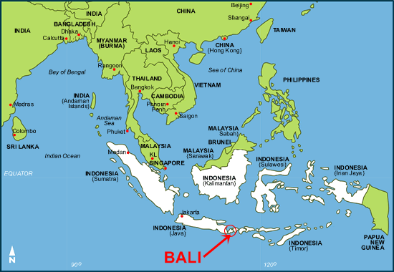
Slide 5
Bye Bye Plastic Bags
Melati and Isabel Wijsen are sisters who live in Bali, an island in Indonesia. Bye Bye Plastic Bags is the organization they started to raise awareness about the dangers of plastic bags. They have asked communities to stop using plastic bags. In 2019, they were successful—Bali now has a ban on single-use plastic bags, just like we do in Boston.

Slide 6
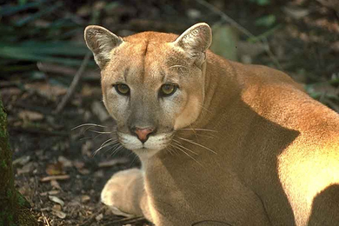
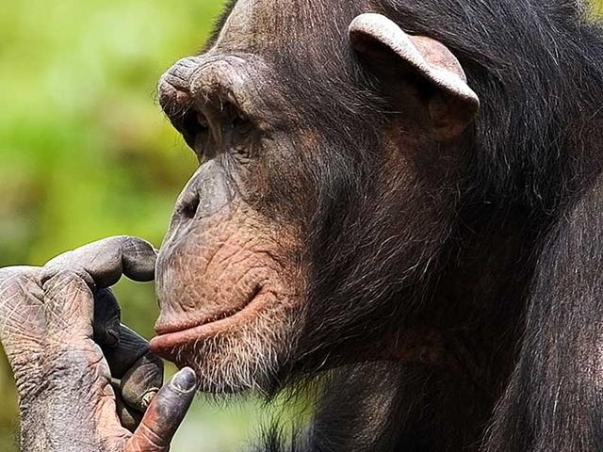
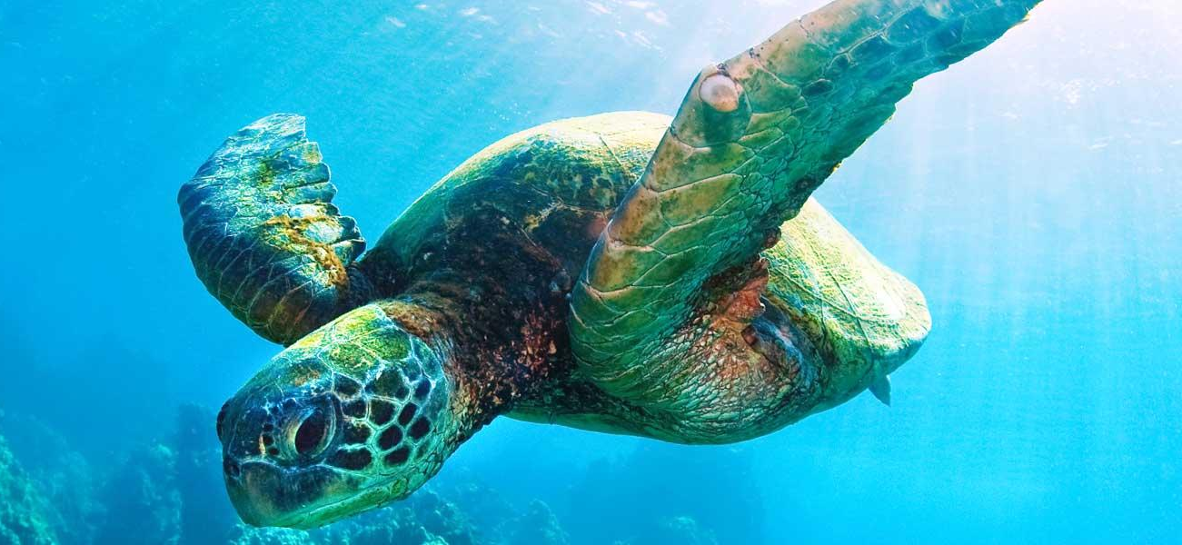
Slide 7
People can take action to conserve the habitats of endangered animals. For example, now there are laws that protect some land in Florida for the Florida panther to live on. This means that humans cannot build houses on that land. There are also small things we can do each day, even without the help of laws.

Slide 7
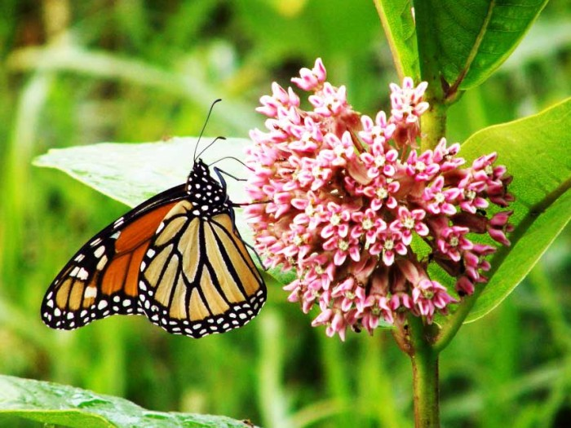
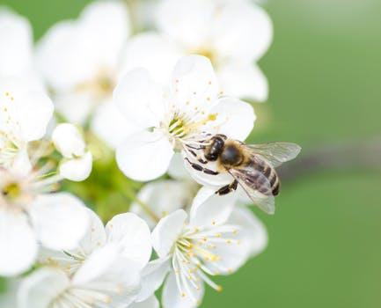
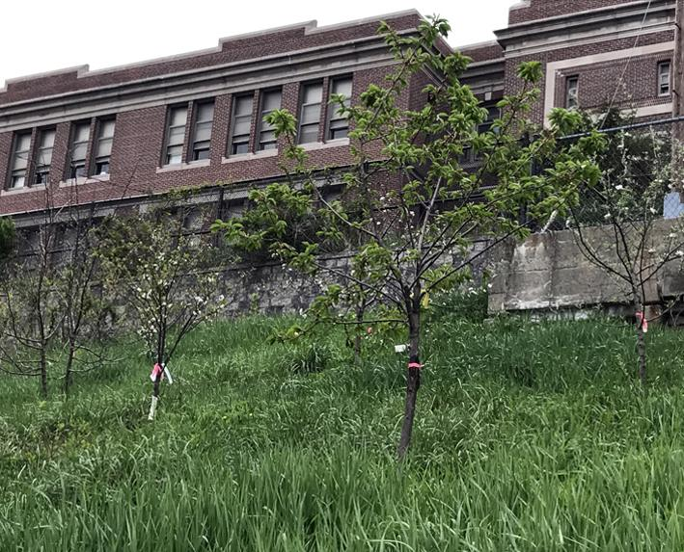
Slide 9
To help, we can plant food animals need. We can plant flowers that provide food for insects like butterflies and bees. We can plant trees that provide fruit and nuts for birds and other small animals. These small animals are prey for larger animals. They are part of the food web.

Slide 8
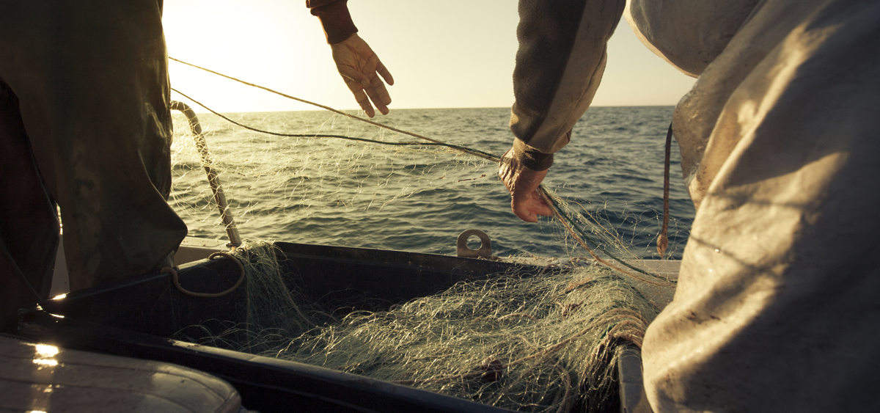
Slide 10
We can help by making sure we do not use up the food animals need. For example, we can make sure we don’t catch all of the fish that other ocean animals need to survive. This helps oceans stay healthy for all of the animals that live there.

Slide 9
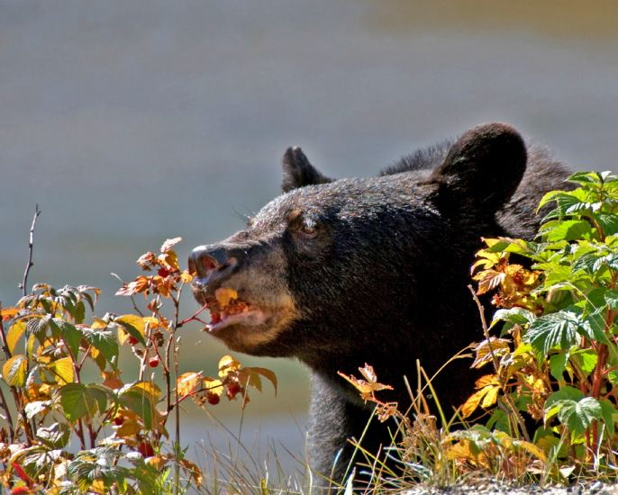
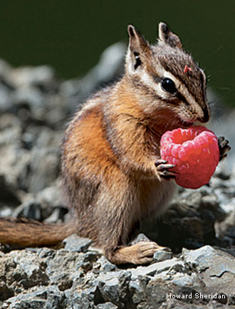
Slide 11
When we find wild foods to pick and eat, we can leave enough for the animals who depend on them.

Slide 10
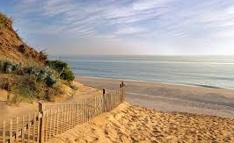
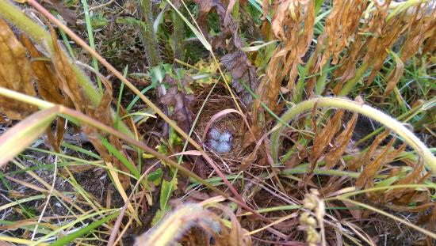
Slide 12
Another way to impact animals’ survival in a positive way is to be careful and respectful when we are traveling in their habitats. Watch where you step!

Slide 11
Citations:
Slide 1: https://mote.org/news/article/goodbye-mr.-t-mote-to-track-rehabilitated-loggerhead-sea-turtle
Slide 2: https://www.gapurabali.com/news/2019/06/25/bali-leads-way-and-officially-bans-single-use-plastic-bags-straws-and-polystyrene
Slide 4: https://www.chicobag.com/product-snack-time-repete-17
Slide 5: https://www.ted.com/talks/melati_and_isabel_wijsen_our_campaign_to_ban_plastic_bags_in_bali?language=en#t-325522; http://www.byebyeplasticbags.org/; https://baliweathermap.blogspot.com/2013/01/bali-map-and-travel-map.html
Slide 7: https://www.worldwildlife.org/species/chimpanzee
Slide 9: https://www.raydunetz.com/tag/fruit-trees/; https://www.savatree.com/blog/2015/01/milkweed-monarchs/; https://eatreadscience.com/2015/11/08/resistance-to-plant-toxins-in-milkweed-butterflies-is-linked-to-toxin-storage-for-defense/
Slide 10: https://www.seafoodwatch.org/
Slide 11: http://www.webexhibits.org/causesofcolor/7C.html; https://www.nwf.org/Magazines/National-Wildlife/2013/DecJan/Gardening/Native-Plants-You-Can-Eat
https://www.almanac.com/content/weather-sayings-and-their-meanings
Slide 12: https://www.capecodchamber.org/beaches; https://www.floridapantherprotection.com/Default.aspx?n=4; https://www.tripadvisor.com/LocationPhotoDirectLink-g42391-d3871068-i156936790-Carl_G_Fenner_Nature_Center-Lansing_Ingham_County_Michigan.html

