Slide 1
David Meshoulam:
Speak for the Trees
Text Talk Week 7, Day 3
Note to teachers: this lesson features a local organization in Boston. If there is another local organization that would serve a similar purpose, please replace the contents of this lesson. If not, it is fine to use this lesson.

Slide 2
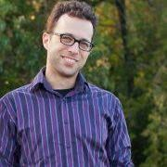
Slide 1
David Meshoulam has some ideas about how we can create positive change in our communities. Like Wangari Maathai, David believes that trees make communities stronger. He helped to start an organization called Speak for the Trees Boston. The people who work together for Speak for the Trees Boston want to make sure that there are lots of trees planted all around Boston and that the trees are cared for and healthy. Here is an interview with David Meshoulam.

Slide 3
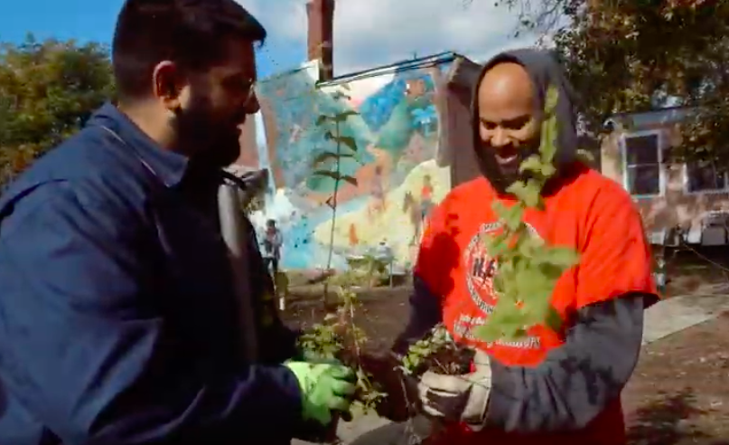
Slide 2
What does Speak for the Trees Boston do?
We love trees, and we want to make sure that everyone in the city also loves and takes care of trees.
We plant trees in neighborhoods that need them.

Slide 4
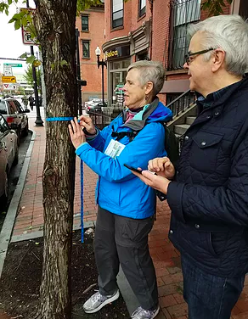
Slide 3
We do a tree inventory. People learn to measure and identify trees so we know what kinds of trees we have and how healthy they are.
Also, we run a youth program, where teenagers get paid to go around the city and learn about trees and inventory them.

Slide 5
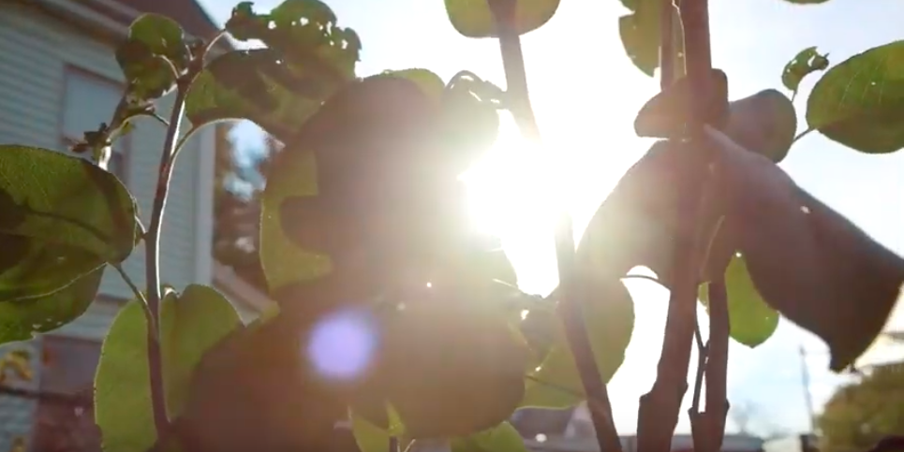
Slide 4
Why is this work important?
Trees clean our air, they shade our homes, they build healthy environments, and they build healthy communities. Our trees are part of a forest that takes care of all of us.

Slide 6
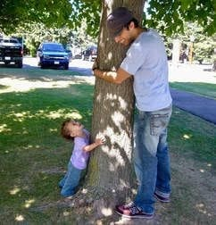
Slide 5
Where did the idea come from?
Before I started this organization, I was teaching science in high school. I wanted my students to understand how the space around them impacts their lives, how they can take care of it, and how they can learn from it. I was also really concerned about our environment, and I wanted to find ways to work with people outside of the classroom to make some of the changes I saw were needed. Also, I just love trees. They’re magical.

Slide 7
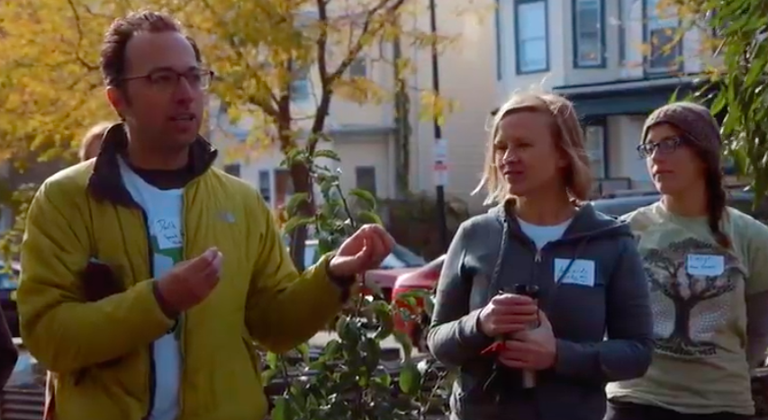
Slide 6
What have you learned about being a leader?
I don’t always know what I’m doing; I’m a new leader. I have had to learn how to make decisions. Sometimes it can be uncomfortable, when I feel like I don’t know more than anyone else around me. Sometimes we make decisions together. Sometimes I have to say, “This is how things are going to be,” even if there’s disagreement.

Slide 8
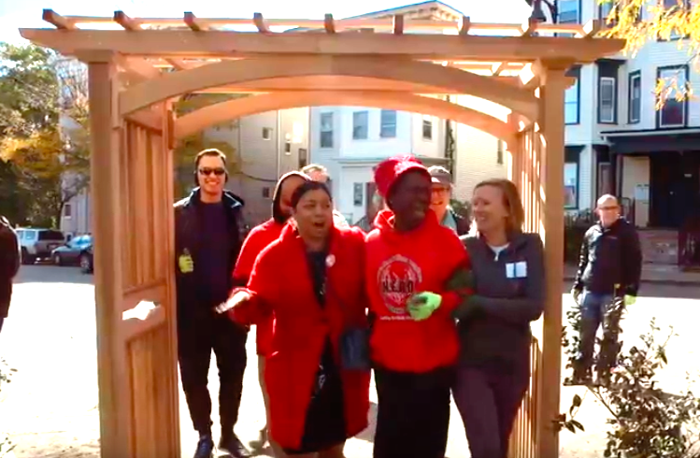
Slide 7
As a leader, you have a vision, but making that vision happen is a challenge. I think about how my colleagues and I can make the vision that we share into something we can actually do together.

Slide 9
Slide 8
What are some different roles in the organization?
Raising money
Making the systems so we can do the work we need to do
Deciding what projects we’ll do and how we will do them
Organizing activities
Making decisions
Working with technology
Making sure we are following rules for organizations
Letting people know about what we do

Slide 10
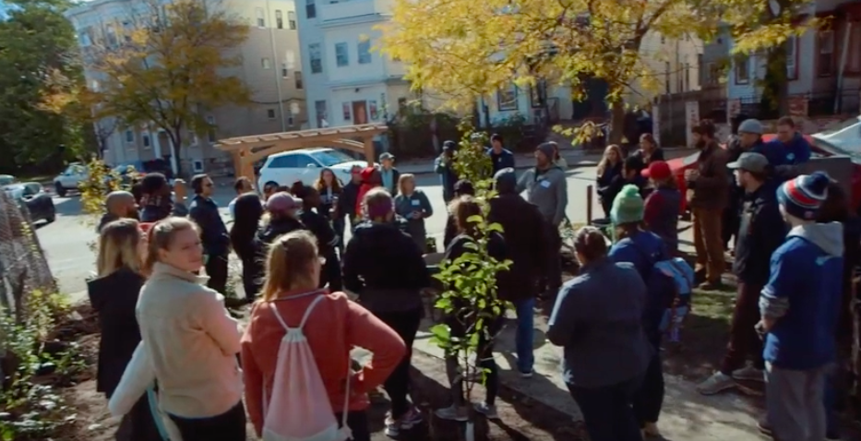
Slide 9
How do you think we can create positive change in our communities?
Speak for the Trees Boston collaborates with other people and organizations who value caring for green spaces in the community and caring for each other. One way we can create positive change in our communities is by coming together to care for and plant trees! We are building connections in our community, and contributing to a healthy environment.

Slide 11
Citations
Slide 1: https://www.sfttbos.org/
Slide 2: Still from https://www.youtube.com/watch?v=L7DEINQhdOk
Slide 3: https://www.sfttbos.org/voluntree, https://docs.wixstatic.com/ugd/794328_83a9babcb669420e8da6a0d29827246e.pdf
Slide 4: Still from https://www.youtube.com/watch?v=L7DEINQhdOk
Slide 5: https://rightquestion.org/resources/branching-questions-using-the-question-formulation-technique-in-a-youth-tree-stewardship-program/
Slide 6: Still from https://www.youtube.com/watch?v=L7DEINQhdOk
Slide 7: Still from https://www.youtube.com/watch?v=L7DEINQhdOk
Slide 9: Still from https://www.youtube.com/watch?v=L7DEINQhdOk

