Slide 1
How People Help Animals Survive and Thrive
Text Talk Week 7, Days 3 and 4
Notes:
global, map

Slide 2
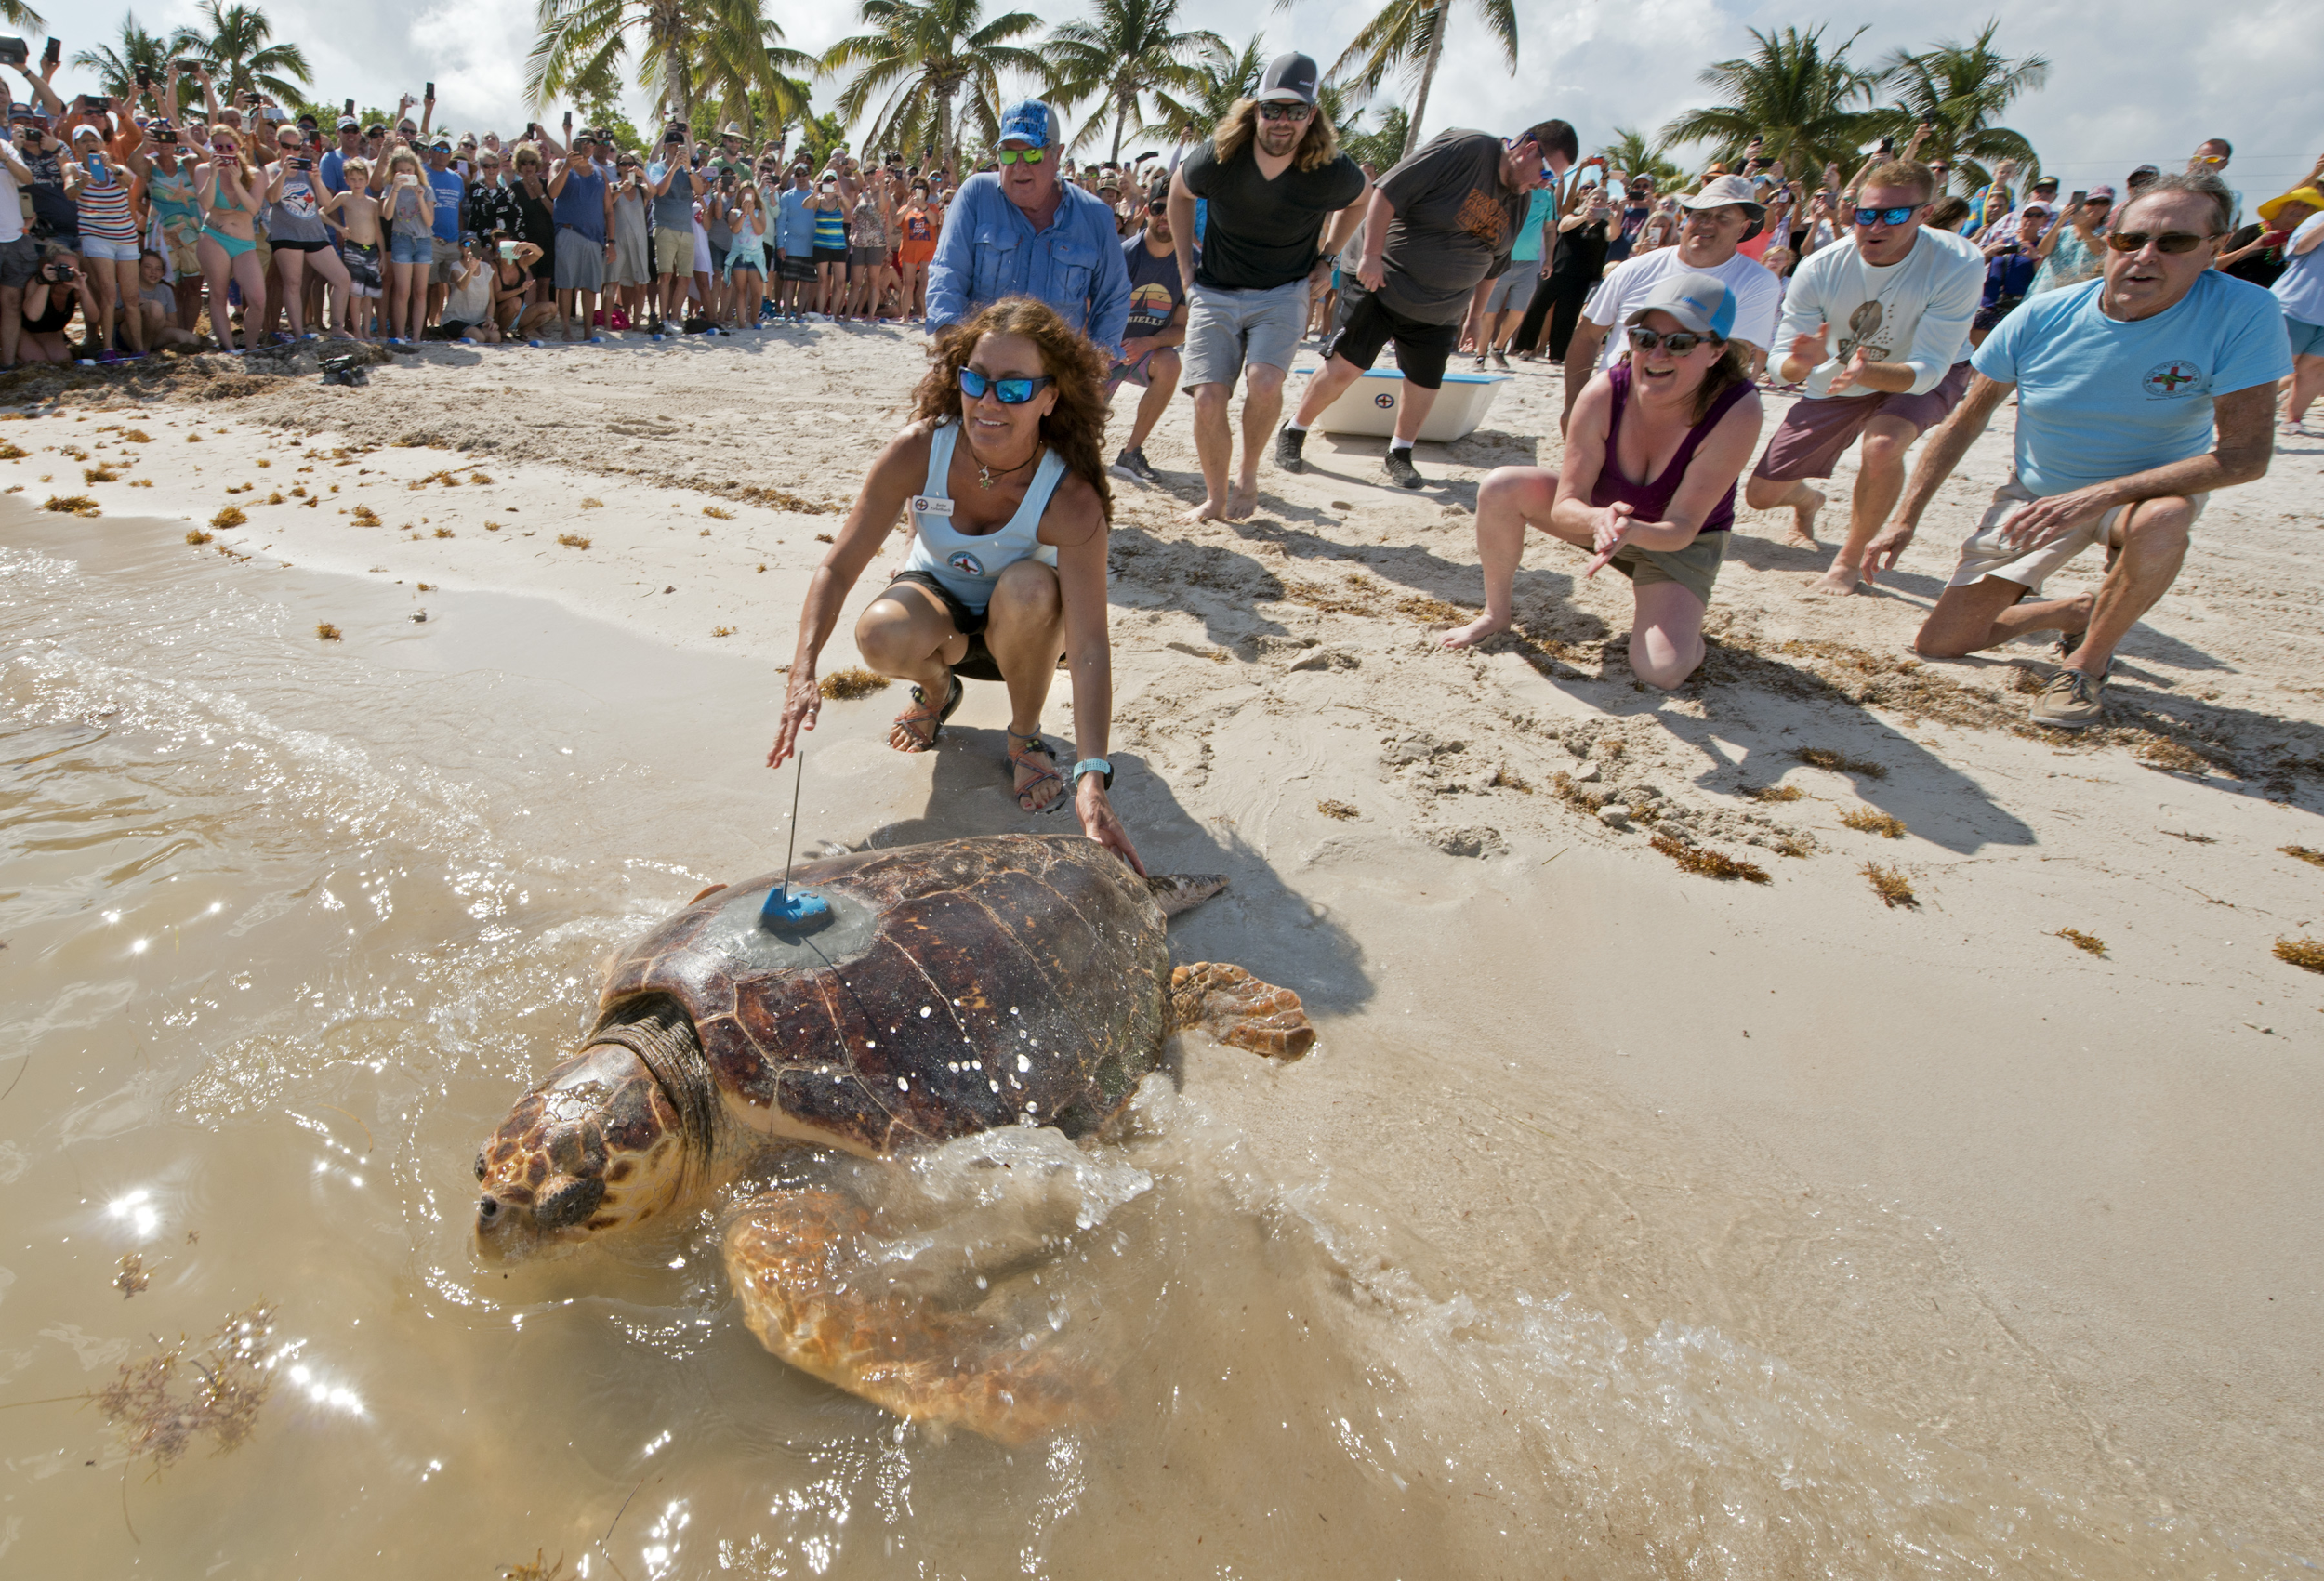
Slide 1
People and animals are interconnected. People can have a positive impact on how animals survive and thrive.

Slide 3
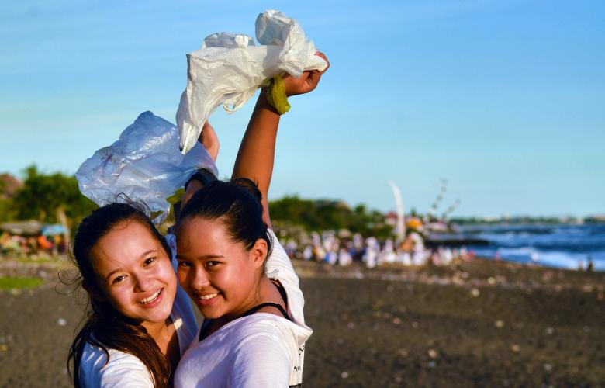
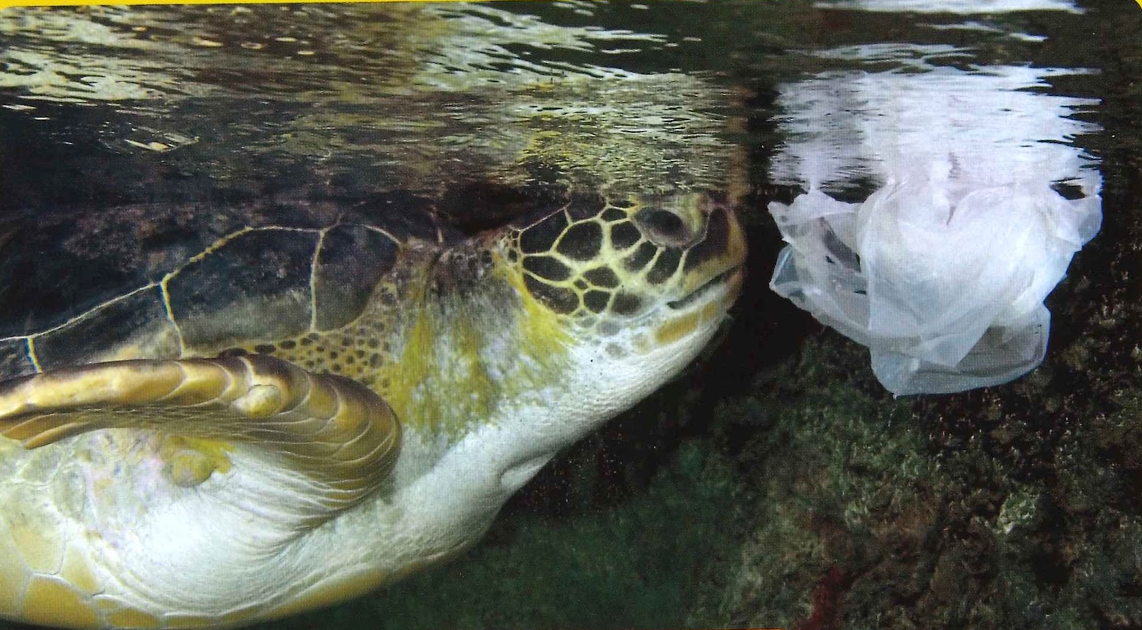
Slide 2
Reducing Trash
One way to impact animals’ survival in a positive way is to reduce the amount of trash we make.

Slide 4
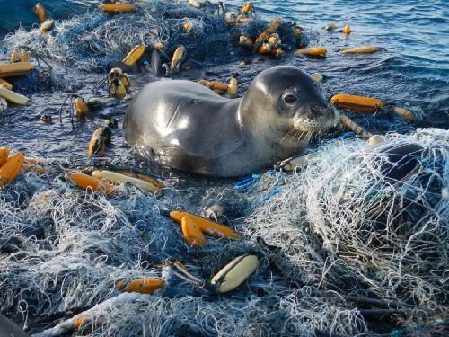
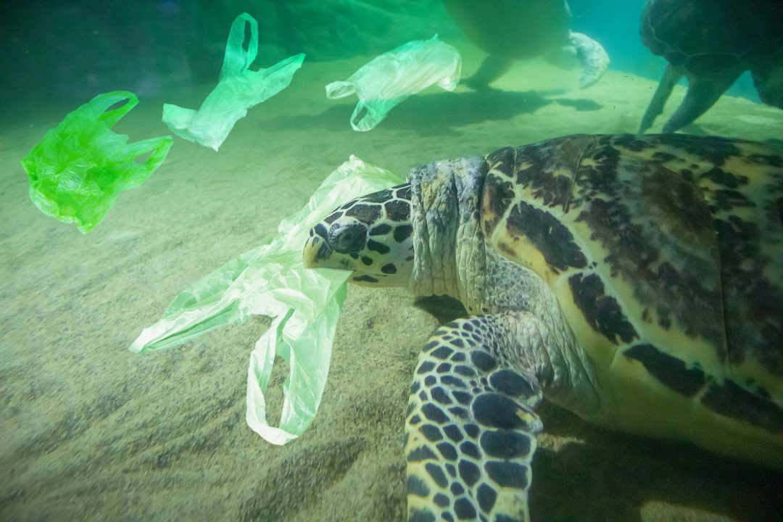
Slide 3
People generate a lot of trash. Trash is a danger for many animals in the ocean. Ocean animals can get tangled up in trash. Some animals, like sea turtles, mistake the trash for food, and eat it.

Slide 5
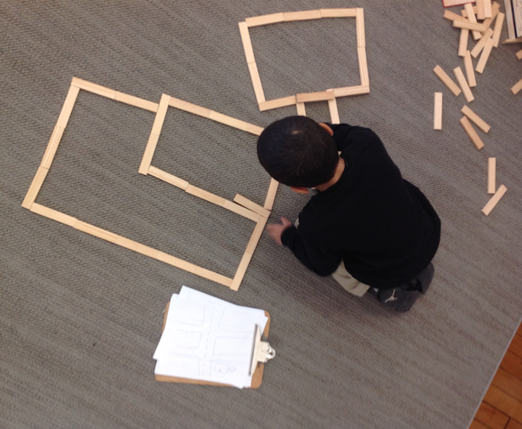
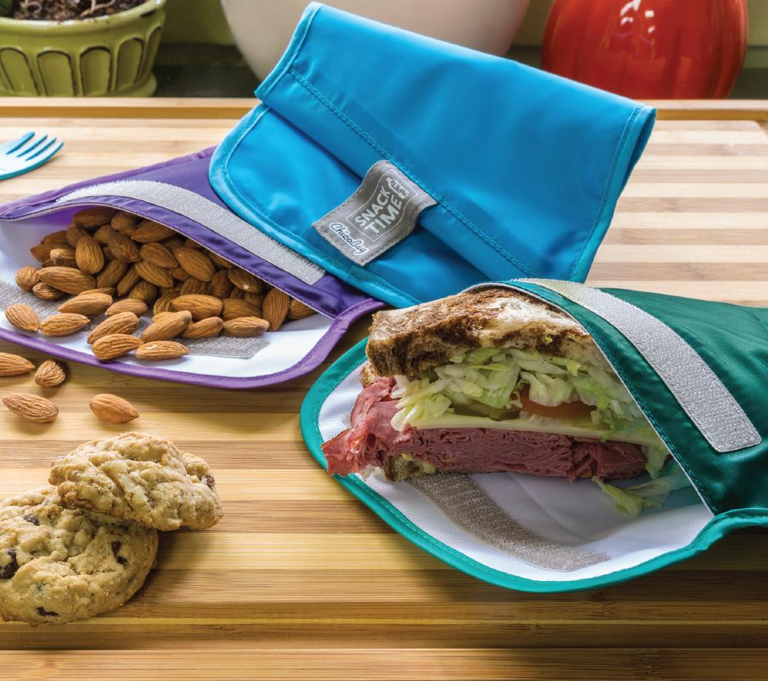
Slide 4
Plastic trash is particularly harmful. We can reduce plastic trash by buying and using less of it. For example, we can use non-plastic toys. We can use reusable cloth bags for our lunches and snacks.

Slide 6

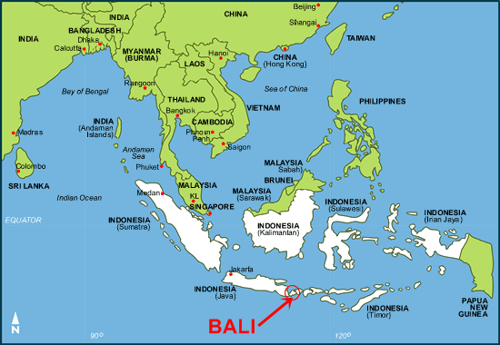
Slide 5
Bye Bye Plastic Bags
Melati and Isabel Wijsen are sisters who live in Bali, an island in Indonesia. Bye Bye Plastic Bags is the organization they started to raise awareness about the dangers of plastic bags. They have asked communities to stop using plastic bags. In 2019, they were successful—Bali now has a ban on single-use plastic bags, just like we do in Boston.

Slide 7
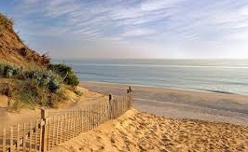
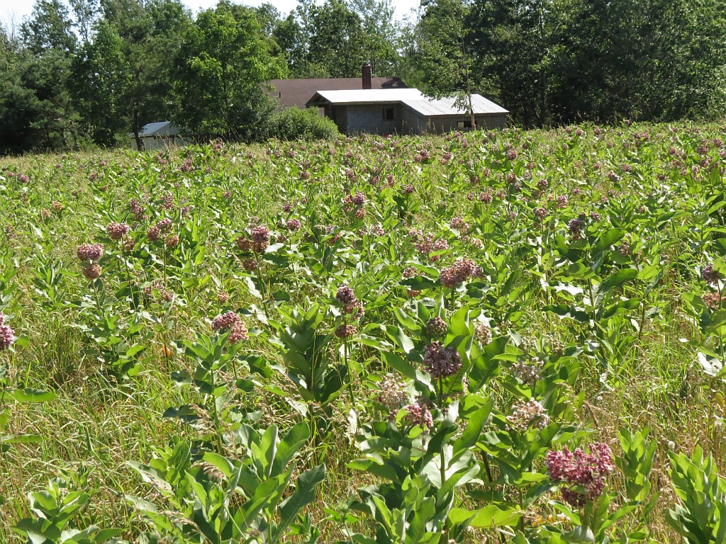
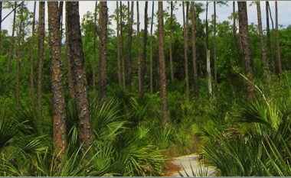
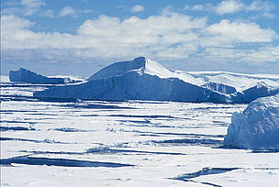
Slide 6
Protecting Habitats, Protecting Food
Loss of habitat is a great danger to animals. Another way to impact animals’ survival in a positive way is to protect habitats and food sources.

Slide 8
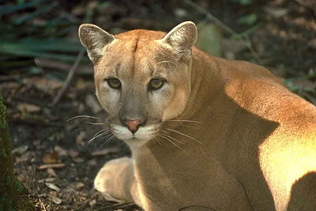
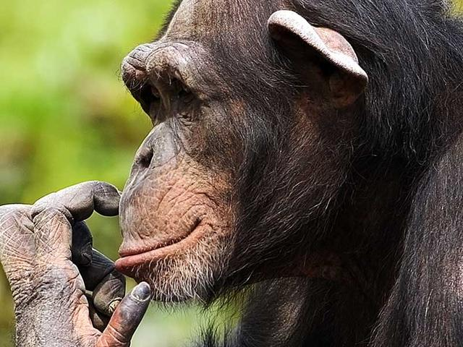
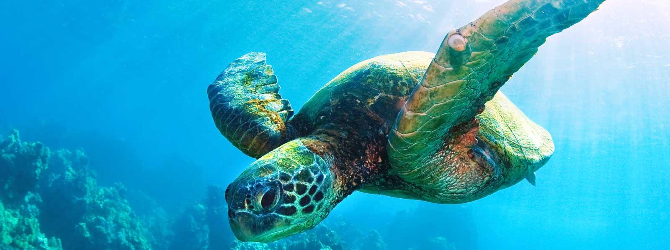
Slide 7
People can take action to conserve the habitats of endangered animals. For example, now there are laws that protect some land in Florida for the Florida panther to live on. This means that humans cannot build houses on that land. There are also small things we can do each day, even without the help of laws.

Slide 9
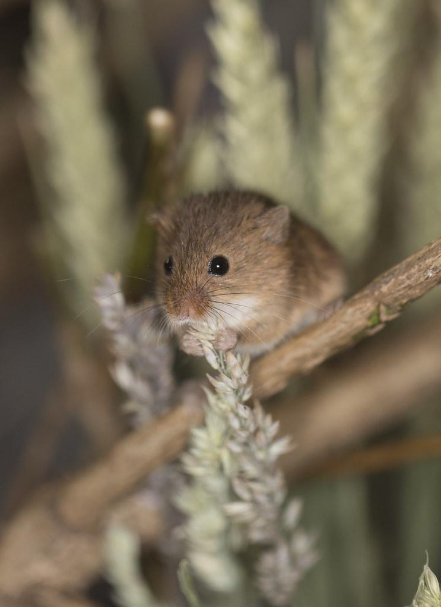
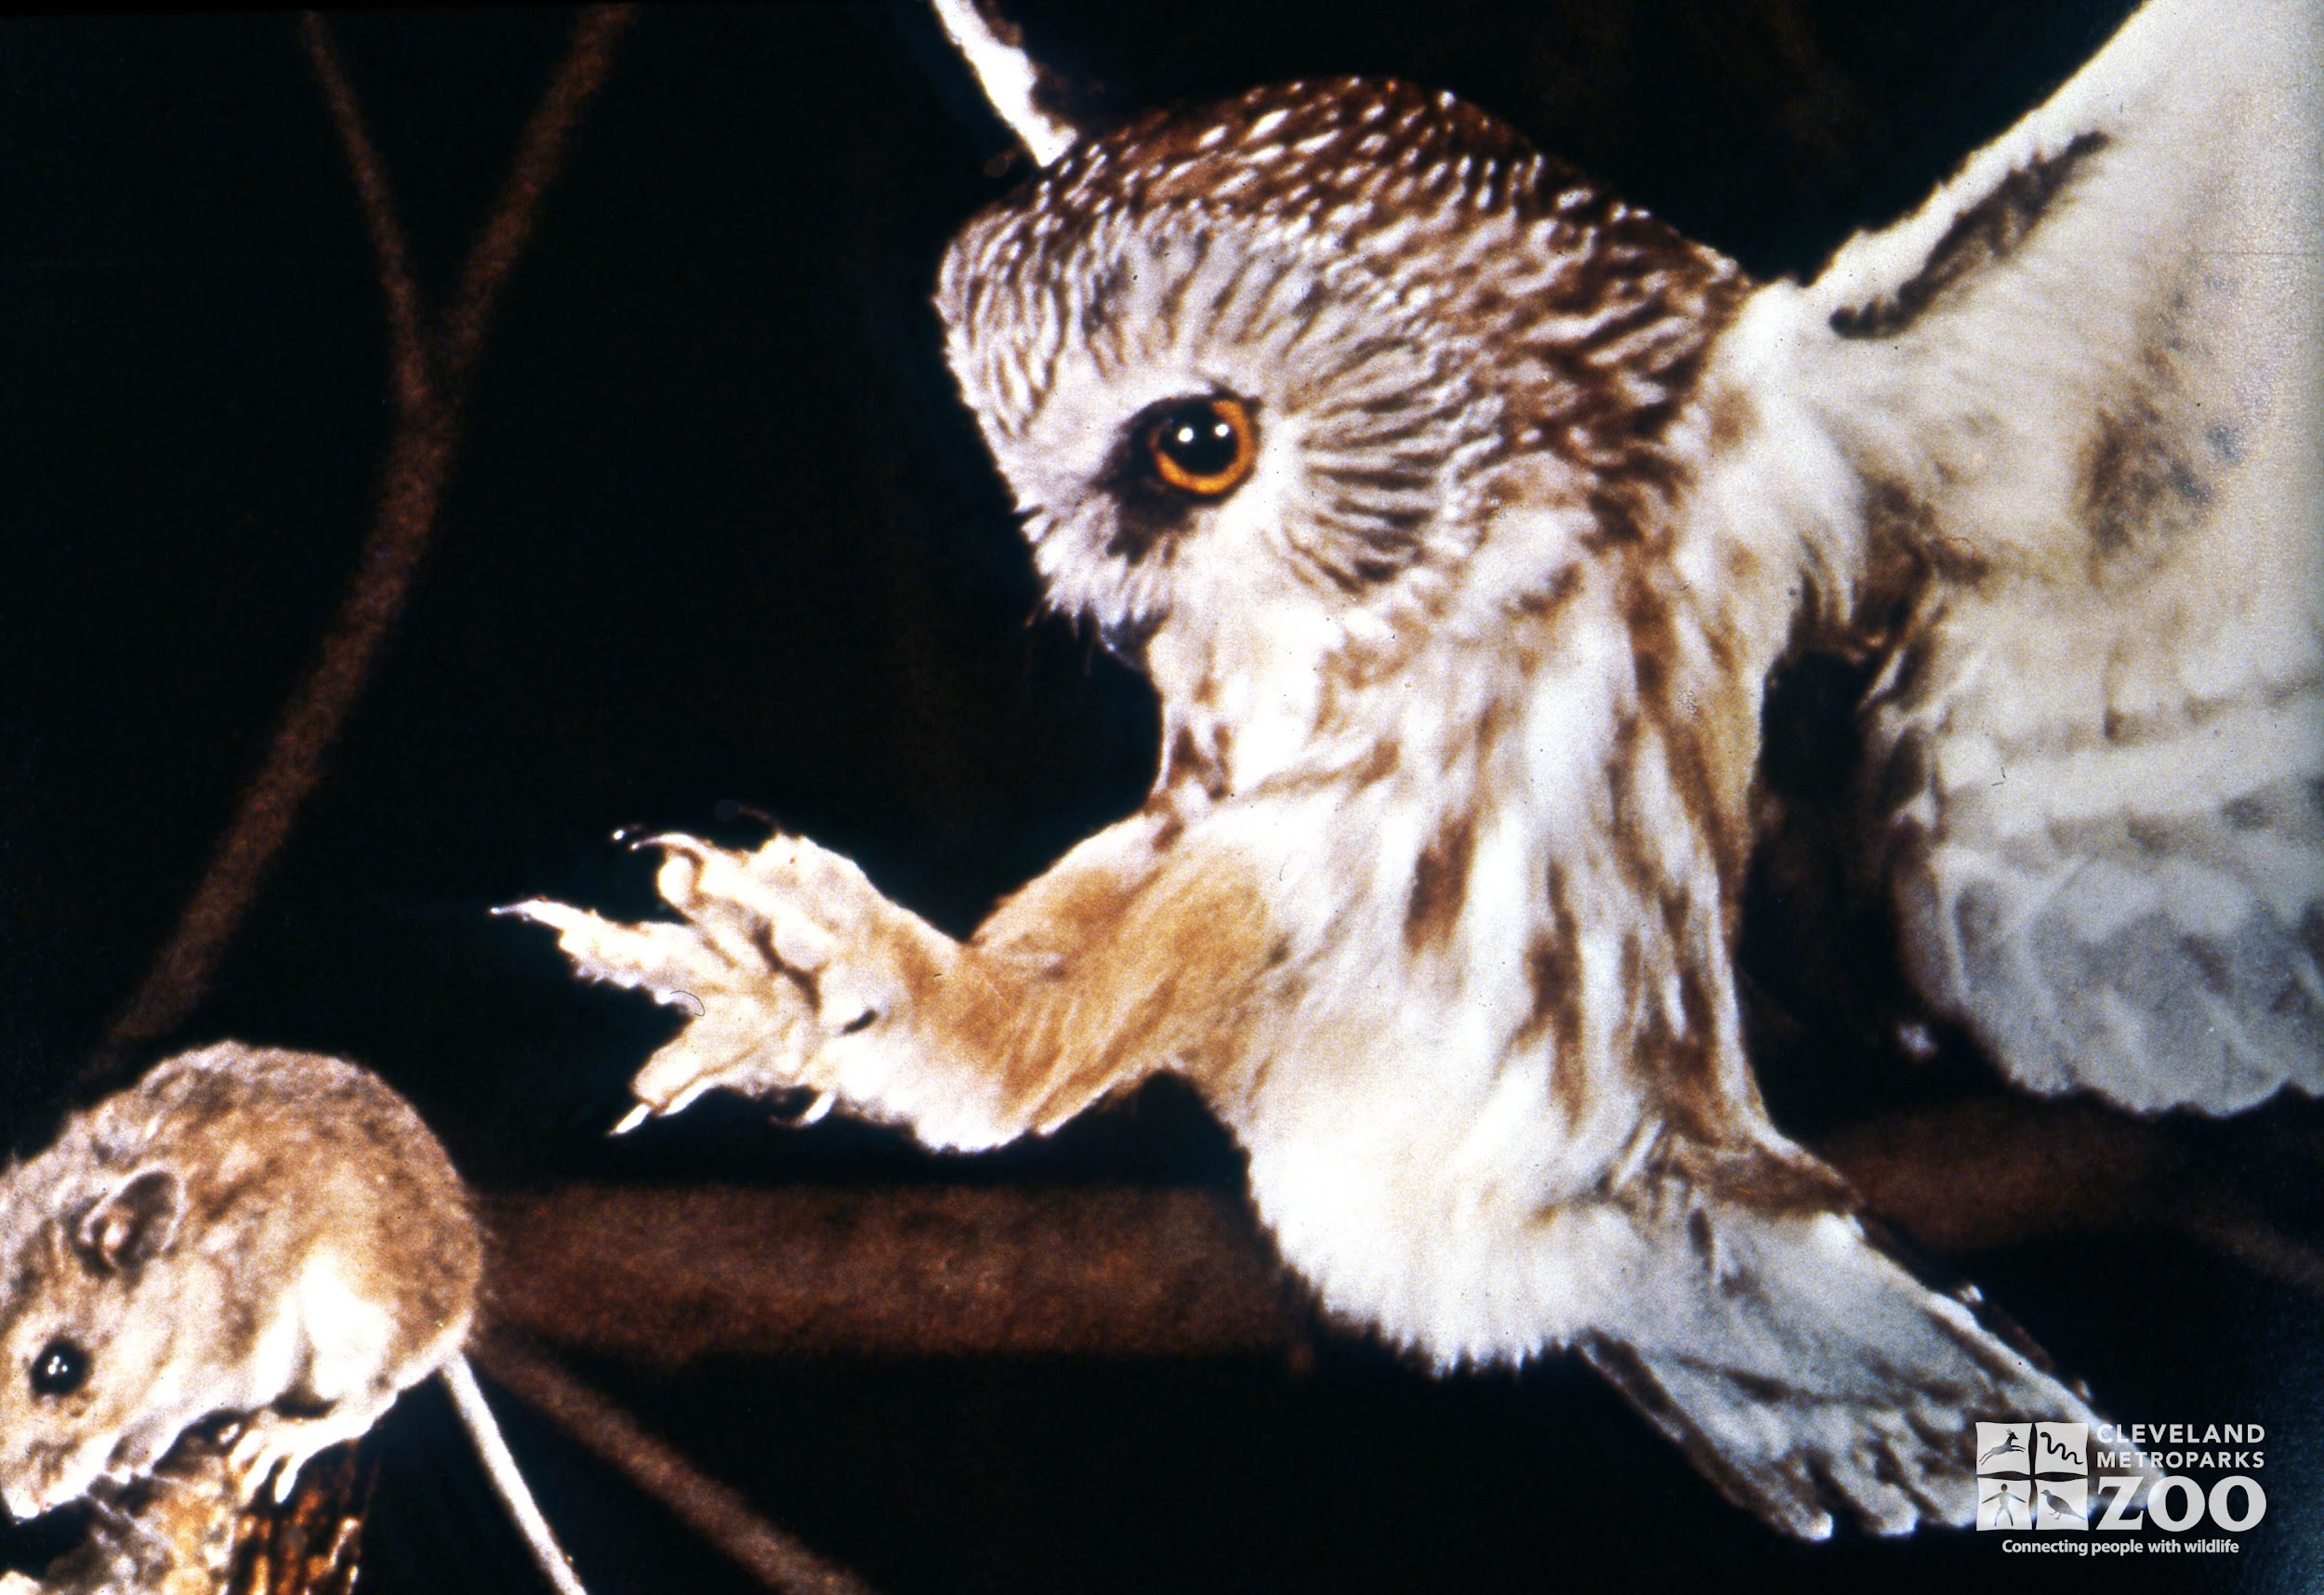
Slide 8
Both animals and plants live in a habitat. They are part of a food web. When the habitat changes or shrinks, food from plants may not be available for certain animals. Those animals will not be able to survive. Then, the larger predators that eat those animals will also not have enough to eat.

Slide 10
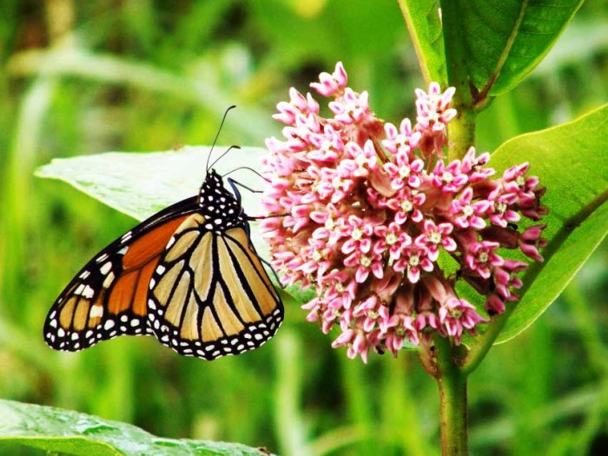
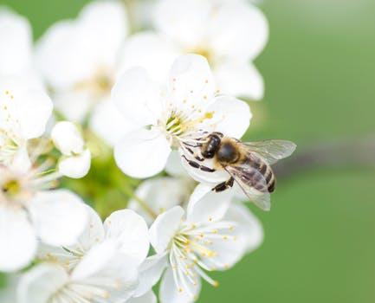
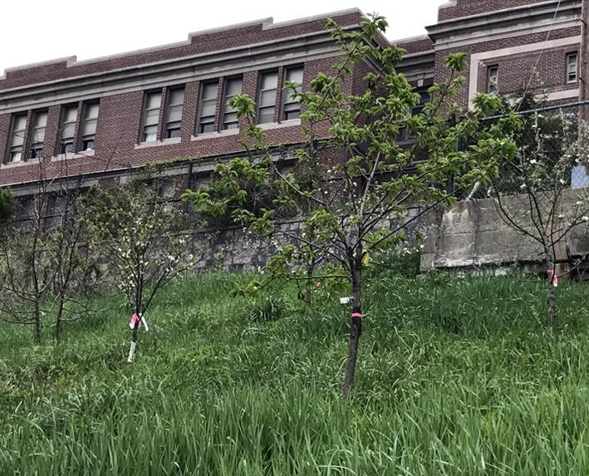
Slide 9
To help, we can plant food animals need. We can plant flowers that provide food for insects like butterflies and bees. We can plant trees that provide fruit and nuts for birds and other small animals. These small animals are prey for larger animals. They are part of the food web.

Slide 11
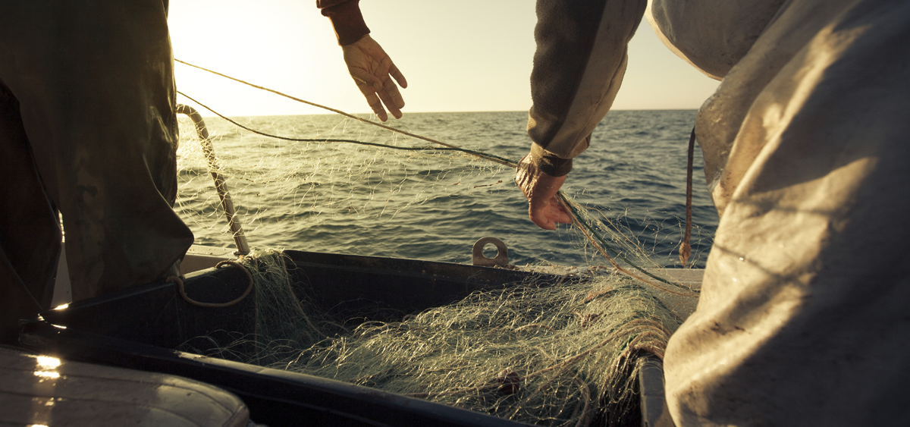
Slide 10
We can help by making sure we do not use up the food animals need. For example, we can make sure we don’t catch all of the fish that other ocean animals need to survive. This helps oceans stay healthy for all of the animals that live there.

Slide 12
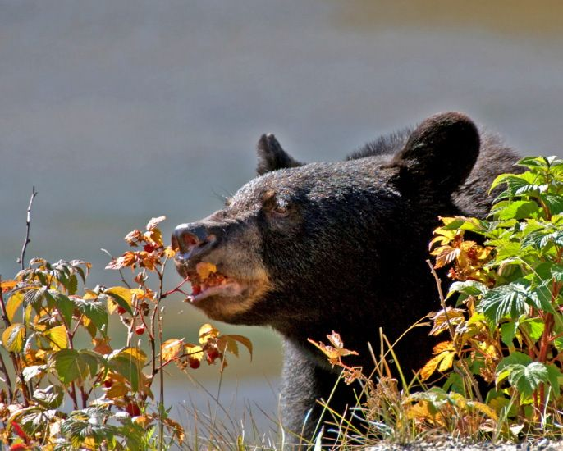
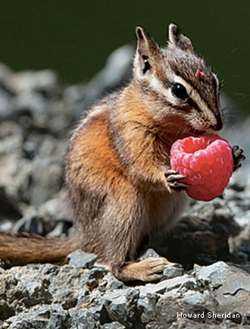
Slide 11
When we find wild foods to pick and eat, we can leave enough for the animals who depend on them.

Slide 13
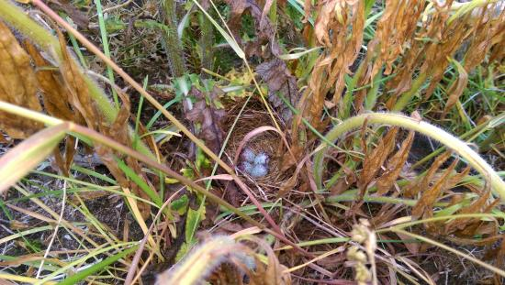
Slide 12
Another way to impact animals’ survival in a positive way is to be careful and respectful when we are traveling in their habitats. Watch where you step!

Slide 14
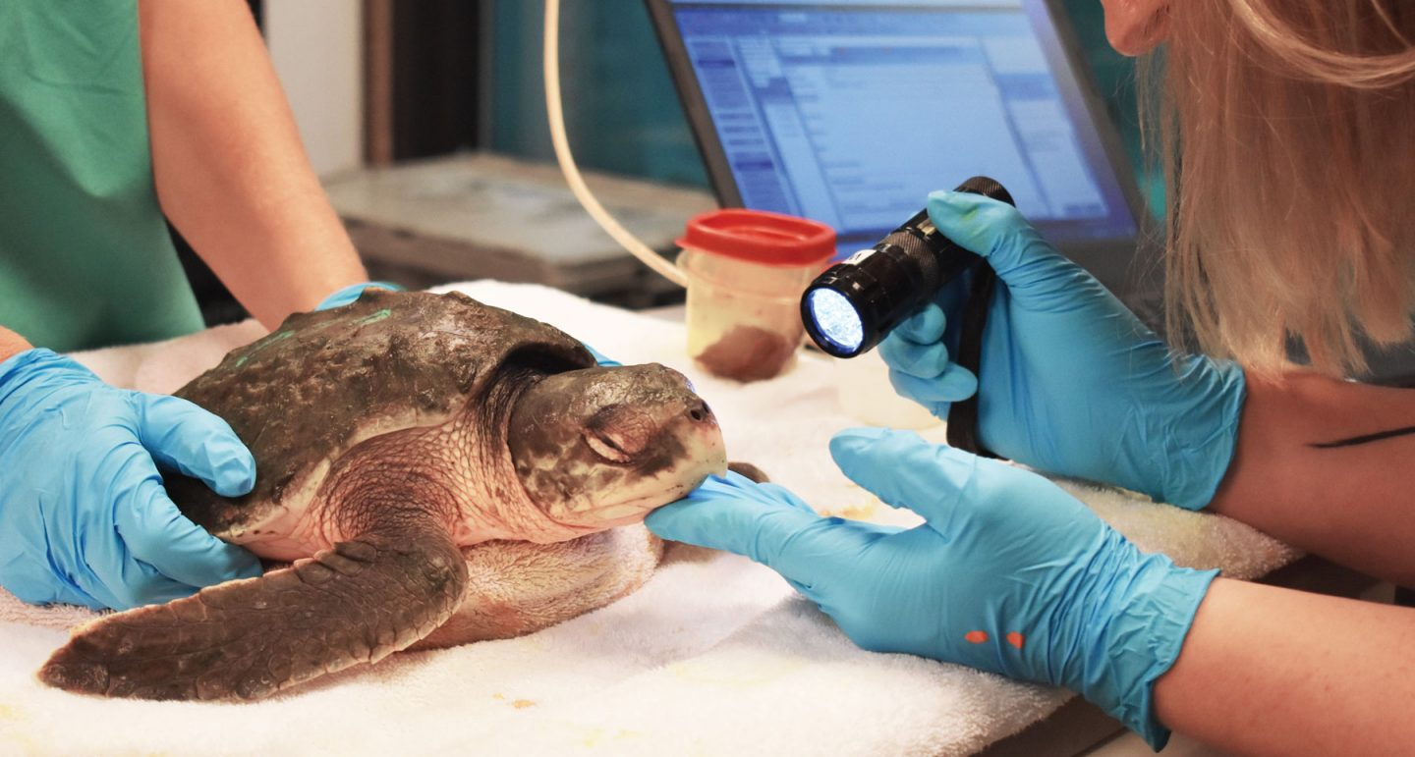
Slide 13
Studying Animals
Another way to impact animals’ survival in a positive way is to study them.

Slide 15
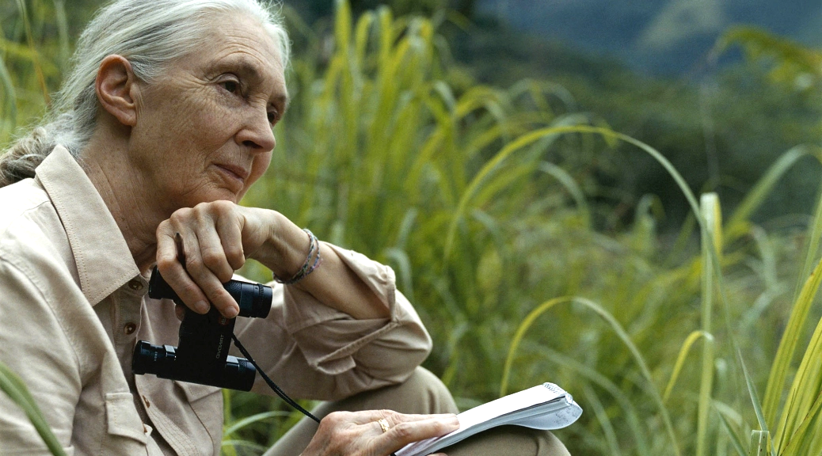
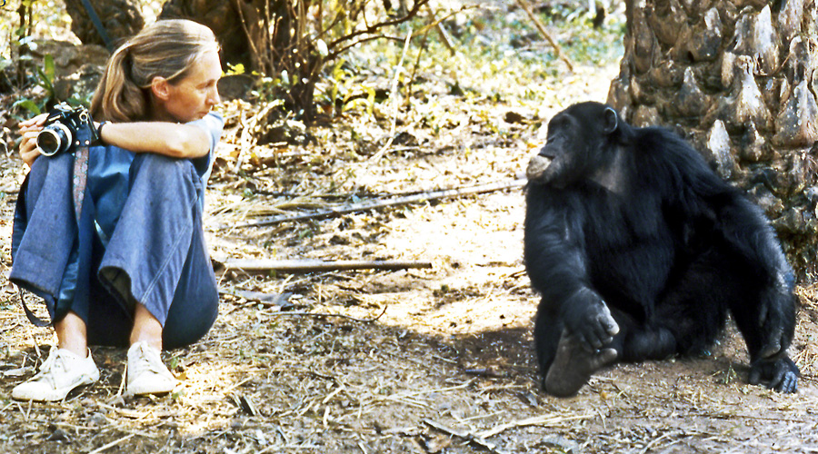
Slide 14
Scientists observe and record information about animals. This can help them understand animal behaviors, what animals need, and how best to help animals survive and thrive.

Slide 16
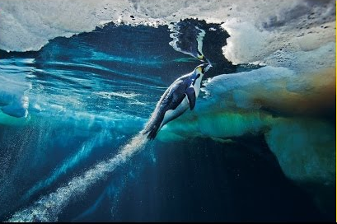
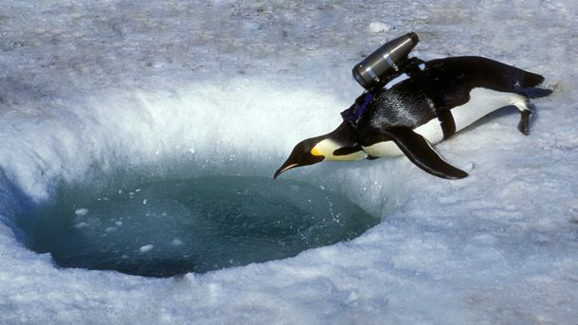
Slide 15
Some scientists use crittercams to find out more about what the life of an animal is like. They can put a camera on a whale to see how it eats and swims. They can film a penguin’s behaviors under the ice!

Slide 17
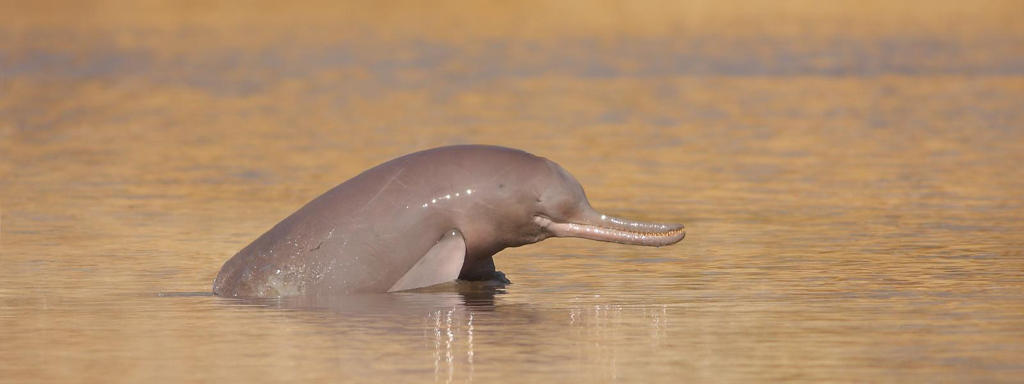
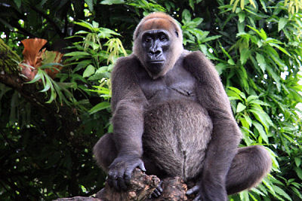
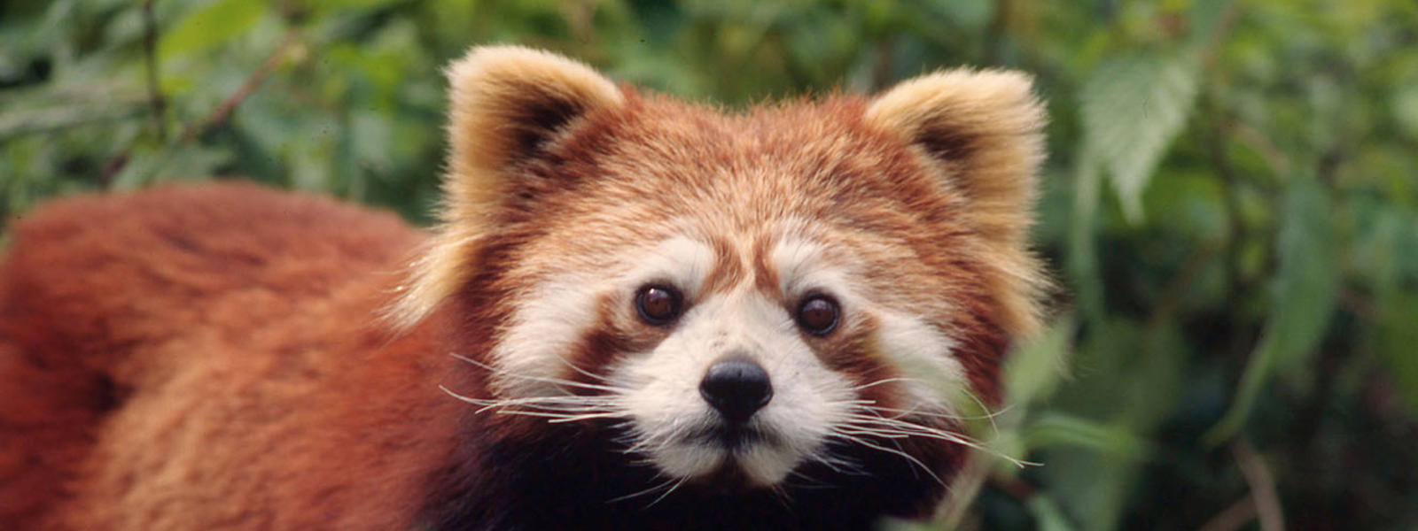
Slide 16
There are many ways people can help animals survive and thrive.
When many different kinds of animals live well, the whole Earth is healthy.

Slide 18
Citations
Written and compiled by Melissa Tonachel and Fay Ferency, Focus on First, 2019.
Slide 1: https://mote.org/news/article/goodbye-mr.-t-mote-to-track-rehabilitated-loggerhead-sea-turtle
Slide 2: https://www.gapurabali.com/news/2019/06/25/bali-leads-way-and-officially-bans-single-use-plastic-bags-straws-and-polystyrene
Slide 3: https://medium.com/usfws/the-trash-at-the-edge-of-the-world-47049d25e464; https://australiascience.tv/microplastics-found-in-every-turtle-tested-in-international-study/
Slide 4: https://www.chicobag.com/product-snack-time-repete-17
Slide 5: https://www.ted.com/talks/melati_and_isabel_wijsen_our_campaign_to_ban_plastic_bags_in_bali?language=en#t-325522; http://www.byebyeplasticbags.org/; https://baliweathermap.blogspot.com/2013/01/bali-map-and-travel-map.html
Slide 6: https://wwf.panda.org/?209005/Increased-protection-of-polar-bear-habitat; https://www.capecodchamber.org/beaches; https://www.floridapantherprotection.com/Default.aspx?n=4; http://www.bogan.ca/index.php?id=raising-monarch-butterflies
Slide 7: https://www.worldwildlife.org/species/chimpanzee
Slide 8: https://www.flickr.com/photos/128840503@N06/28243172377; http://zoo.avantia.net/photos/4927
Slide 9: https://www.raydunetz.com/tag/fruit-trees/; https://www.savatree.com/blog/2015/01/milkweed-monarchs/; https://eatreadscience.com/2015/11/08/resistance-to-plant-toxins-in-milkweed-butterflies-is-linked-to-toxin-storage-for-defense/
Slide 10: https://www.seafoodwatch.org/
Slide 11: http://www.webexhibits.org/causesofcolor/7C.html; https://www.nwf.org/Magazines/National-Wildlife/2013/DecJan/Gardening/Native-Plants-You-Can-Eat
https://www.almanac.com/content/weather-sayings-and-their-meanings
Slide 12: https://www.capecodchamber.org/beaches; https://www.floridapantherprotection.com/Default.aspx?n=4; https://www.tripadvisor.com/LocationPhotoDirectLink-g42391-d3871068-i156936790-Carl_G_Fenner_Nature_Center-Lansing_Ingham_County_Michigan.html
Slide 13: https://www.neaq.org/blog/an-ocean-of-progress-in-2018/
Slide 14: https://allyouneedisbiology.wordpress.com/2019/01/20/jane-goodall-conferences/; https://businesschicks.com/dr-jane-goodall-interview/
Slide 15: https://www.nationalgeographic.org/education/crittercam-education/; https://www.youtube.com/watch?v=A9mbCNs47FI
Slide 16: https://www.worldwildlife.org/species/directory

