Slide 1
Comparing Rosa Stories
Text Talk Week 7, Day 3

Slide 2
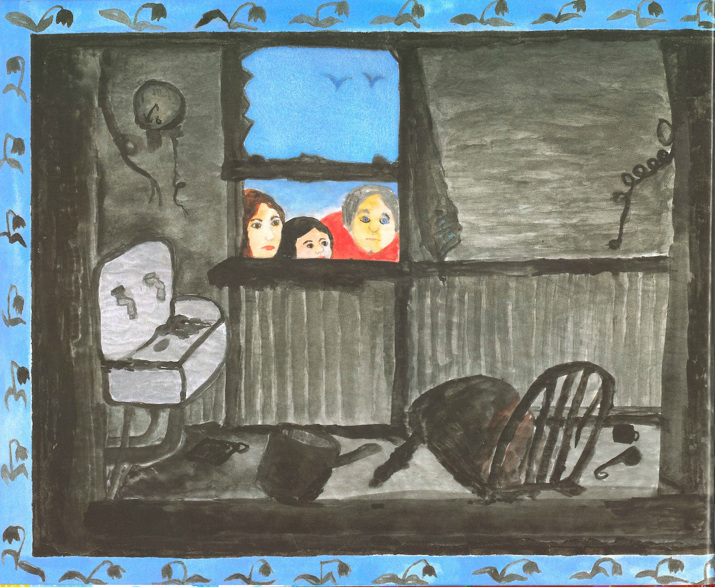

Slide 1

Slide 3
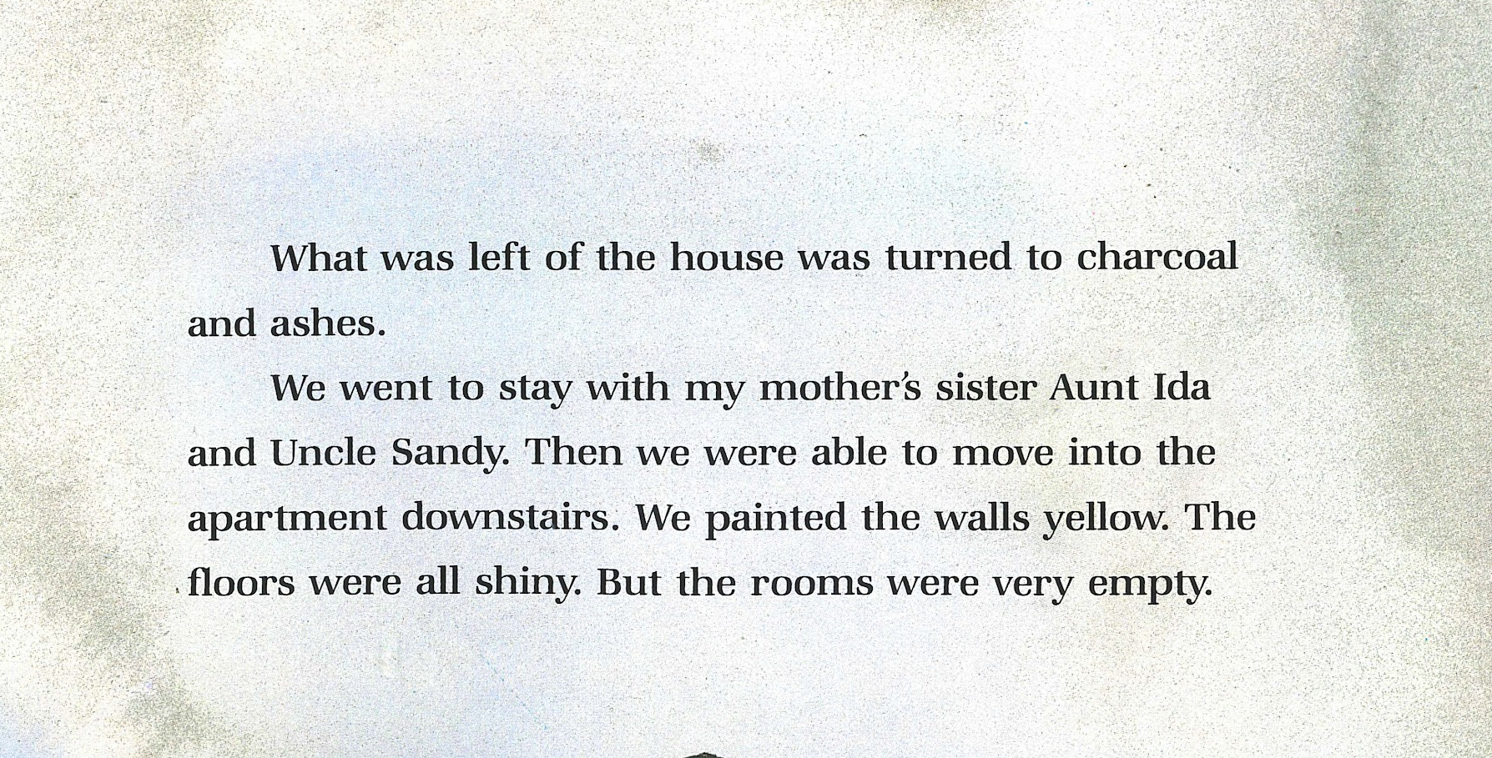
Slide 2

Slide 4
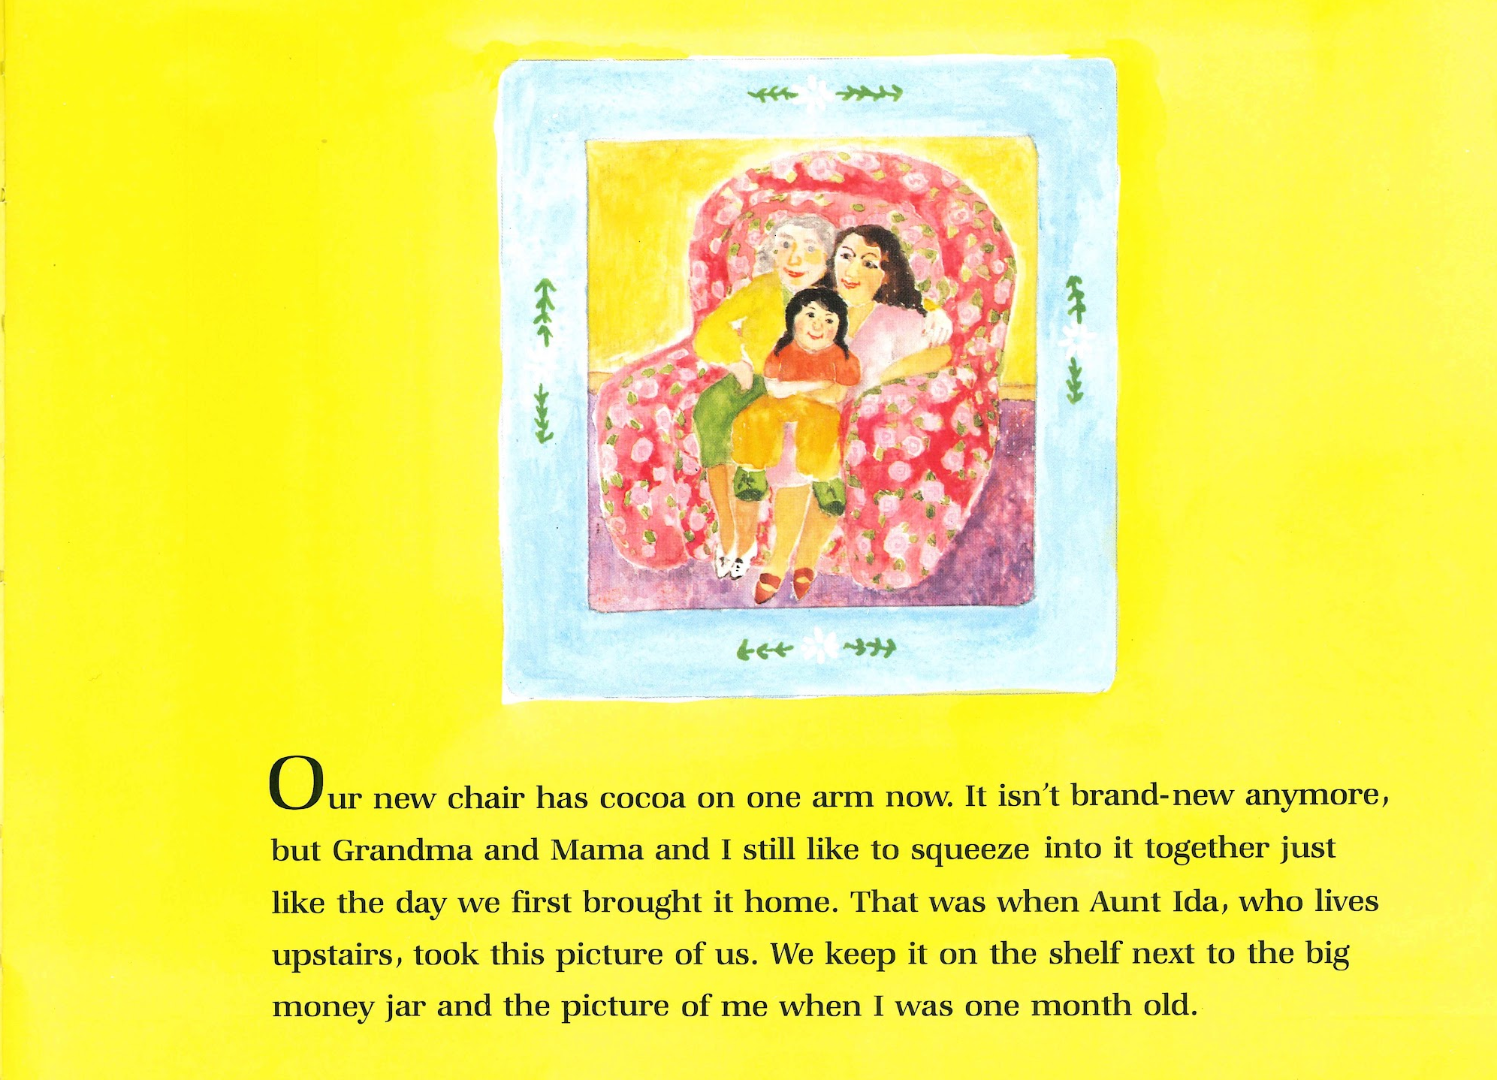

Slide 3

Slide 5
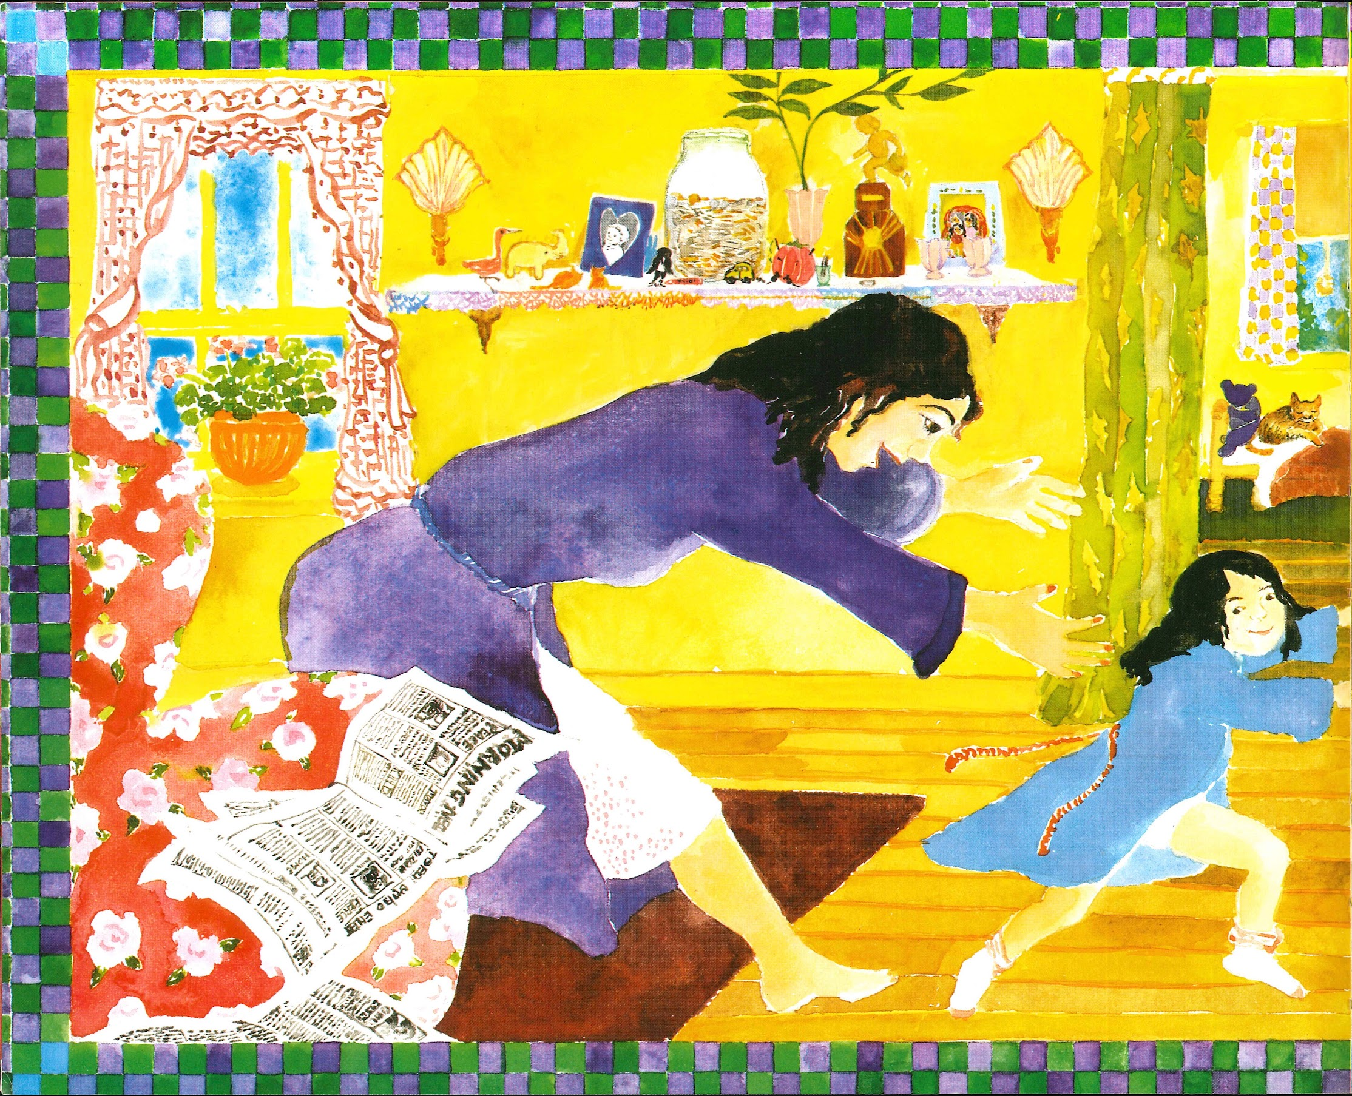
Slide 4

Slide 6
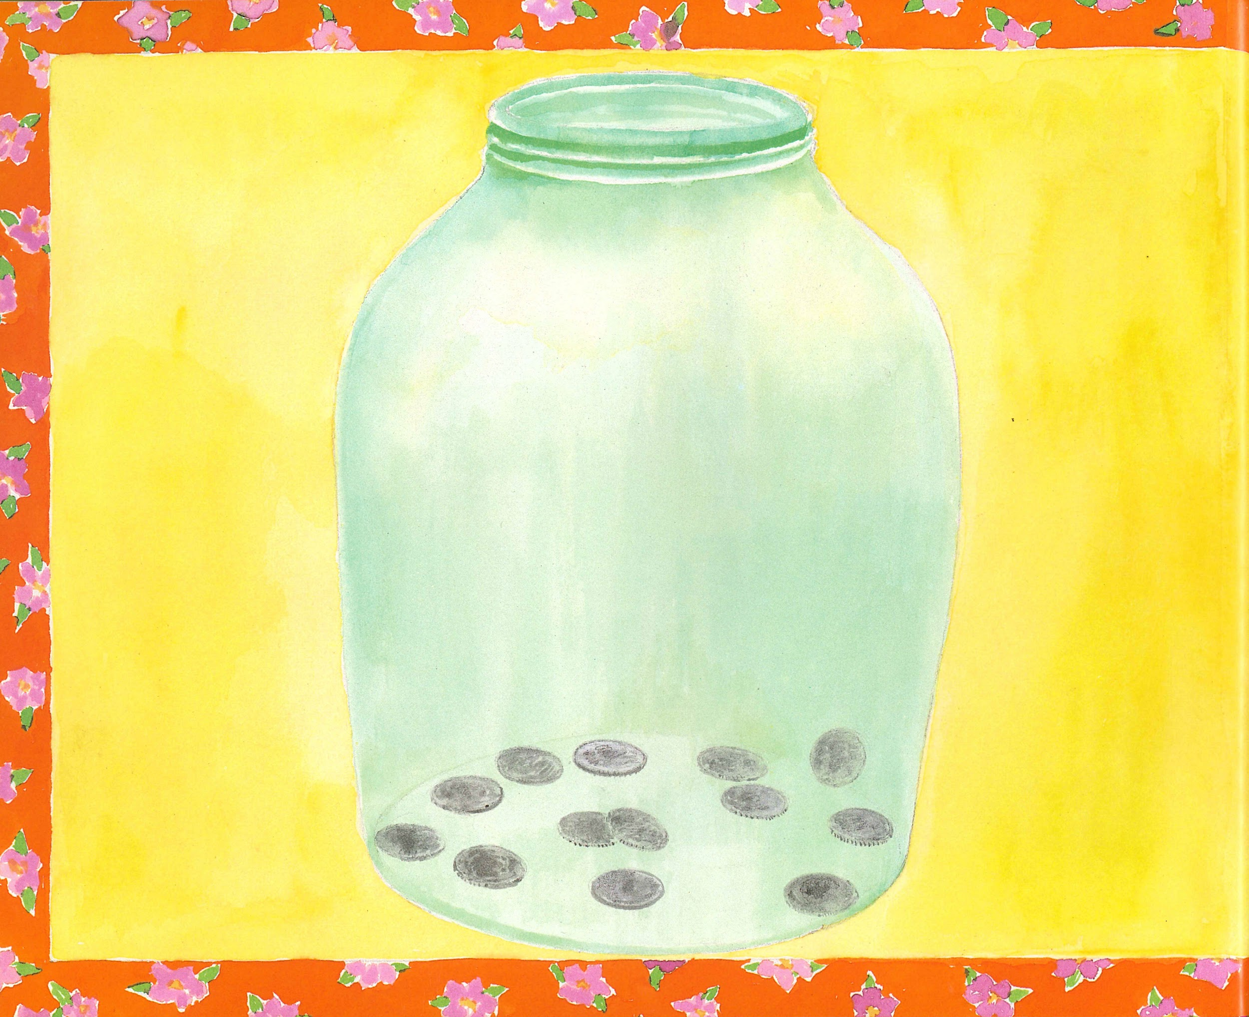
Slide 5

Slide 7
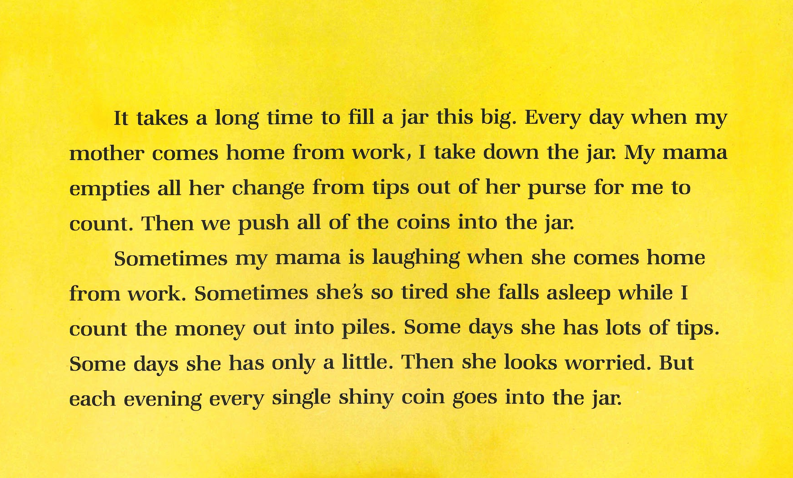
Slide 6

Slide 8
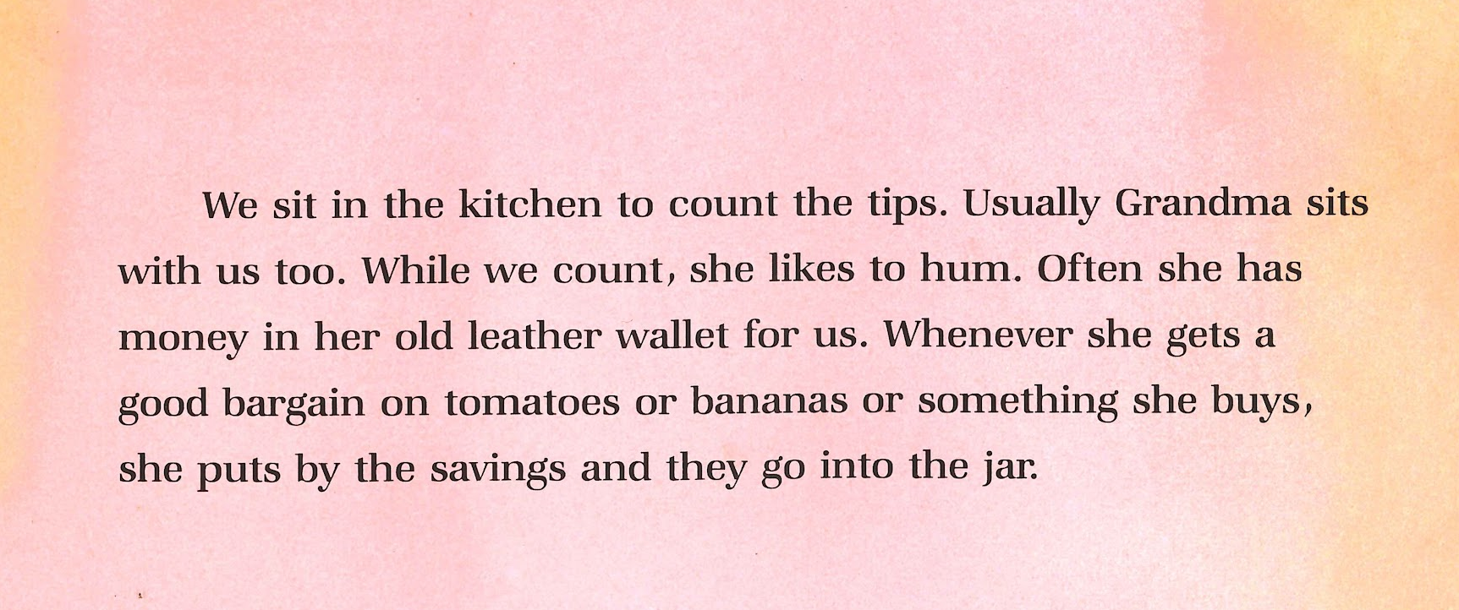
Slide 7

Slide 9
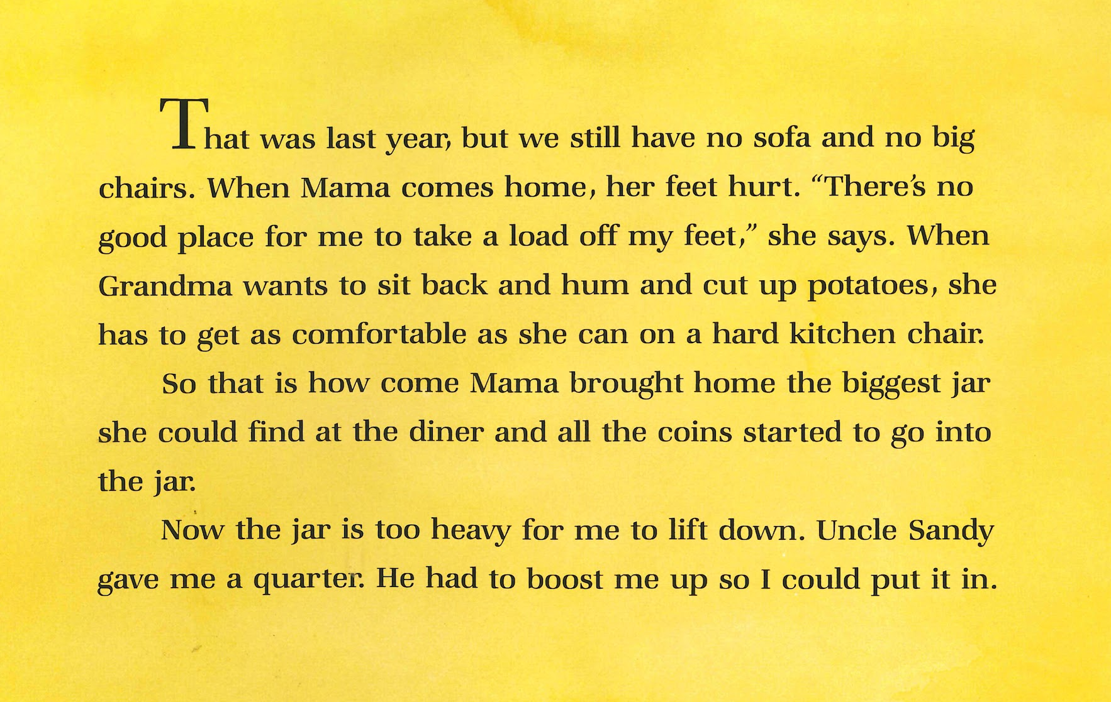
Slide 8

Slide 10

Slide 9

Slide 11
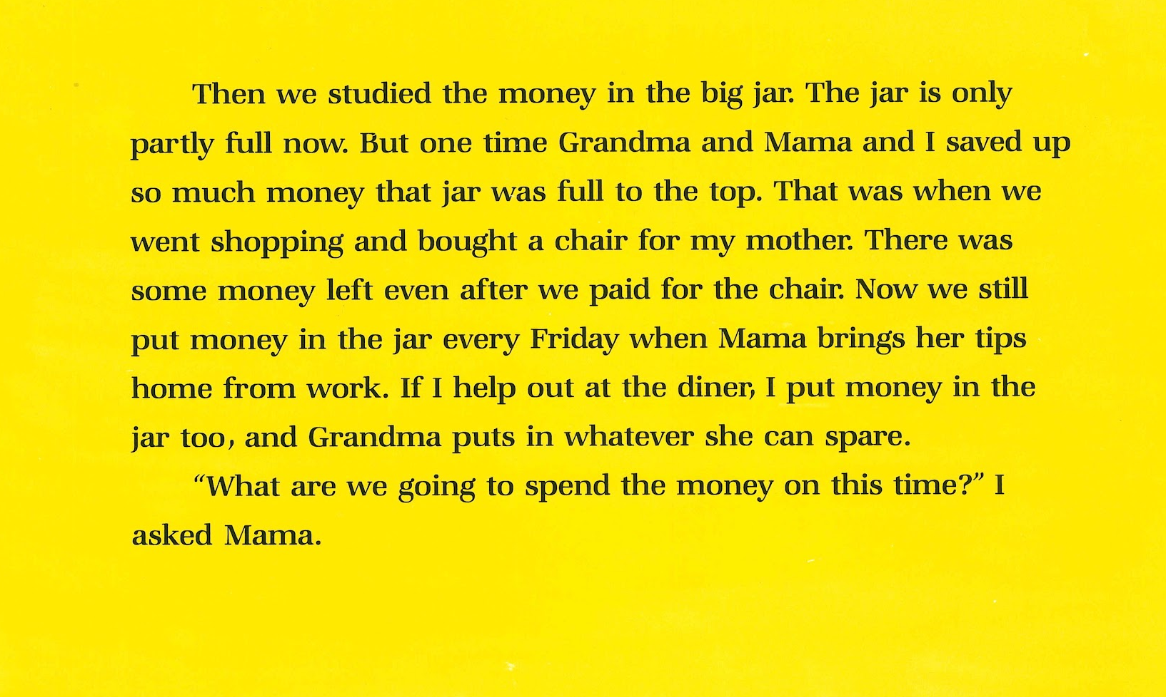
Slide 10

Slide 12
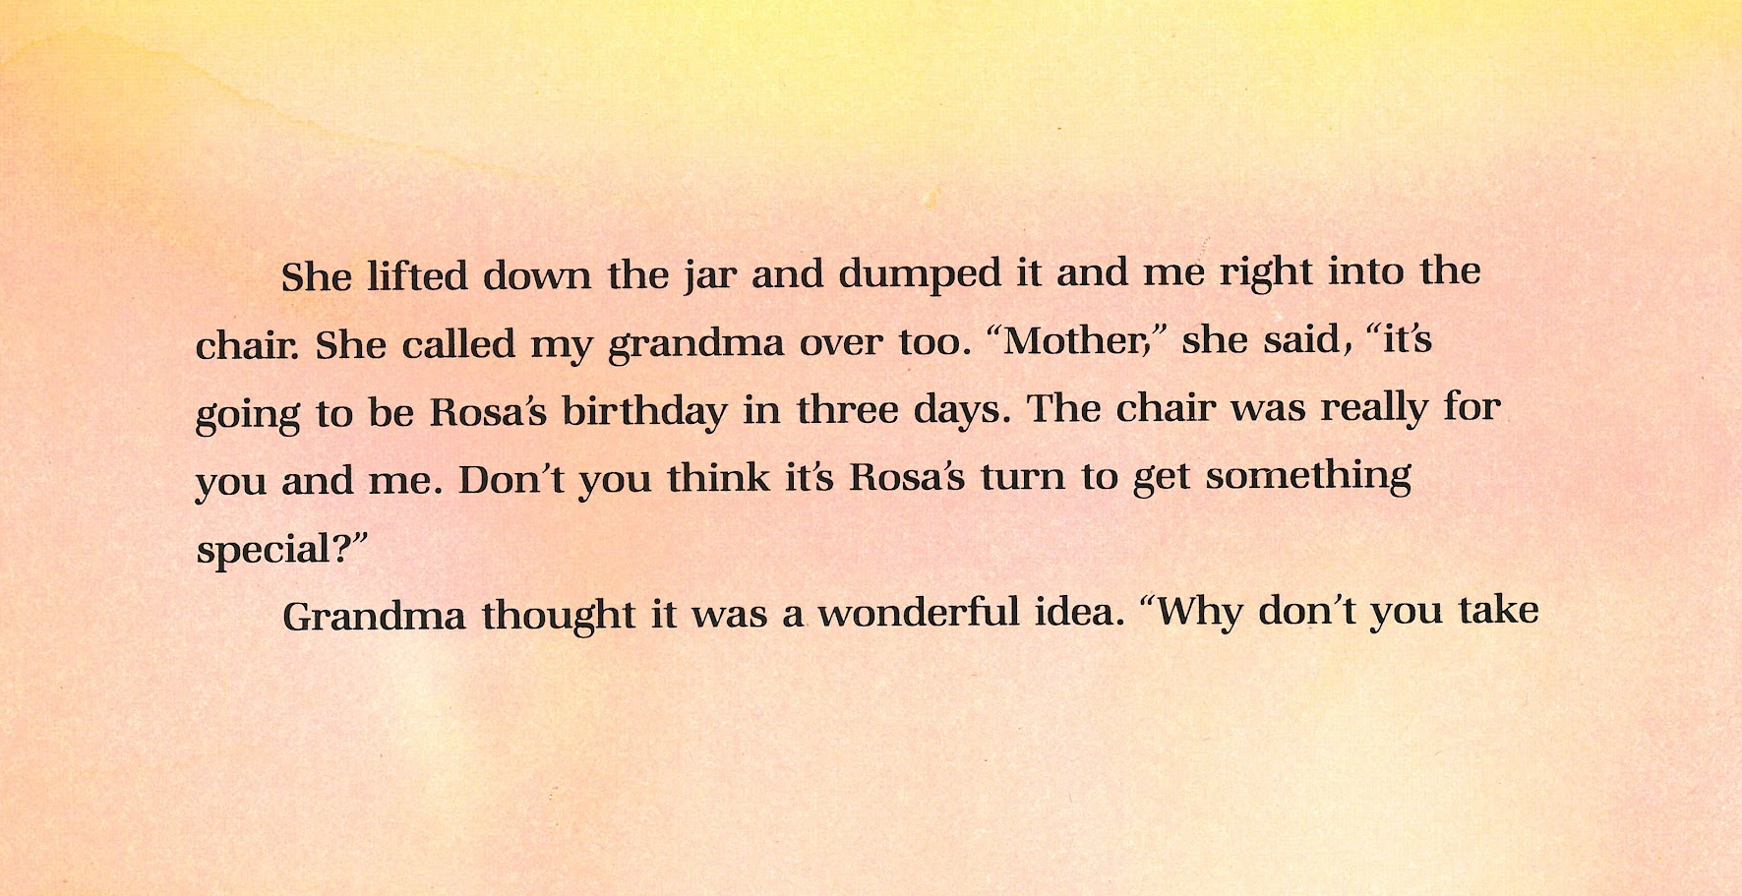
Slide 11

Slide 13
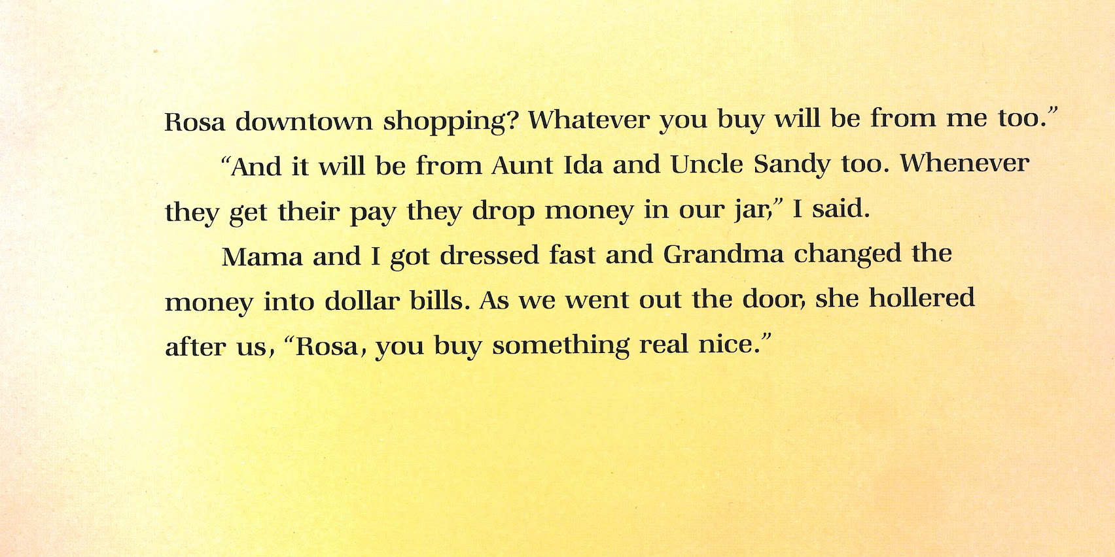
Slide 12

