Slide 1
Something Special For Me
Pages 23-27
Text Talk Week 7, Day 2

Slide 2
Slide 1
How are Rosa’s friends and family important in helping her make her decision?

Slide 3
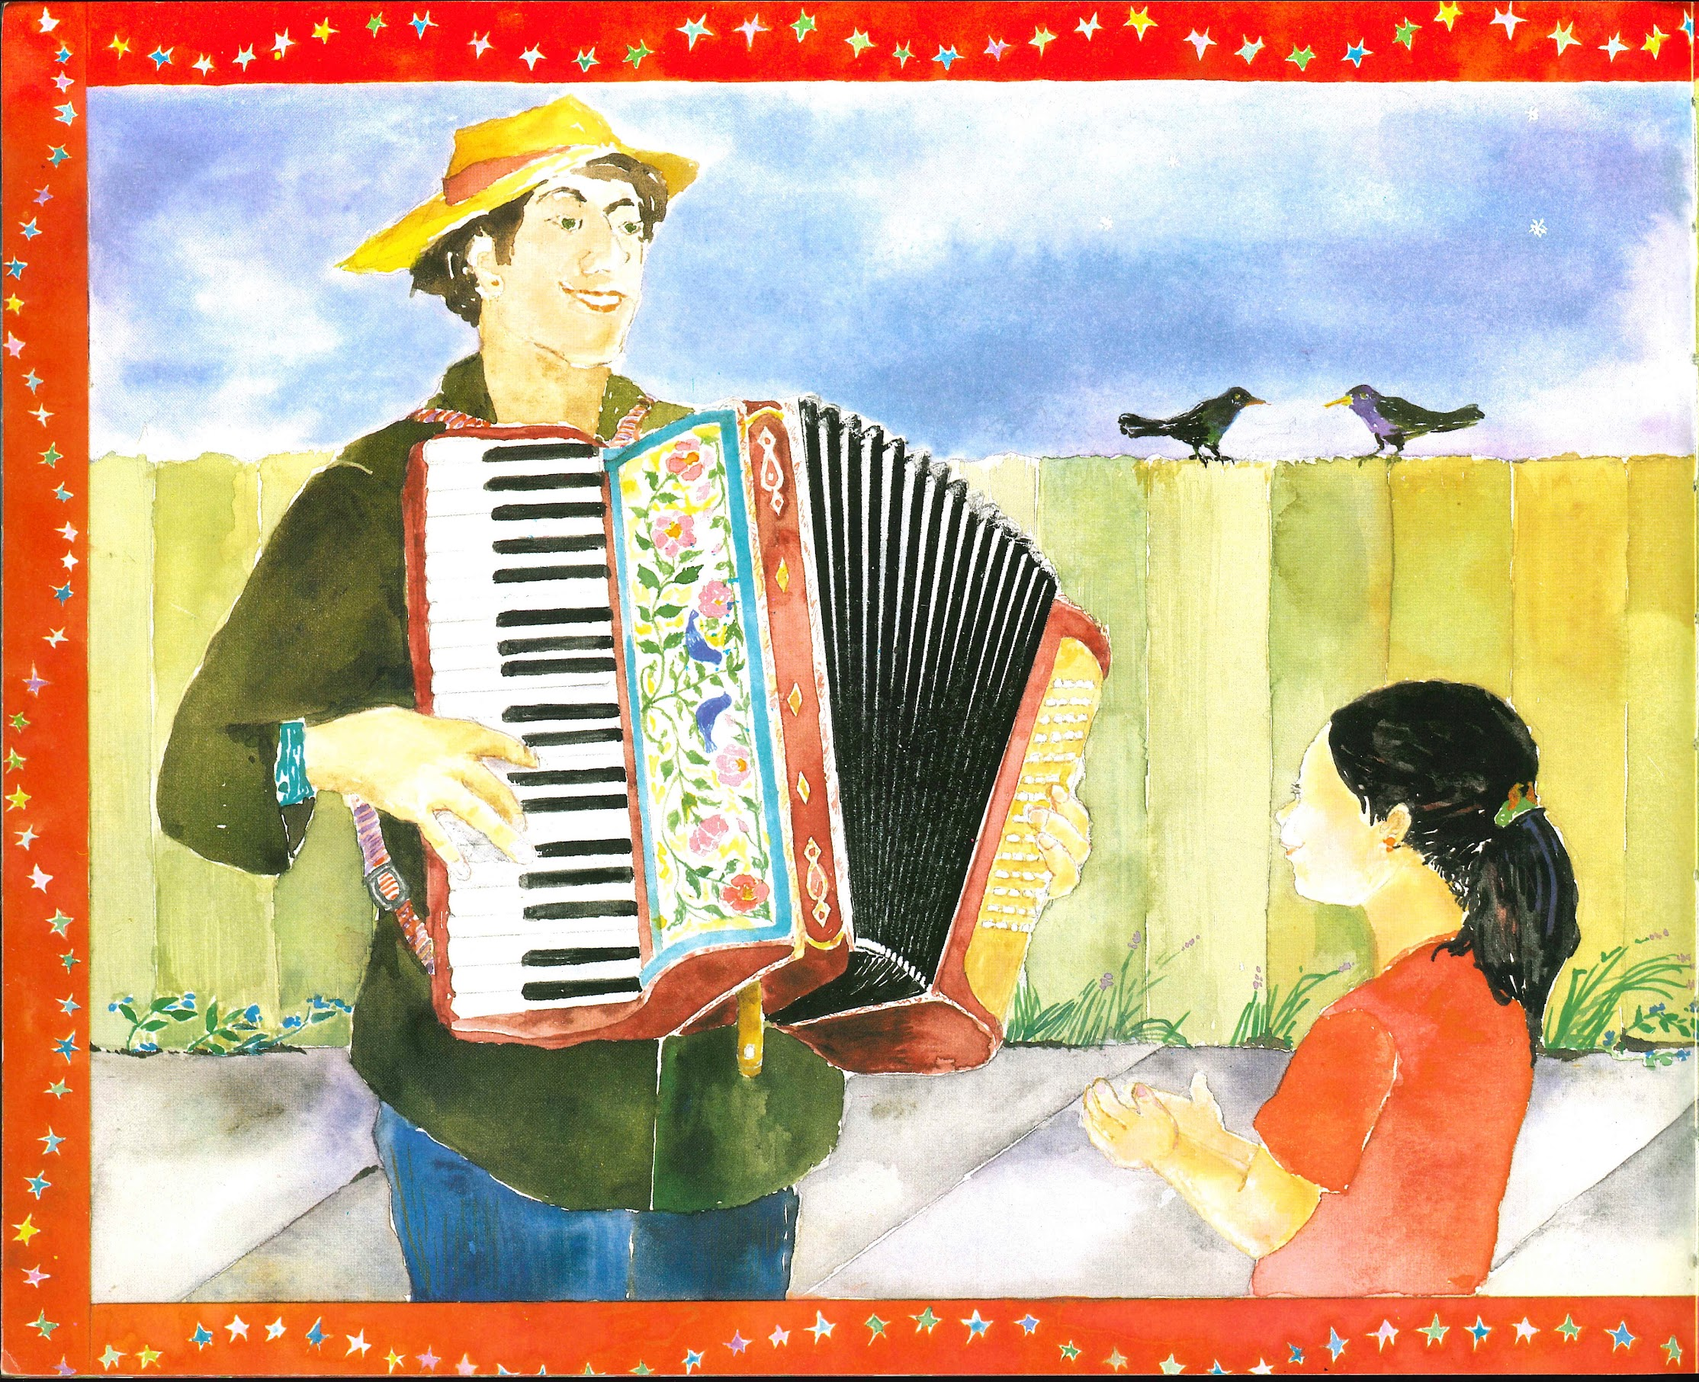
Slide 2

Slide 4
Slide 3

Slide 5
Slide 4

Slide 6
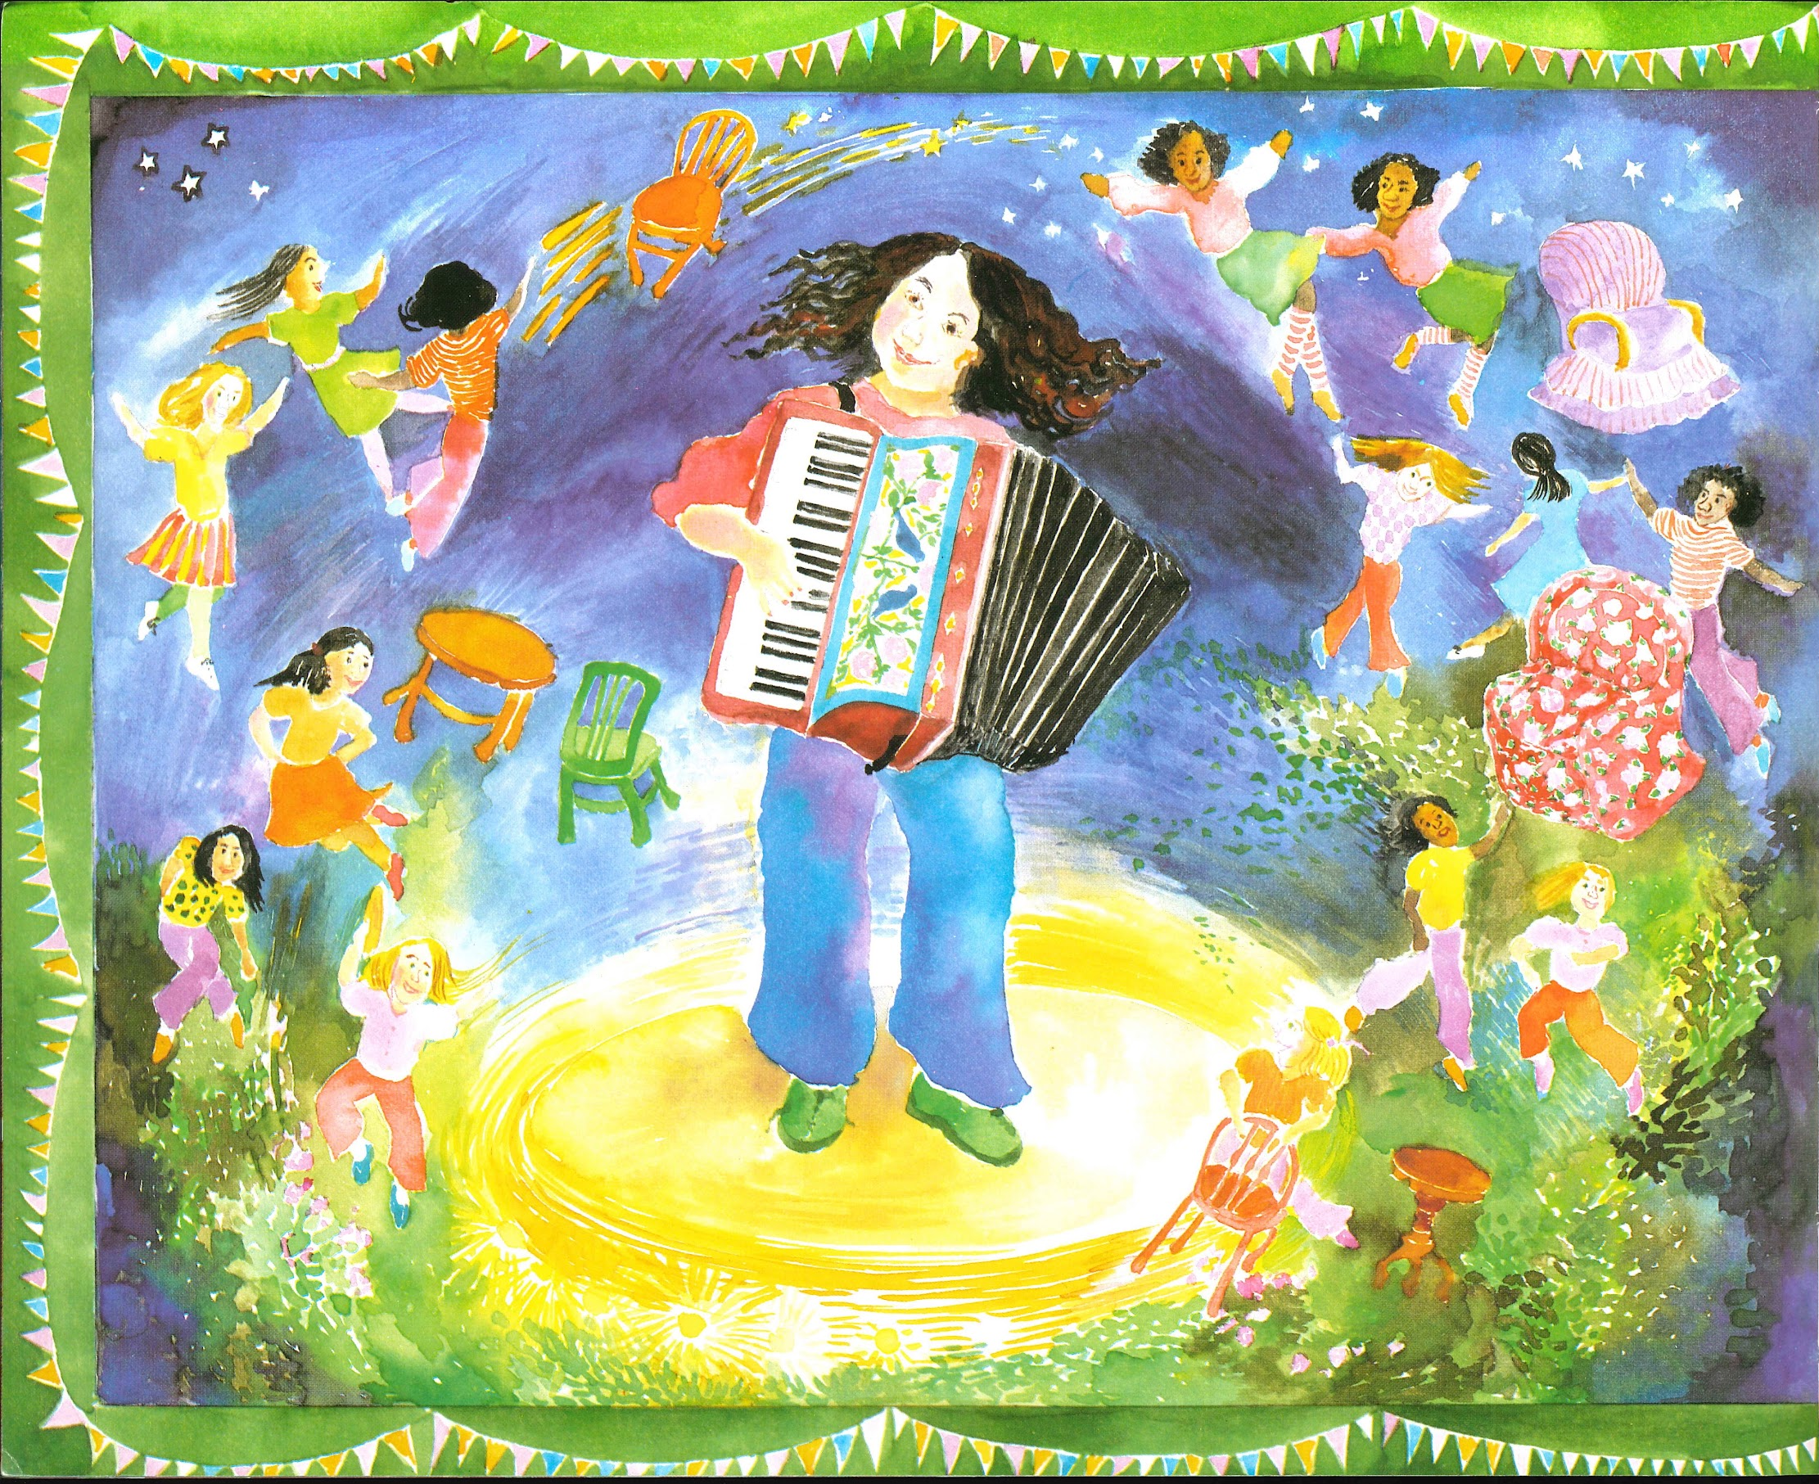
Slide 5

Slide 7
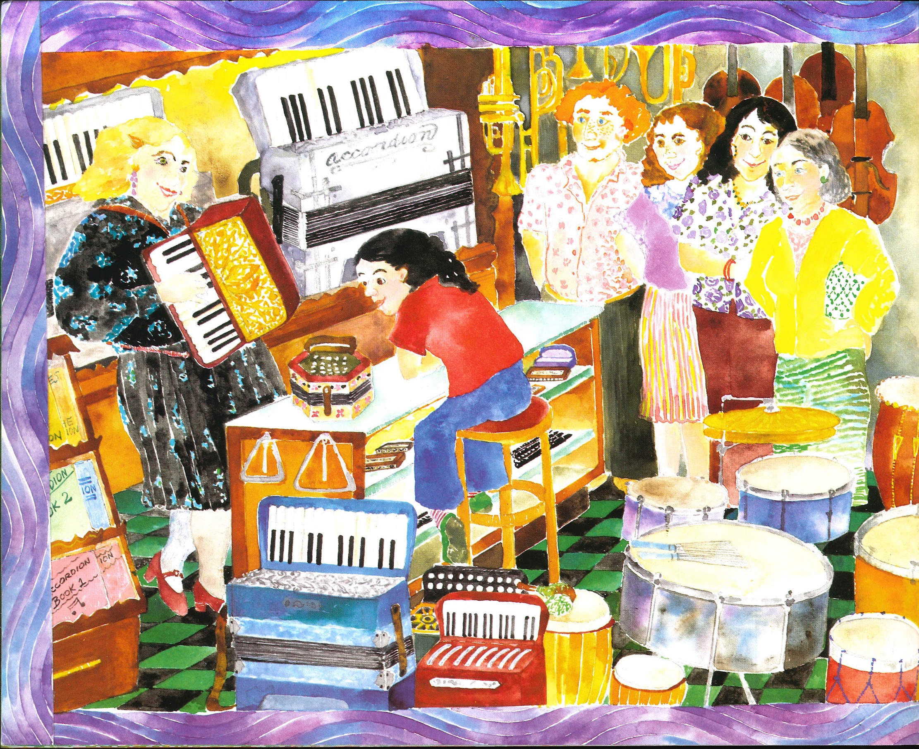
Slide 6

Slide 8
Slide 7

