Slide 1
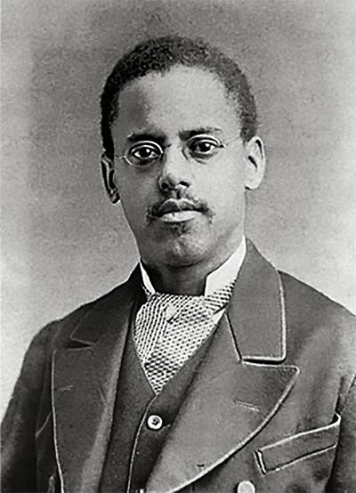
Lewis Latimer and the
Long-Lasting Light Bulb
Text Talk Week 6, Day 5

Slide 2
Imagine the sun is setting, and it’s getting dark indoors. There is no light switch, so you need to light a candle to see. Your family needs to cook and eat dinner. You need to find your way to the bathroom. You want to play a game or read a book… You do all of this by dim candlelight.
This is what life used to be like, before the electric light bulb was invented.
Richard Stucky, “Evening Study by Candlelight” (1830)

Slide 3
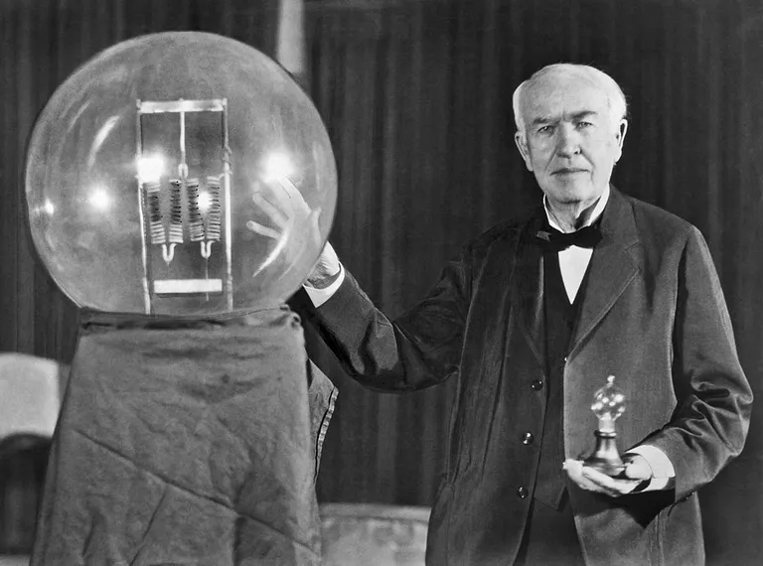
Inventing the Light Bulb
During the 1800’s many inventors were working on designing electric light bulbs. Thomas Edison worked with a team of scientists, and the light bulb they invented was much less expensive than other light bulbs. This was important because now light bulbs were available for everyday use.
Thomas Edison
at a celebration of his light bulb, 1929

Slide 4
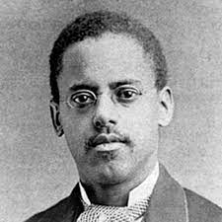
Unfortunately, they didn’t last very long.
Edison’s light bulbs were delicate. They only lasted a couple of days and then had to be thrown out.
Lewis Latimer worked with another team of scientists. He wanted to create a light bulb that lasted longer than the one Edison invented.
Lewis Latimer

Slide 5
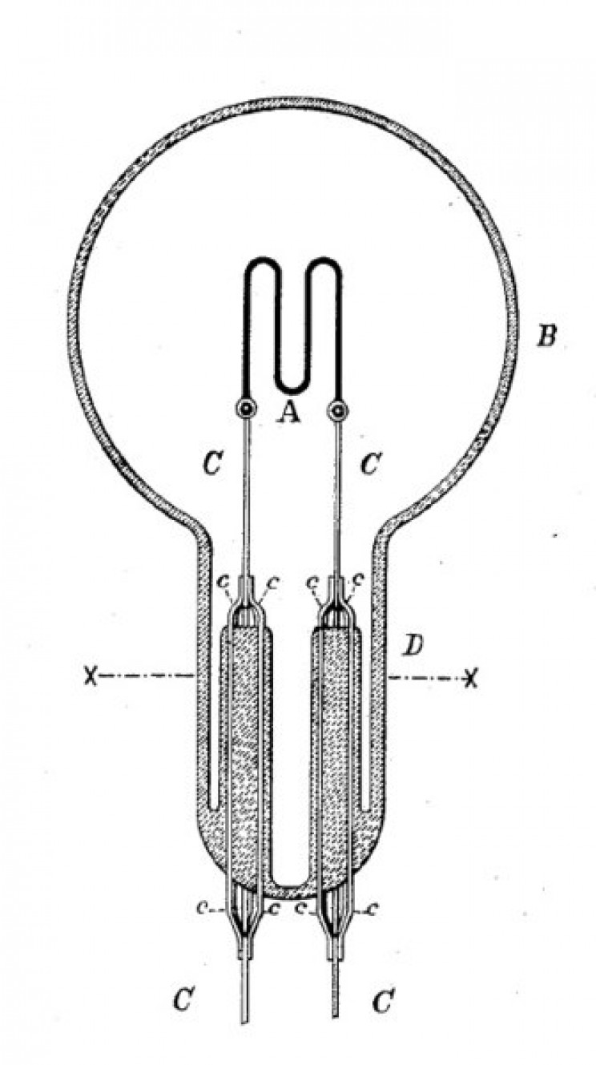
The filament is the part of the light bulb inside the glass that glows with light. This is the part of Edison’s light bulb that kept breaking. Sometimes the filament broke because it got too hot or even caught on fire. This was dangerous!
Lewis tested lots of different filaments. In 1880 he added a coating to the filament that protected it and made a longer-lasting light bulb.
filament
Drawing by Lewis Latimer

Slide 6
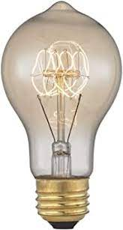
This was not Lewis Latimer’s first invention, but it was a very important one. The long-lasting light bulb helped light the daily activities in many people’s lives, like reading, cooking, playing games, and working. The new light bulb was safer than candles and safer than other light bulbs. It also helped to reduce trash, because light bulbs were not being thrown out as often as when each one only lasted a few hours.

Slide 7
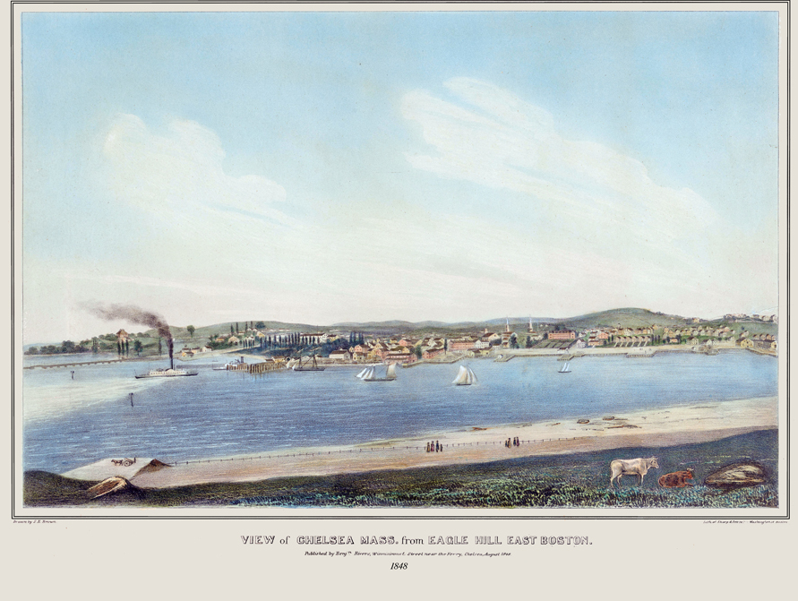
Lewis Latimer’s Early Life
Lewis grew up in Massachusetts with his parents and four siblings. His parents had escaped slavery in Virginia and came to Massachusetts to live as free people.
Lewis loved to read and draw. He also helped his father at the barbershop where he worked.
1848 painting of Chelsea, Massachusetts

Slide 8
Lewis Latimer’s Work
When he was a teenager, Lewis got a job to help his family. He worked at a law office in Boston. The lawyers there helped inventors apply for patents. A patent prevents other people from copying inventors’ ideas and making money from them.
That first experience in the law office shaped Lewis’s life. As he helped with paperwork and ran errands for the lawyers, Lewis paid attention to the inventions people were working on. He started reading books about inventions, bought a set of tools, and taught himself mechanical drawing. He was hired as a draftsman, making detailed patent drawings of people’s inventions.

Slide 9
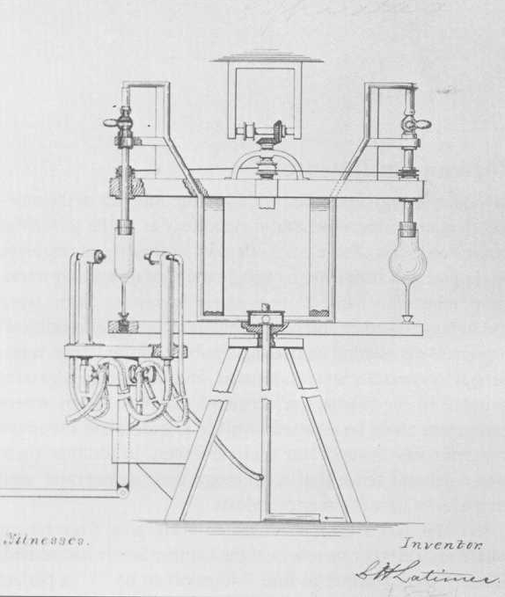
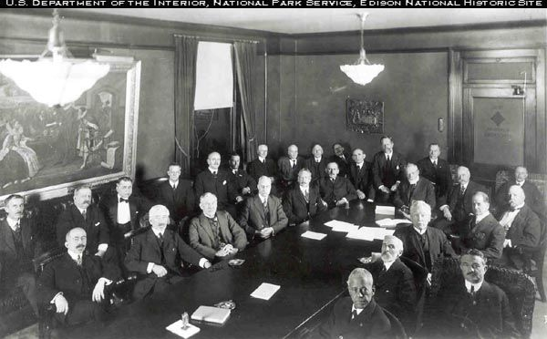
He was recognized as an excellent draftsman and became part of a group of scientists and inventors called the Edison Pioneers. Although people from many communities were inventors, Lewis was the only Black inventor to be included in this well-known group.
Glassblowing Apparatus, 1881
Edison Pioneers (Lewis Latimer in front)

Slide 10
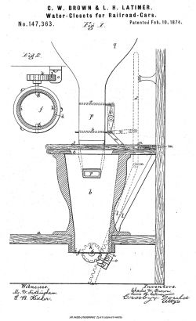
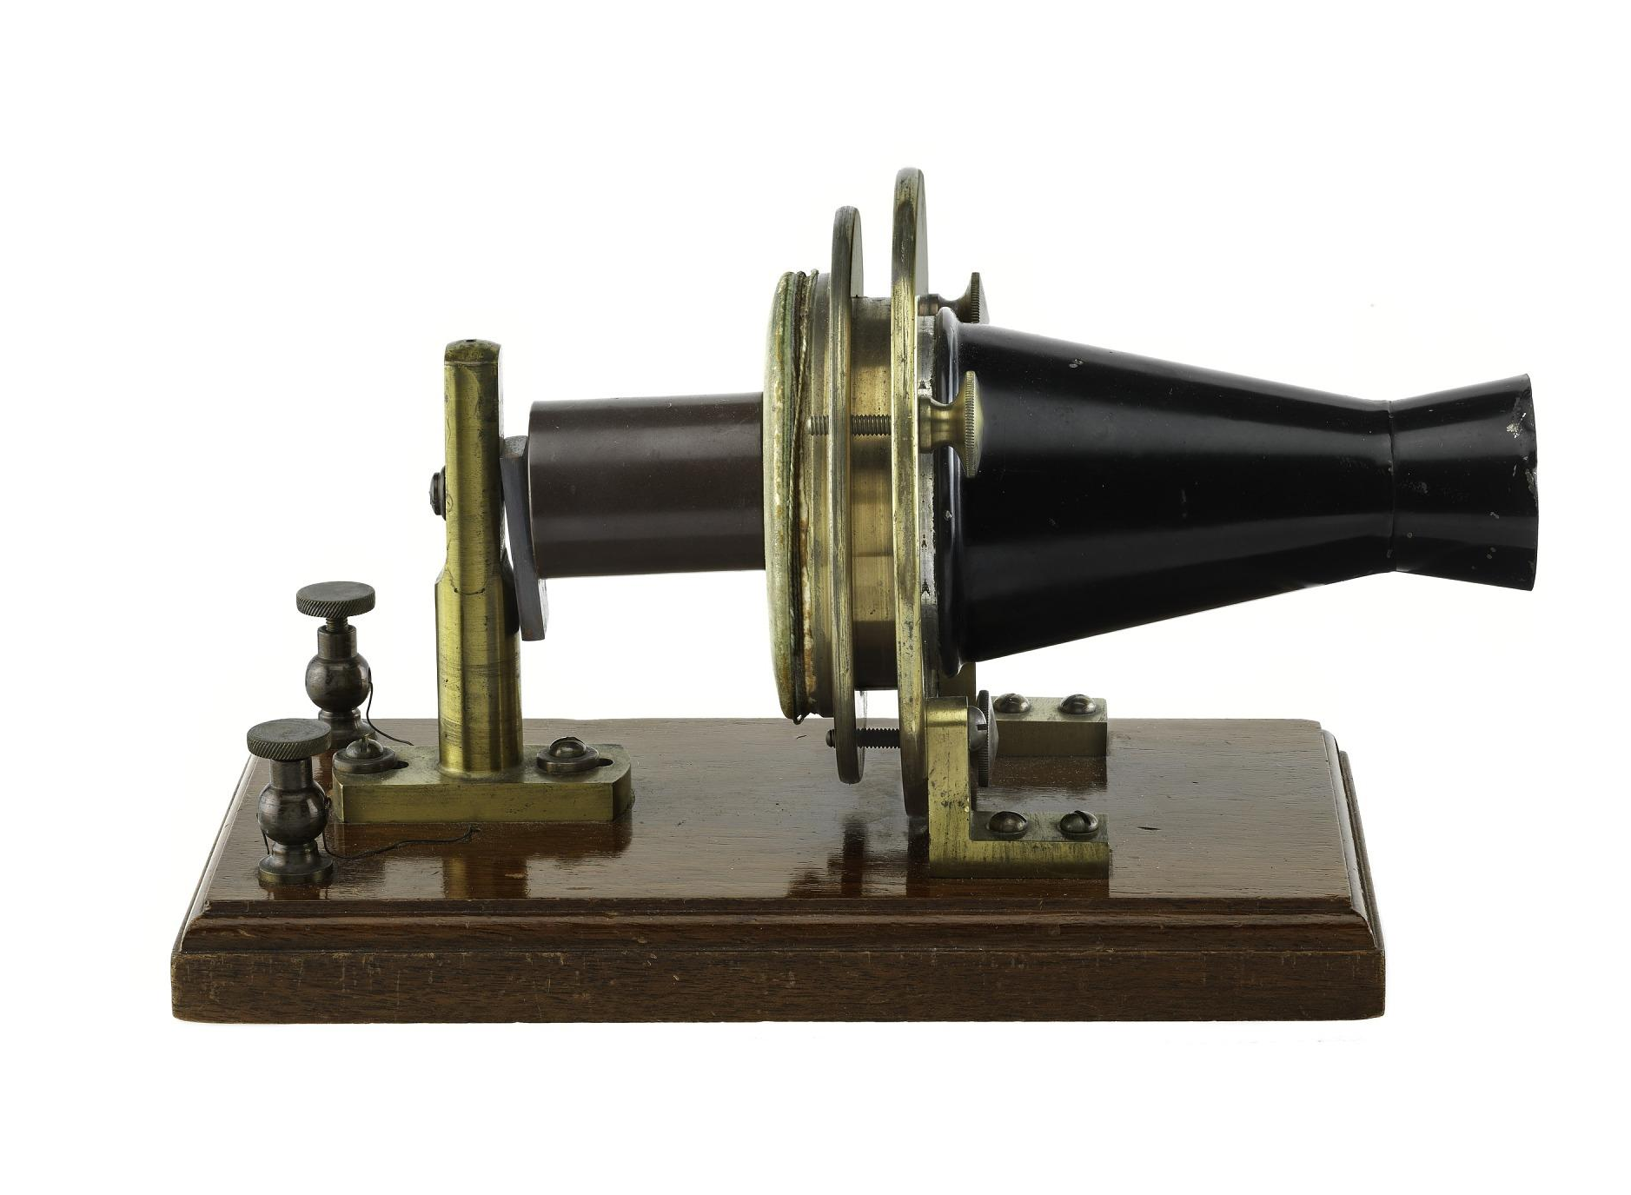
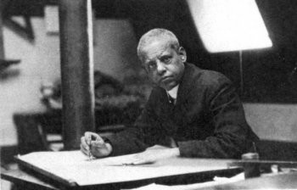
Many Inventions and Interests
Lewis designed many important inventions. He invented a toilet that could work on trains, and he drew the designs that helped Alexander Graham Bell invent the telephone.
He also painted, played the flute, and wrote poetry and plays.
Alexander Graham Bell’s first telephone
toilet system for trains

Slide 11
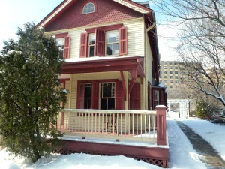
Lewis eventually moved to New York City. He had seen the exclusion of Black inventors, and he began working for equal rights for African Americans. His home was a meeting place where inventors and anti-racist activists gathered to discuss ideas and try to solve different kinds of problems.
Today his home in Queens, New York is a museum. People visit to learn about the life and contributions of this important inventor.
Lewis Latimer House
Queens, NY

Slide 12
Citations
Information and photos for this text were gathered from the following sources.
Lewis Latimer: The Man Behind a Better Light Bulb, Smithsonian Little Explorers, Nancy Dickmann, 2020
Lewis Latimer Awarded First Patent
Innovative Lives: Lewis Latimer (1848-1928): Renaissance Man | Lemelson Center for the Study of Invention and Innovation
https://www.richardstucky.com/blog/87422/evening-study-by-candle-light-1830
"Biography of Thomas Edison, American Inventor
Lewis Latimer Helped Invent Lightbulbs and Patent the Telephone
Lewis Howard Latimer - Inventions, Accomplishments & Facts
View of Chelsea, Mass., from Eagle Hill East Boston. - Prints -
Lewis H. Latimer Glassblowing Apparatus, 1881
Lewis Latimer: Contributing to a Brighter World
Lewis Latimer & The Invention Of Electric Light
Alexander Graham Bell Experimental Telephone | National Museum of American History
Lewis H. Latimer: Inventor and Early Advocate for Civil Rights

