Slide 1



Inventors!
Text Talk Week 6, Day 4

Slide 2
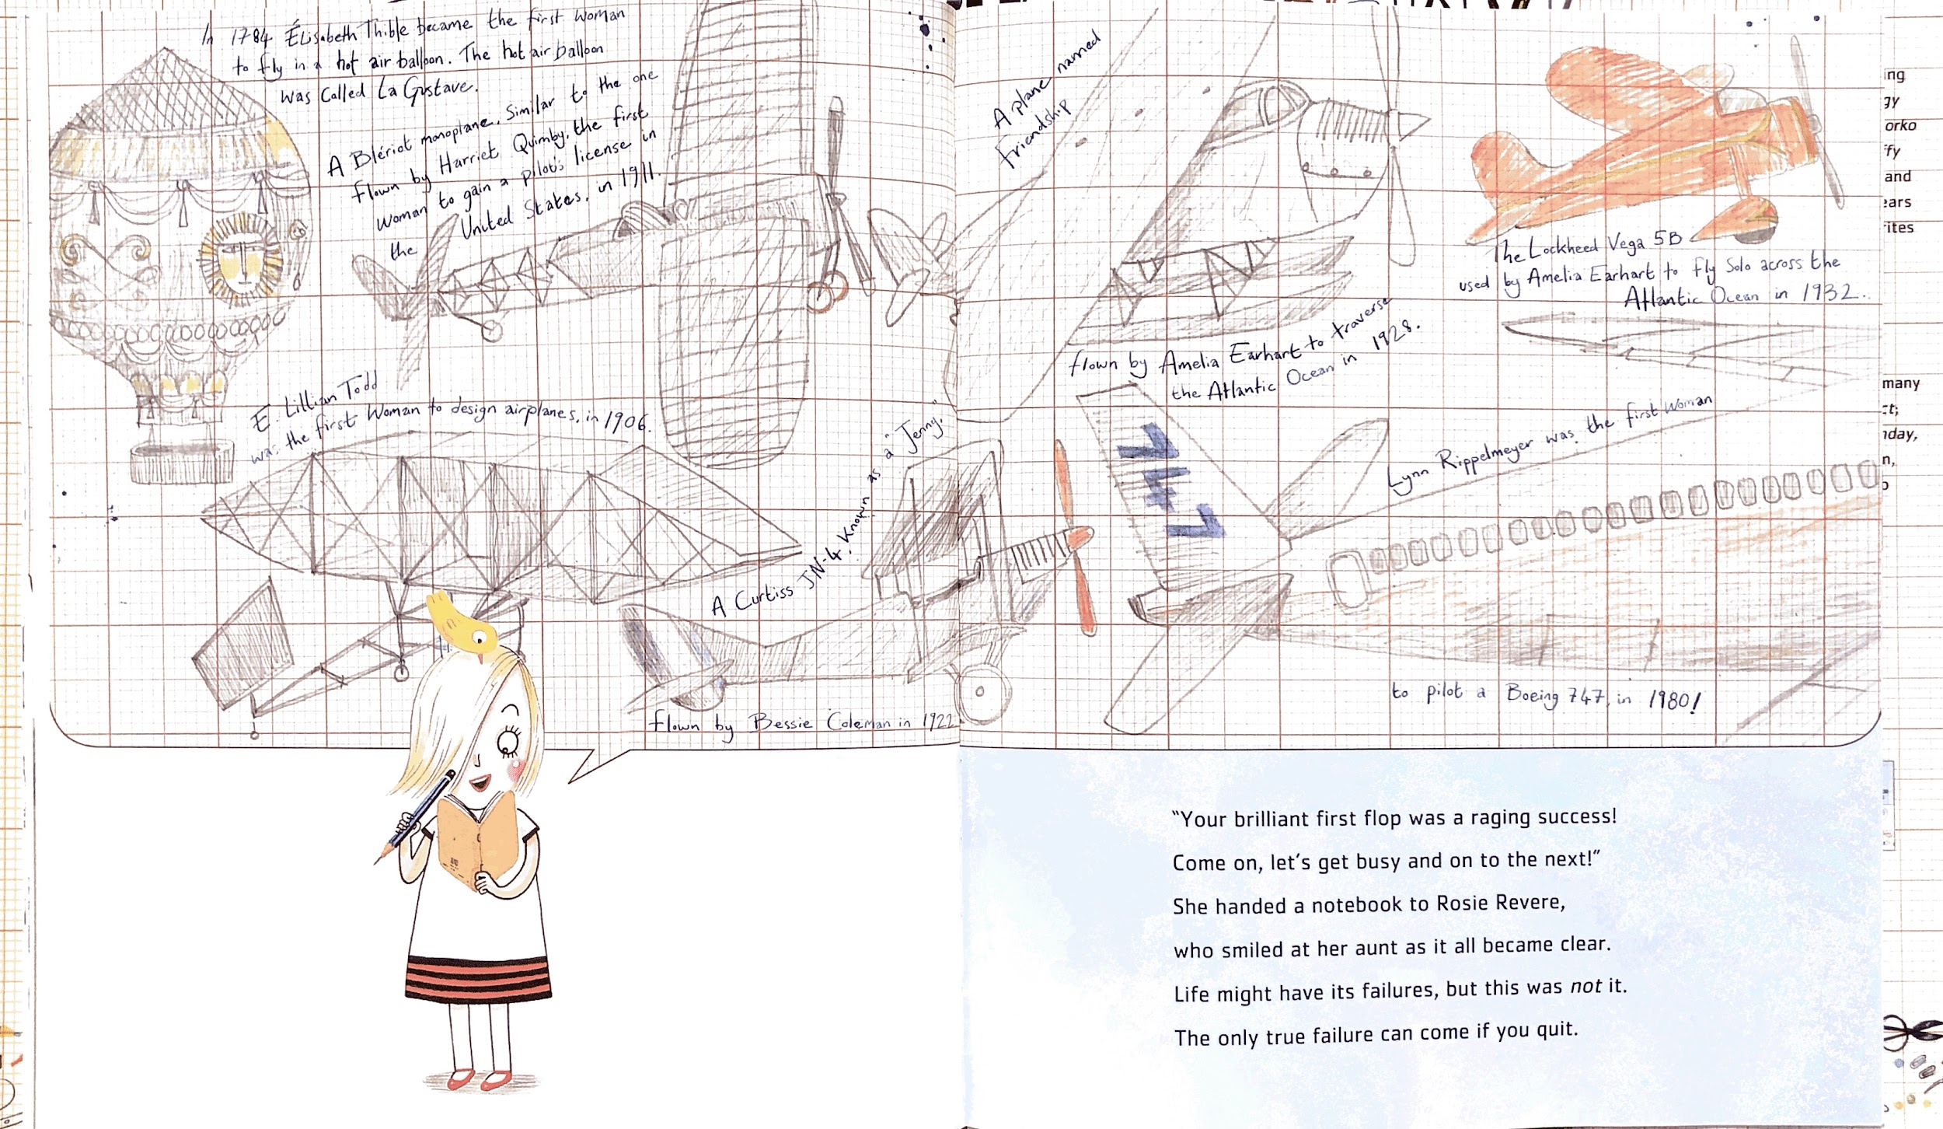
Like Rosie Revere, inventors solve problems by thinking of new ideas and trying them out. People have been inventing throughout history and around the world. Who are they, and what have they created?

Slide 3
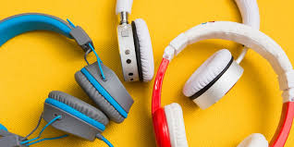
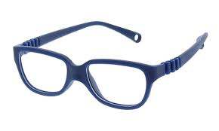
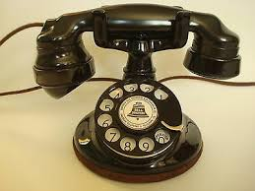
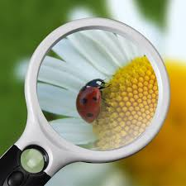
Inventions with light and sound
Watch for inventions that use sound or light to solve a problem or to help people better see or communicate about what they are studying.

Slide 4
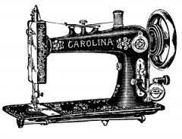
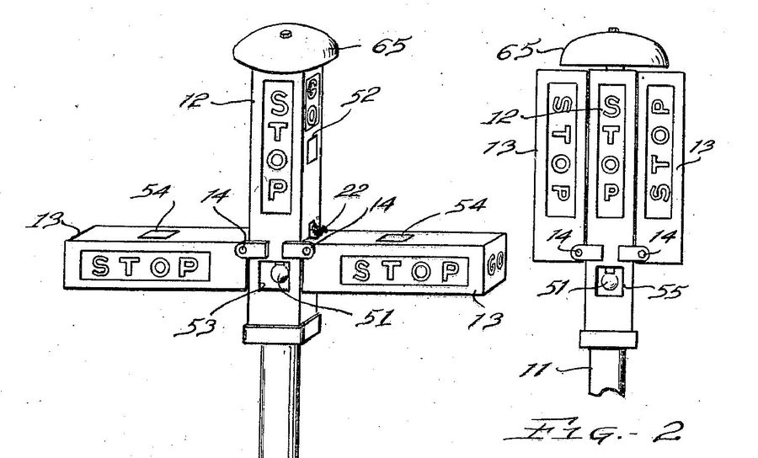
Garrett Morgan
Garrett Morgan was born in 1877 and lived most of his life in Ohio. As a young man he became very interested in how sewing machines worked. He invented one that was better than others and opened his own repair shop.
Later, he witnessed a traffic accident in a busy intersection. He created a new kind of traffic signal—one with a warning light to warn drivers that they would need to stop.

Slide 5
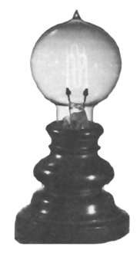
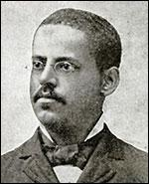
Lewis Latimer
Lewis Latimer was born in Chelsea, Massachusetts in 1848. He invented many different things. He is best known for creating a light bulb that could run for a longer time than first ones that had been invented by Thomas Edison, another famous inventor.

Slide 6
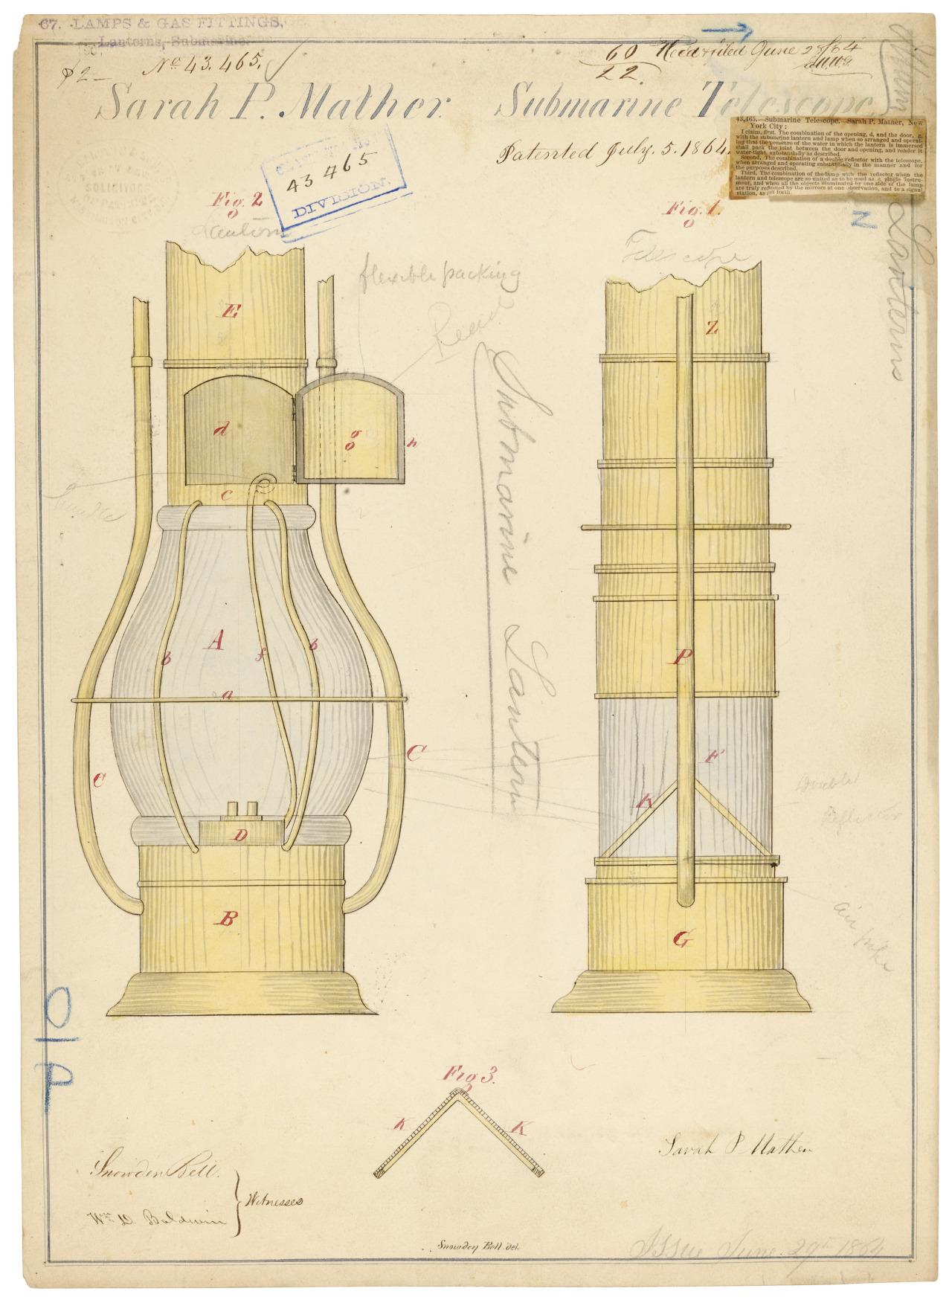
Sarah Mather
Sarah Mather was an inventor and an innovator: she created a tool and then improved it.
Sarah Mather finished her Aquascope in 1845. It was part telescope and part lamp, and it was used on submarines and ships. Tools like it are still used to study the depths of the ocean.
Sarah Mather lived in New York. Not very much is known about her life.

Slide 7
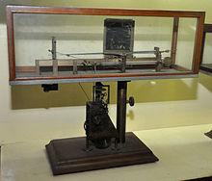
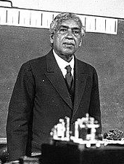
Jagadish Chandra Bose
This Indian inventor worked in many different fields of science. One of his important inventions is the Crescograph, which uses powerful magnifiers to measure the growth of plants.
Most inventors put their name and a number on their inventions, called a patent. JC Bose believed that his inventions should be shared so other people could use and learn from them.

Slide 8
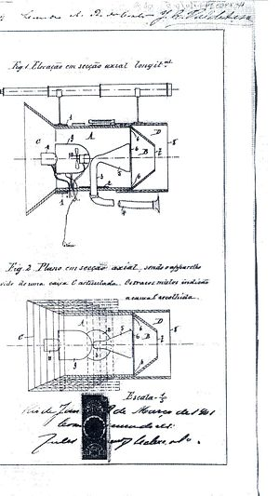
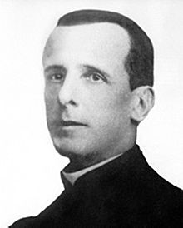
Roberto Landell de Moura
Roberto Landell lived and worked in Brazil. In the early 1900s he invented the Tellogostomo, a tool to provide two-way communication by sound “at a distance, with or without wire, through space, Earth, and water.”

Slide 9
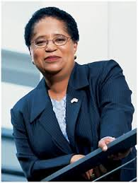
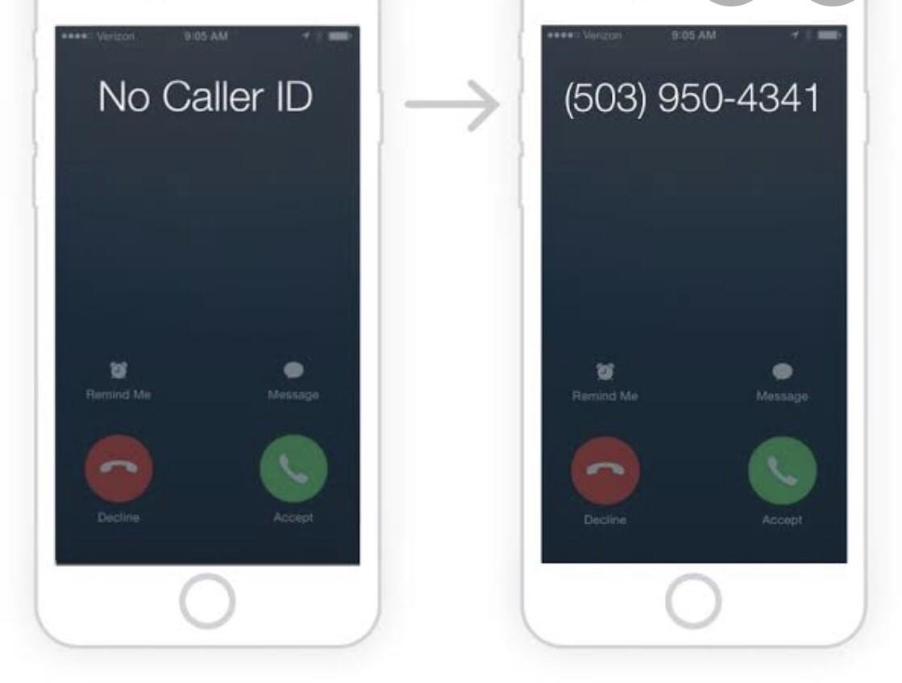
Shirley Jackson
Shirley Jackson began conducting science experiments as a child. She went to the Massachusetts Institute of Technology (MIT). Her research has allowed others to invent important technology for communication by sound. Some examples are touch tone telephones, solar cells, and the technology of caller ID and call waiting.

Slide 10
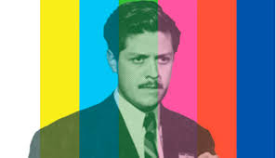
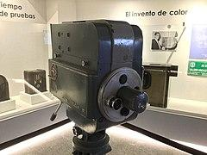
Guillermo González Camarena
Not that long ago, people could only watch television with images in black and white. In Mexico, in 1941, Guillermo Camarena started to change that. He was only 17 years old when he invented his Chromoscopic Adapter for Television Equipment. This device was added to a black and white TV to make images show in color.

Slide 11
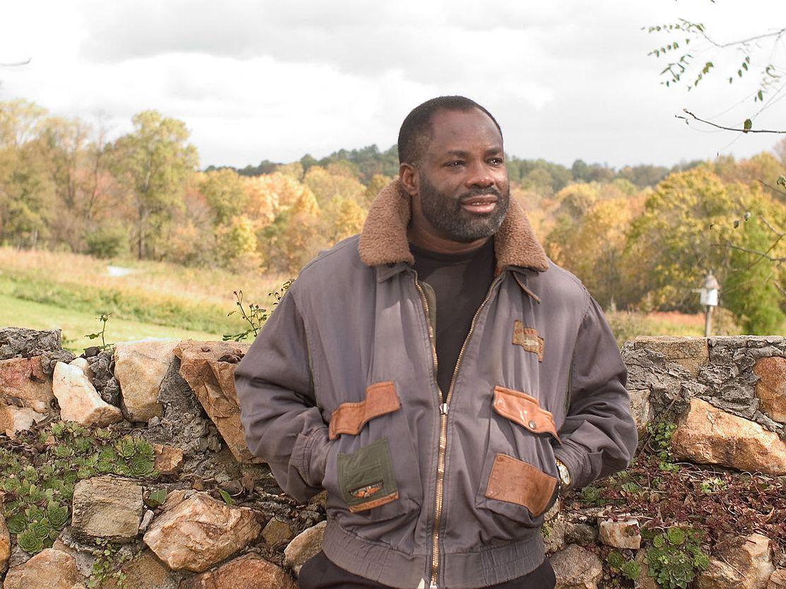
Phillip Emeagwali
This inventor from Nigeria has created the fastest computer on earth. He says he was inspired by studying honeybees. He observed that they worked together and communicated efficiently instead of doing tasks separately to build their honeycomb. He wanted to build a computer that worked the same way.
Phillip Emeagwali’s computers help watch patterns in our environment, such as in the weather and the spread of disease. His discoveries also helped lead to the creation of the internet.

Slide 12
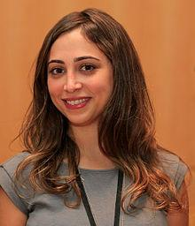
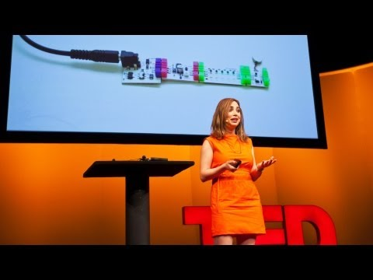
Ayah Bdeir
Ayah Bdeir grew up in Iran and came to the United States to study at MIT. In 2011 she started the company “littleBits” to encourage people to invent and build with electricity.
Watch her video!

Slide 13
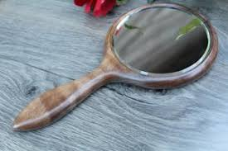
Hold up a mirror…
You can be an inventor, too!

Slide 14
Citations
Slide 2: David Roberts, illustrator, from Rosie Revere, Engineer by Andrea Beaty (2013)
Slide 3: The Best Kids Headphones for 2020 | Reviews by Wirecutter, Best Glasses for Kids, Details about Antique Original 1920s Round Western Electric 102 Telephone Works!, Traffic light
Slide 4: Garrett Morgan invented gas mask, traffic signal: Black History Month, Who was Garrett A. Morgan? – COMTO Kansas City, So, wait, is today the traffic light's 100th anniversary or not?
Slide 5: Lewis Latimer - Inventor of the Carbon Filament Light Bulb
Slide 6: Today's Document — Sarah P. Mather's Submarine Telescope, 07/05/1864 ...
Slide 7: Jagadish Chandra Bose, Crescograph
Slide 8: Roberto Landell de Moura
Slide 9: Guillermo González Camarena, Guillermo González Camarena y su amor por los colores
Slide 10: 12 Famous Women Inventors of All Time, Shirley Jackson, Did you know a black woman by the name of Dr. Shirley Jackson created the caller ID?
Slide 11: Biography of Philip Emeagwali, Computer Pioneer
Slide 12: Ayah Bdeir, https://www.youtube.com/watch?v=YguB-keZ4Tk&feature=emb_logo
Slide 13: JIMWOODWORKING

