Slide 1
Rosie the Riveter
Rosie Revere, Engineer
Text Talk Week 6 Day 3

Slide 2
Notes:
https://bloximages.newyork1.vip.townnews.com/omaha.com/content/tncms/assets/v3/editorial/0/1b/01b63568-2548-11e6-9463-835bef6b6d8c/574a1e3291235.image.jpg?crop=312%2C312%2C87%2C4&resize=1200%2C1200&order=crop%2Cresize

Slide 3
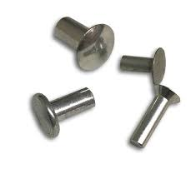
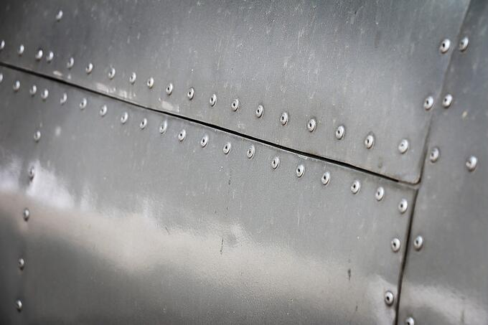
Notes:
https://www.rivetsonline.com/solid-rivets/solid-steel-rivets, https://noodle-head.com/2015/07/install-rivets.html, https://blog.baysupply.com/pop-rivets-vs-blind-rivets

Slide 4
Notes:
https://bloximages.newyork1.vip.townnews.com/omaha.com/content/tncms/assets/v3/editorial/0/1b/01b63568-2548-11e6-9463-835bef6b6d8c/574a1e3291235.image.jpg?crop=312%2C312%2C87%2C4&resize=1200%2C1200&order=crop%2Cresize

