Slide 1
Access to Books
and Project Introduction
Text Talk Week 6, Day 3
NOTE TO TEACHERS: There is content on these slides specific to Boston (slides 2 and 11) . Replace it with information relevant to your children and community.
Notes:
We have been learning about people who recognize needs in their communities and how they respond to them. Three people in three different communities noticed that people did not have the books that they needed—Marley Dias, Luis Soriano, and Arturo Schomburg—and they all did something about this.
Set a purpose for the lesson.
Today we’ll look at some slides about how people get access to books; we’ll watch a video about the importance of books; and then we’ll share some ideas about what we might do to continue to address this need.

Slide 2
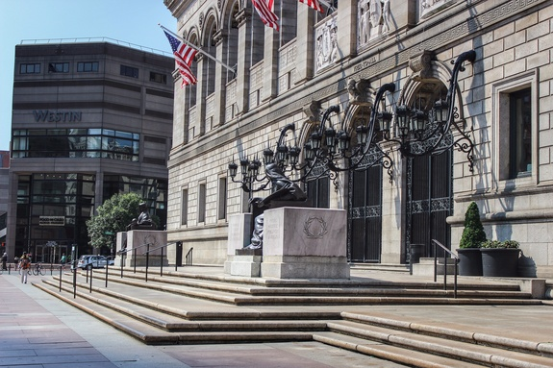
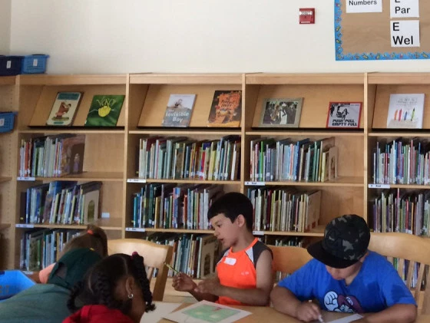
Slide 1
Libraries are useful and important places for people to read, find books they like, and do research. At public libraries, books are free to use and to borrow.

Slide 3
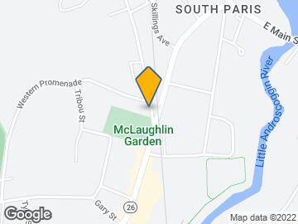
Slide 2
In South Paris, many people live near a library branch. However, many other people live in neighborhoods that do not have a library close by.
This is a problem. The people in these communities might not have access to, or be able to use or get, books.
Notes:
Pause to look closely at the map. Locate the school’s neighborhood, the neighborhoods where children live, and the libraries in proximity. Allow for children’s responses.

Slide 4
Slide 3
Some areas do have libraries, but these libraries are not equipped with enough books for everyone to read and enjoy.
This library branch, for example, has rows of empty shelves.

Slide 5
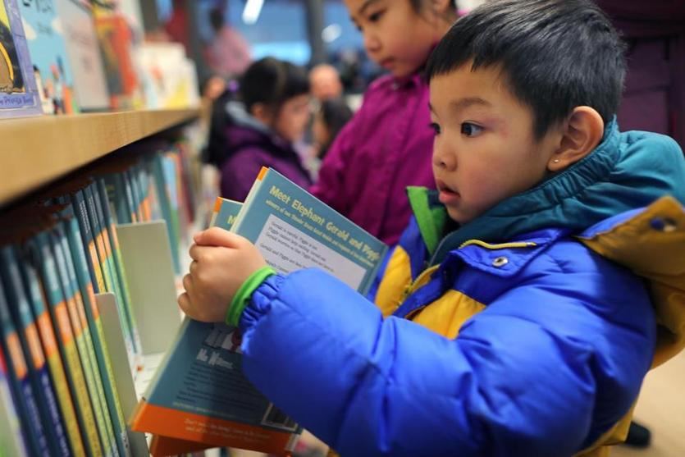
Slide 4
Everyone should have access to books. It is not equitable for some people to use, borrow, and read many kinds of books and for other people not to.
Notes:
Equitable means fair.

Slide 6
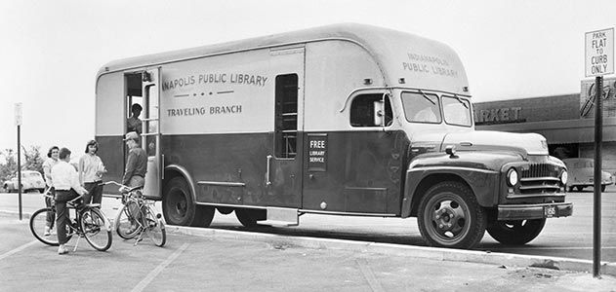
Slide 5
How can we get books to people who need and want them?
In the past, there were traveling libraries in sope places. These trucks were called bookmobiles.

Slide 7
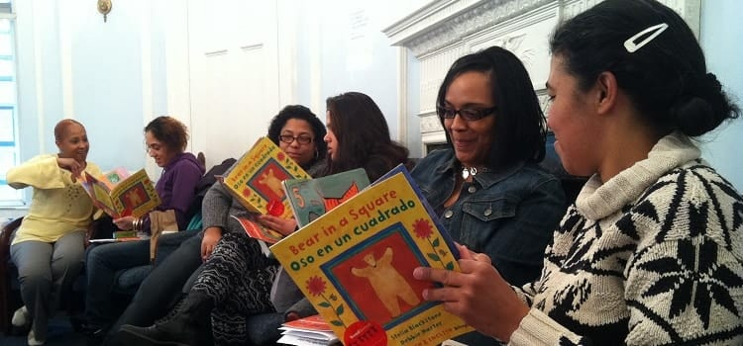
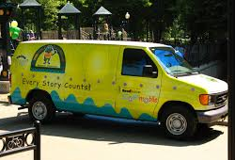
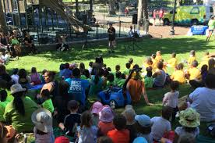
Slide 6
In some towns or cities, there are vehicles that offers lending libraries for families to borrow books and read at home. Here is a vehicle called the ReadBoston Storymobile. During the summer, it travels to parks to give storytelling performances. Children who attend receive a book to take home.
ReadBoston is a program that gives people access to books.

Slide 8
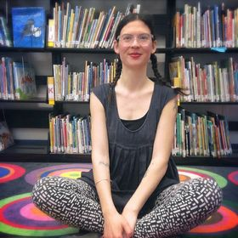
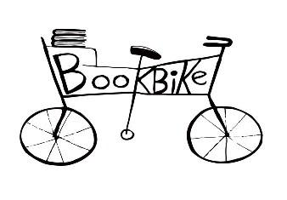
Slide 7
Liz Phipps Soeiro, a librarian in a Cambridge elementary school, read to her students about Luis Soriano and his Biblioburro. It made her think about children in Cambridge who didn't have access to books. That's when she had the idea to use a bike as a traveling library. With some help from friends, she built a set of shelves for a bike and launched the program.

Slide 9
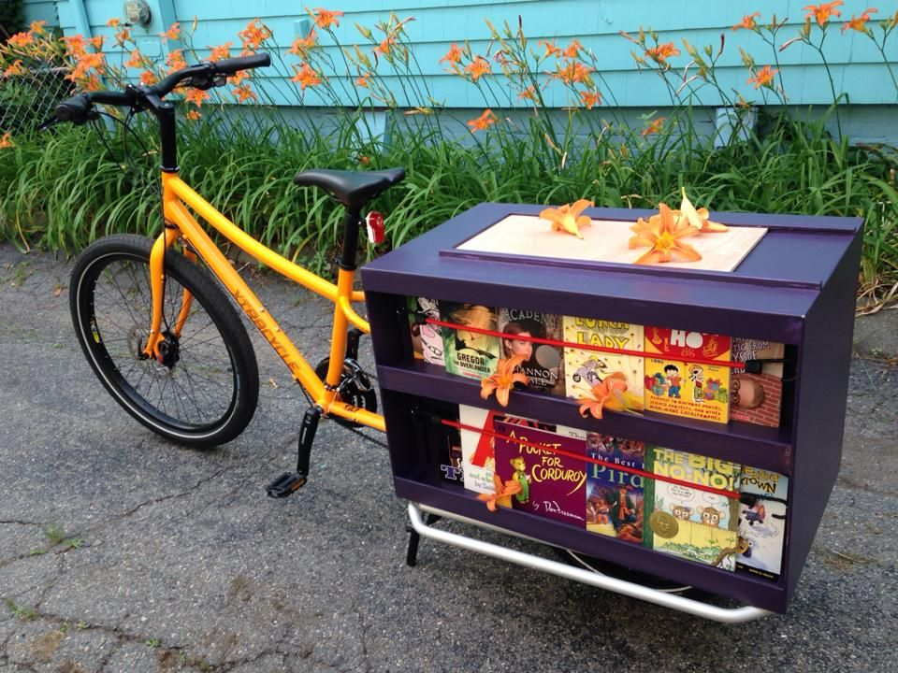
Slide 8
The Cambridge Book Bike brings new, free books to children throughout Cambridge during the summer. Kids come to parks, where they can work on craft projects, listen to stories, and leaf through new favorite books. Then they get to take those books home.
A book bike is another way that people can have access to books.
Notes:
Thumbs up if you have noticed a Little Free Library somewhere.

Slide 10
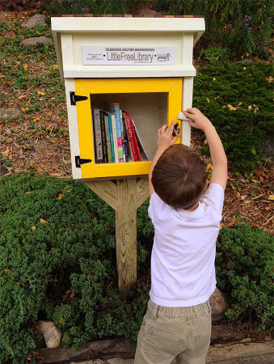
Slide 9
In some places, there are book- sharing boxes such as the Little Free Library around town. You can take a book or leave a book in the box. The people who developed these boxes want to increase reading and help community members feel more connected to each other.
These book boxes provide people with more access to books.

Slide 11
Slide 10
Maybe you have a great branch library in your neighborhood. Maybe you have seen a van like the Storymobile. But maybe it’s hard for you and your family to get books.
How can we make sure that children and families in all of our towns have access to books?
INSERT image of map of the town/area.
Notes:
Think, Pair, Share.
What are some of the ways people get access to books, according to
this text?

Slide 12
Citations
Written and compiled by Fay Ferency and Melissa Tonachel, Focus on First, 2019.
Slide 1: https://www.thehistorylist.com/venues/boston-public-library-central-library-in-copley-square-boston-massachusetts, https://lewissievers.com/2014/08/21/engaging-children-at-your-library/
Slide 2: https://bpl.bibliocommons.com/locations (Leventhal Map Center)
Slide 3: https://www.bostonglobe.com/metro/2014/08/07/bpl-push-reduce-books-community-branches-stirs-complaints/Hx9dCXFaUBv91yIr9gVkxO/story.html
Slide 4: https://www.bostonglobe.com/metro/2018/02/03/city-opens-library-branch-chinatown/9DyNLb9xyJFQ1MTaAJWTfO/story.html
Slide 5: https://www.smithsonianmag.com/arts-culture/long-overdue-the-bookmobile-is-back-353143/
Slide 6: https://www.flickr.com/photos/boston_public_library/5229432227
Slide 7: http://www.cambridgebookbike.org/
Slide 8: https://scoutcambridge.com/cambridge-book-bike/
Slide 9: https://littlefreelibrary.org/
Slide 10: http://www.kars4kidsgrants.org/our-grantees/readboston-getting-kids-access-to-the-world-of-words/, http://eastbostondotcom.blogspot.com/2013/07/coming-to-east-boston-readbostons.html, http://www.readboston.org/
Slide 11: https://bpl.bibliocommons.com/locations (Leventhal Map Center)

