Slide 1
Dr. Michelle Anderson
Sprout Kids Dentistry
Text Talk Week 6, Day 2

Slide 2
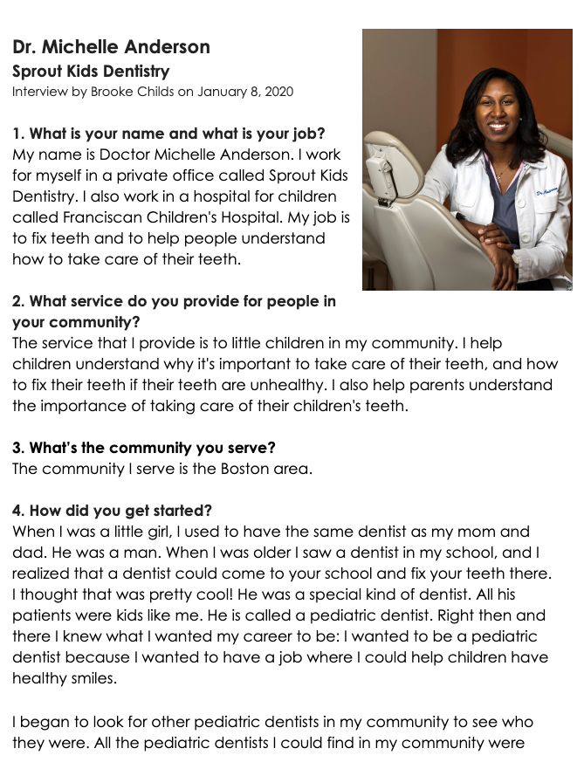

Slide 3
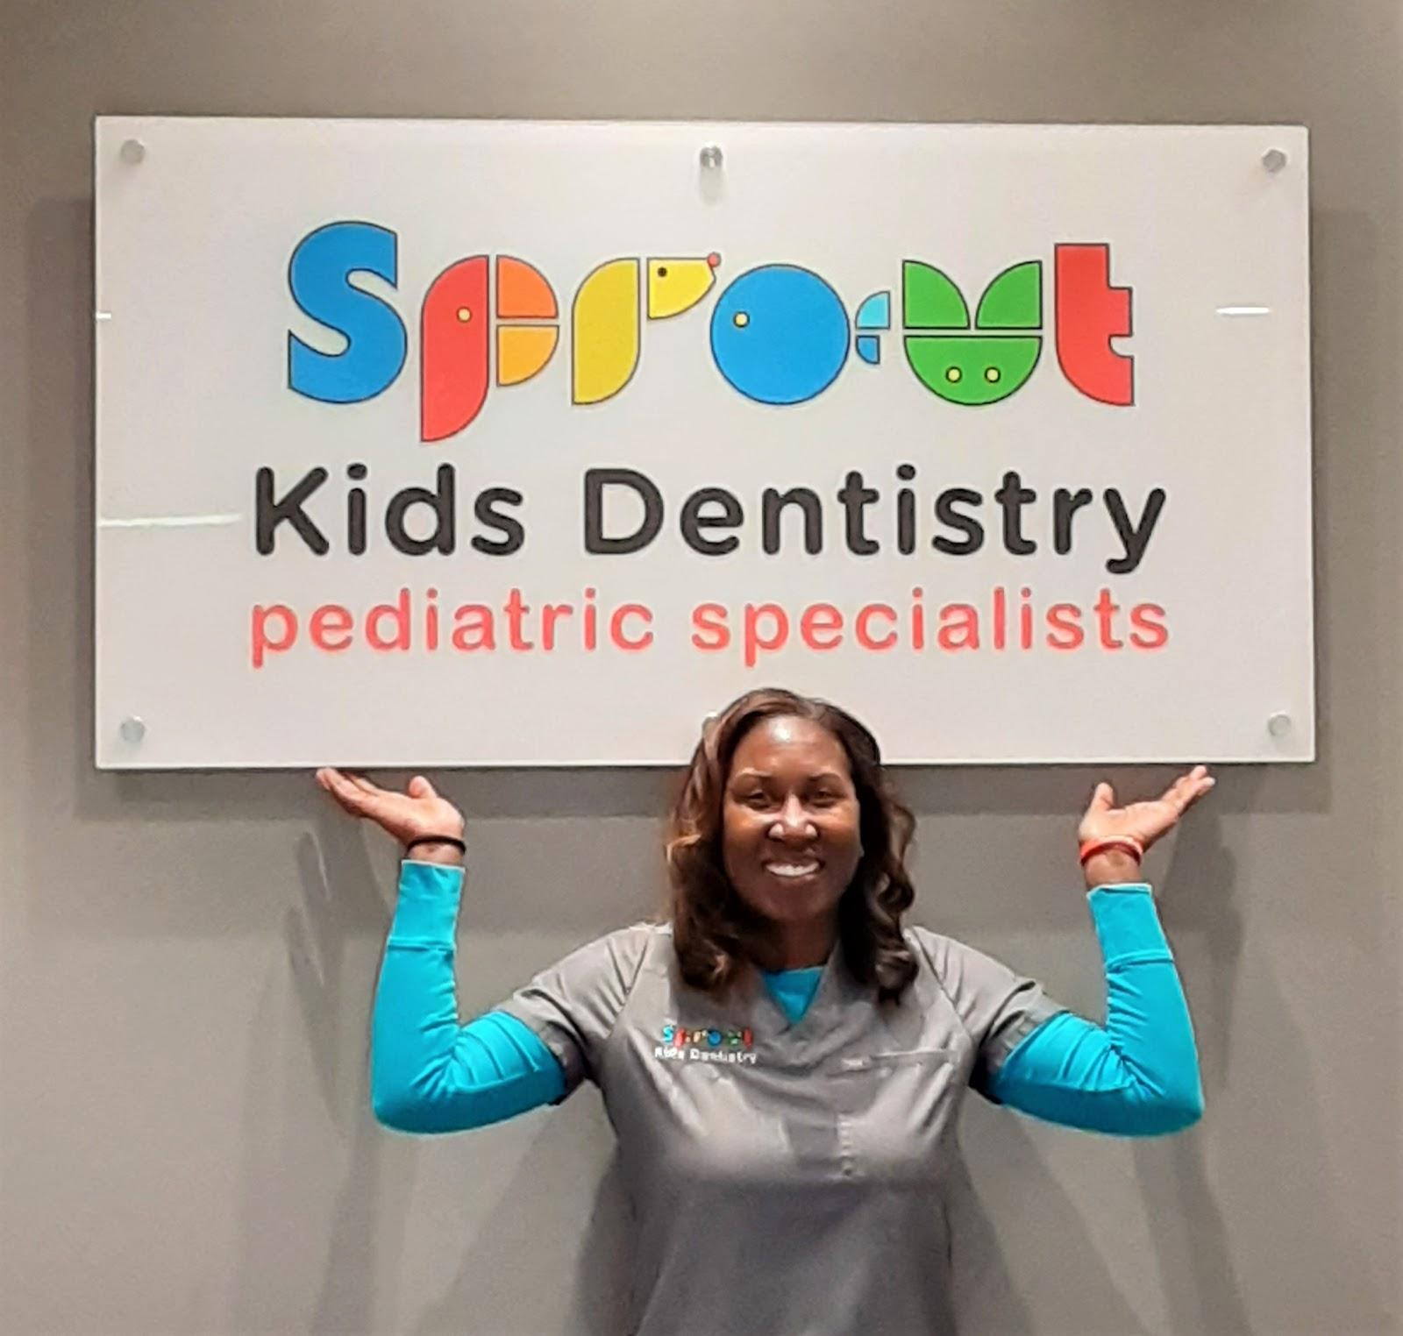
Slide 1
This is Doctor Michelle Anderson.
She is a pediatric dentist—a dentist for children.

Slide 4
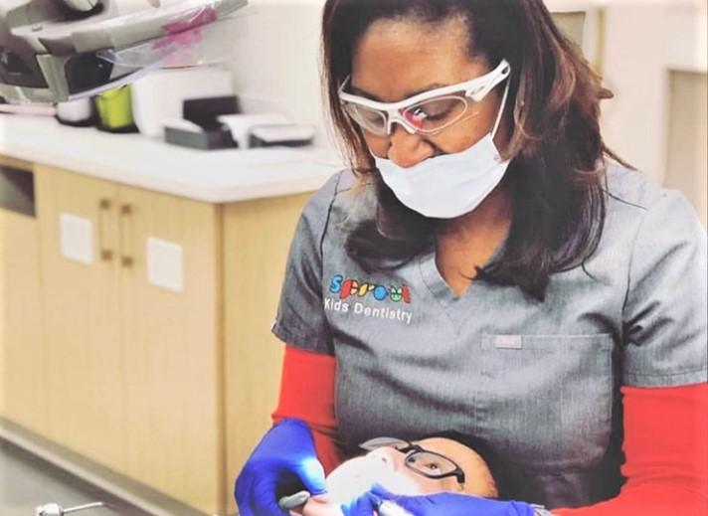
Slide 2
“I help children understand why it's important to take care of their teeth, and how to fix their teeth if their teeth are unhealthy. I also help parents understand the importance of taking care of their children's teeth.”
(Interview Question 2)

Slide 5
Slide 3
“All the pediatric dentists I could find in my community were men and not women. I was motivated to be a pediatric dentist because I wanted to prove that a woman could be a pediatric dentist, too.”
(Interview Question 4)

Slide 6
Slide 4
“In college, I studied biology. Then I went to dental school at Tufts University. I studied dentistry for four years. All that studying allowed me to fix grown-up teeth. I wanted to have a job fixing children's teeth, so I had to stay in dental school for two more years to learn exactly how to work in a child's mouth.”
(Interview Question 5)

Slide 7
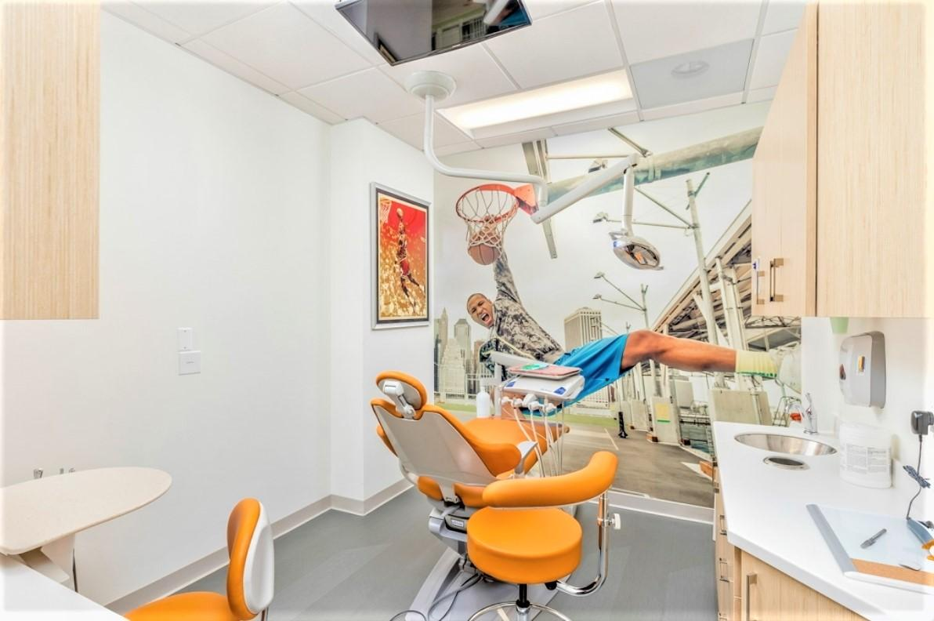
Slide 5
At her dentist office, Dr. Anderson has decorations on the wall and TVs on the ceiling.

Slide 8
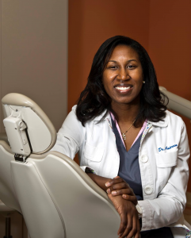
Slide 6
“Dentistry is a really fun career. Working with kids is also really fun. Little girls don't need to think about dentistry as a job that only boys can do—it can be a career for girls, too. It doesn't matter what color you are either. If you want to be a dentist, you can be one, just like me. You should stay in school and study hard, and you can grow up to be anything you want to be.”
(Interview Question 9)

Slide 9
Citations
Compiled and written by Brooke Childs, Focus on First, 2019.
All photos courtesy of Dr. Michelle Anderson and Sprout Kids Dentistry.
https://www.sproutkidsdentistry.com/

