Slide 1
Dangers to Animals
Text Talk Week 6, Day 2 | Packet 2
Citations:
Slide 9: https://www.fws.gov/endangered/news/episodes/bu-spring2015/story1/index.html
Slide 10: http://blogs.ifas.ufl.edu/wecdept/2016/05/11/intervene-not-intervene-individual-based-approach-dynamics-persistence-florida-panther-population/
Slide 11: https://www.savatree.com/blog/2015/01/milkweed-monarchs/; https://eatreadscience.com/2015/11/08/resistance-to-plant-toxins-in-milkweed-butterflies-is-linked-to-toxin-storage-for-defense/
Slide 12: https://wwf.panda.org/?209005/Increased-protection-of-polar-bear-habitat; https://www.capecodchamber.org/beaches; https://www.floridapantherprotection.com/Default.aspx?n=4; http://www.bogan.ca/index.php?id=raising-monarch-butterflies
Slide 13: https://www.denverpost.com/2018/07/23/colorado-drought-west-wild-horses/; https://blog.nationalgeographic.org/2016/10/03/qa-extreme-drought-in-south-africas-kruger-national-park-how-is-wildlife-faring/
Slide 14: https://www.sccpre.cat/show/hiiox_globe-world-world-map-graphic-design-png-image/
Slide 15: image from Sea Turtles by Laura Marsh; http://www.thesuperfins.com/do-turtles-eat-jellyfish/
Slide 16: https://medium.com/usfws/the-trash-at-the-edge-of-the-world-47049d25e464
Slide 17: https://blogs.wwf.org.uk/blog/habitats/oceans/marine-turtles-and-plastics/;
https://www.stateparks.org/sc-sea-turtles-finding-sc-beaches-more-often-for-nesting/
Notes:
global, map

Slide 2
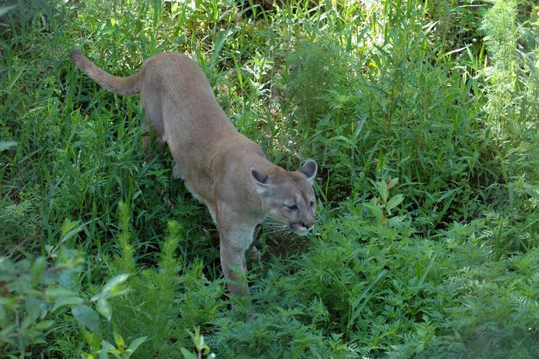
Slide 9
Habitat Loss
The Florida panther lives in wetlands, swamps, and forests.
Florida panthers are endangered by the loss of their habitat, as people have built homes and roads. There are not very many Florida panthers left. They live in a small, protected area of Florida.

Slide 3
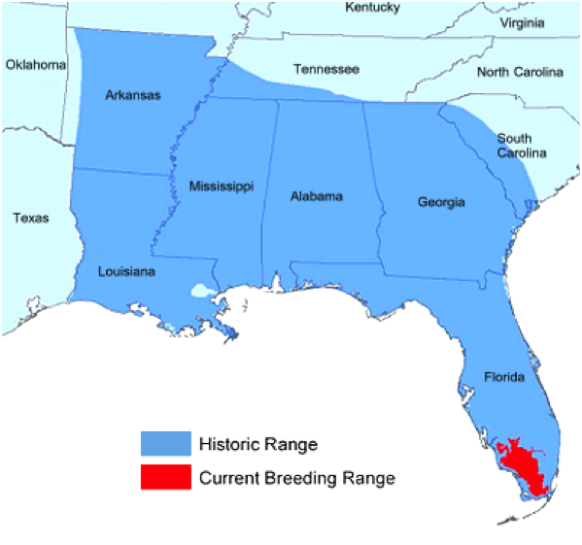
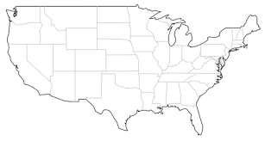
Slide 10
This map shows the area where Florida panthers used to live, and where they live now.
Florida is part of the United States.

Slide 4
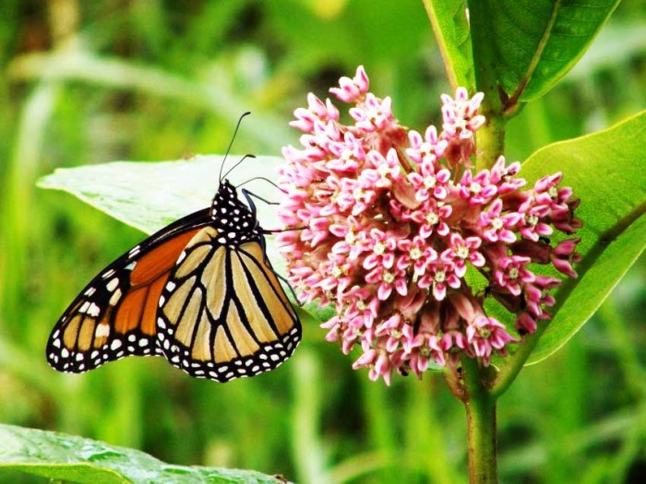
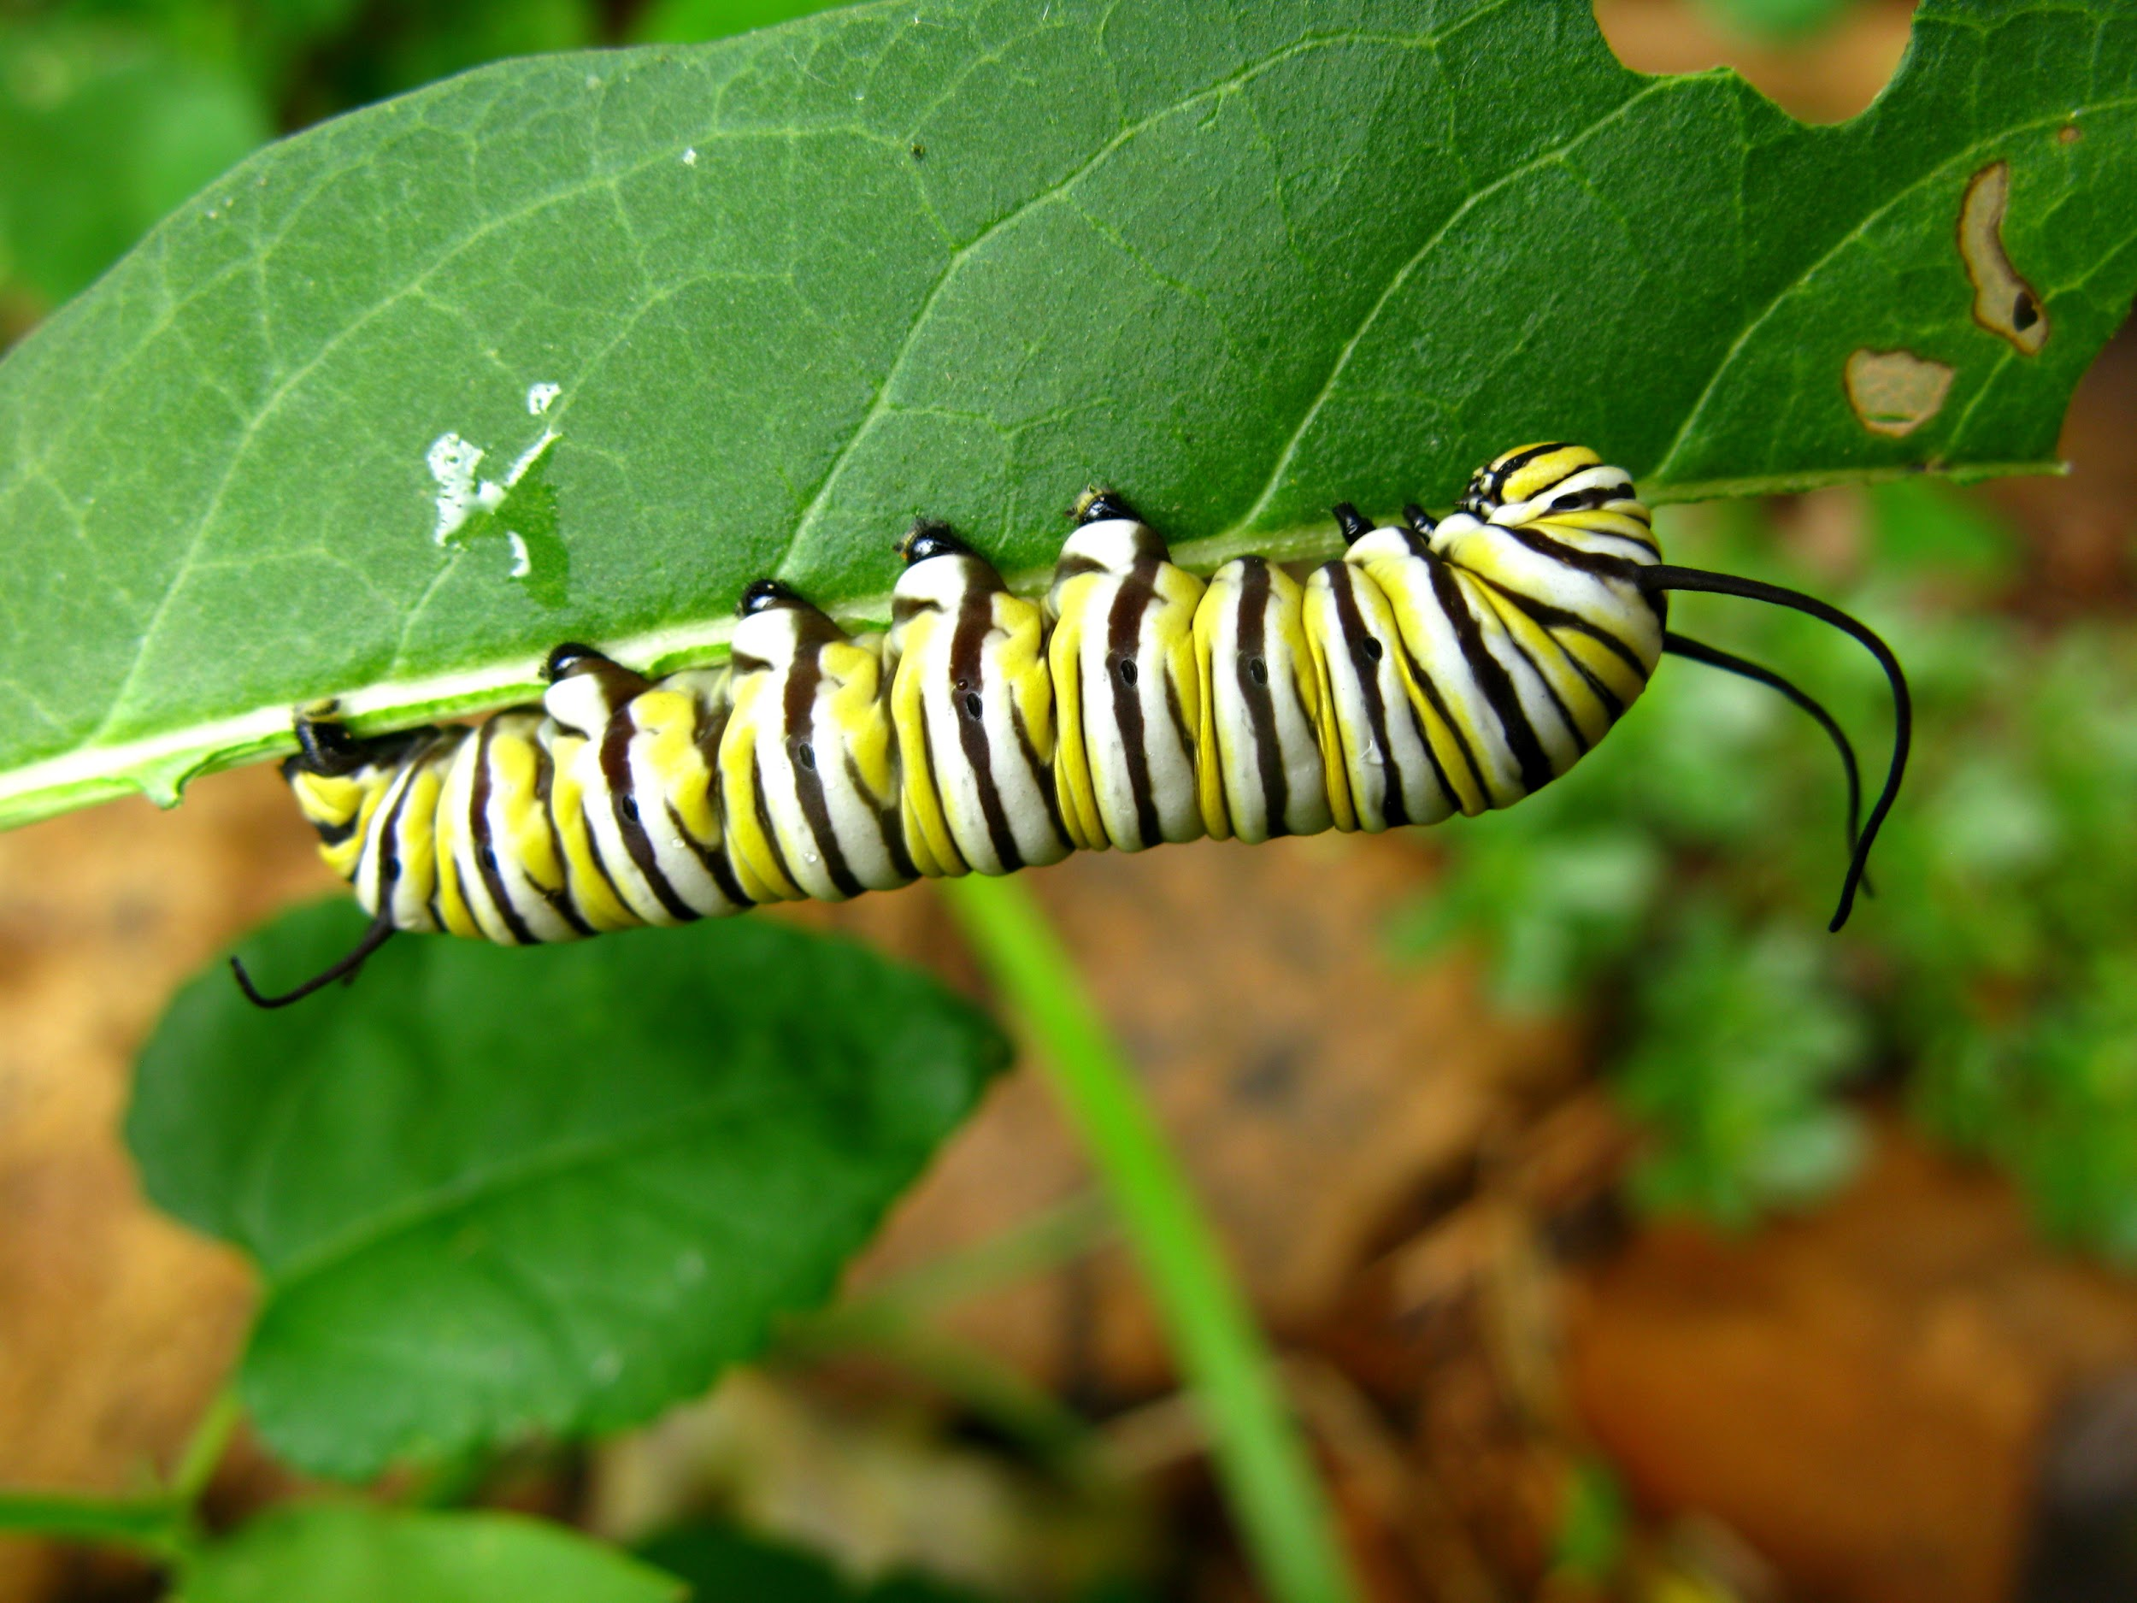
Slide 11
Monarchs lay their eggs on the plant’s leaves so that the caterpillars have food to eat when they hatch.
Monarch butterflies depend on finding milkweed in their habitat. Where there is not enough milkweed, the monarchs are in danger.

Slide 5
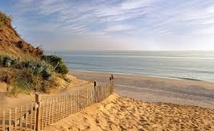
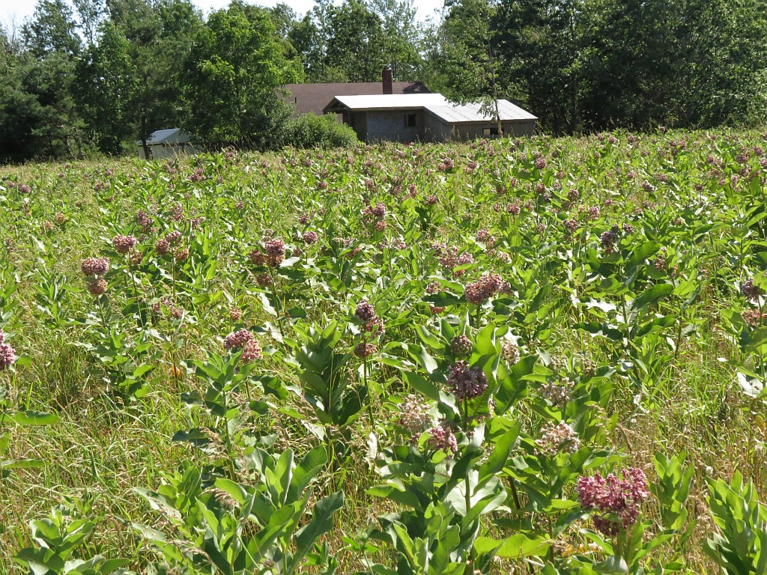
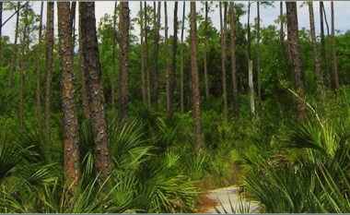
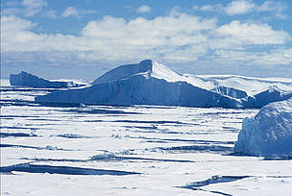
Slide 12
Loss of habitat is the greatest danger to animals in the United States.

Slide 6
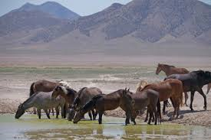
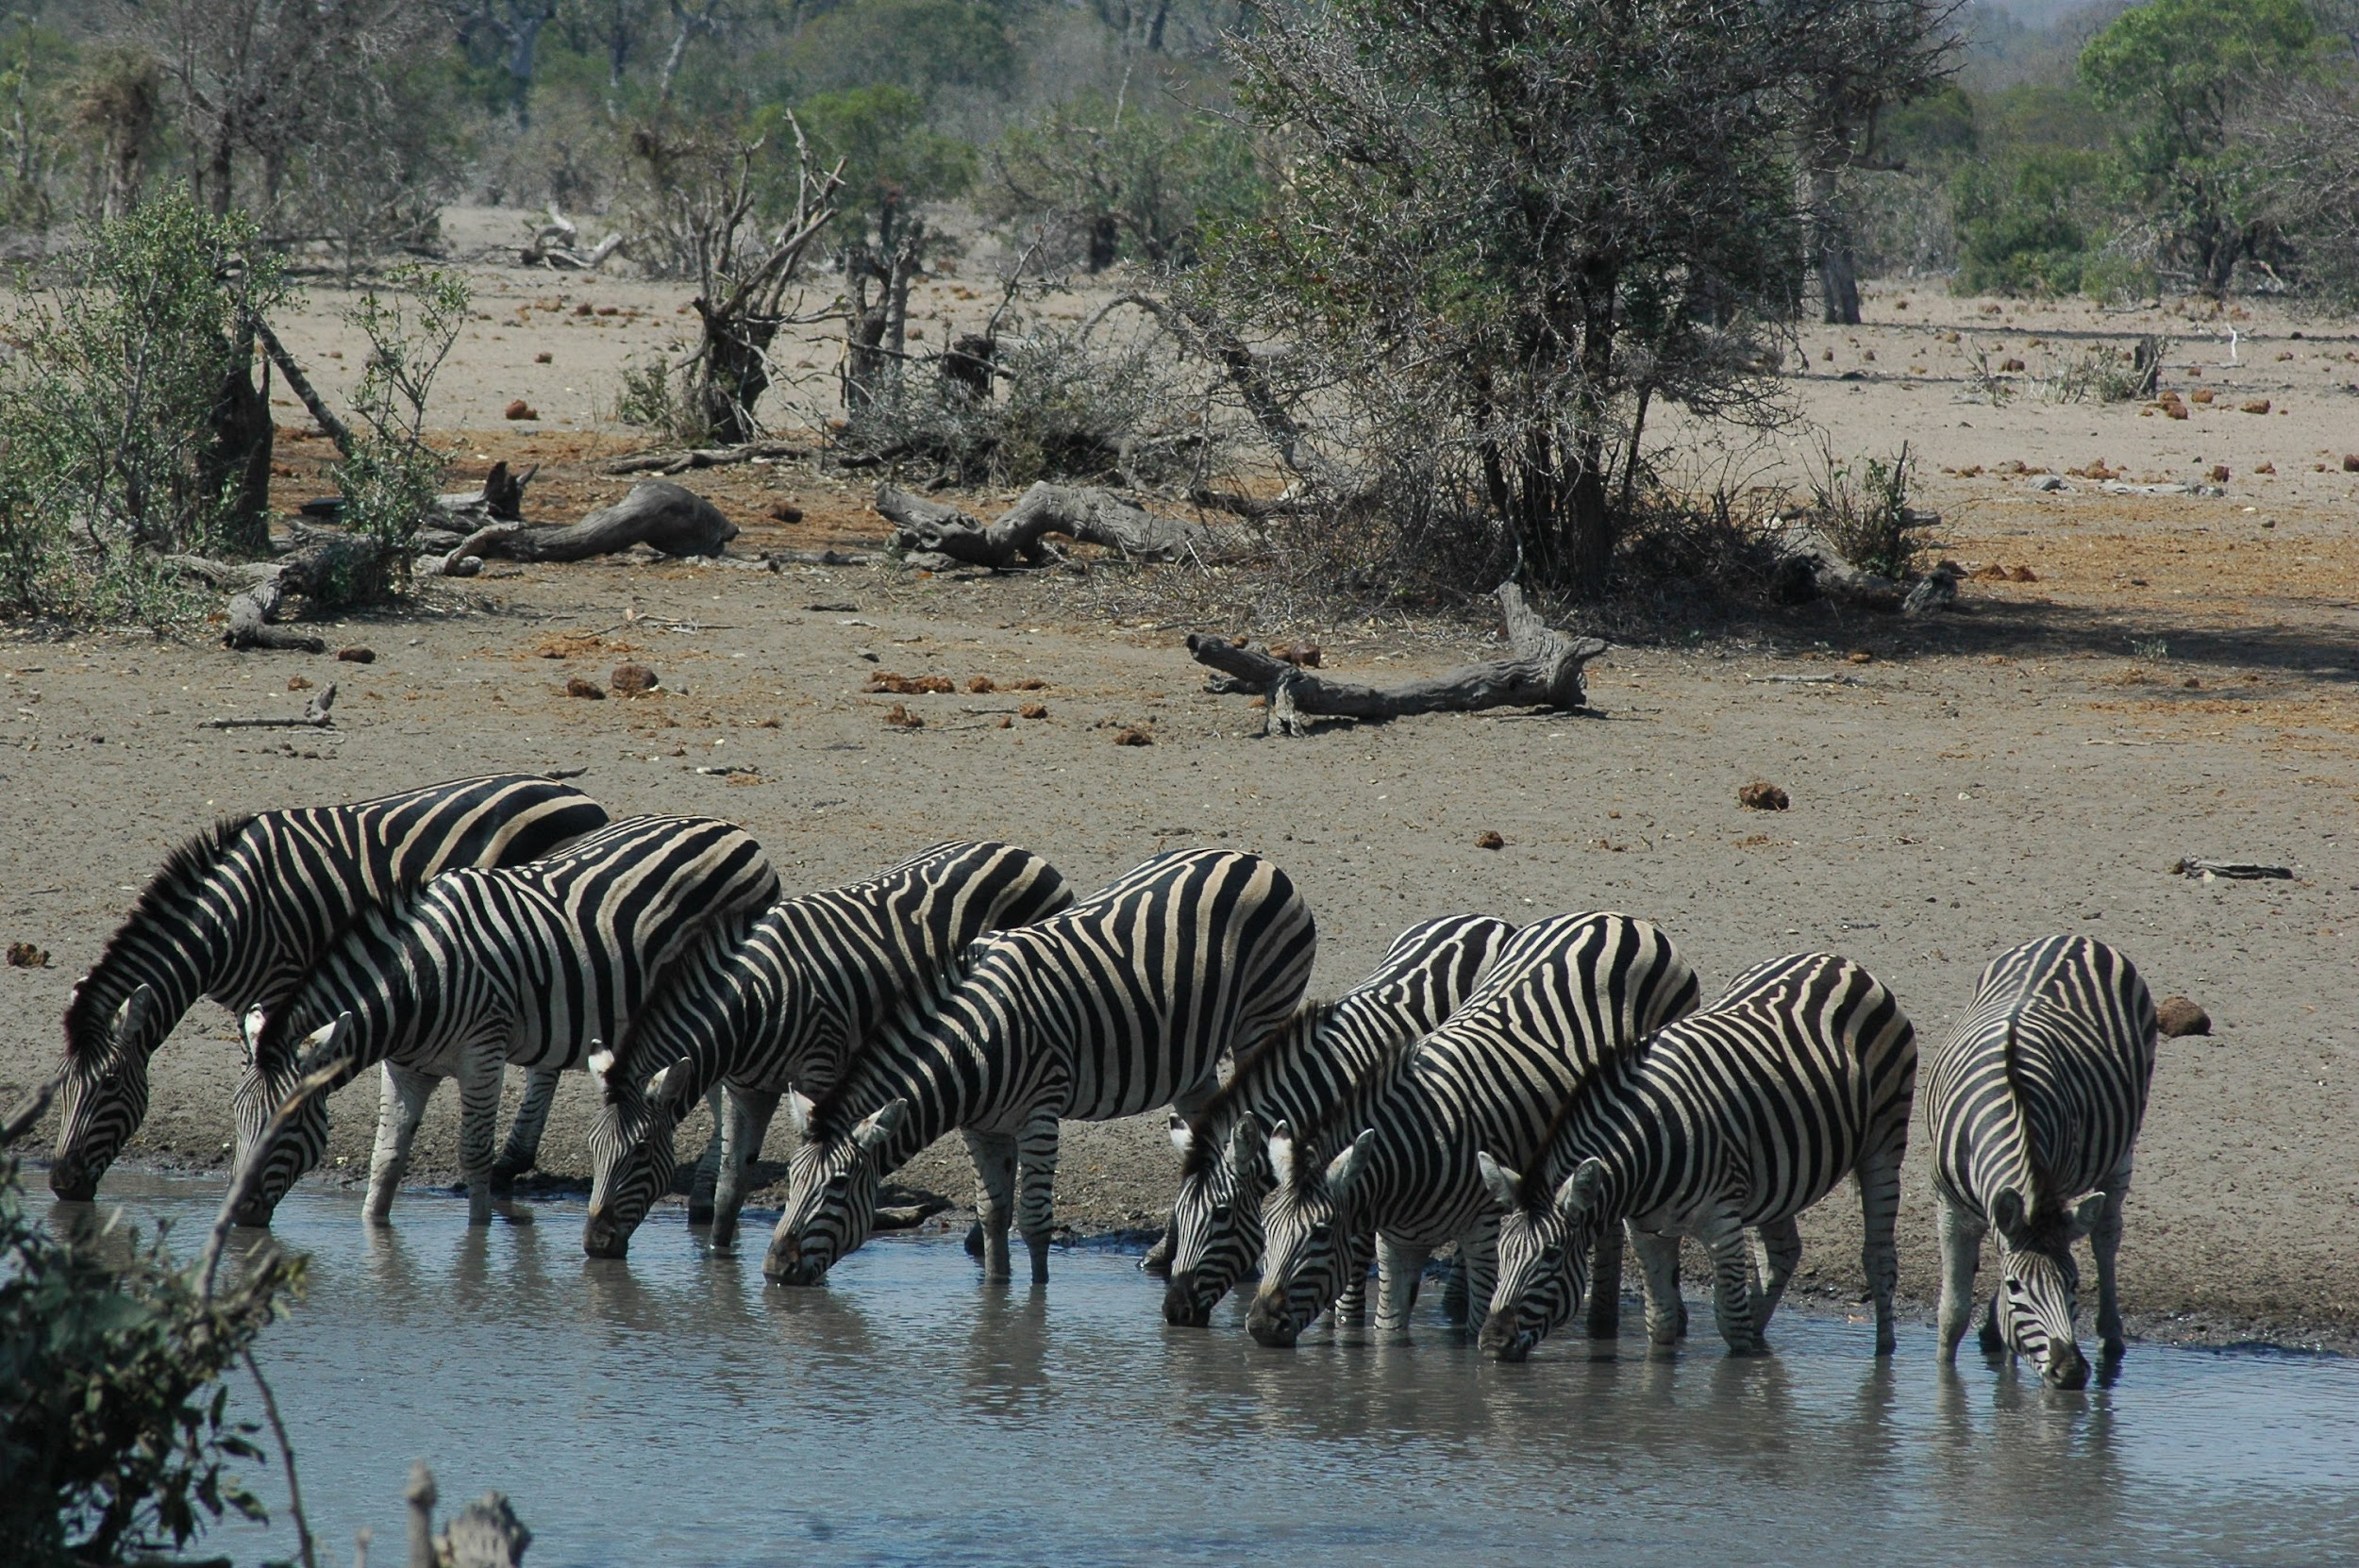
Slide 13
Drought
Wild horses in Colorado in the United States and zebras in South Africa drink from water holes and rivers.
Sometimes animals encounter drought—a shortage of water. When there is not enough rain to fill rivers, lakes, and ponds, animals are thirsty. They may need to travel long distances to find the water they need to survive.

Slide 7
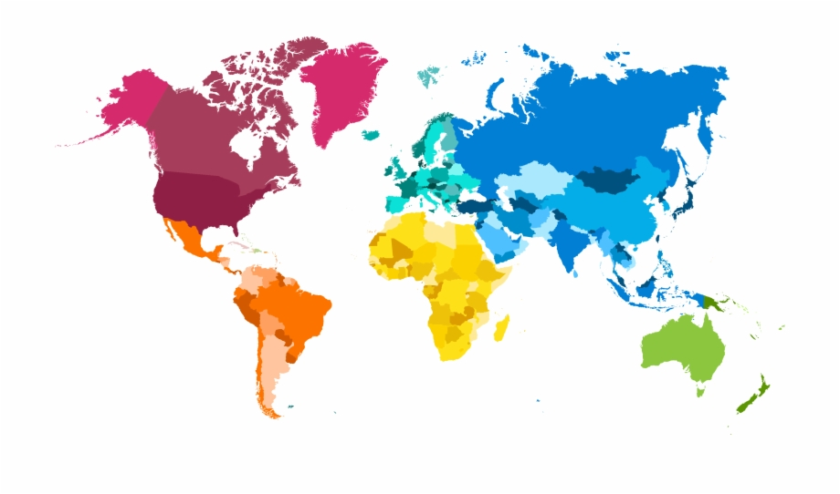
Slide 14
Wild horses in Colorado in the United States
Zebras in
South Africa
Animals all over the world experience drought.

Slide 8
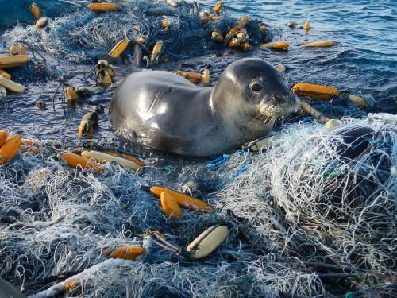
Slide 15
Trash
Another serious danger that animals encounter is trash, especially in the ocean. Seals, whales, sea birds, and sea turtles can get tangled up in trash.

Slide 9
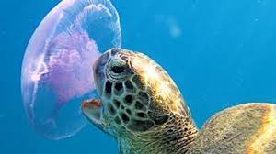
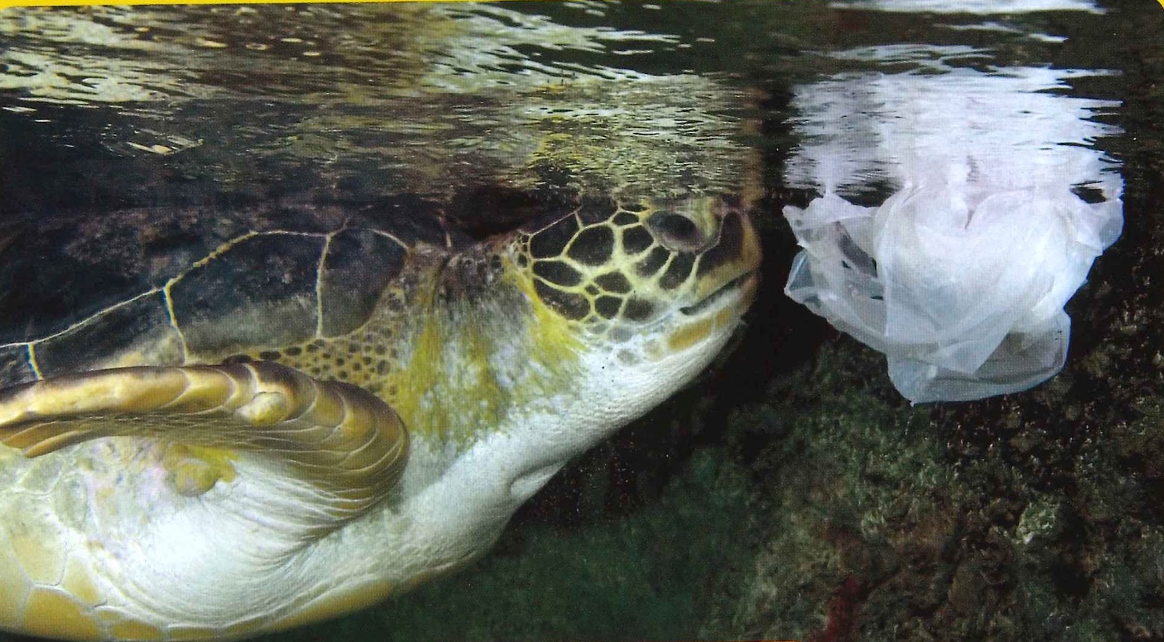
Slide 16
Sea turtles live in oceans around the world, including in the Atlantic Ocean, near Boston.
Sea turtles can live to be 80 years old or more.
But sea turtles are endangered.
Sea turtles eat jellyfish. But a plastic bag can look like a jellyfish. What happens when a sea turtle eats a plastic bag?

Slide 10
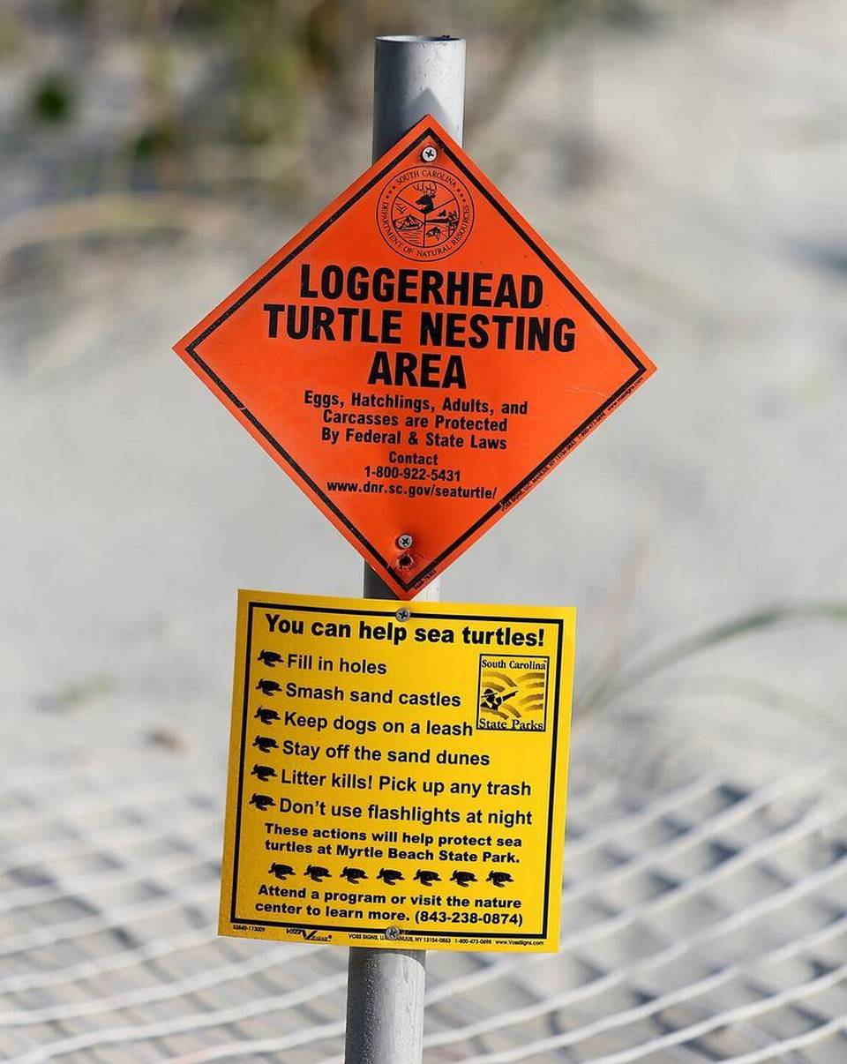
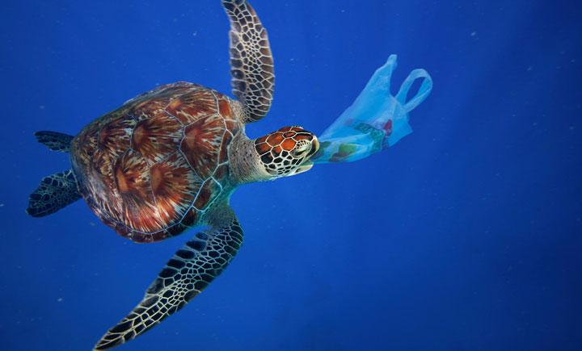
Slide 17
Researchers put up signs to inform people about turtle nesting areas and about what they can do to help protect sea turtles.
Sea turtles are at risk when they encounter plastic in the ocean.
Animals face natural dangers, like predators and drought.
Animals also face dangers that are not natural. People can take action to lessen dangers to animals.

