Slide 1
People in Our Neighborhoods/Towns
Text Talk Week 6, Day 2

Slide 2
Slide 1
People all around the town offer services to other people in their communities.

Slide 3
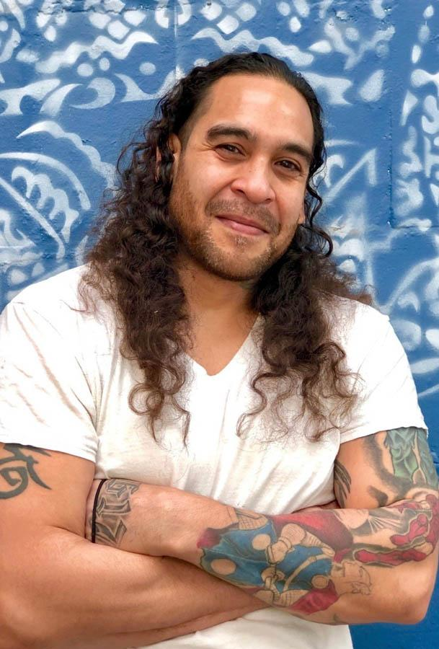
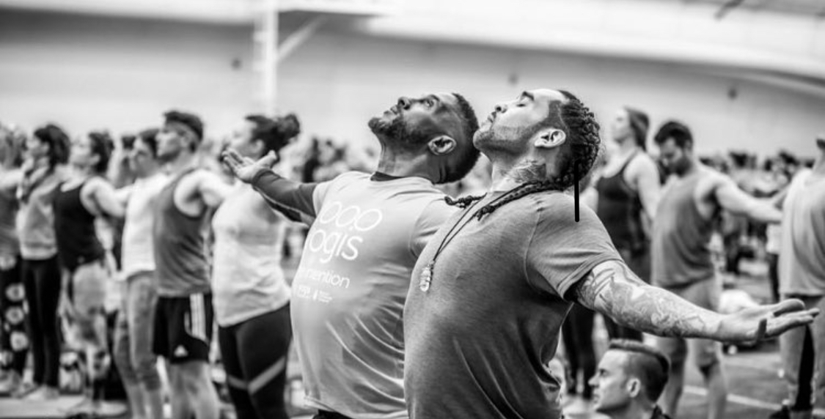
Slide 2
Mike Massey is a yoga teacher. He likes to convince people who have not tried yoga before to try it.

Slide 4
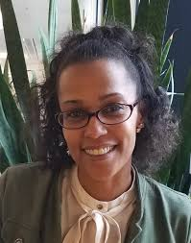
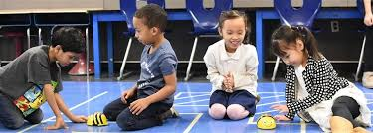
Slide 3
TeeAra Dias is a friend of Mike’s.
TeeAra is the Director of Universal Pre-K in Boston. She works with the Mayor to make sure that all 3- and 4-year olds have access to an excellent start in school.

Slide 5
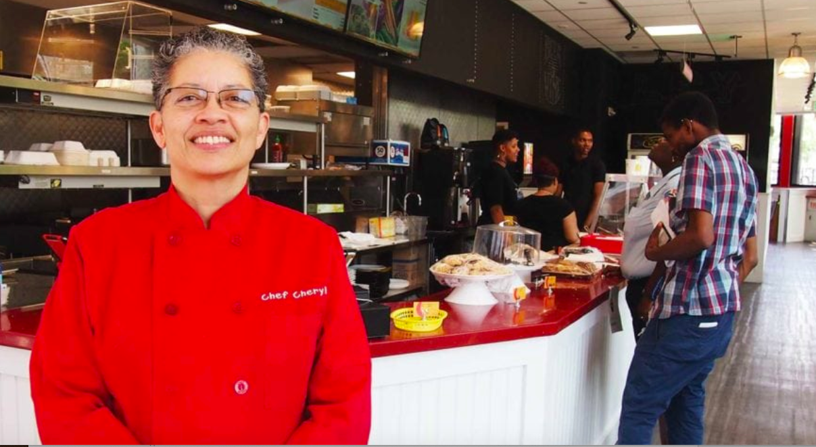
Slide 4
TeeAra likes to eat lunch at Soleil Restaurant, right downstairs from her office. Cheryl Straughter is the owner and chef at Soleil.

Slide 6
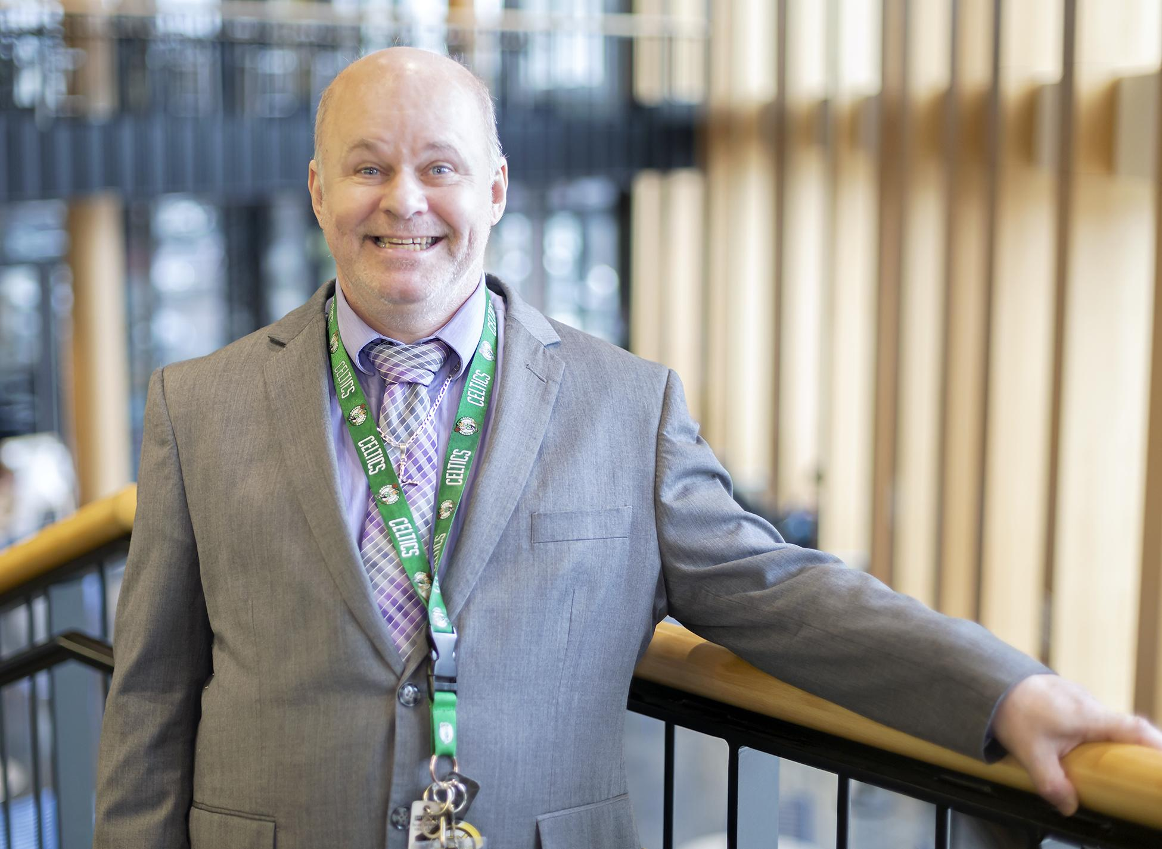
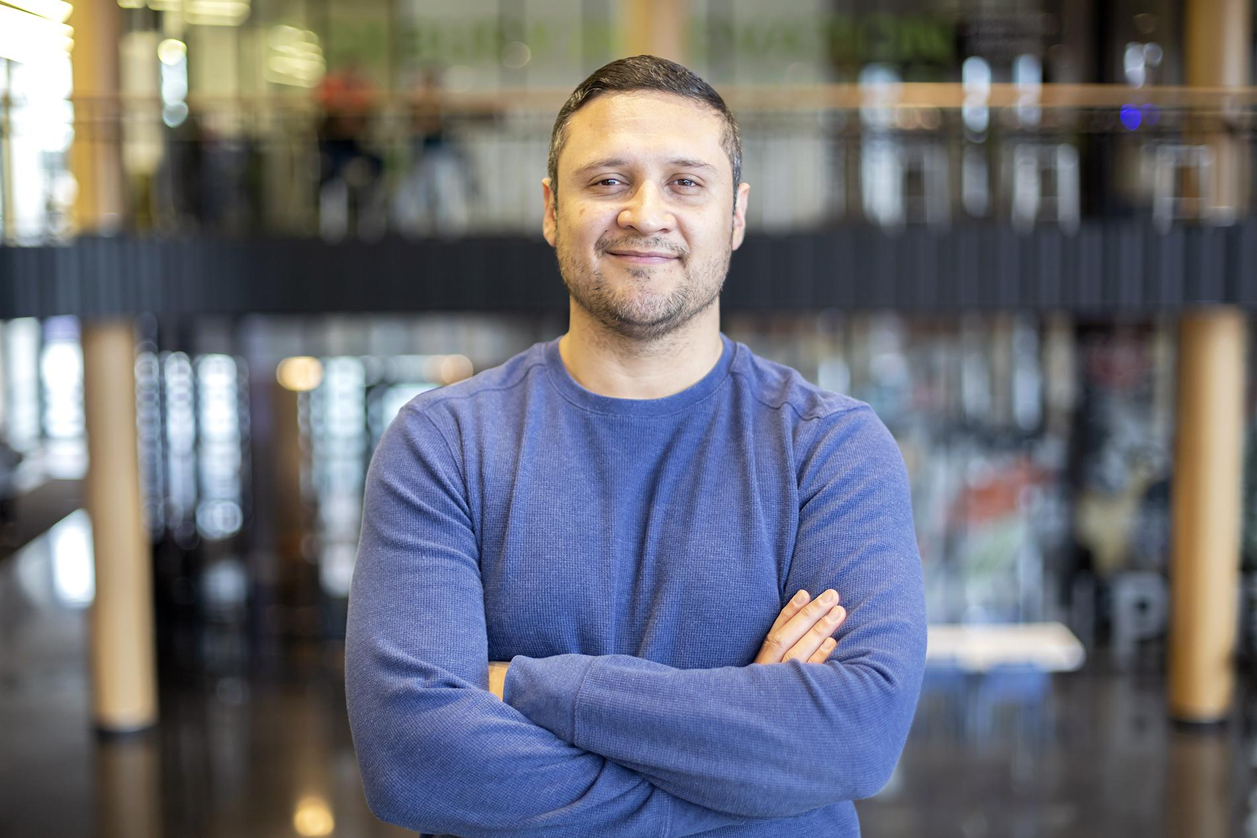
Slide 5
Mike McAdams and Cesar Depaz also work for the School District in the building with TeeAra and Soleil Restaurant. They make sure everyone gets their mail. They print notices and other documents!
Mike loves all the Boston sports teams.
Cesar plays the piano—sometimes at a public piano where anyone passing by can listen!

Slide 7
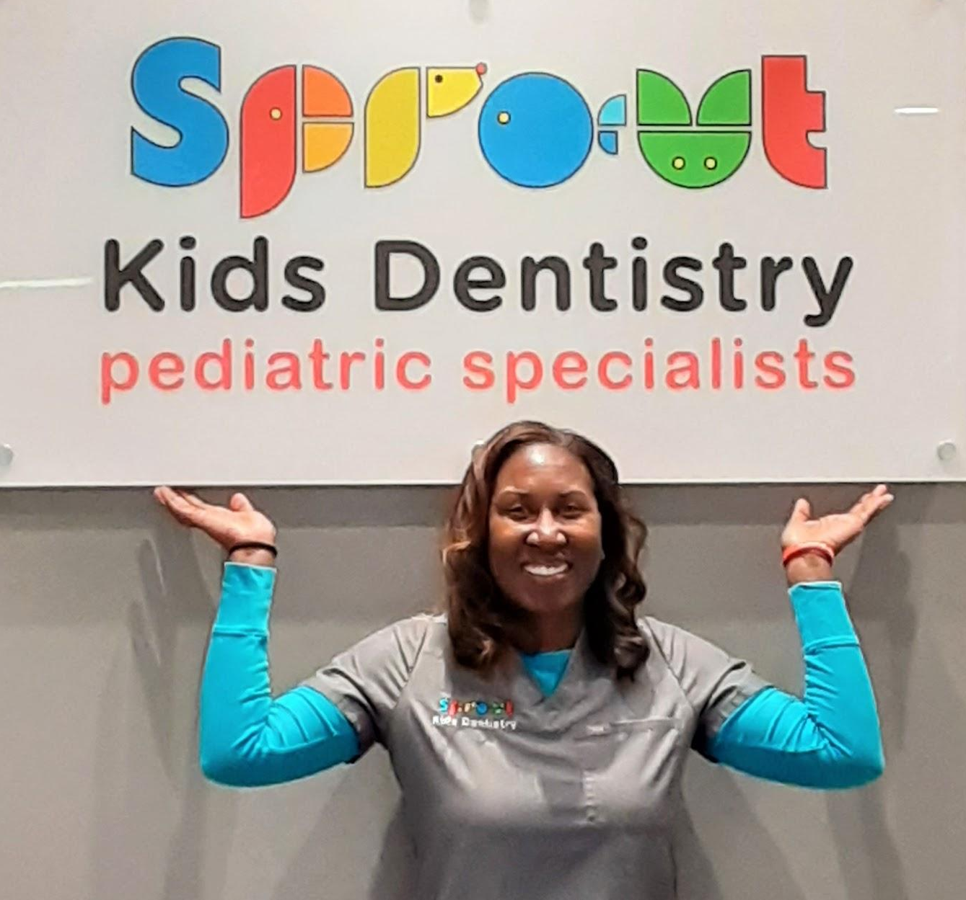
Slide 6
Children need to go to school. They also need health care.
Keilah Acevedo and April Pumphret are school nurses.
Dr. Anderson is a dentist who works outside the schools.

Slide 8
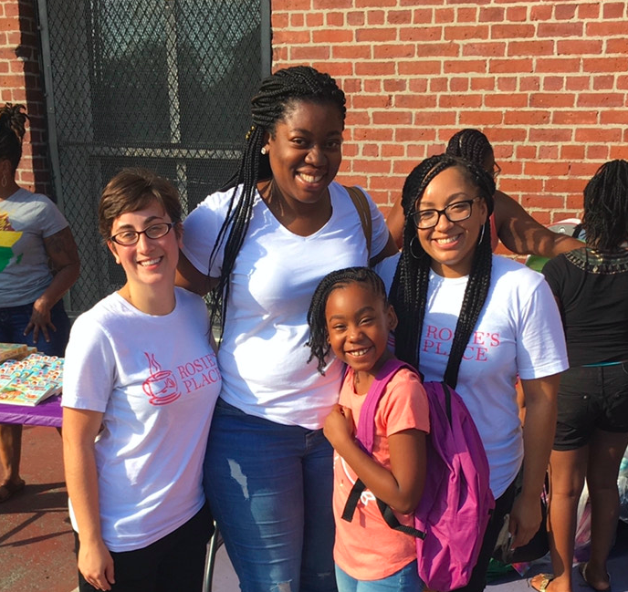
Slide 7
Tenisha Daluz works at Rosie’s Place. Rosie’s Place provides basic needs for any woman in her town—food, a place to stay, paying bills, and getting advice about housing. Tenisha makes sure that children’s families have what they need to be healthy.
Tenisha

Slide 9
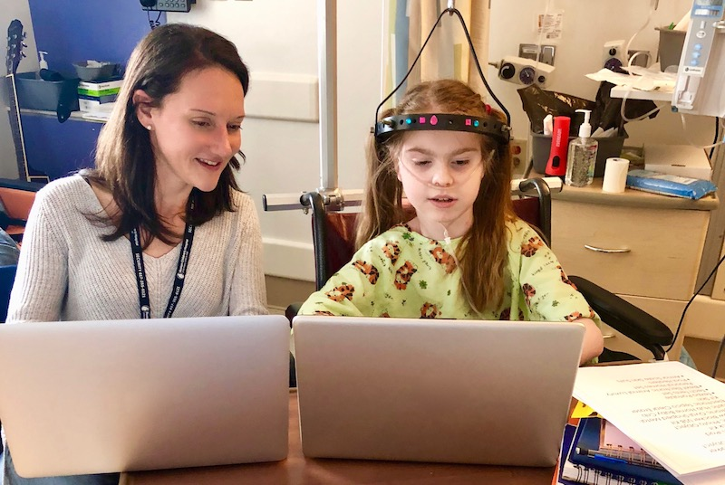
Slide 8
With Ginny’s help, Lexi Abbott wrote “Catalogue of Inventions.” This book includes all of her ideas for inventions that could make the world better for patients, families, and others.
Ginny Lewis is a writer. She volunteers her time to help children at Boston Children’s Hospital write and publish their ideas.

Slide 10
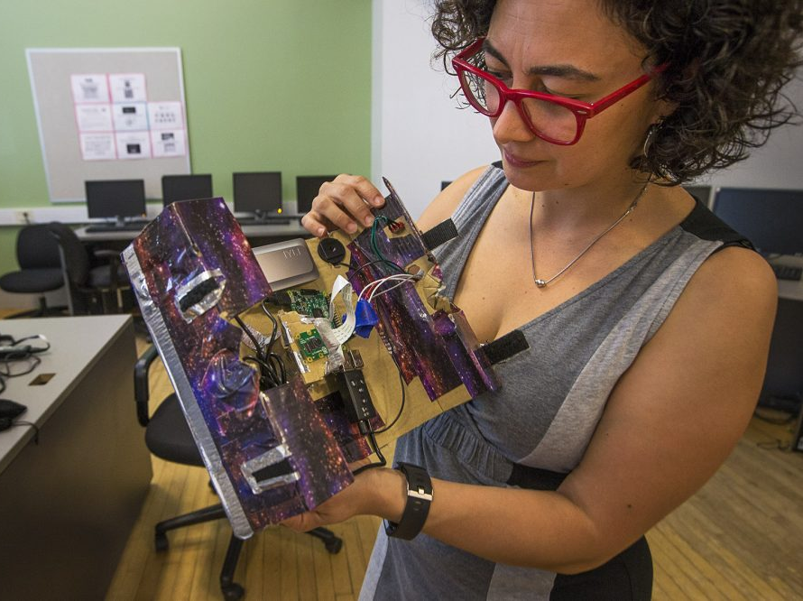
Slide 9
Lina Maria Giraldo is an artist. She helped people make working video cameras out of recycled materials.

Slide 11
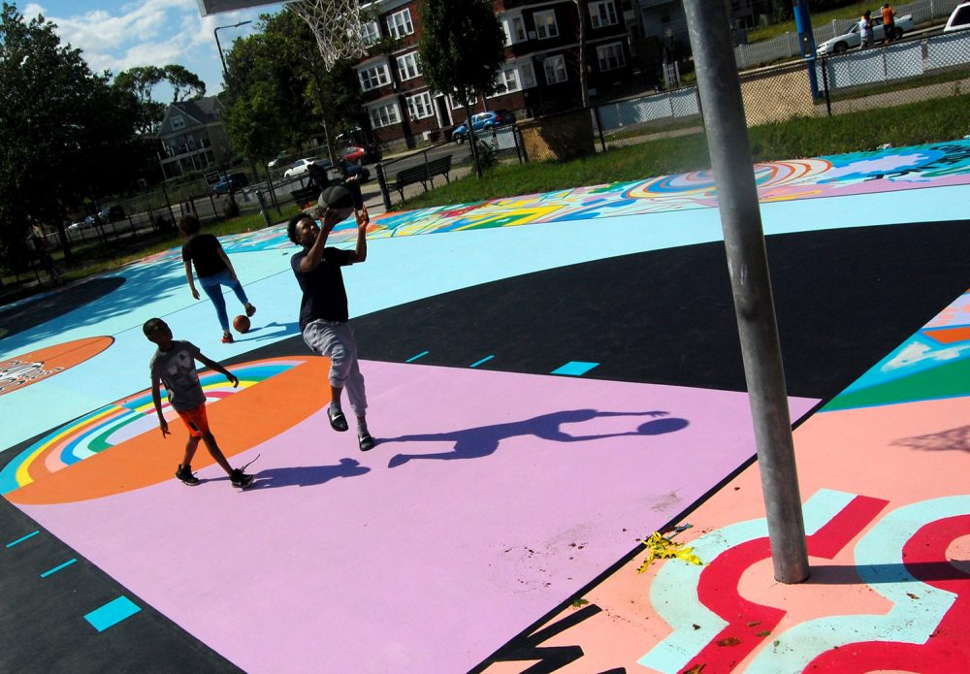
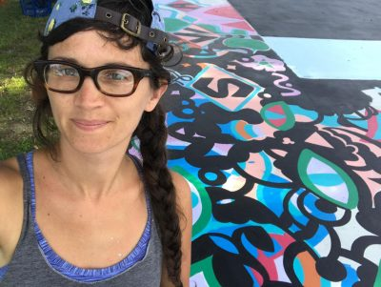
Slide 10
Maria Molteni is another artist. She and her friends painted the “Hands in the Paint” basketball court their town.

Slide 12
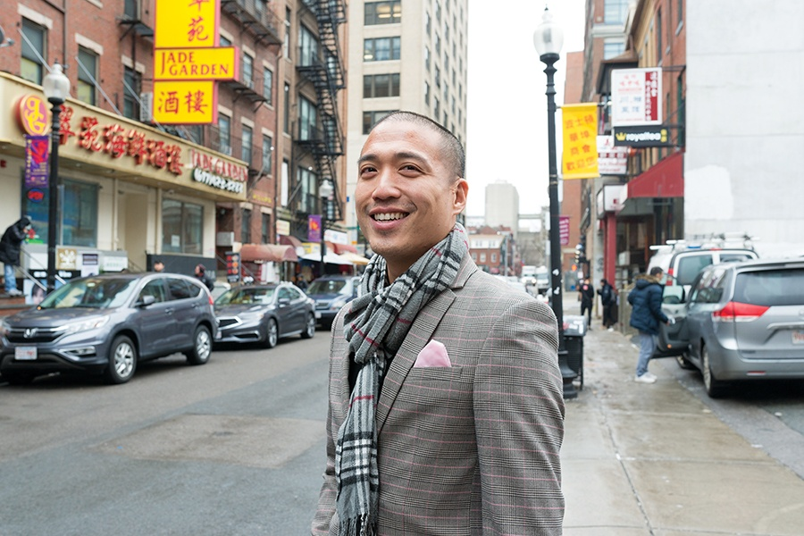
Slide 11
Giles Li is the director of the Chinatown Neighborhood Center. Giles opened the Pao Arts Center where people of all ages can gather to make and enjoy music, storytelling, and visual arts.

Slide 13
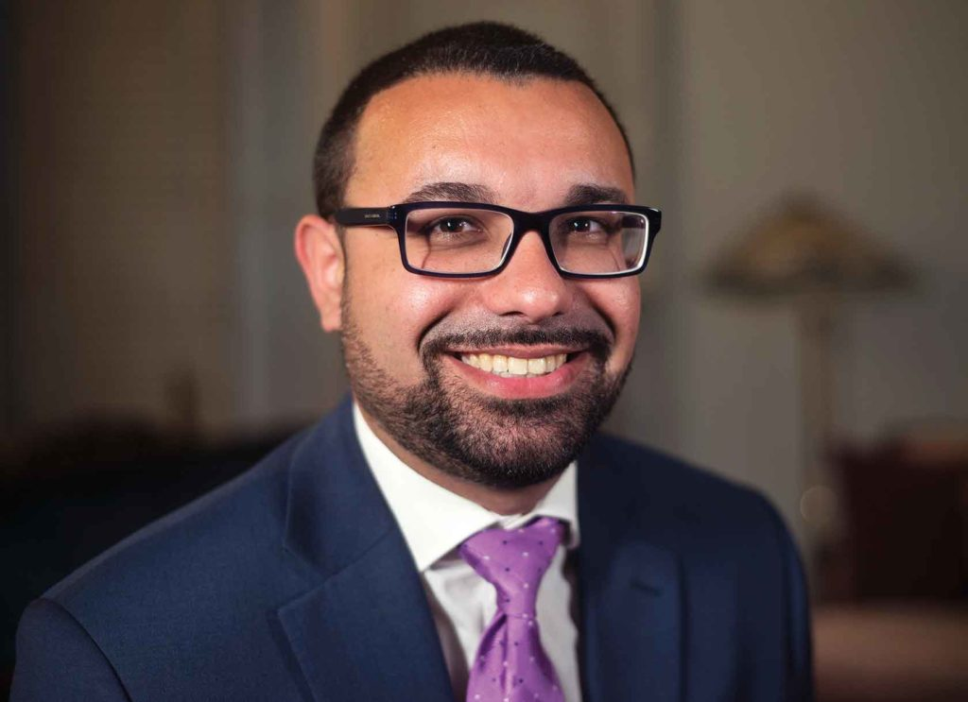
Slide 12
Ricardo Arroyo is a City Councilor. His job is to help make sure that our communities are healthy. He believes this can happen when everyone’s voice is part of making decisions for our city.
Ricardo’s father was also a City Councilor, and his mother was a teacher.

Slide 14
Slide 13
These are just a few of the people all around their town who offer services to people in their communities.

Slide 15
Citations
Compiled and written by Melissa Tonachel, Focus on First, 2019.
Slide 1: https://collections.leventhalmap.org/search/commonwealth:h989r707c
Slide 2: Mike: https://loveyogafest.com/team-showcase/mike-massey/, http://bostonvoyager.com/interview/meet-mike-massey-33-degree-yoga-roxbury/
Slide 3: https://cap.law.harvard.edu/art-speaker-biographies-spring-2020/, https://www.bostonpublicschools.org/domain/2678
Slide 4: https://www.soleilboston.com/
Slide 5: photo courtesy of Cesar Depaz
Slide 6: Brooke Childs, https://www.sproutkidsdentistry.com/
Slide 7: photo courtesy of Tenisha Daluz)
Slide 8: http://discoveries.childrenshospital.org/young-inventor/
Slide 9: https://www.wbur.org/artery/2017/07/27/boston-artists-in-residence (Jesse Costa, WBUR)
Slide 10: https://www.wbur.org/artery/2017/07/12/maria-molteni
Slide 11: https://www.bostonmagazine.com/news/2019/02/05/chinatown-power-players/
Slide 12: https://www.baystatebanner.com/2018/12/12/hyde-park-attorney-to-take-on-district-5-councilor/

