Slide 1
Dangers to Animals
Text Talk Week 6, Day 1 | Packet 1
Citations:
Slide 2: http://zoo.avantia.net/photos/4927
Slide 3: https://www.trails.com/list_1967_predatory-mammals-new-england.html
Slide 4: image from Turtle Tide, illustrated by Bruce Hiscock
Slide 5: http://www.outwardon.com/article/animals-adapting-changing-climate/
Slide 6: https://i.cbc.ca/1.2505132.1390323250!/fileImage/httpImage/image.jpg_gen/derivatives/16x9_780/hi-climate-change-852-jpg.jpg
Slide 7: https://celebrating200years.noaa.gov/events/conservstewards/image7.html
Slide 8: http://www.biodiversitya-z.org/content/turtle-nesting-site; http://ternandplover.unl.edu/plover/nesteggchick-plover.asp; http://therealcape.com/piping-plover-situation-crazy-defies-logic/; https://verovine.com/news/protect-the-sea-turtles/
Notes:
global, map

Slide 2
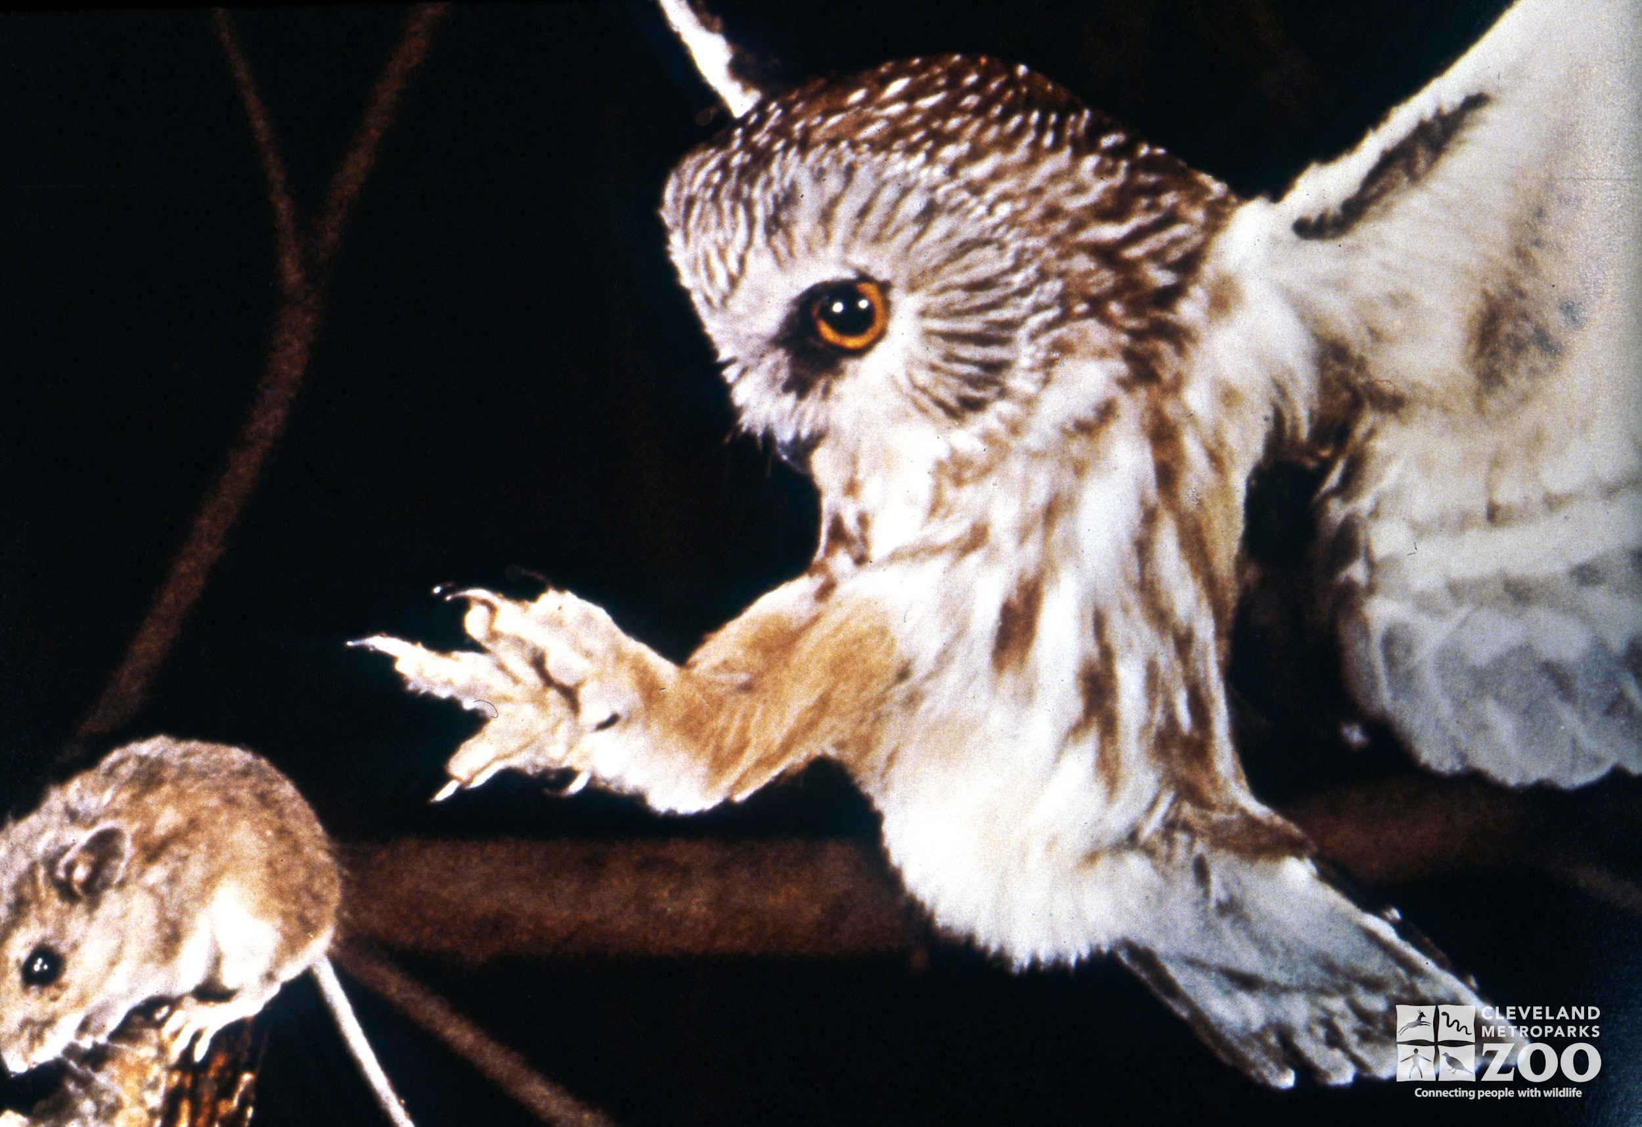
Slide 2
Predators
One danger that animals encounter is predators, animals that hunt other animals.
Owls are predators of insects, smaller birds, and small mammals like mice.
Owls use their sharp talons to capture their prey.

Slide 3
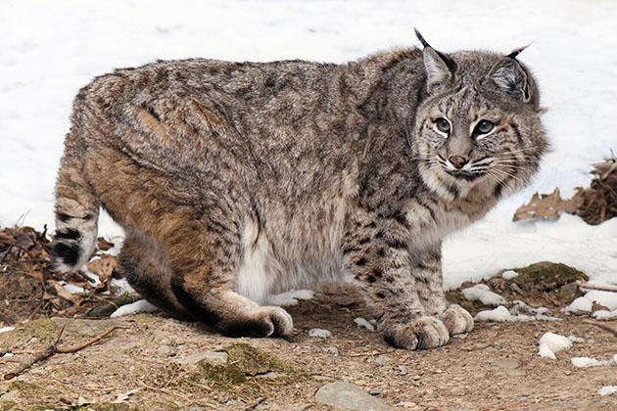
Slide 3
Even though bobcats are predators, they need to keep their offspring safe.
A mother bobcat has several different dens while she raises her kittens. She moves them from place to place to keep them safe from other predators.
Bobcats live deep in forests in Massachusetts and other states. They hunt at night for rabbits, squirrels, birds, and snakes.

Slide 4
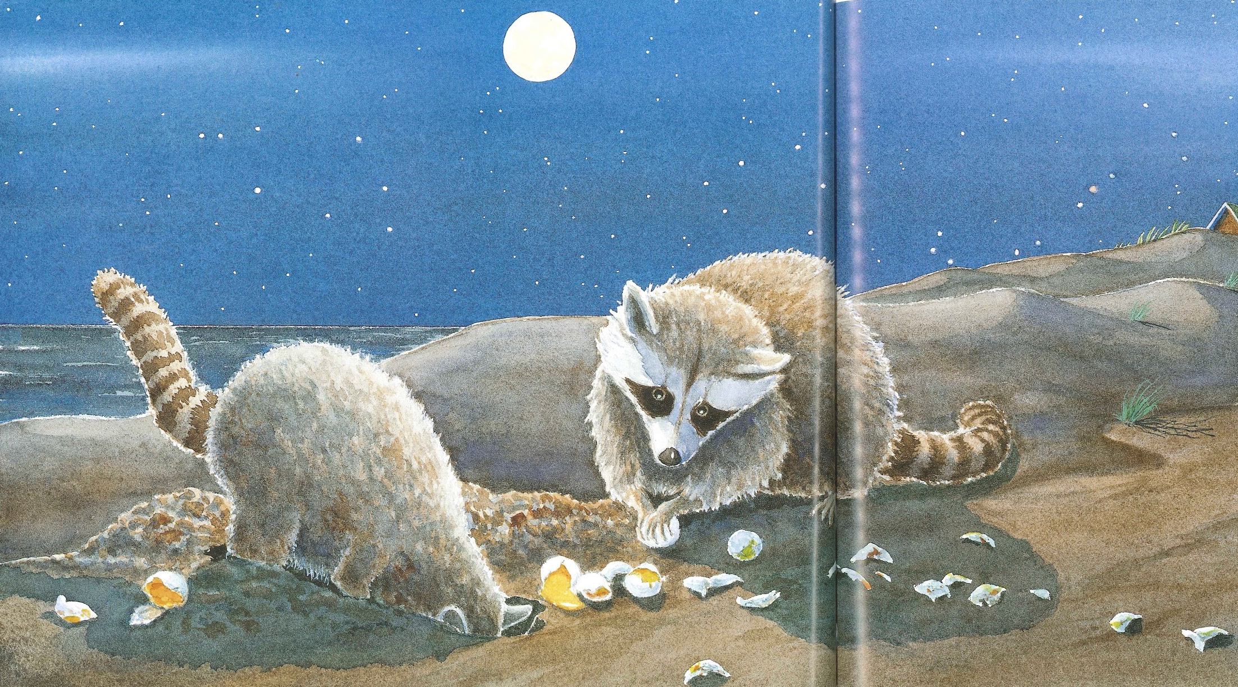
Slide 4
Racoons mostly hunt for small animals such as frogs, fish, crayfish, insects, rodents, and bird eggs.
Racoons are predators of sea turtles. They dig up sea turtle eggs and eat them.

Slide 5
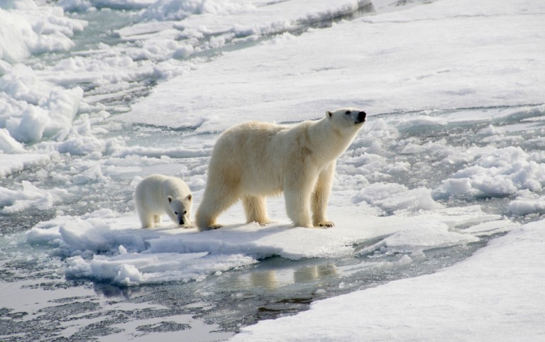
Slide 5
Polar bears use the ice as a platform for hunting.
Everything a polar bear eats, like seals, eats another animal or plant that also depends on the icy habitat.
Habitat Loss
Another danger animals encounter is habitat loss, when the places they depend on become smaller.
Our Earth is getting warmer. Warmer temperatures cause ice to melt. As ice melts, the polar bear habitat shrinks. The ice-covered water of the Arctic is the only place polar bears live.

Slide 6
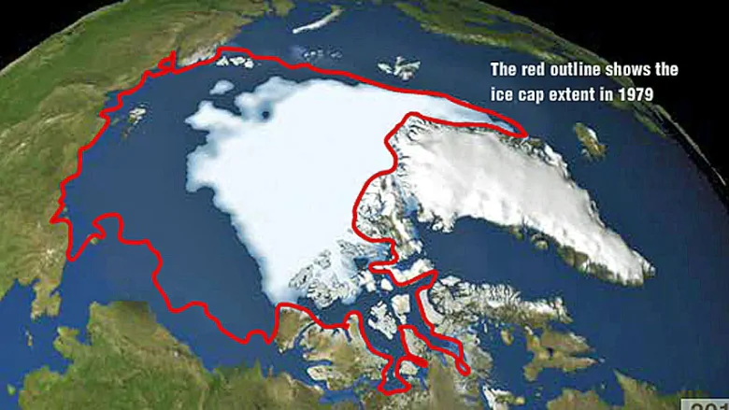
Slide 6
This map shows how the Arctic ice cap, the habitat for polar bears, has changed as the Earth’s temperatures have warmed.

Slide 7
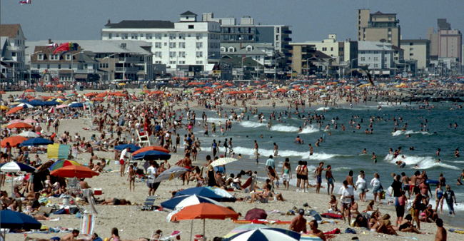
Slide 7
Many people like to live and play on beaches. What happens to animals that depend on the beach and nearby water for their habitat?

Slide 8
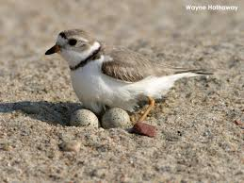
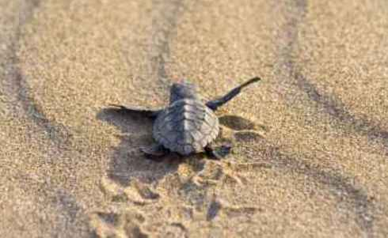
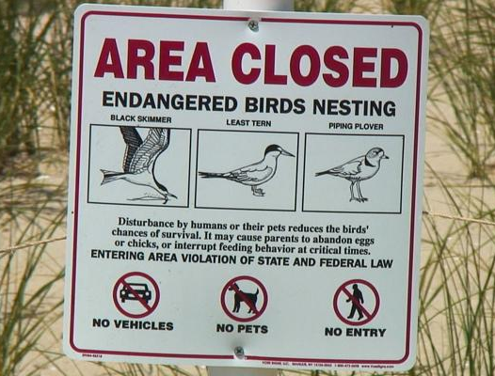
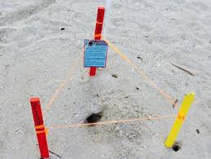
Slide 8
Birds and sea turtles use the sandy beach for making nests.
People walking on a beach can be a danger to these animals.

