Slide 1
Look and Listen!
Project Introduction
Text Talk Week 6, Day 1
Notes:
global, map

Slide 2
Slide 2

Slide 3
Slide 3

Slide 4
Slide 4

Slide 5
Slide 5

Slide 6
Slide 6
Max Found Two Sticks

Slide 7
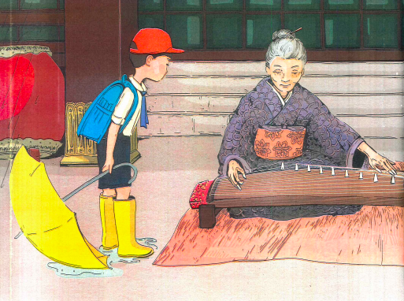
Slide 7
The Sound of Silence

Slide 8
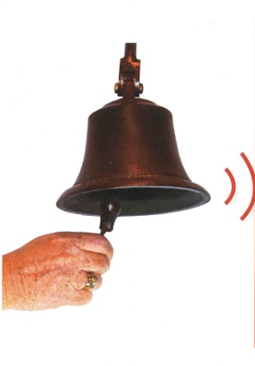
Slide 8
Sounds All Around, FOSS Sound and Light, “Listen to This”

Slide 9
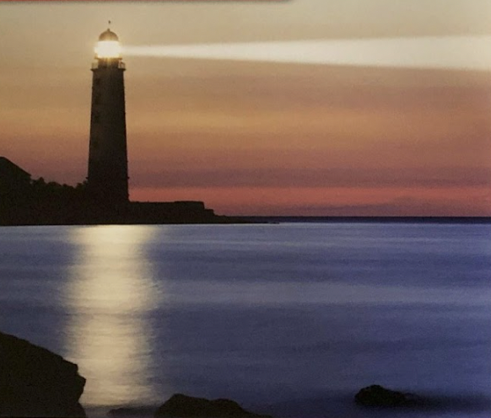
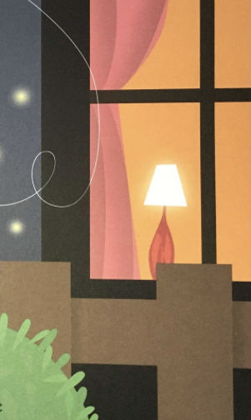
Slide 9
Sending Messages with Light and Sound,
Keep the Lights Burning, Abbie, Oscar and the Moth

Slide 10
Slide 10
All About Light

Slide 11
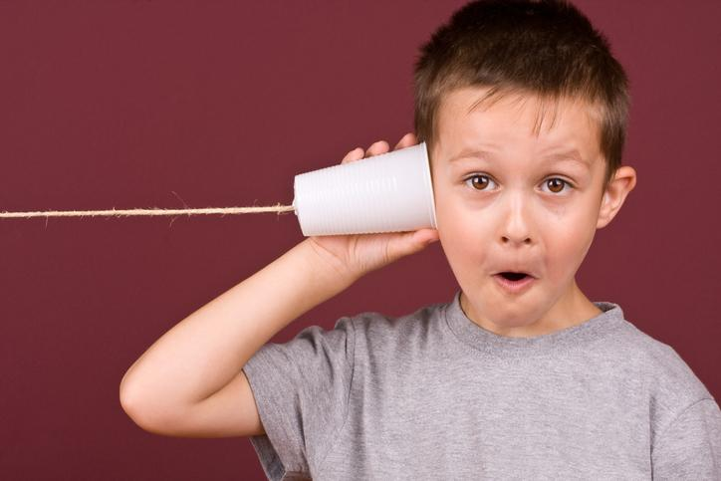
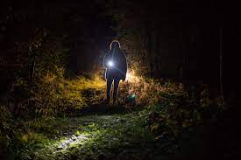
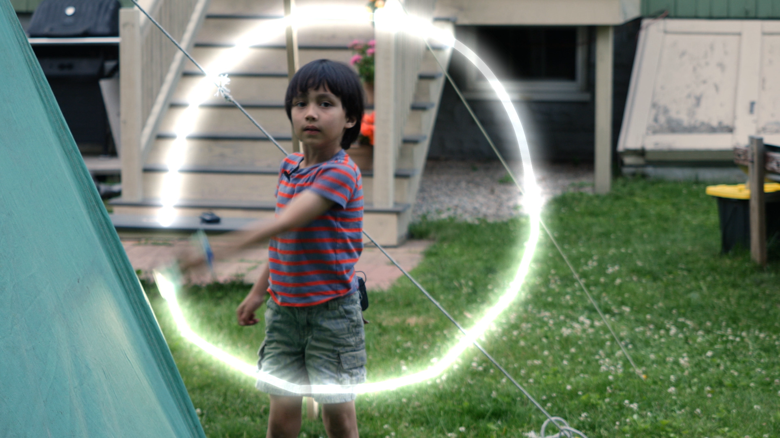
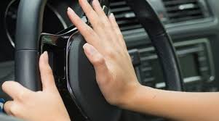
Slide 11

Slide 12
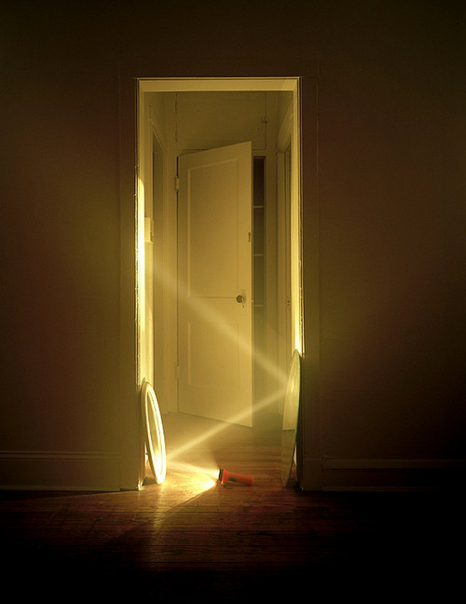
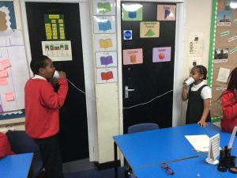
Slide 12
How could you send a message around a corner?

Slide 13
Slide 13
How could you send a message a long distance without making any sound?
How could you send a message using sound that you want only one person to receive?
How could you send a message to a group of people?
How could you send a message from inside to outside, or from outside to inside?
What tools can we create for sending a message using light or sound?

Slide 14
Citations
Slide 6: Max Found Two Sticks,
Slide 7: The Sound of Silence, Julia Kuo and Katrina Goldsaito
Slide 8: Sounds All Around, Wendy Pfeffer
FOSS Sound and Light, “Listen to This”
Slide 9: Sending Messages with Light and Sound, Jennifer Boothroyd, Keep the Lights Burning, Abbie, Peter and Connie Roop, Oscar and the Moth: a Book about Light and Dark, Geoff Waring
Slide 10: All About Light, Lisa Trumbauer
Slide 11: https://letstalkscience.ca/educational-resources/lessons/sound-travels, https://www.emphas.is/car-horn-etiquette/, https://www.thoughtco.com/invention-of-the-flashlight-1991794, https://mass.pbslearningmedia.org/resource/buac18-k2-sci-ps-communicatelight/communicating-with-light/
Slide 12: https://www.brocklawsonphoto.com/blog/2013/2/3/a-flashlight-and-a-mirror, https://windsorprimaryblogs.com/year42018/2018/11/15/sound-making-string-telephones/

