Slide 1
Dangers to Animals
Text Talk Week 6, Day 1
Notes:
Today we will read Dangers to Animals, by Melissa Tonachel and Fay Ferency. These slides provide information about dangers animals encounter, or deal with nearby and around the world.
As we read today, we will use text features and key details from words and illustrations to describe two dangers animals face like predators and habitat loss. We will analyze the way that illustrations, captions, text boxes and maps support and clarify what we are learning in the main text.

Slide 2
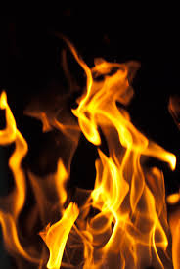
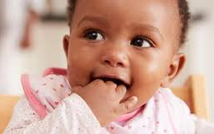
Slide 1
DANGER!
A danger is something that might cause hurt or harm. Fire is an example of a danger. Small objects can be dangerous for babies if they put them in their mouths.
What dangers do animals encounter? Let’s find out!

Slide 3
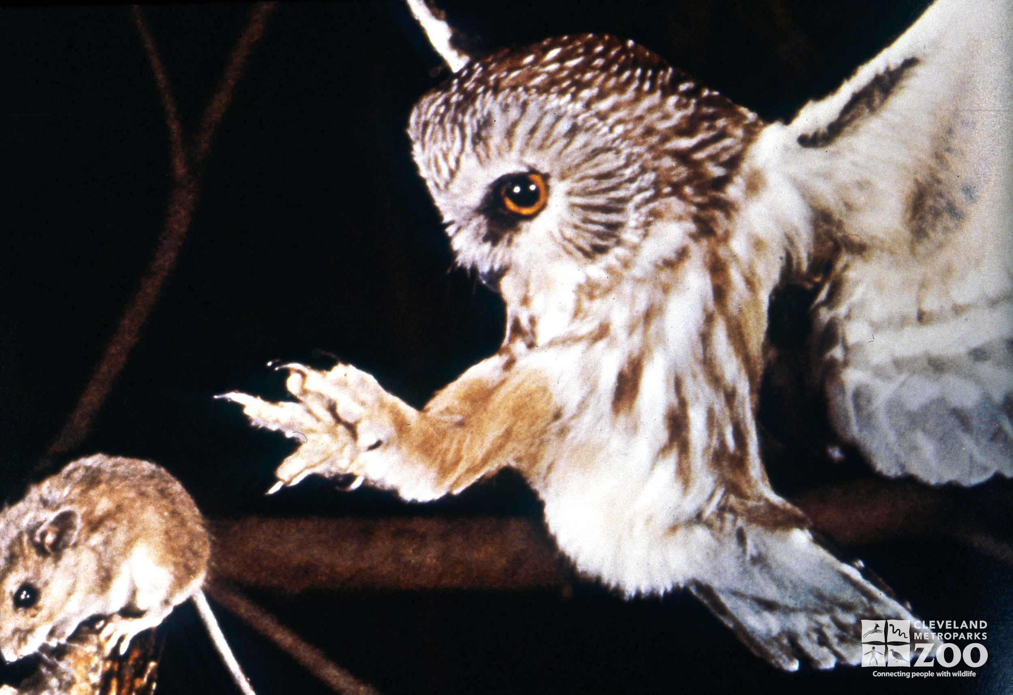
Slide 2
Predators
One danger that animals encounter is predators, animals that hunt other animals.
Owls are predators of insects, smaller birds, and small mammals like mice.
Owls use their sharp talons to capture their prey.
Notes:
Photographs and captions can add specific details to new concepts.

Slide 4
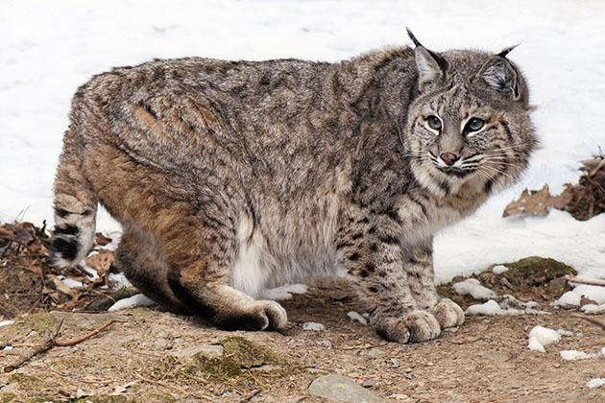
Slide 3
Even though bobcats are predators, they need to keep their offspring safe.
A mother bobcat has several different dens while she raises her kittens. She moves them from place to place to keep them safe from other predators.
Bobcats live deep in forests in many states. They hunt at night for rabbits, squirrels, birds, and snakes.

Slide 5
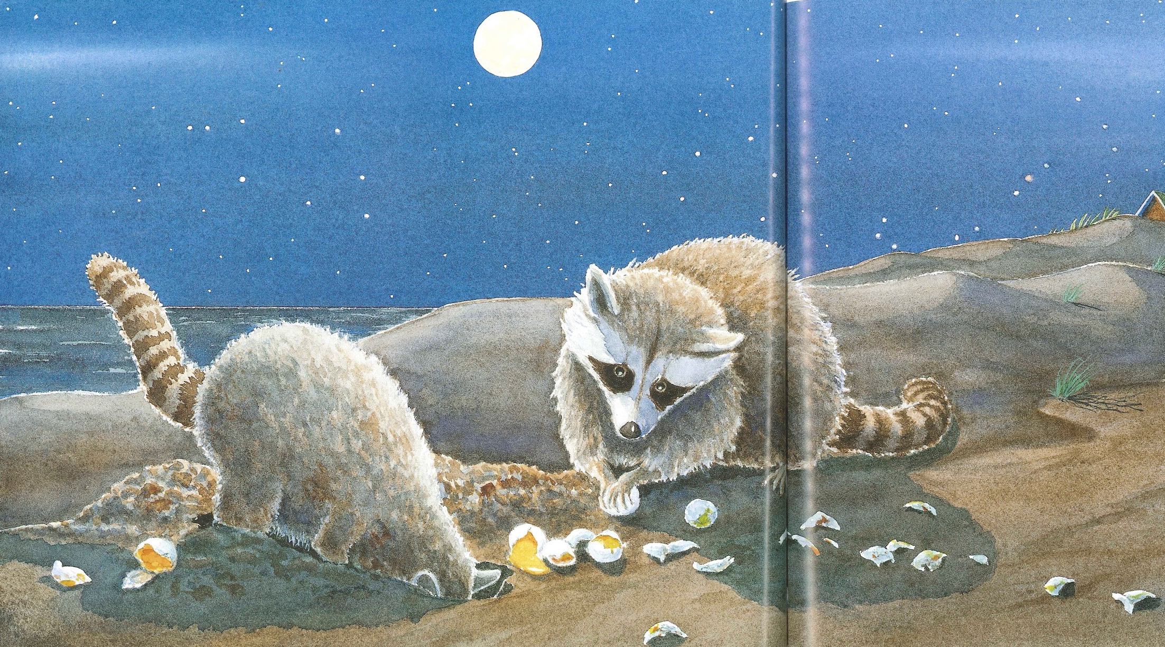
Slide 4
Racoons mostly hunt for small animals such as frogs, fish, crayfish, insects, rodents, and bird eggs.
Racoons are predators of sea turtles. They dig up sea turtle eggs and eat them.
Notes:
Why do you think the author has chosen to tell us about predators in a variety of ways like words, photographs, captions and text boxes?

Slide 6
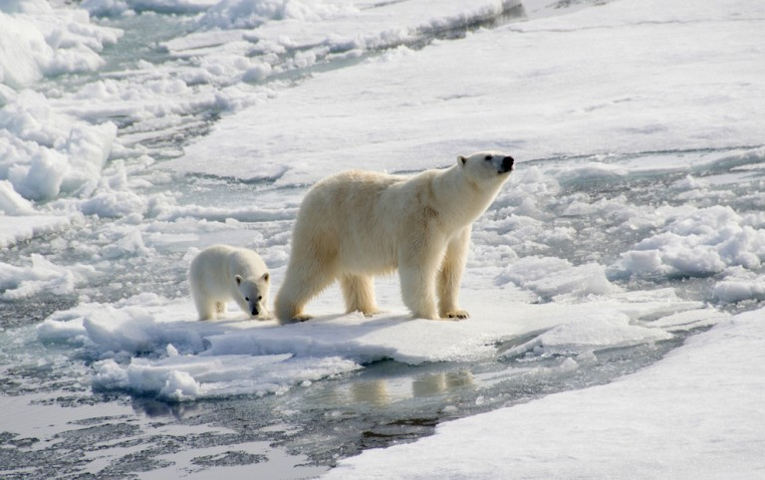
Slide 5
Polar bears use the ice as a platform for hunting.
Everything a polar bear eats, like seals, eats another animal or plant that also depends on the icy habitat.
Habitat Loss
Another danger animals encounter is habitat loss, when the places they depend on become smaller.
Our Earth is getting warmer. Warmer temperatures cause ice to melt. As ice melts, the polar bear habitat shrinks. The ice-covered water of the Arctic is the only place polar bears live.
Notes:
What is happening to the habitat of polar bears?
Let’s take a look at the text box…How is the way polar bears hunt dependent on their habitats?

Slide 7
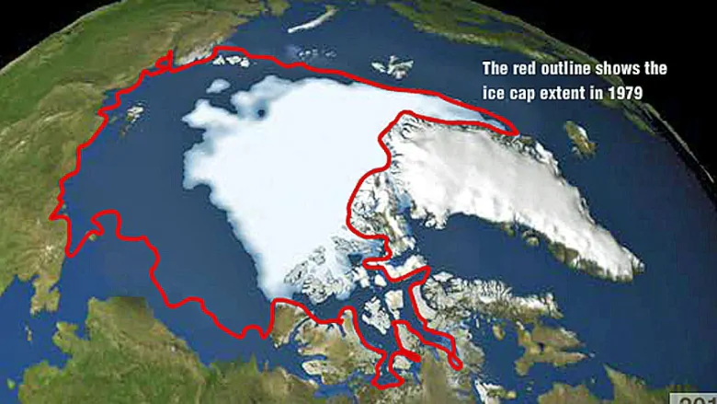
Slide 6
This map shows how the Arctic ice cap, the habitat for polar bears, has changed as the Earth’s temperatures have warmed.
Notes:
This map shows the north pole of the earth. The North Pole in the Arctic is where polar bears and many other animals live.
This red line shows where the habitat of polar bears used to be. The white shows where their habitat, the Arctic ice cap is now. What do you notice?
What questions do you have?

Slide 8
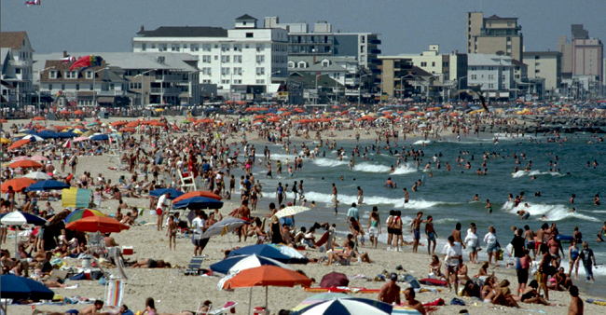
Slide 7
Many people like to live and play on beaches. What happens to animals that depend on the beach and nearby water for their habitat?

Slide 9
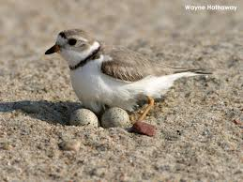
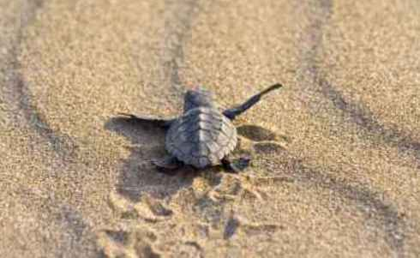
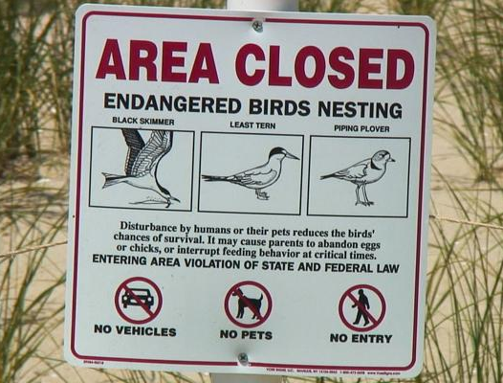
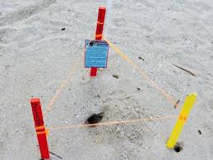
Slide 8
Birds and sea turtles use the sandy beach for making nests.
People walking on a beach can be a danger to these animals.
Notes:
How can people walking on the beach be a danger to birds and sea turtles? Revert back to slide 7

Slide 10
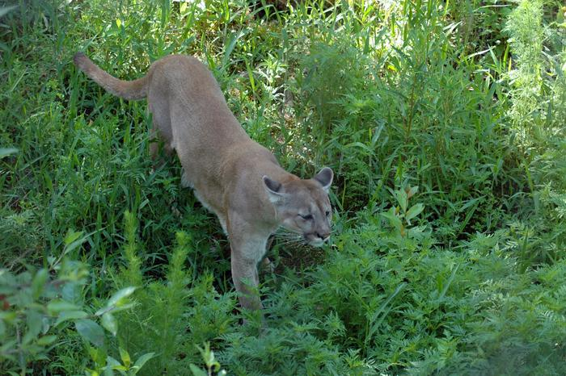
Slide 9
The Florida panther lives in wetlands, swamps, and forests.
Florida panthers are endangered by the loss of their habitat, as people have built homes and roads. There are not very many Florida panthers left. They live in a small, protected area of Florida.
Notes:
How does the photograph of the panther help you imagine the panther and its habitats?

Slide 11
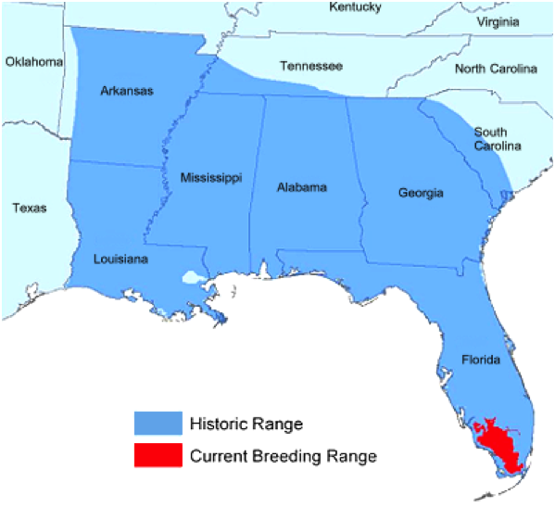
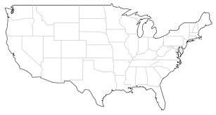
Slide 10
This map shows the area where Florida panthers used to live, and where they live now.
Florida is part of the United States.
Notes:
What do you notice about the map of where panthers used to live and where they live now?
What’s the purpose of the second map?
What do you think about the loss of habitat for the Florida panther?

Slide 12
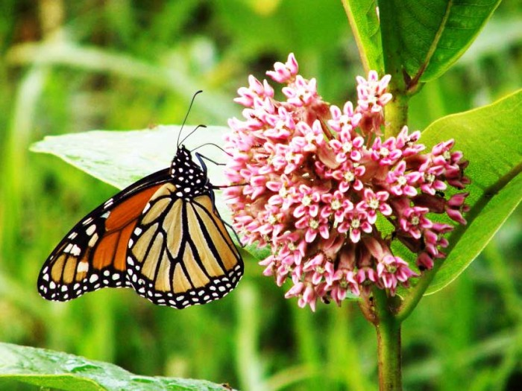
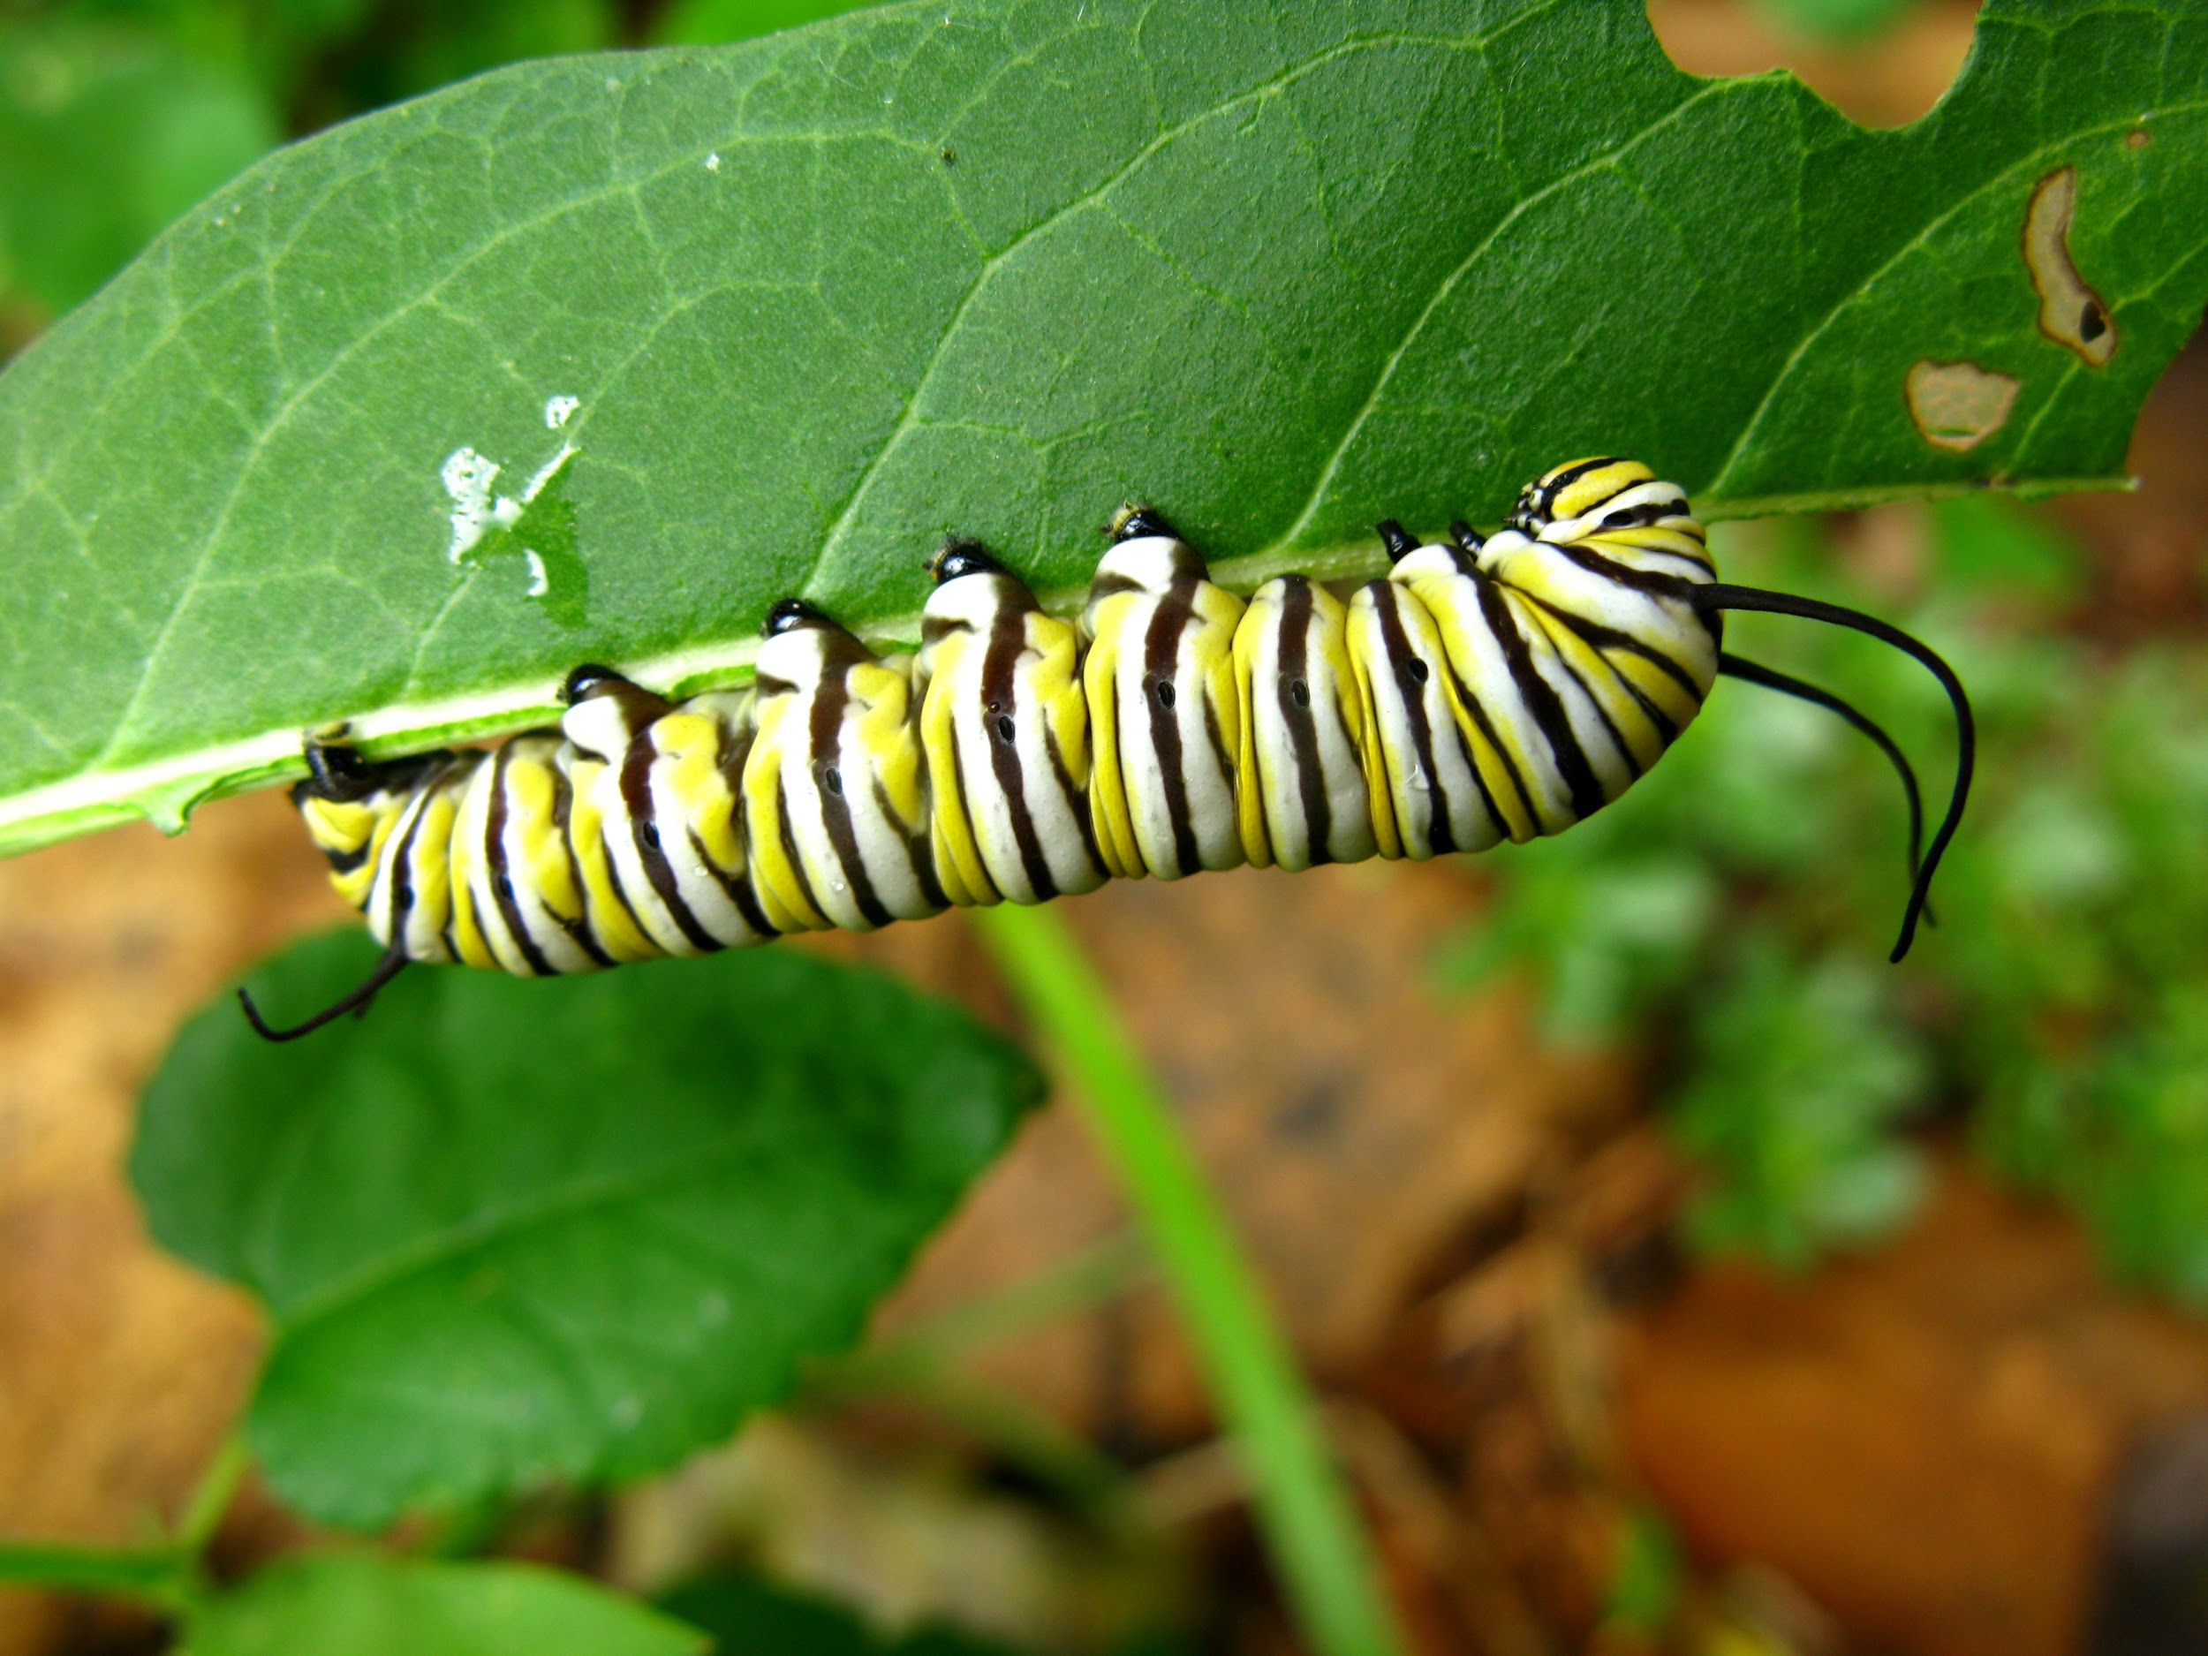
Slide 11
Monarchs lay their eggs on the plant’s leaves so that the caterpillars have food to eat when they hatch.
Monarch butterflies depend on finding milkweed in their habitat. Where there is not enough milkweed, the monarchs are in danger.
Notes:
What new information about monarchs do we learn in the text box?
How is this parent taking care of their offspring?

Slide 13
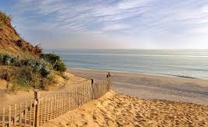
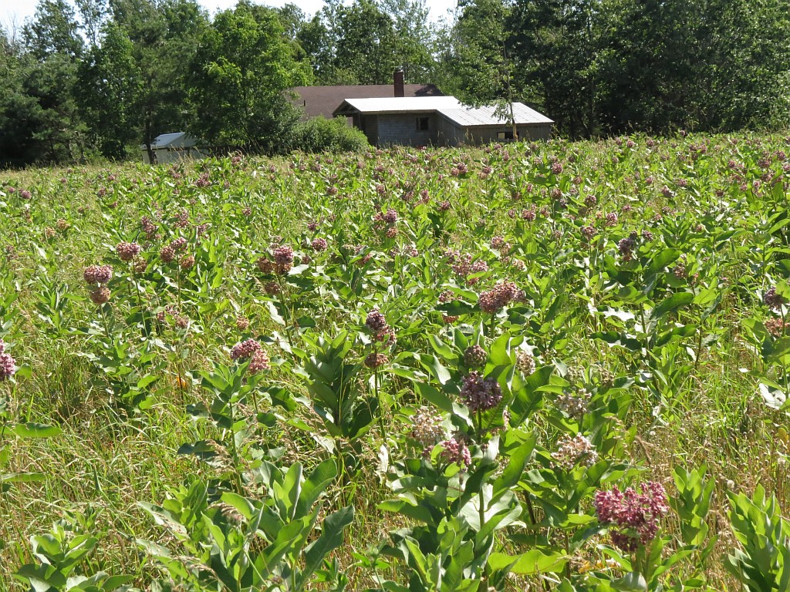
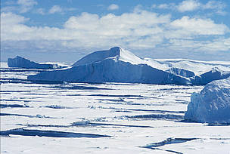
Slide 12
Loss of habitat is the greatest danger to animals in the United States.

Slide 14
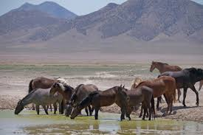
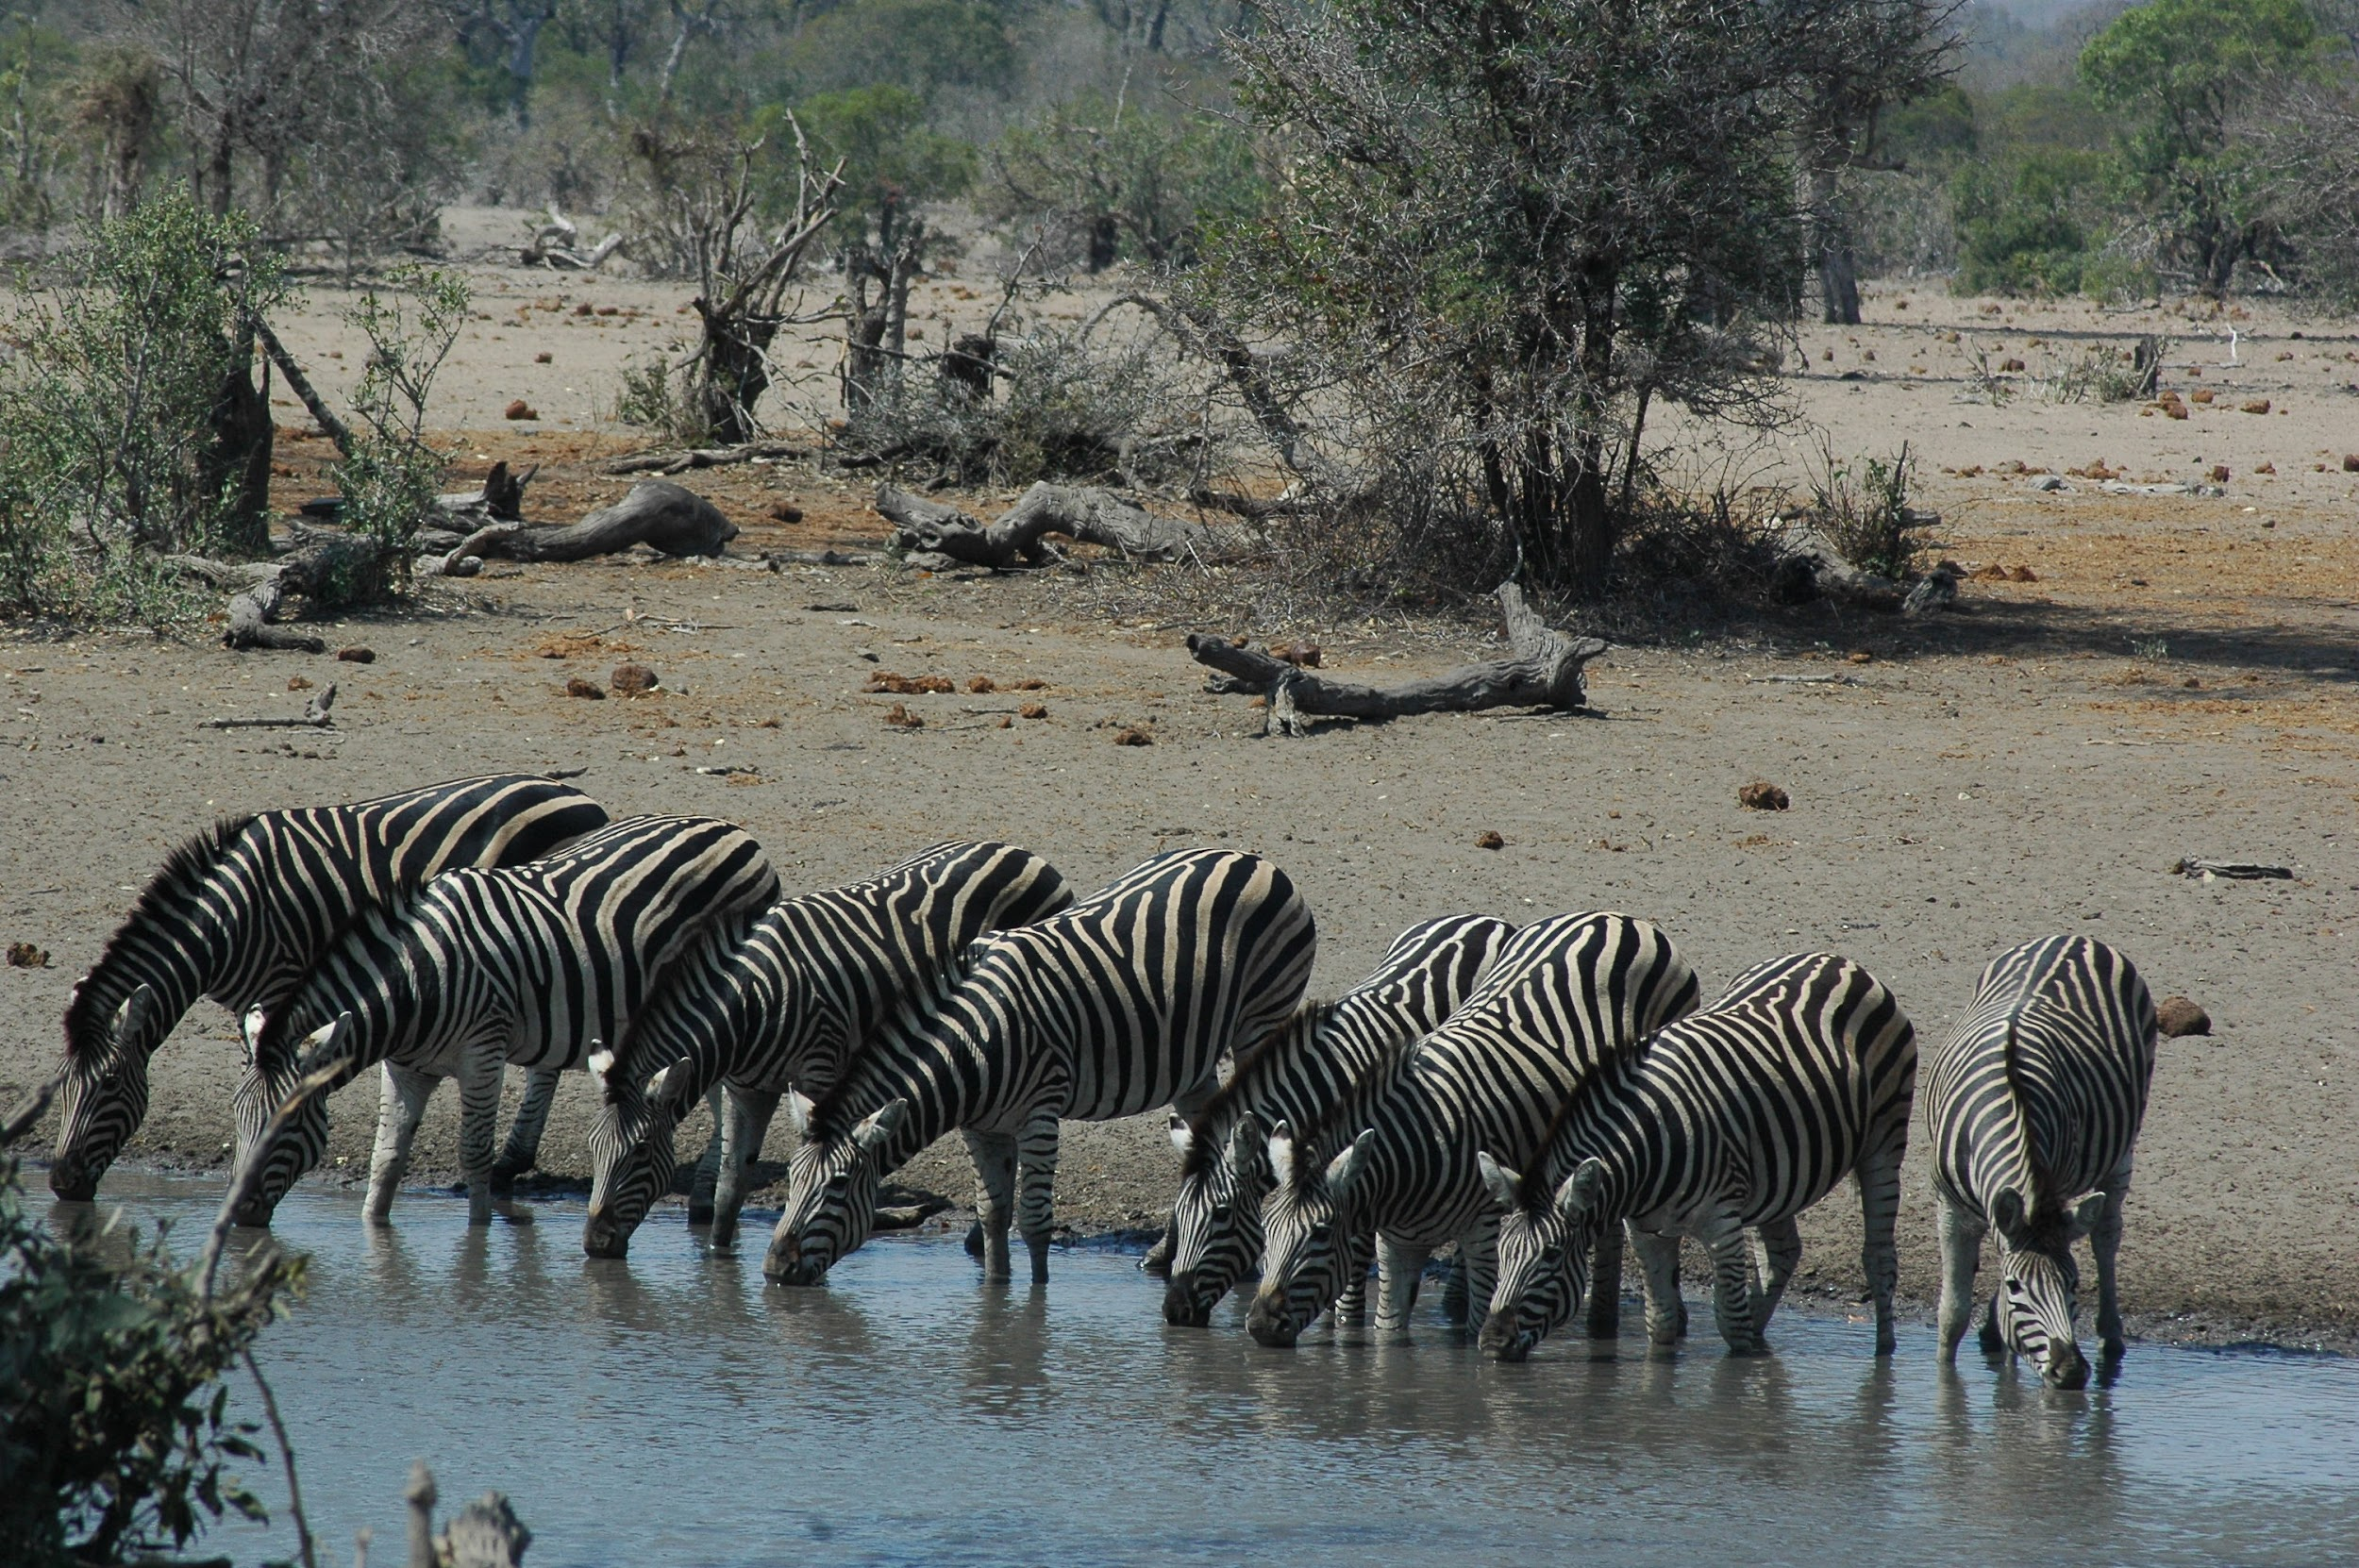
Slide 13
Drought
Wild horses in Colorado in the United States and zebras in South Africa drink from water holes and rivers.
Sometimes animals encounter drought—a shortage of water. When there is not enough rain to fill rivers, lakes, and ponds, animals are thirsty. They may need to travel long distances to find the water they need to survive.
Notes:
Thumbs up if you have heard of drought. According to the text, what is it?

Slide 15
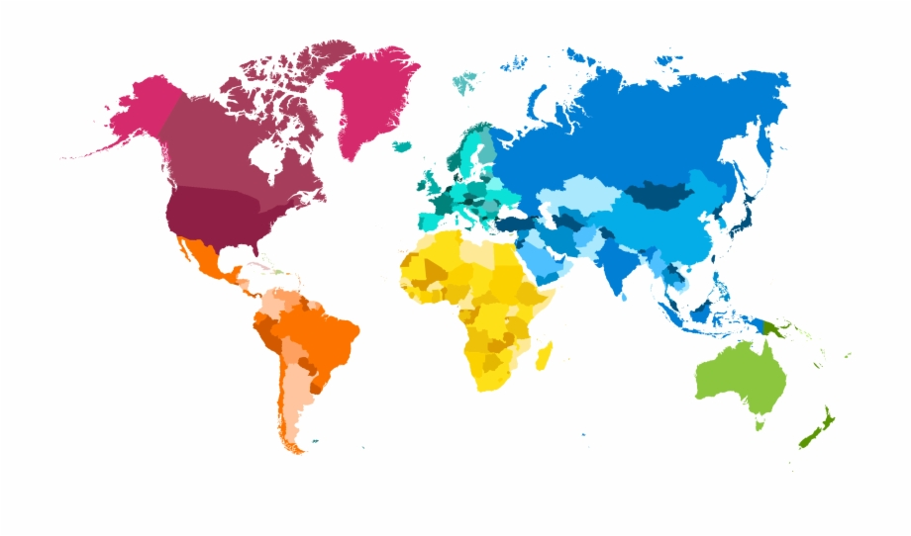
Slide 14
Wild horses in Colorado in the United States
Zebras in
South Africa
Animals all over the world experience drought.
Notes:
This slide has a map with photos and labels.
What is this map showing us?
What information do we learn about drought?

Slide 16
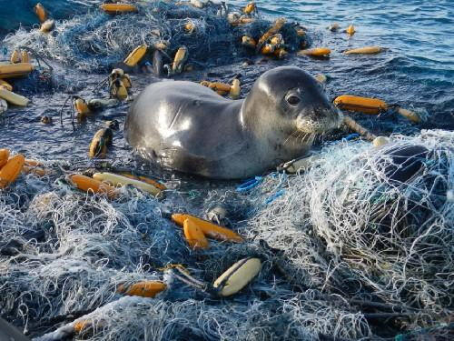
Slide 15
Trash
Another serious danger that animals encounter is trash, especially in the ocean. Seals, whales, sea birds, and sea turtles can get tangled up in trash.
Notes:
Sea turtles are endangered. What do you think happens when a sea turtle eats a plastic bag?

Slide 17
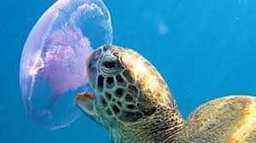
Slide 16
Sea turtles live in oceans around the world, including in the Atlantic Ocean, near Boston.
Sea turtles can live to be 80 years old or more.
But sea turtles are endangered.
Sea turtles eat jellyfish. But a plastic bag can look like a jellyfish. What happens when a sea turtle eats a plastic bag?

Slide 18
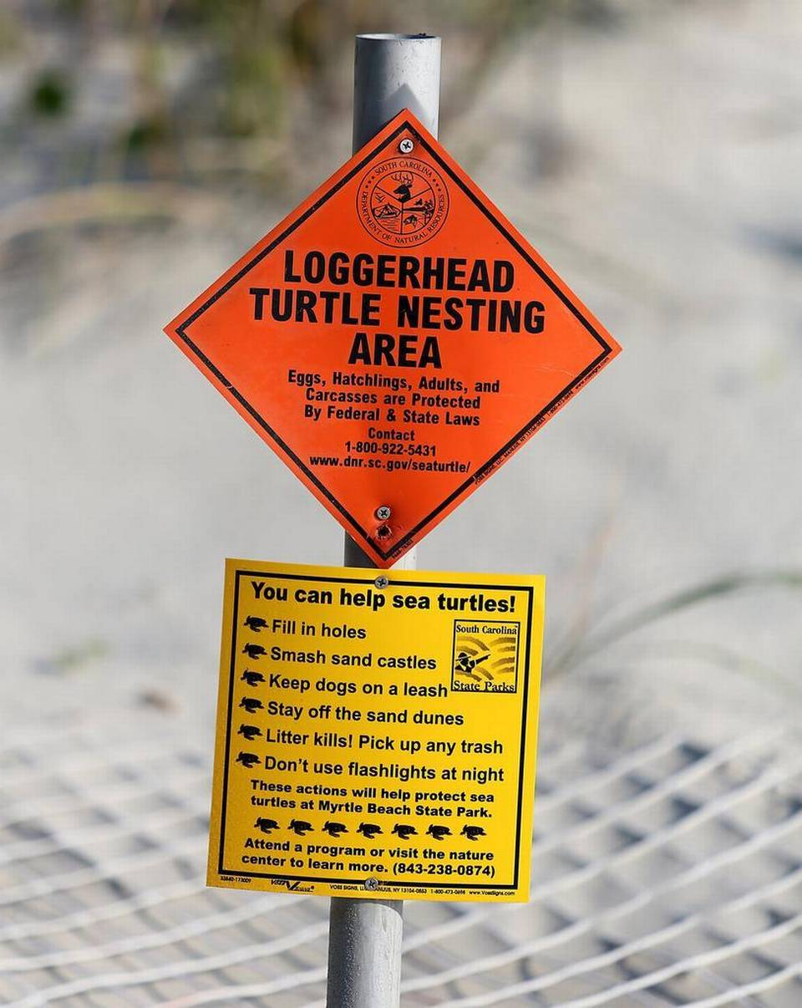
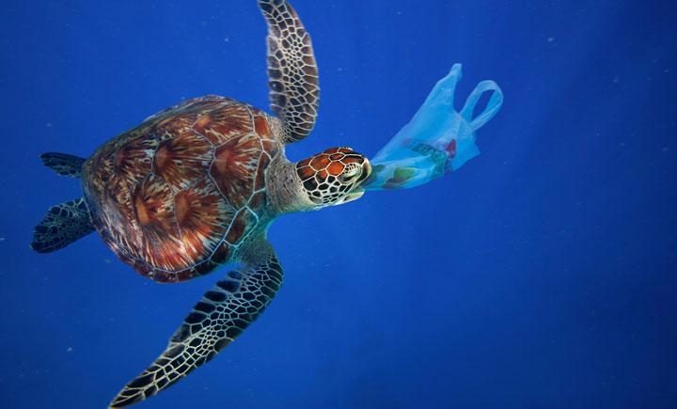
Slide 17
Researchers put up signs to inform people about turtle nesting areas and about what they can do to help protect sea turtles.
Sea turtles are at risk when they encounter plastic in the ocean.
Animals face natural dangers, like predators and drought.
Animals also face dangers that are not natural. People can take action to lessen dangers to animals.
Notes:
What actions can people take to lessen dangers to animals?

Slide 19
Citations
Written and compiled by Melissa Tonachel and Fay Ferency, Focus on First, 2019.
Slide 1: http://discovermagazine.com/2013/jan-feb/49-humans-had-mastered-fire-by-1000000-bc, https://www.naeyc.org/our-work/families/understanding-and-responding-children-who-bite
Slide 2: http://zoo.avantia.net/photos/4927
Slide 3: https://www.trails.com/list_1967_predatory-mammals-new-england.html
Slide 4: image from Turtle Tide, illustrated by Bruce Hiscock
Slide 5: http://www.outwardon.com/article/animals-adapting-changing-climate/
Slide 6: https://i.cbc.ca/1.2505132.1390323250!/fileImage/httpImage/image.jpg_gen/derivatives/16x9_780/hi-climate-change-852-jpg.jpg
Slide 7: https://celebrating200years.noaa.gov/events/conservstewards/image7.html
Slide 8: http://www.biodiversitya-z.org/content/turtle-nesting-site; http://ternandplover.unl.edu/plover/nesteggchick-plover.asp; http://therealcape.com/piping-plover-situation-crazy-defies-logic/; https://verovine.com/news/protect-the-sea-turtles/
Slide 9: https://www.fws.gov/endangered/news/episodes/bu-spring2015/story1/index.html
Slide 10: http://blogs.ifas.ufl.edu/wecdept/2016/05/11/intervene-not-intervene-individual-based-approach-dynamics-persistence-florida-panther-population/
Slide 11: https://www.savatree.com/blog/2015/01/milkweed-monarchs/; https://eatreadscience.com/2015/11/08/resistance-to-plant-toxins-in-milkweed-butterflies-is-linked-to-toxin-storage-for-defense/
Slide 12: https://wwf.panda.org/?209005/Increased-protection-of-polar-bear-habitat; https://www.capecodchamber.org/beaches; https://www.floridapantherprotection.com/Default.aspx?n=4; http://www.bogan.ca/index.php?id=raising-monarch-butterflies
Slide 13: https://www.denverpost.com/2018/07/23/colorado-drought-west-wild-horses/; https://blog.nationalgeographic.org/2016/10/03/qa-extreme-drought-in-south-africas-kruger-national-park-how-is-wildlife-faring/
Slide 14: https://www.sccpre.cat/show/hiiox_globe-world-world-map-graphic-design-png-image/
Slide 15: image from Sea Turtles by Laura Marsh; http://www.thesuperfins.com/do-turtles-eat-jellyfish/
Slide 16: https://medium.com/usfws/the-trash-at-the-edge-of-the-world-47049d25e464
Slide 17: https://blogs.wwf.org.uk/blog/habitats/oceans/marine-turtles-and-plastics/;
https://www.stateparks.org/sc-sea-turtles-finding-sc-beaches-more-often-for-nesting/

