Slide 1
Arturo Schomburg:
A Leader in Libraries
Text Talk Week 6, Day 1

Slide 2
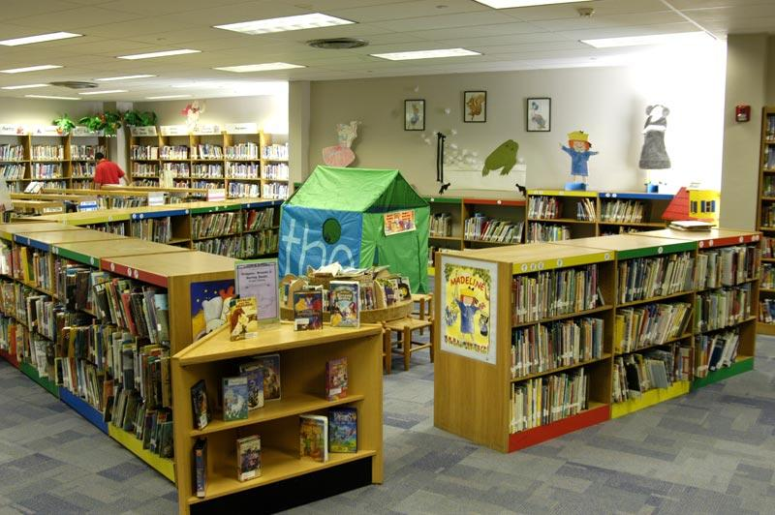
Slide 1
A library is a room or building with collections of books, magazines, music, and other resources for people to read and borrow. Librarians keep the library organized and help people find what they need when they visit.
Notes:
Collections are sets of books grouped together
Resources are something people need that is useful
Organized means having things be neat and easily usable.

Slide 3
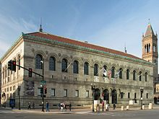
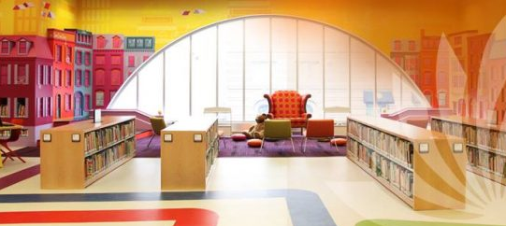
Slide 2
A public library is a library that is free and open to all members of the community. The first public library in the United States was the Boston Public Library. The library in Copley Square opened in 1895. It was the first library in the United States to include a children’s room.

Slide 4
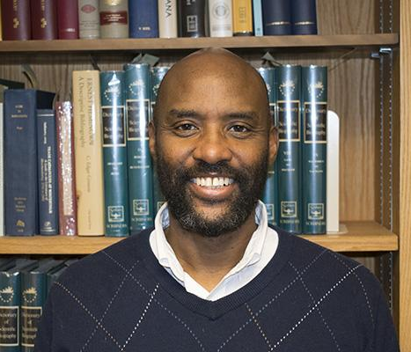
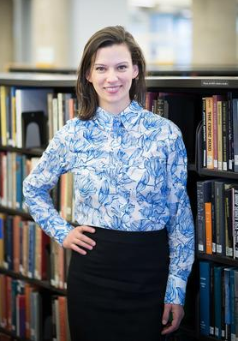
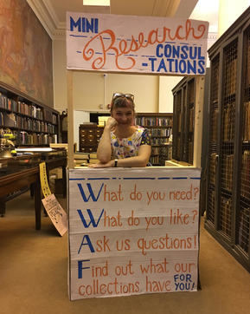
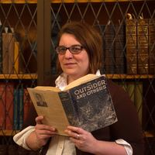
Slide 3
Librarians are responsible for helping to decide what kinds of books are in a library. They think about what people like to read and what is important for people to know and be able to learn about.
Notes:
Here, responsible means it’s their job to take care of what people want and need.

Slide 5
Slide 4
Marley Dias is not a librarian, but she loves libraries. But she discovered that libraries sometimes do not have the books to tell all people’s stories. She started #1000BlackGirlBooks to change that.

Slide 6
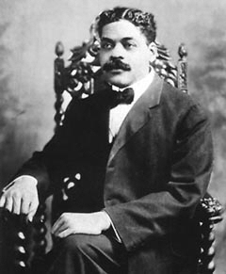
Slide 5
A long time before Marley, someone else discovered the same problem and did something to change it.
Arturo Schomburg was born in Puerto Rico in 1874. When Arturo was a child, he wondered why he was not learning in school about people who looked like him, about people like his own family who came from African countries.
Notes:
What is Arturo thinking about his education when he is a child?
Why does this matter?

Slide 7
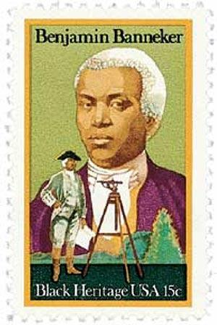
Slide 6
Arturo started to study history on his own to find out about great people who made important contributions to their communities. He searched and searched to learn about Black inventors, writers, thinkers, and leaders.
Arturo was inspired by Benjamin Banneker, who invented the wooden clock. He was a farmer, a mathematician, an astronomer and an author.
Notes:
What does Arturo want to learn about?

Slide 8
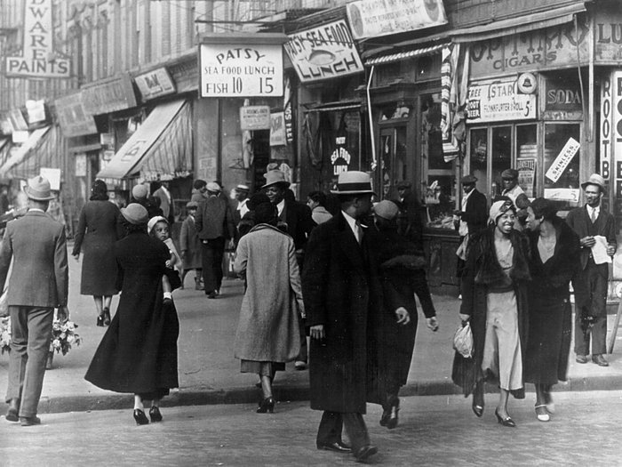
Slide 7
When he was 17 years old, Arturo moved from his home in Puerto Rico to New York City. There, he lived around other Puerto Rican and Cuban people.
It was important to Arturo to help make his community stronger. He collected as many books and other resources by African people as he could. He said he had “the book hunting disease.”
Notes:
Though sometimes disease means illness, in this case, disease means something you can’t stop.
Arturo really cares about learning about people like himself, and he is studying on his own about Black thinkers and leaders.
What do you think the “book hunting disease” is?

Slide 9
Slide 8
His family described their home like this: “There were books from the cellar to the top floor, in every room, including the bathroom.”
Arturo collected over ten thousand documents about the people and history of Africa and the places African people live. He had so many documents that he could no longer keep them in his house. He donated his collection to the New York Public Library and became its librarian.
Notes:
What do you think inspired Arturo to do his work?

Slide 10
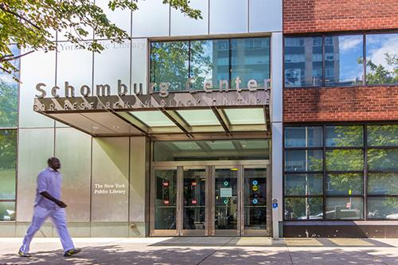
Slide 9
Today, the Schomburg Center for Research in Black Culture of the New York Public Library is an important research center, with more than 10 million items.
Notes:
What positive changes did Arturo Schomburg bring to libraries?
How do you think this change will affect other people?
This week we are exploring the question: How can we create positive change in our communities? Positive means good.
In Arturo Schomburg: Aleader in libraries, we learned that Arturo made libraries better by collecting texts that represented people of color.
Let’s record this idea on our chart: Arturo Schomburg made libraries better by collecting texts that represented people of color

Slide 11
Citations
Slide 1: library http://lbplchildren.blogspot.com/
Slide 2: BPL https://en.wikipedia.org/wiki/Boston_Public_Library; children’s room https://www.bpl.org/services-central-library/childrens-library-at-the-central-library/
Slide 3: librarian portraits https://www.finebooksmagazine.com/fine_books_blog/bright-young-librarians/
Slide 4: Marley https://kristof.blogs.nytimes.com/2016/09/06/1000blackgirlbooks-campaign-expands/ Credit Christopher Occhicone for The New York Times
Slide 5: shomburg portrait https://www.blackpast.org/african-american-history/schomburg-arturo-alfonso-1874-1938/
Slide 6: bnejamin banneker stamp https://www.mysticstamp.com/Products/United-States/1804/USA/
Slide 7: harlem https://www.npr.org/templates/story/story.php?storyId=129827444
Slide 8: piles of books https://www.the-tls.co.uk/get-rid-book/
Quote: https://brooklyneagle.com/articles/2012/01/24/on-this-day-in-history-january-24-a-pioneer-of-black-history/
Slide 9: schomburg center https://www.nypl.org/locations/schomburg

