Slide 1
“Early Risers”
and
Mobile Markets
Text Talk Week 5, Day 4

Slide 2
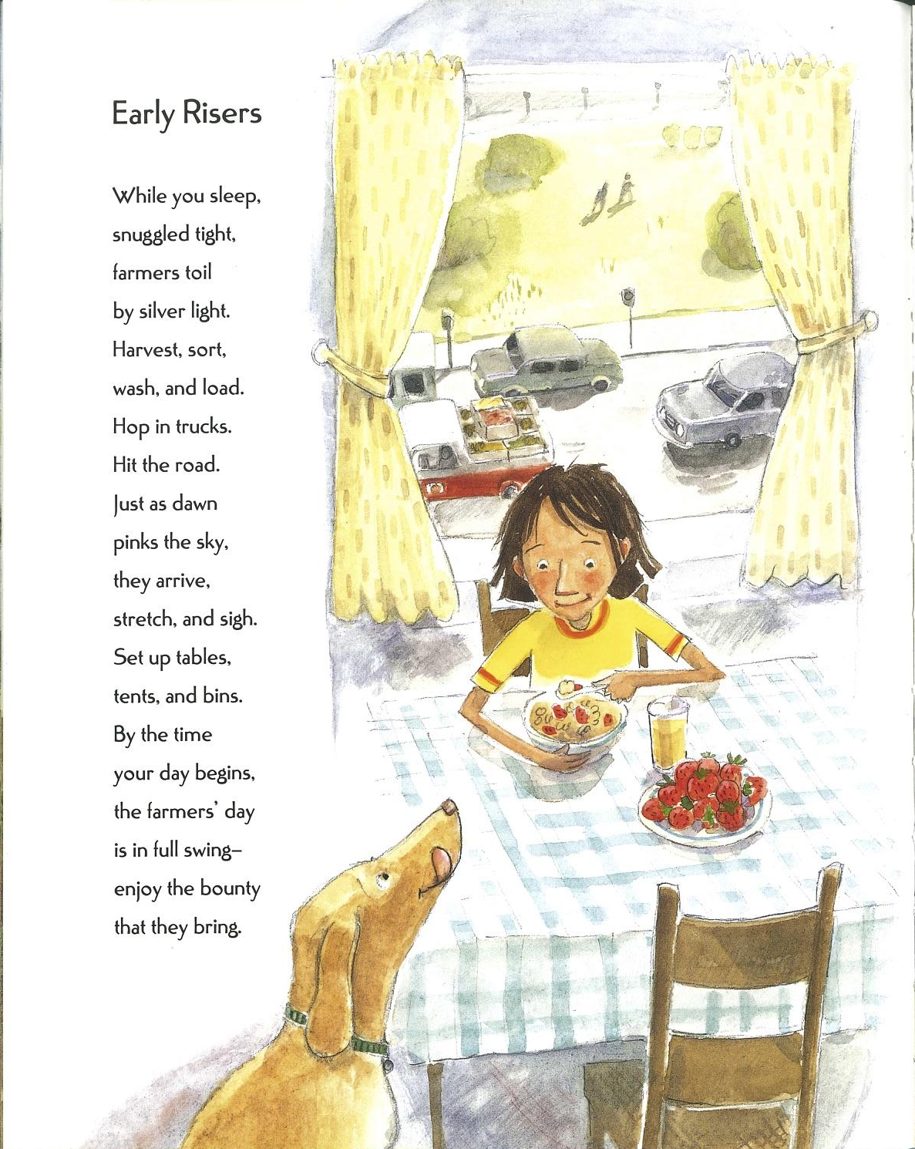
Slide 1

Slide 3
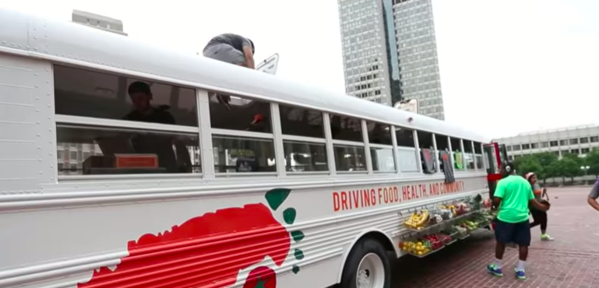
Slide 2
Click on the image to watch the video about Fresh Truck.

Slide 4
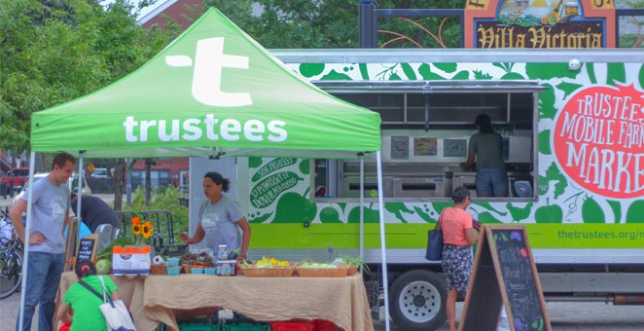
Slide 3
The Trustees Mobile Farmers Market makes stops every Wednesday, Thursday, Friday and Saturday. Click here to see an article about the market.

Slide 5
Slide 4
What do residents say about the Trustees Mobile Farmers Market?
“There’s a big difference between this locally grown produce versus what you see in Stop and Shop.”
- customer Duchess Cook
“Fresh food coming off a farm, you know what I’m saying? It tastes different.”
- customer Sonja Dixon

Slide 6
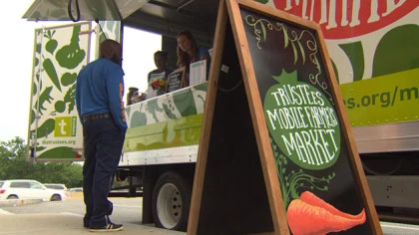
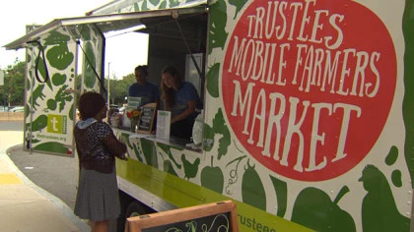
Slide 5
“My family needs the mobile market. Cooking is what we do. It’s part of our culture, and you can’t cook with bad ingredients. [This market] has the best ingredients I’ve seen in Boston, and I can actually afford it.”
- customer at the Roxbury YMCA mobile Farmers Market stop

Slide 7
Citations
Slide 1: from Fresh Picked Poetry, written by Michelle Schaub and illustrated by Amy Huntington
Slide 2: https://www.youtube.com/watch?v=NMzNwXIQAW8
Slide 3: http://www.thetrustees.org/places-to-visit/csa/mobile/
Slides 4 and 5: https://boston.cbslocal.com/2017/07/27/mobile-farmers-market/

