Slide 1
Local Leaders
Text Talk Week 5, Days 4 and 5
NOTE TO TEACHERS: These slides are about Boston leaders. Please replace with local leaders who are relevant to your children.

Slide 2
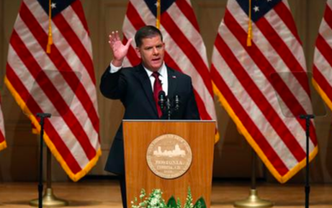
Elected Leaders
Slide 1
Martin J. Walsh is a local leader. He is the mayor of the city of Boston. A mayor is someone who is elected by the people to lead the city.

Slide 3
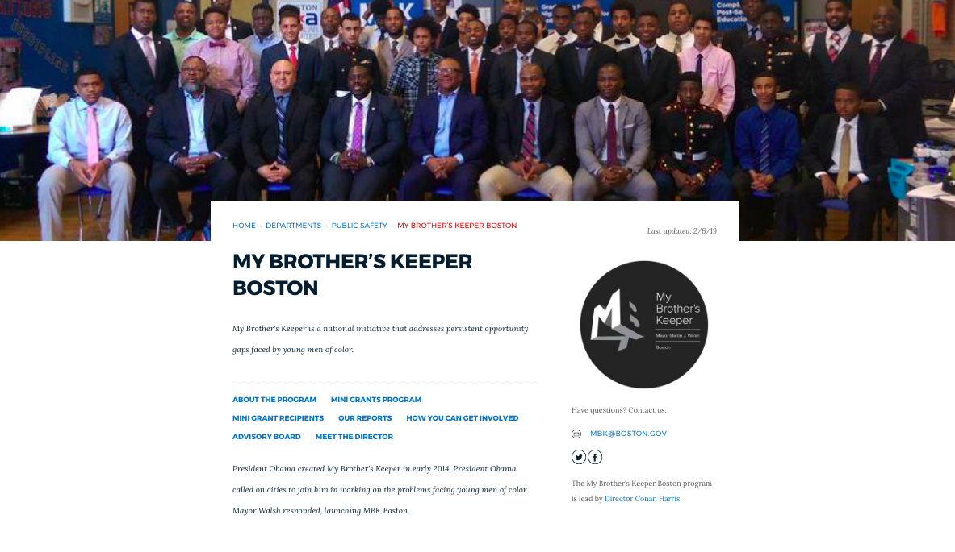
Slide 2
The mayor has many projects that support different groups of people in the city. For example, one of his important projects is to create job opportunities in the community for young men of color.

Slide 4
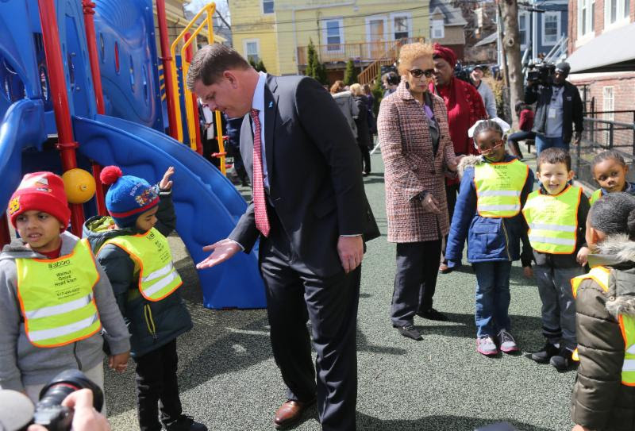
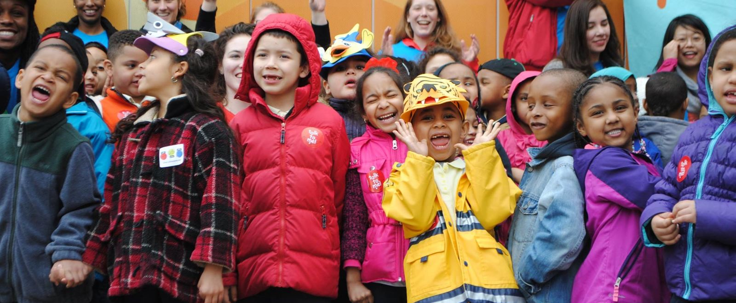
Slide 3
A new project that the mayor is supporting is Universal Pre-K. This project will mean that eventually all 4-year olds in Boston will have a spot in an excellent Pre-K program.

Slide 5
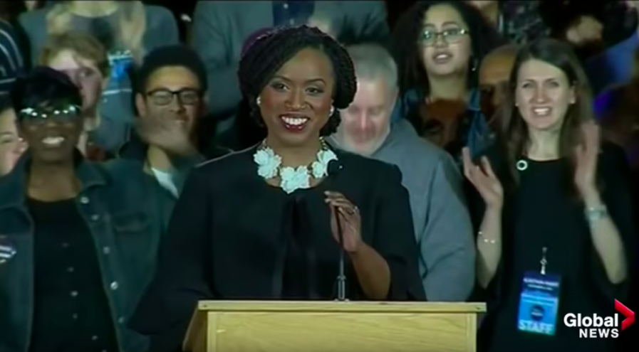
Slide 4
Ayanna Pressley is a local leader who is also a national leader. She was first elected as a city councillor in Boston, and then was elected by the people of Massachusetts to represent us in the United States Congress.

Slide 6
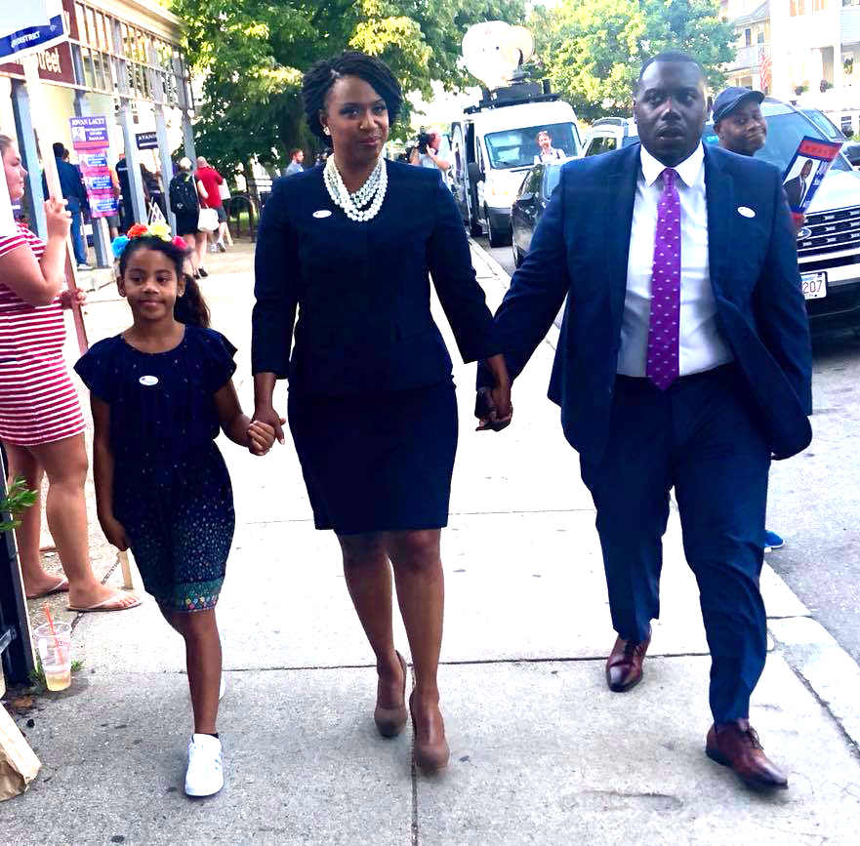
Slide 5
Congresswoman Pressley has many ideas about supporting the people of Massachusetts and the people of the United States. Two things that are important to her are: keeping families together and safe, and making sure that everyone in the country has an opportunity for an excellent education.

Slide 7
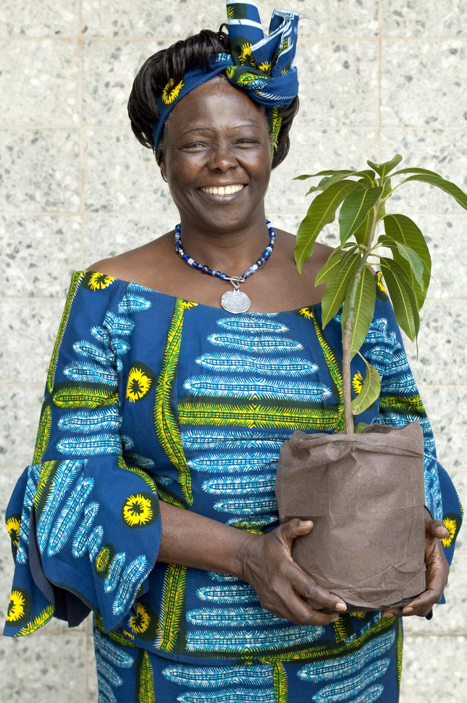
Leading without being elected
Slide 6
Unlike Mayor Walsh and Congresswoman Pressley, some leaders are not elected. For example, Wangari Maathai was a leader for many years because of her actions. Her leadership in planting trees made positive change for the environment and for the people of Kenya.

Slide 8
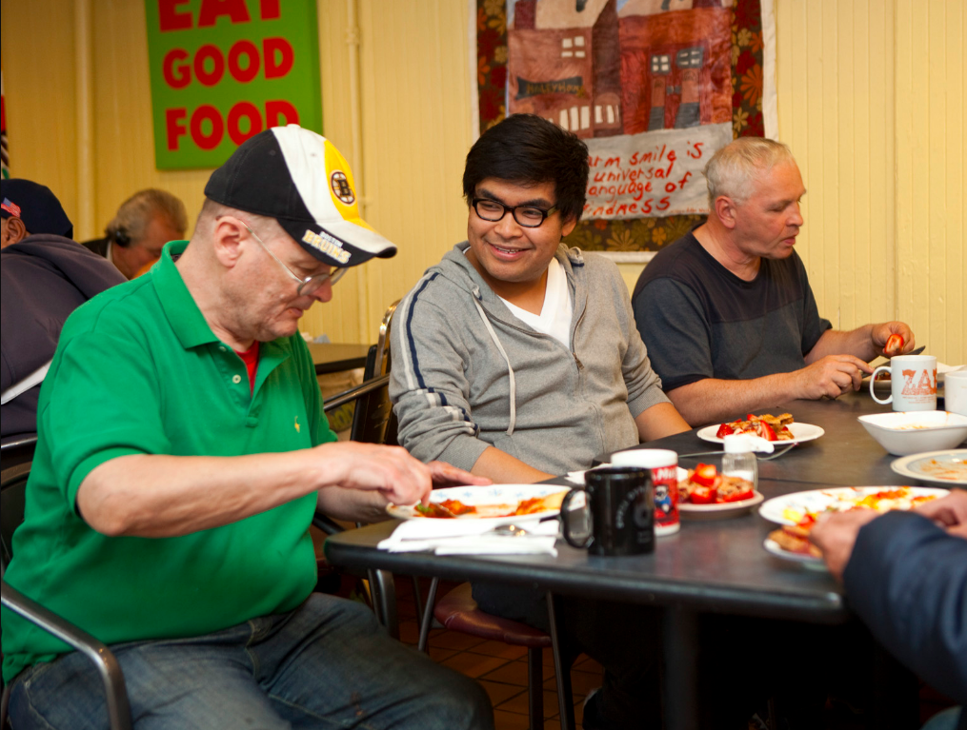
Slide 7
Some important Boston leaders are not elected. These people become leaders because of the valuable work they do in the community.
For example, the founders of the Haley House are important leaders.

Slide 9
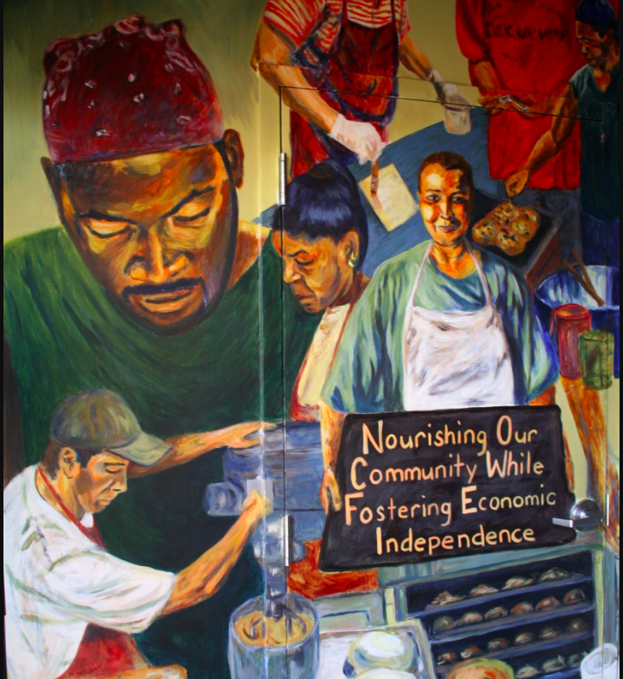
Slide 8
The founders of the Haley House, Kathe and John McKenna, designed a place that welcomes and supports people, especially people living without a house or an apartment. The Haley House gives people food, shelter, and jobs. The Haley House also grows food in urban farms and gardens. The Haley House is important to many people in the community.

Slide 10
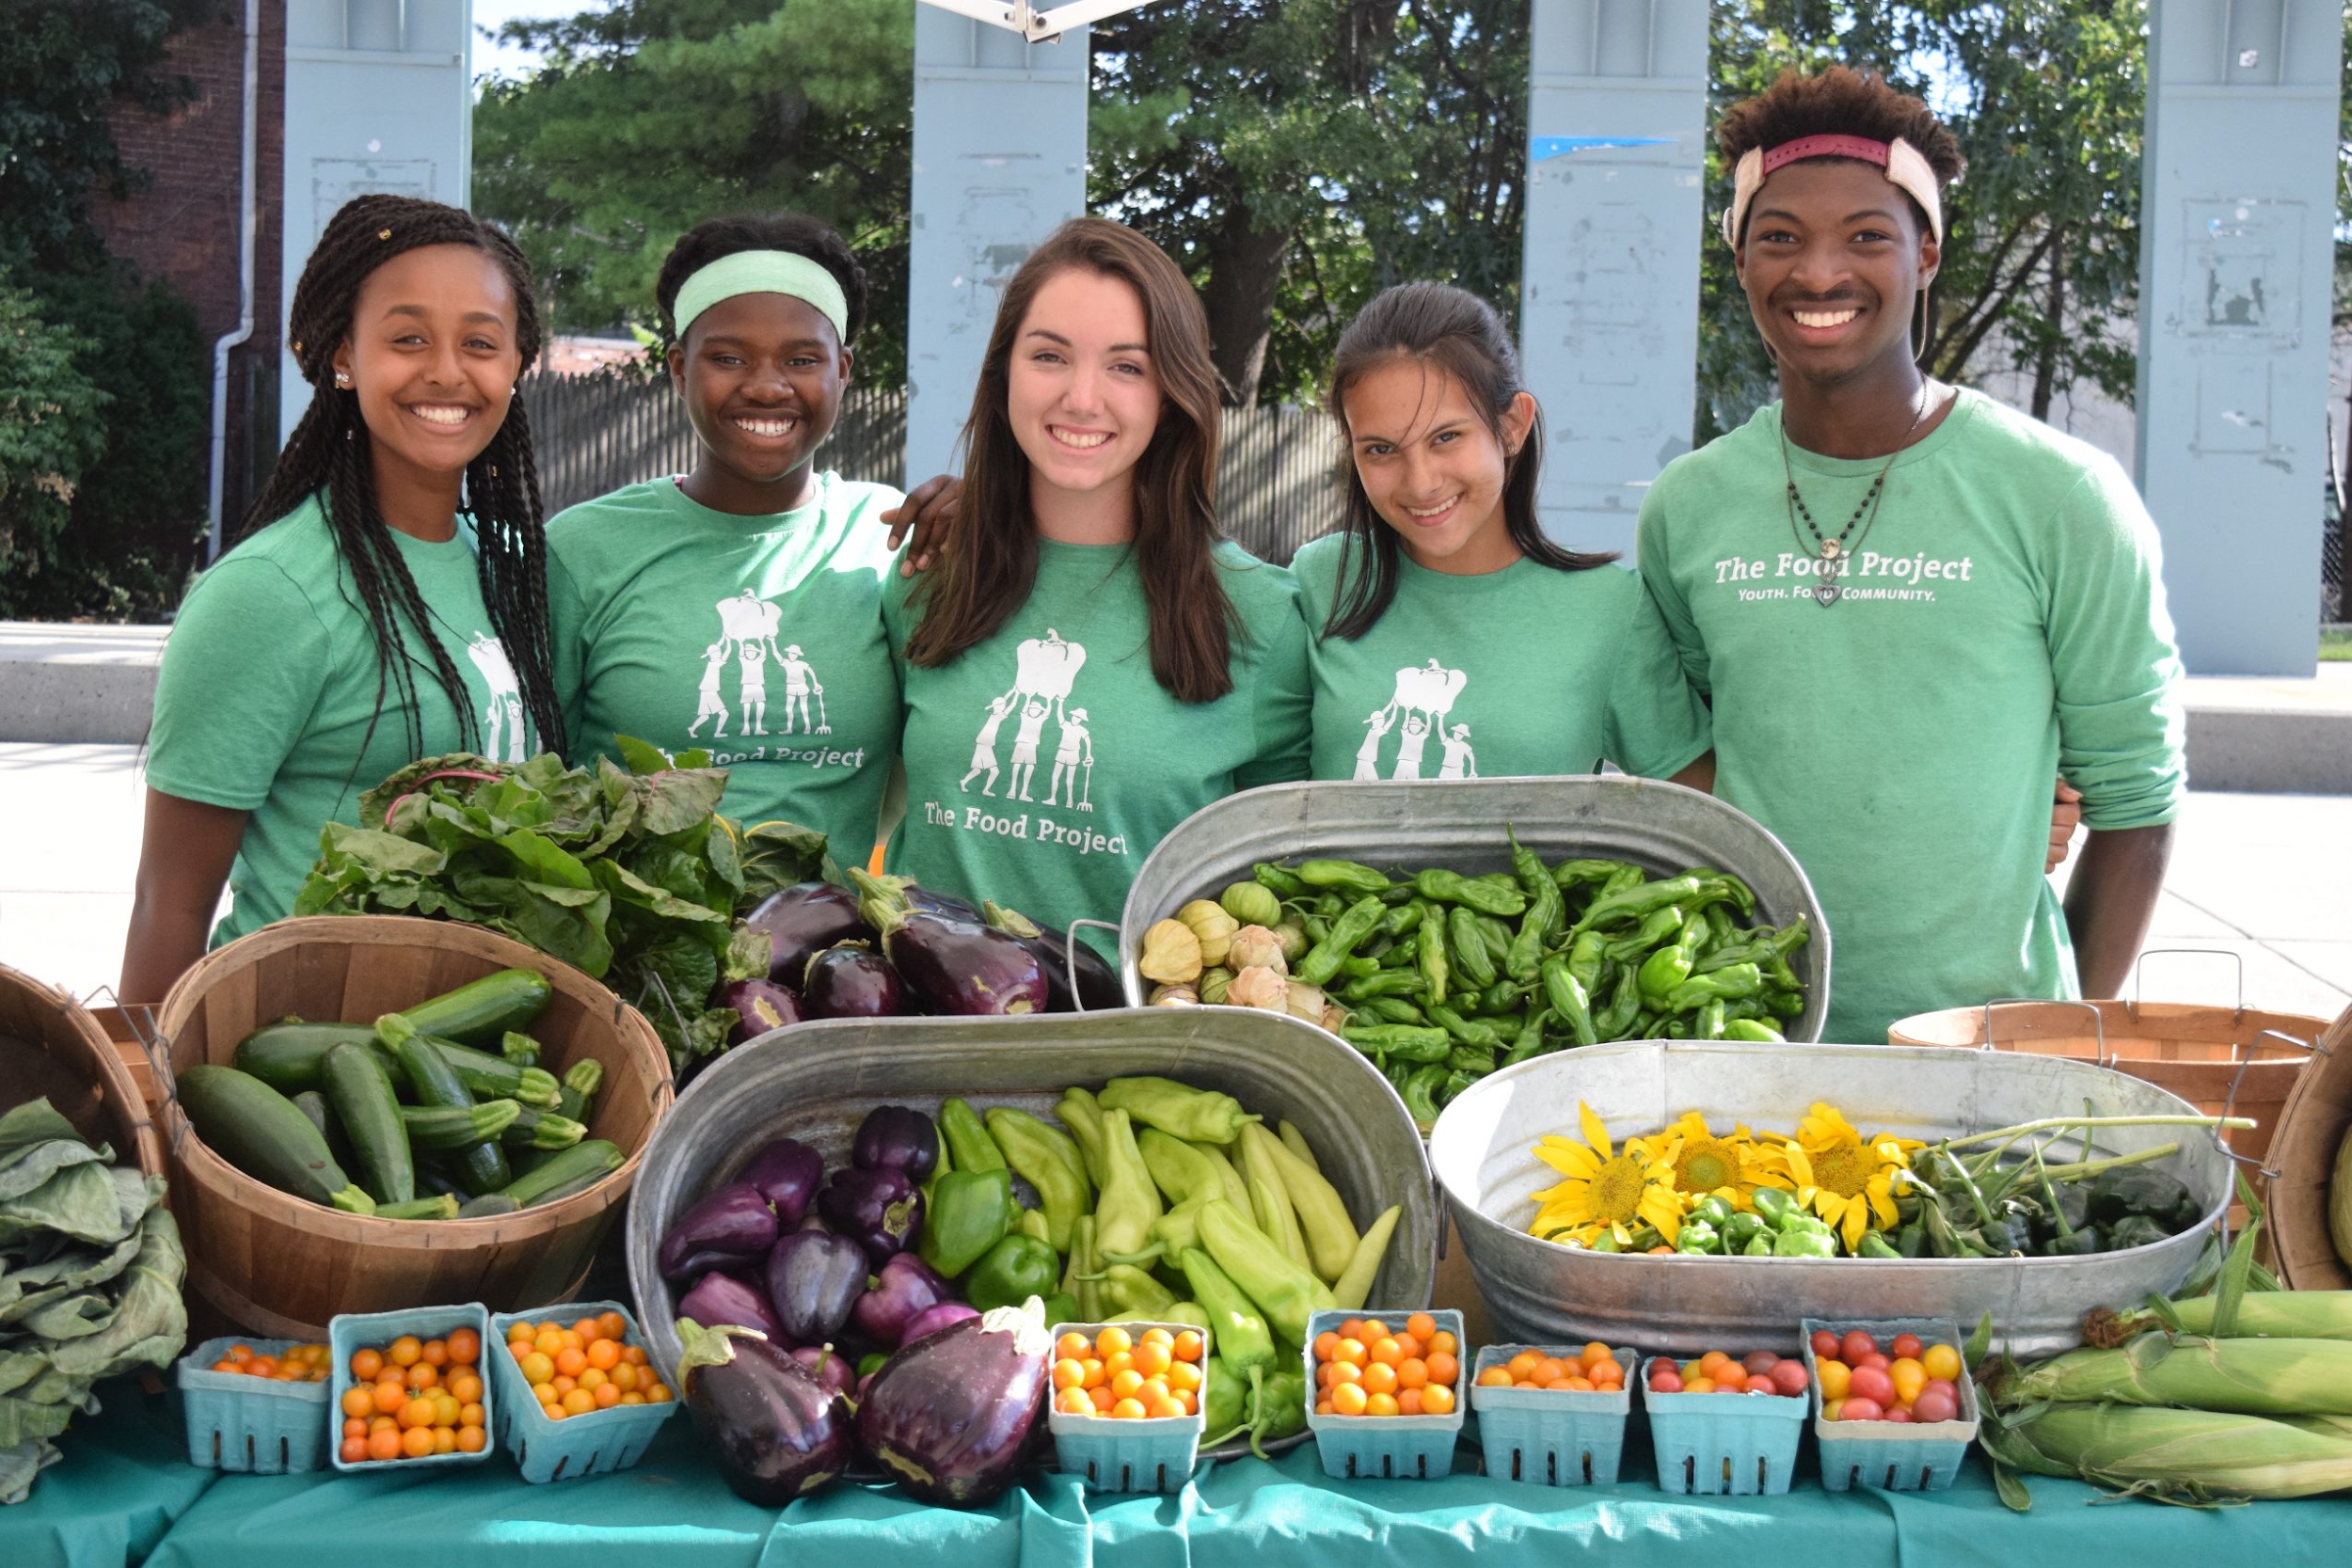
Slide 9
James Harrison is the Executive Director of The Food Project in Dorchester. The Food Project brings together youth and adults from diverse backgrounds to grow food and learn on farms.
The Food Project helps people feel connected to the land and to each other. It helps make sure that everyone has access to fresh, delicious food.

Slide 11
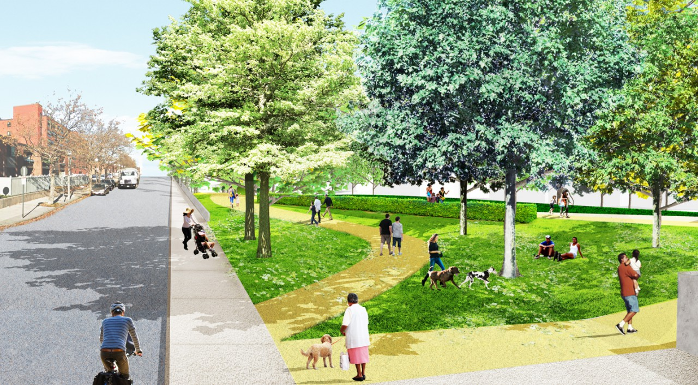
Slide 10
Leading as part of a team
Some local leaders work together. For instance, the Climate Resilience Solutions project has plans to prevent flooding in East Boston and Charlestown. A lot of different people are working together to help these communities. This team work is a good example of how local leaders can work together to help our Boston community.

Slide 12
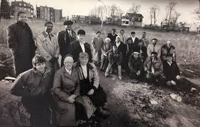
Slide 11
The Dudley Street Neighborhood Initiative is a team of people who work together to help local residents. The Dudley Street Neighborhood Initiative works with community members to advocate for what is important to create a diverse and healthy neighborhood. A community is stronger when people are empowered to make the changes they need.

Slide 13
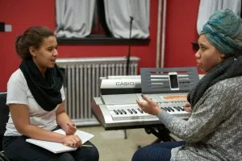
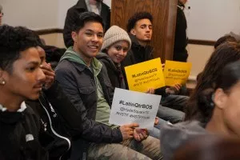
Youth Leaders
Slide 12
Some local leaders are youth. Young people can be leaders in many different ways. They can participate in programs like Musicians in Community where they learn to play, perform, and teach all forms of music. They can be Youth Community Organizers who learn to advocate for themselves, their schools, and their communities. They can make their voices heard about important topics.

Slide 14
Slide 13
School Leaders
School principals are local leaders too. Principals run many aspects of the school day, making sure the day goes smoothly for everyone in the school community. Students, families, and staff all depend on principals. Principals also have a role in connecting community members in the school neighborhood. Principals are important local leaders.

Slide 15
Citations
Slide 1: https://www.boston.gov/departments/mayors-office
Slide 2: https://www.boston.gov/departments/mayors-office#my-brother-039-s-keeper-boston
Slide 3: https://www.boston.gov/news/15-million-investment-universal-pre-k-guarantee-equitable-access-free-high-quality-pre-k-all, https://www.barrfoundation.org/blog/charting-a-course-to-universal-high-quality-pre-k
Slide 4: Still from https://www.youtube.com/watch?v=swMiHkWBJBA
Slide 5: https://twitter.com/ayannapressley/status/1036985859361394689
Slide 6: https://womenscenter.unc.edu/2016/03/inspiration-for-womens-history-month-wangari-maathai/
Slide 7: http://haleyhouse.org/who-we-are/mission/
Slide 8: http://haleyhouse.org/who-we-are/mission/
Slide 9: http://bostonvoyager.com/interview/meet-james-harrison-food-project-dorchester/
Slide 10: http://www.stoss.net/projects/50/coastal-resilience-solutions/
Slide 11: https://www.dsni.org/
Slide 12: https://www.hydesquare.org/what-we-do/jovenes-en-accion/
Slide 13: https://www.aitonelementary.org/

