Slide 1
The History and Geography of Matinicus Rock
Text Talk Week 5, Day 3

Slide 2
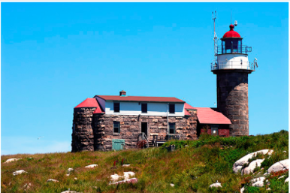
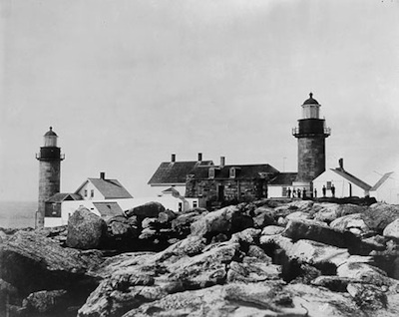
Present
2020
1856
200 years ago
1820
1920
Rebuilt Matinicus Rock Lighthouse, Matinicus, Maine
Notes:
https://www.nelights.com/exploring/Maine/matinicus_rock_light.html

Slide 3
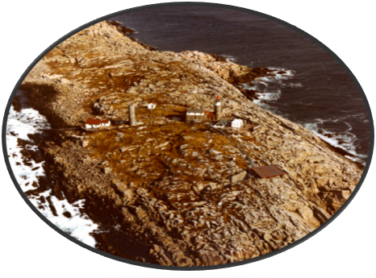
Matinicus Rock Lighthouse, aerial view
Notes:
https://uslhs.org/education/educational-materials/teaching-guides

Slide 4
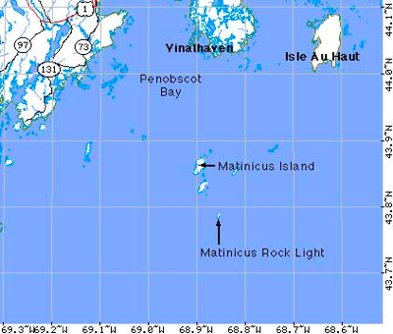
Matinicus is the name of a small island and a rock in the southern waters of Penobscot Bay, Maine.
The name Matinicus is from the Abnaki for “far away place.”
Notes:
https://uslhs.org/education/educational-materials/teaching-guides
Map: http://www.lighthouse.cc/matinicusrock/map2.html

Slide 5
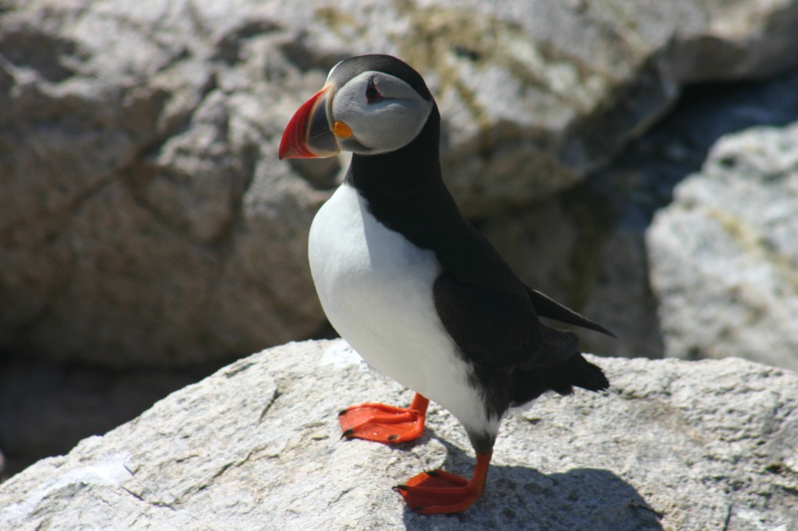
Today, Matinicus Rock is a bird sanctuary with a protected puffin nesting colony. Boats are allowed to go around the rocky island, but people are not allowed to walk on it.
Notes:
https://projectpuffin.audubon.org/conservation/matinicus-rock

Slide 6
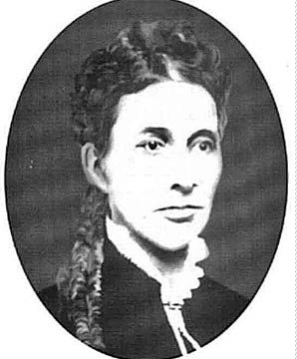
Abbie wrote in diaries and wrote letters to friends. Historians have learned about her life as a caretaker of the lighthouse through her writing.
To learn more about her work and life visit: https://uslhs.org/education/educational-materials/teaching-guides
Abbie Burgess

