Slide 1
The Shiny Sculptures of Anish Kapoor
Text Talk Week 5, Day 1

Slide 2
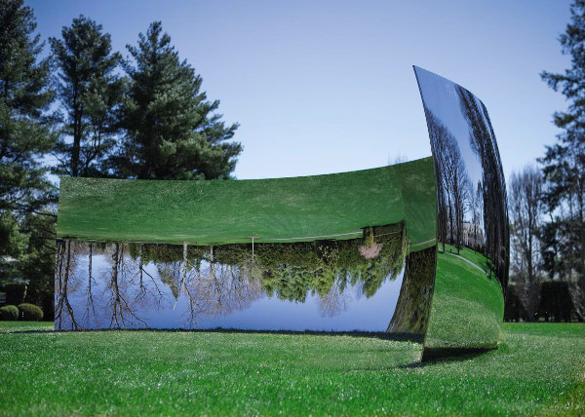
C-Curve (2007)
Cleveland, Ohio

Slide 3
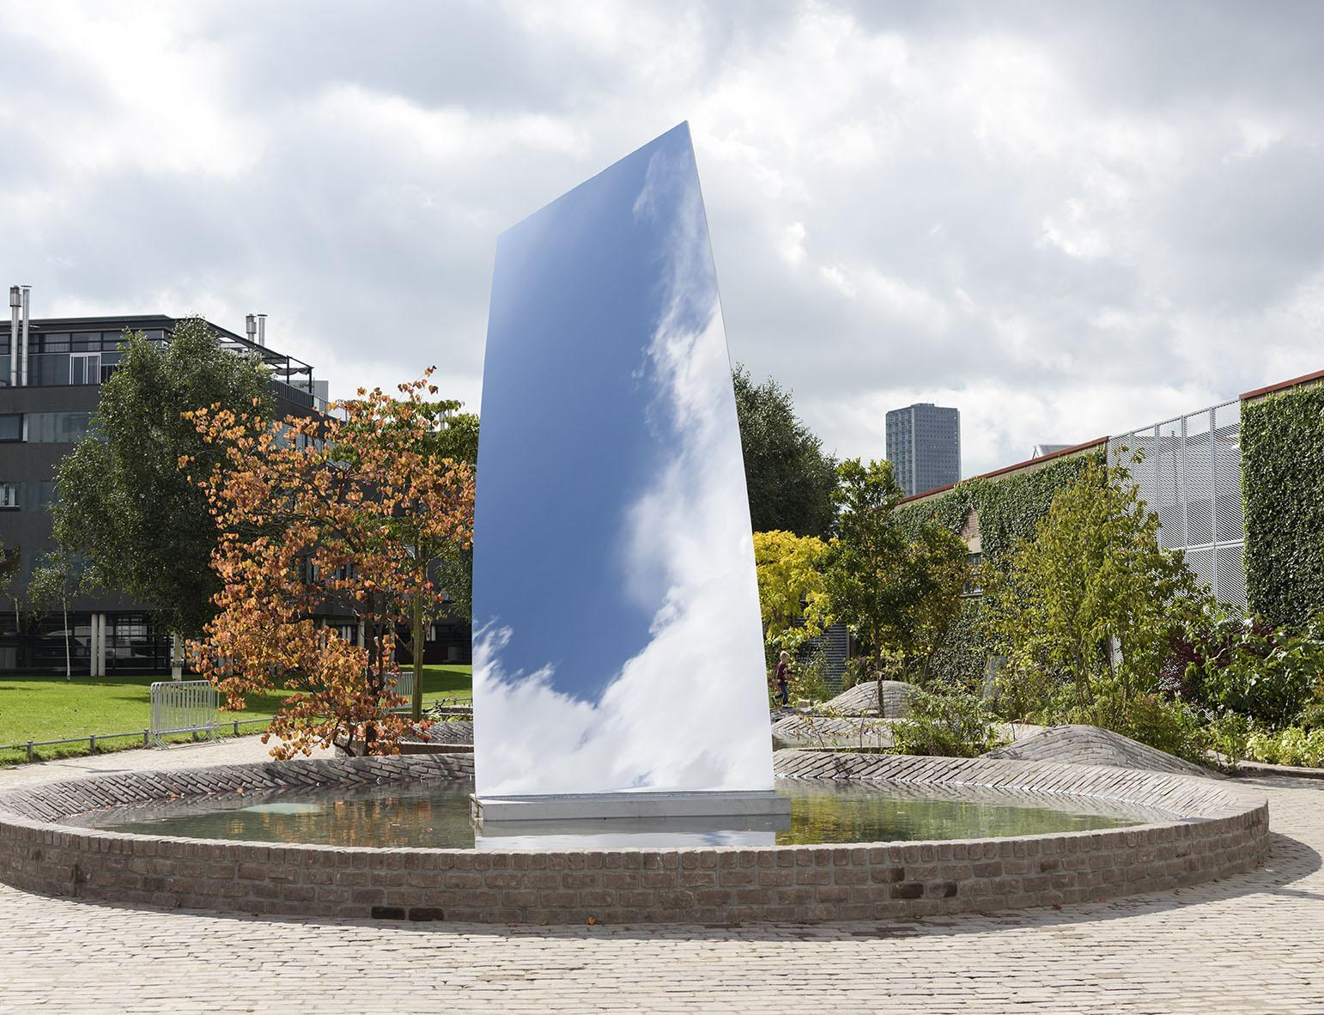
Sky Mirror (for Hendrik) (2017)
Tilburg, Netherlands

Slide 4
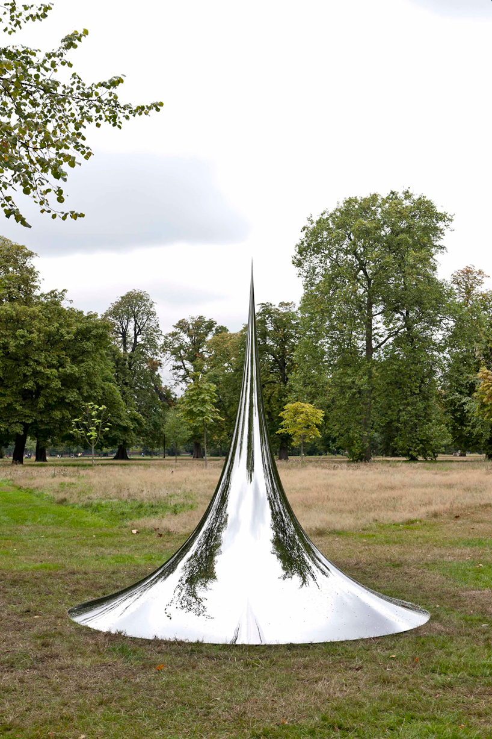
Non-object (Spire) (2007)
London, England

Slide 5
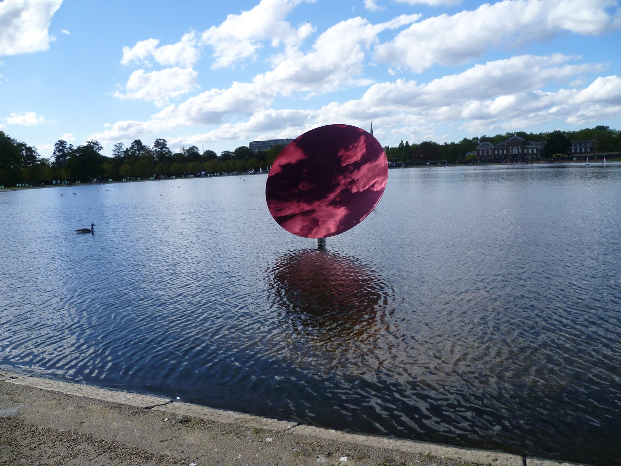
Red Sky Mirror (2009)
London, England

Slide 6
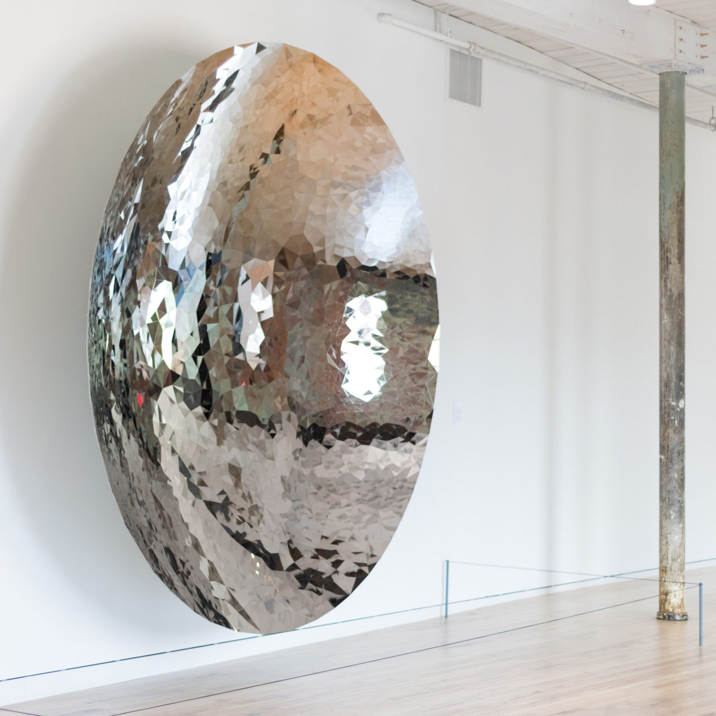
Untitled (2012)
Stainless steel
Massachusetts

Slide 7
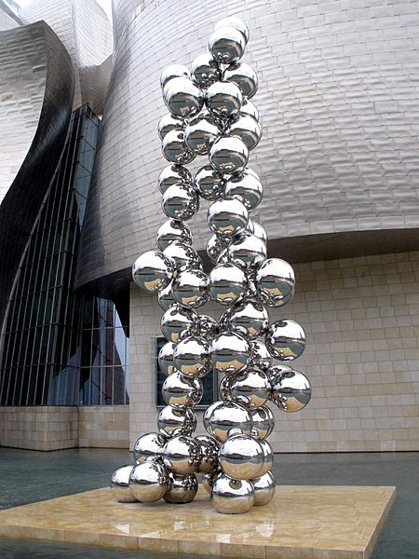
Tall Tree and the Eye(2015)
Bilbao, Spain

Slide 8
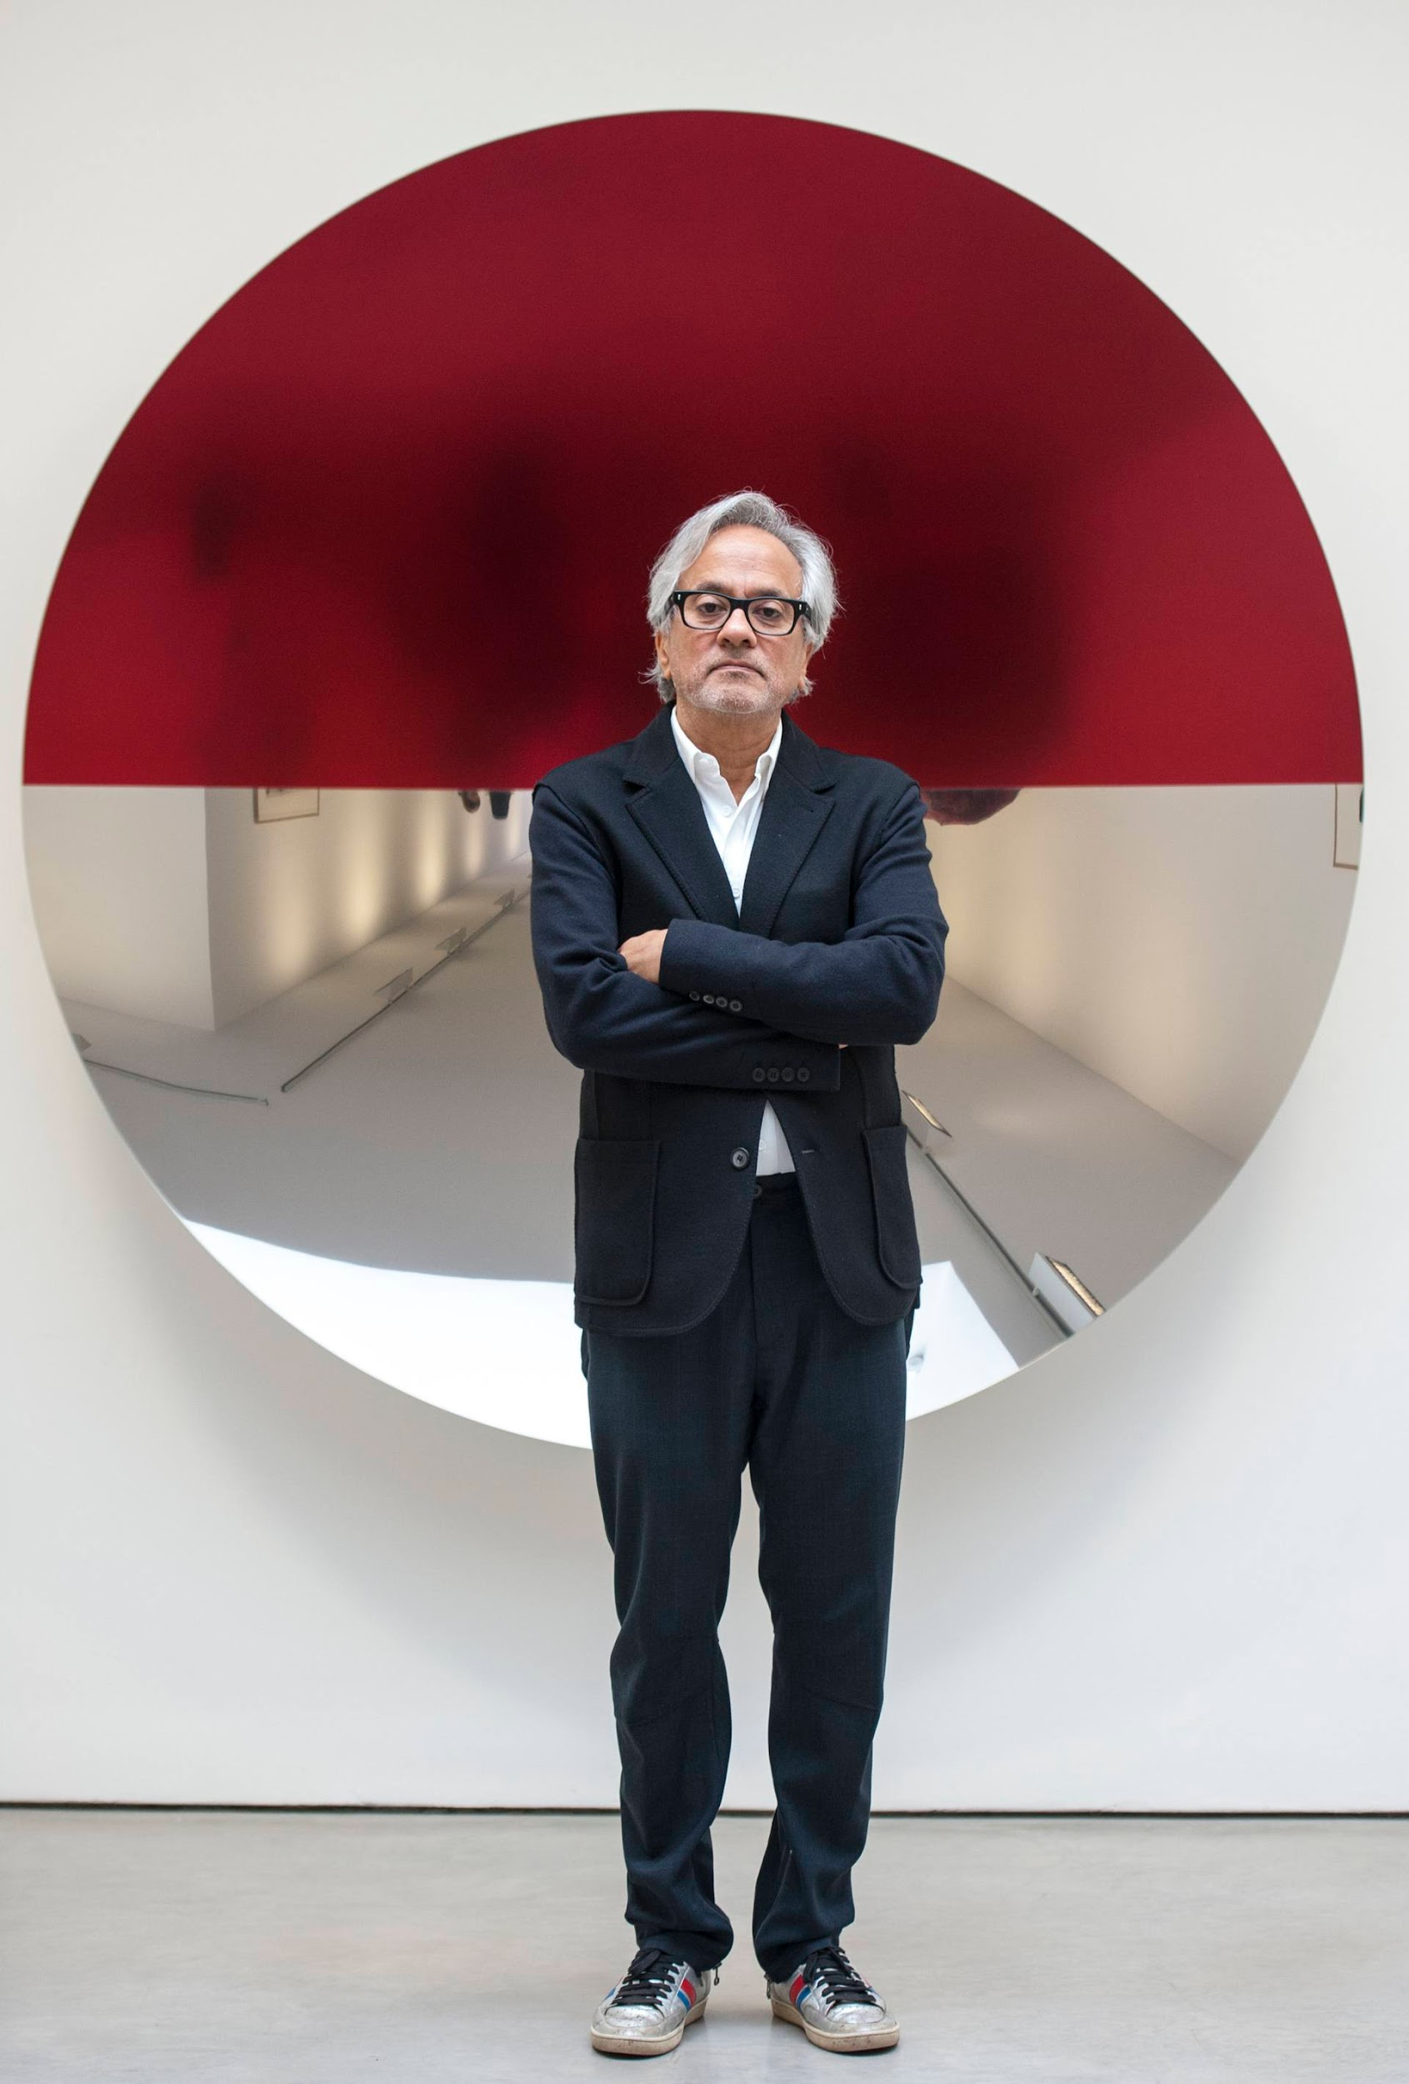
Anish Kapoor is a sculptor. He was born in Mumbai, India. As a teenager he moved to London, England to study art. He still lives there.
Anish Kapoor uses many different materials, including shiny, polished metals. His works of art are shown inside museums and outdoors.
Anish Kapoor standing in front of his sculpture “Mirror (Red) 2016”

Slide 9
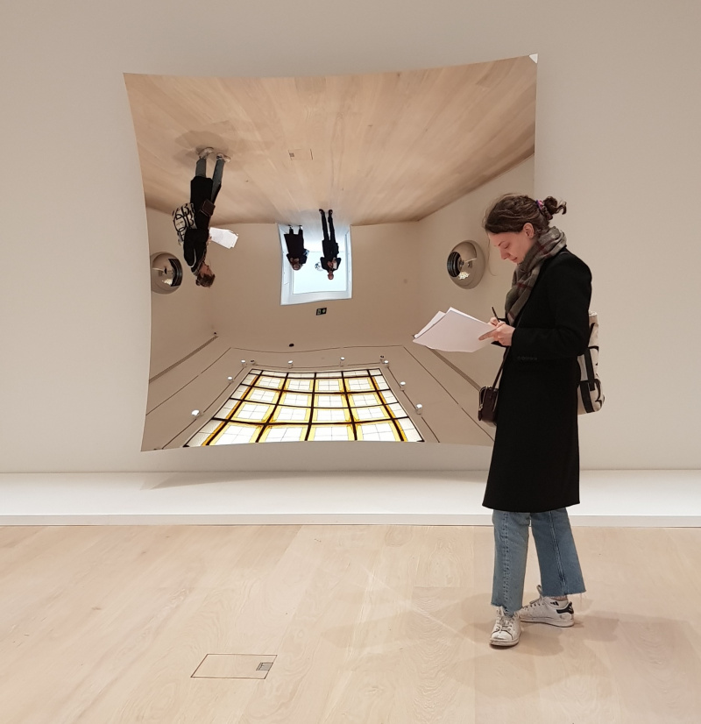
Title unknown, London

Slide 10
“… You are entering another world, but it is also telling you that the world is not what you think it is. The floor is the ceiling, the ceiling is the floor. It gives you this sense of tumbling in. … I’m kind of toying with all these potential ways to think.”
Title unknown, London
Notes:
Adapted from “Anish Kapoor on the Power of Concave Mirrors”, an interview with Anish Kapoor by Sonia Kolesnikof-Jessop, published in cobosocial.com (2019)

Slide 11
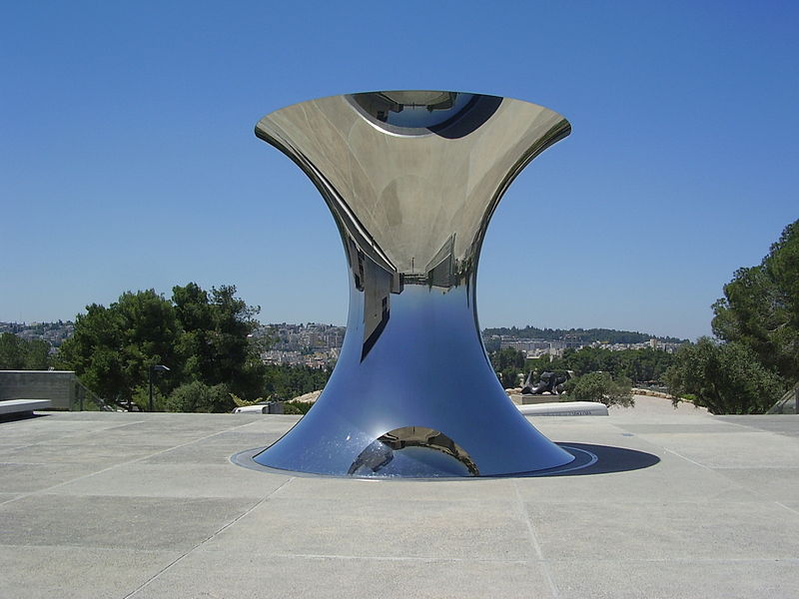
Turning the World Upside Down (2010)
Jerusalem

Slide 12
“The concave mirror is an exploration of space… and an exploration time, because as you move in front of that mirror something very weird happens; there is the opposite movement, and you’re upside down. … ‘What am I looking at?’ “
Turning the World Upside Down (2010) Jerusalem
Notes:
Adapted from “Anish Kapoor on the Power of Concave Mirrors”, an interview with Anish Kapoor by Sonia Kolesnikof-Jessop, published in cobosocial.com (2019)

Slide 13
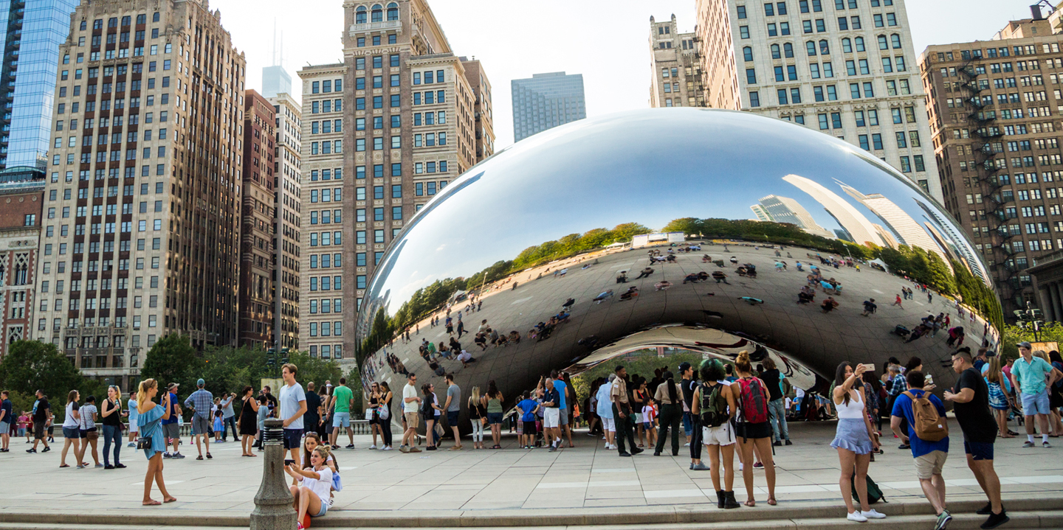
Cloud Gate (2006), also known as “The Bean,” Chicago, Illinois

Slide 14
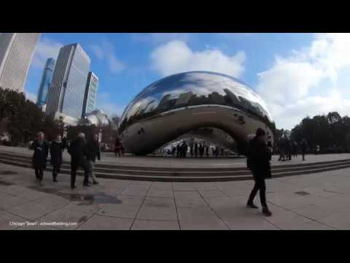
“A mirror brings in everything, it brings in its own space.
So it has its own light…”
Watch this video to visit Cloud Gate.

Slide 15
Citations
Slide 2: https://www.clevelandart.org/about/press/media-kit/cleveland-museum-art-announces-installation-anish-kapoor-sculpture
Slide 3: https://www.lissongallery.com/news/anish-kapoor-unveils-new-sculpture-at-museum-de-pont
Slide 4: https://arrestedmotion.com/2010/10/showing-anish-kapoor-turning-the-world-upside-down-kensington-gardens/kapoor06/
Slide 5: http://walktofreeartlondon.blogspot.com/2010/10/sky-mirror-2009-by-anish-kapoor.html
Slide 6: https://massmoca.org/event/anish-kapoor/
Slide 7: https://commons.wikimedia.org/wiki/File:Bilbao_-_Museo_Guggenheim,_Tall_Tree_and_the_Eye_(Anish_Kapoor)_5.jpg
Slide 8: http://www.abitare.it/en/events/2010/09/24/anish-kapoor-turning-the-world-upside-down-2/
Slides 9 & 10: https://www.cobosocial.com/dossiers/anish-kapoor-on-the-power-of-concave-mirrors/, quote adapted from “Anish Kapoor on the Power of Concave Mirrors”, an interview with Anish Kapoor by Sonia Kolesnikof-Jessop, published in cobosocial.com (2019)
Slides 11 & 12: https://www.flickr.com/photos/25756848@N04/6837215608, quote adapted from “Anish Kapoor on the Power of Concave Mirrors”, an interview with Anish Kapoor by Sonia Kolesnikof-Jessop, published in cobosocial.com (2019)
Slide 13: https://www.choosechicago.com/articles/tours-and-attractions/the-bean-chicago/
Slide 14: https://www.youtube.com/watch?v=50DBi-cypck

