Slide 1
Pages 20-21 for close reading
Text Talk Week 4, Day 5

Slide 2
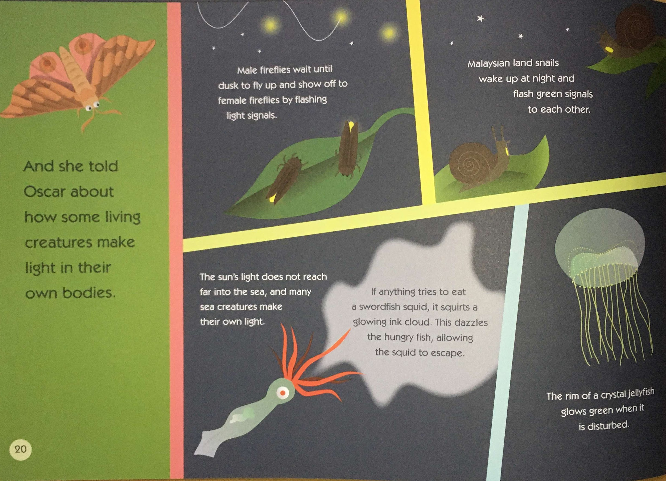

Slide 3
