Slide 1
Marley Dias:
#1000BlackGirlBooks
Text Talk Week 4, Day 5

Slide 2
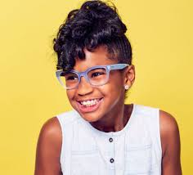
Slide 1
Meet Marley Dias. She is 14 years old. She is a leader.
Marley was not elected by a vote of her community members. But she did something that made her community see her as a leader.

Slide 3
Slide 2
When she was 11 years old, Marley noticed a problem. Marley loves to read. But she had trouble finding books with characters that look like her. She thought it was important for kids to see strong characters who look like themselves, so that they can become strong people.

Slide 4
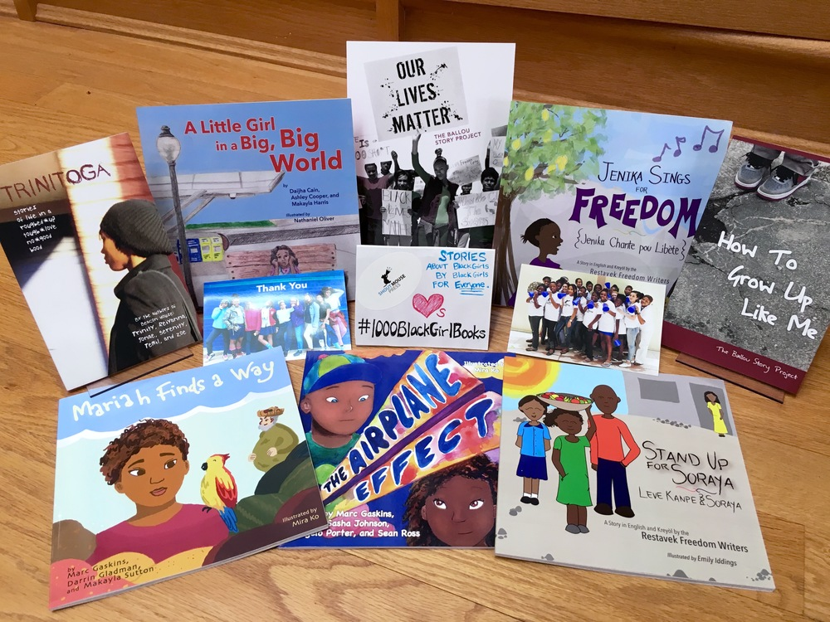
Slide 3
Her mother asked her, “So what are you going to do about it?”
Marley answered by starting a project called #1000BlackGirlBooks. Her plan was to find and collect one thousand books that have strong girls of color as main characters, and then give them away to libraries, schools, and community organizations.

Slide 5
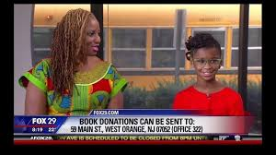
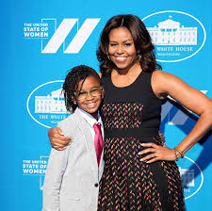
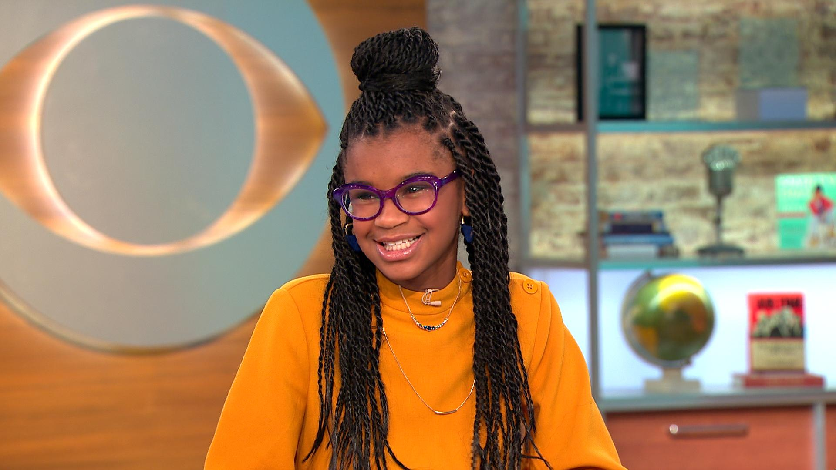
Slide 4
Marley told everyone she could about her project. Grown ups noticed her project and invited her to talk about it—in magazine articles, on the radio, and on television.

Slide 6
Slide 5
Marley Dias, the person behind the nonprofit #1000BlackGirlBooks, looks through some of the books donated to her group.
She collected more and more books. Some people gave her books, and some people gave her money to buy books. So far, she has collected 12,000 books! These books have been sent to places in the United States and around the world.

Slide 7
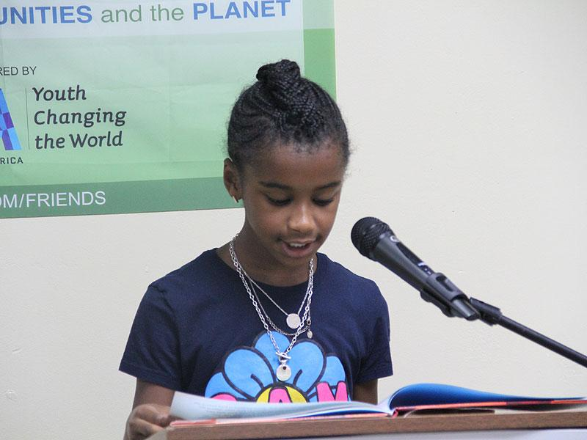
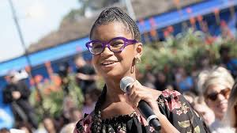
Slide 6
Marley also travels to cities all over the United States to talk with adults and kids about her project. She tells people how important it is to hear many different stories from many different perspectives.

Slide 8
Slide 7
Marley lives and goes to school in the state of New Jersey. One part of her project is advocating for more diverse books in her own school library and on the lists of books the school recommends to students.

Slide 9
Slide 8
“Because it was my story I wanted to share ‘how’ I did it, so other kids can learn how they can use their gifts, talents and passions to make a change in the world.
I also wanted adults to know what they could do to help kids change the world.”
When she was 13 years old, Marley wrote a book! In this book, she shares tips and encourages other young people to do something to make a difference in their own communities.

Slide 10
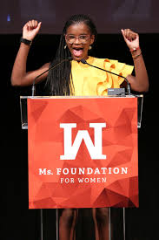
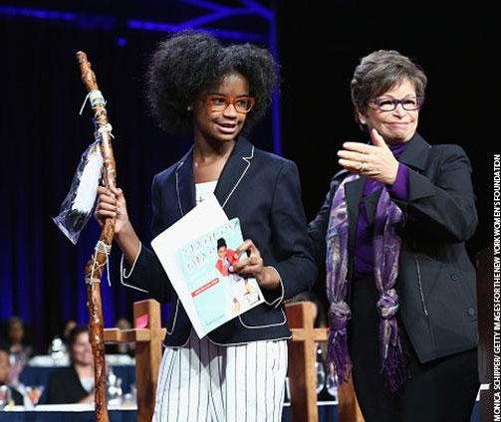
Slide 9
Marley has received lots of awards for the work she has done. When leaders are recognized for their work, they inspire others.

Slide 11
Slide 10
Marley is still collecting books. Now she hopes to collect one million books.
"I want this book drive to teach other kids that they can do whatever they want to do," she says.

Slide 12
Citations: Information
https://www.pbs.org/newshour/arts/13-year-old-founder-of-1000blackgirlbooks-shares-some-of-her-favorite-reads
https://kristof.blogs.nytimes.com/2016/09/06/1000blackgirlbooks-campaign-expands/
https://www.forbes.com/sites/maggiemcgrath/2017/06/13/from-activist-to-author-how-12-year-old-marley-dias-is-changing-the-face-of-childrens-literature/#c75987a4ce0f
https://www.colorlines.com/articles/icymi-new-jersey-girl-seeks-collect-1000blackgirlbooks
https://www.smithsonianmag.com/innovation/marley-dias-collect-books-girls-color-180967231/
https://www.wbls.com/news/black-history/game-changers-marley-dias-video-photo
https://people.com/celebrity/marley-dias-collects-books-with-relatable-lead-characters/
https://www.commonlit.org/en/texts/marley-dias-the-13-year-old-activist-author

Slide 13
Citations: Images
Slide 1: yellow background https://bckonline.com/2016/09/23/marley-dias-launches-zine-elle-com/2/
Slide 2:
Slide 3: books https://www.shoutmousepress.org/blog/1000blackgirlbooks
Slide 4: on tv https://www.cbs.com/shows/cbs_this_morning/video/_zyKwfejsZzE4O_oYFRvzcxXhkOuiOgf/teen-activist-marley-dias-on-her-new-mission-for-racial-harmony/; fox29 http://www.fox29.com/news/nj-11-year-old-launches-1000blackgirlbooks
Slide 5: shelving books https://kristof.blogs.nytimes.com/2016/09/06/1000blackgirlbooks-campaign-expands/ Credit Christopher Occhicone for The New York Times
Slide 6: reading at school https://people.com/celebrity/marley-dias-collects-books-with-relatable-lead-characters/; outdoors https://www.thewrap.com/back-creep-hillary-clinton-yara-shahidi-address-teen-vogues-next-gen-leaders-la-photos/the-teen-vogue-summit-la-keynote-conversation-with-hillary-rodham-clinton-and-actress-yara-shahidi/ with mic https://www.bbc.co.uk/newsround/42027105
Slide 7: #1000 logo https://www.nypl.org/blog/2016/03/24/live-qa-marley-dias-1000blackgirlbooks
Slide 8: book scholastic.com
Slide 9: Michelle Obama https://www.instyle.com/celebrity/marley-dias-1000blackgirlbooks-campaign-badass-women; Ms. Foundation http://www.zimbio.com/photos/Marley+Dias/Ms+Foundation+30th+Annual+Gloria+Awards+After/RSZnDoSvKsx; achiever of the year https://www.success.com/2017-success-achiever-of-the-year-marley-dias/
Slide 10: lying on books https://www.nbcnews.com/news/nbcblk/marley-dias-continues-find-color-kid-s-literature-n583071

