Slide 1
Voting Images
Text Talk Week 4, Day 3

Slide 2
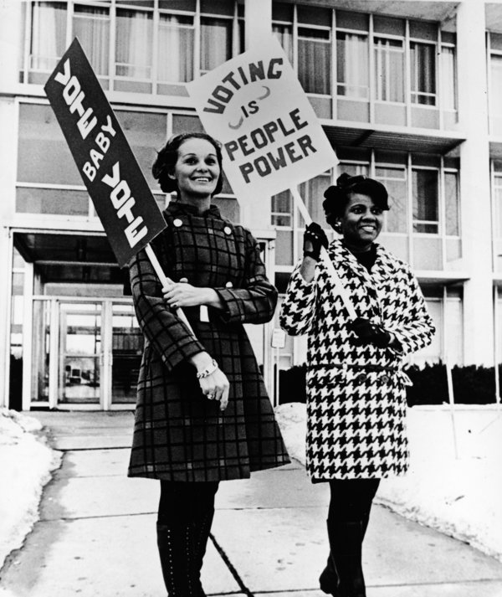
Slide 1

Slide 3
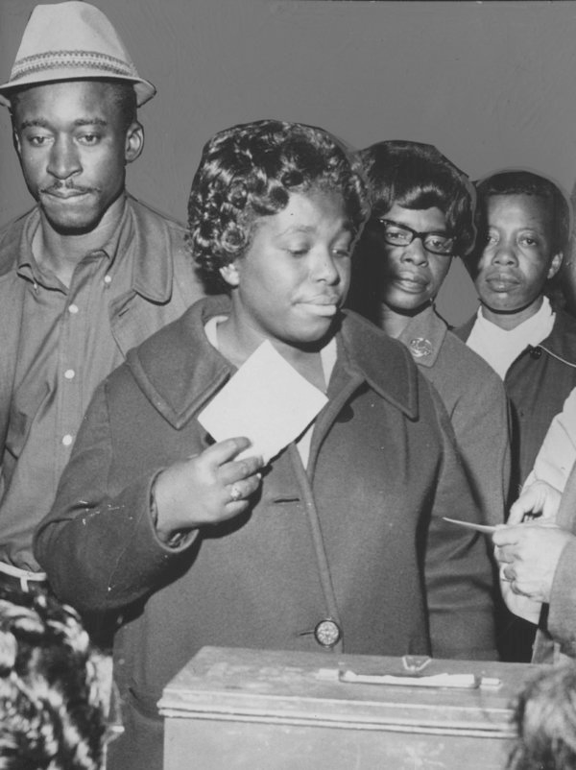
Slide 2

Slide 4
Citation
Images
Slide 1: https://www.huffingtonpost.com/2014/11/02/photos-women-voting_n_6083808.html?ncid=edlinkushpmg00000055
Slide 2: https://www.gettyimages.com/detail/news-photo/group-of-african-american-voters-stand-in-line-while-a-news-photo/486822485
Information informing the images
https://www.huffingtonpost.com/2014/11/02/photos-women-voting_n_6083808.html?ncid=edlinkushpmg00000055
https://en.wikipedia.org/wiki/Voting_Rights_Act_of_1965

