Slide 1
Where does wool come from?
Text Talk Week 4, Day 1

Slide 2
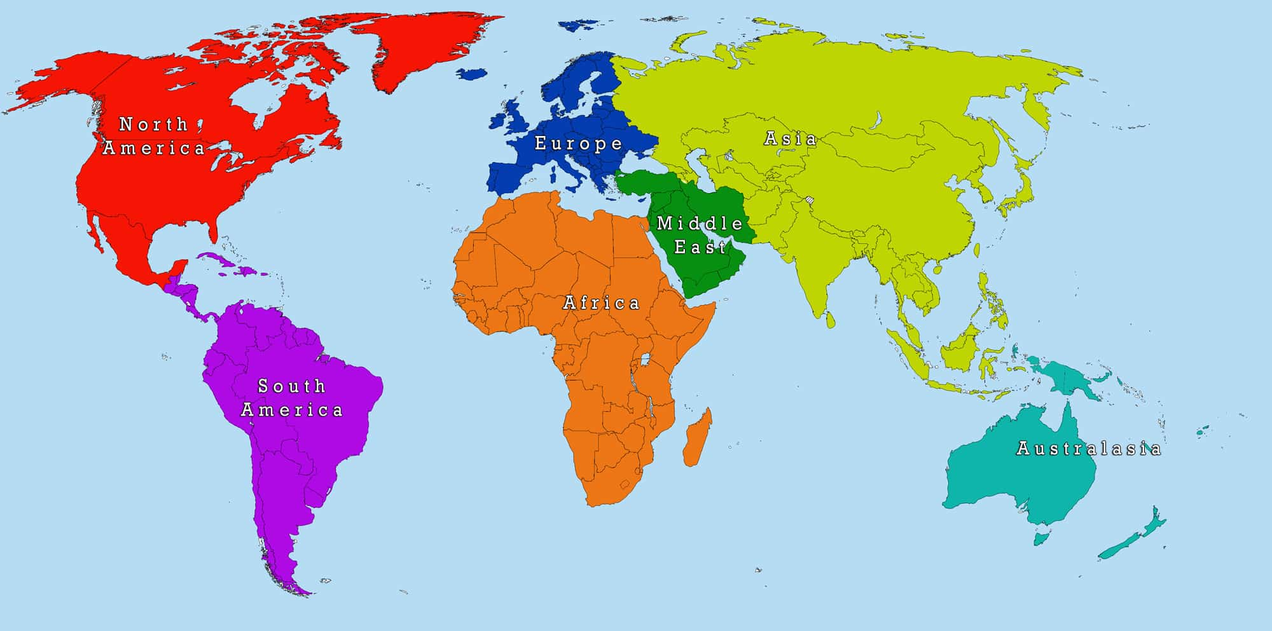
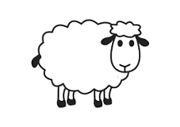
Slide 1
Boston

