Slide 1
How Animals Use Sound
Text Talk Week 3, Day 5

Slide 2
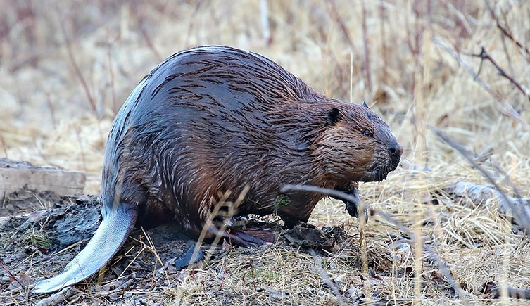
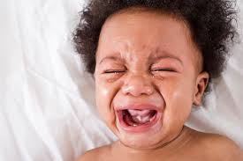
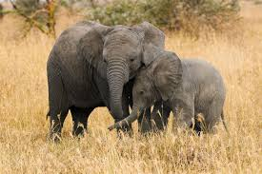
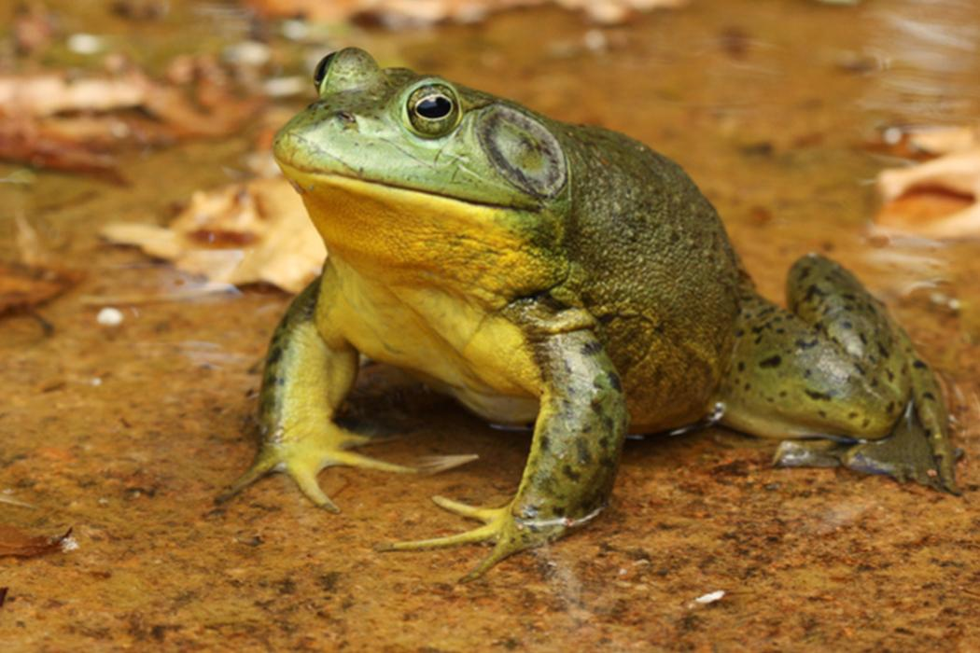
Slide 1
People use sound to communicate. Animals do, too.
What messages do animals communicate with sound? How do they do it?

Slide 3
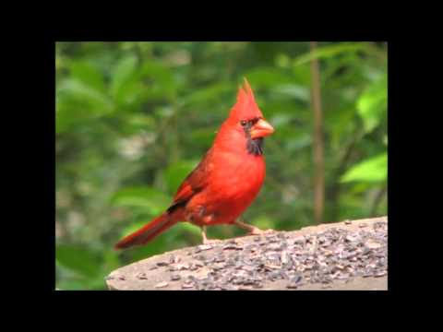
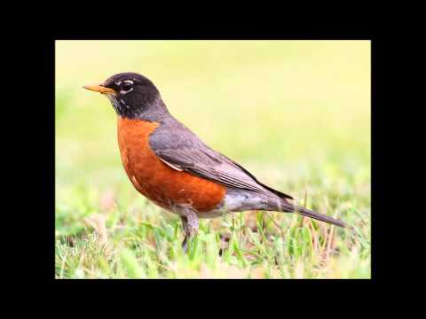
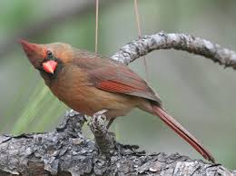
Slide 2
I’m over here! Come see me!
Birds use songs and calls to attract mates.
Both male and female cardinals sing. In other bird species, the male does most of the singing.

Slide 4
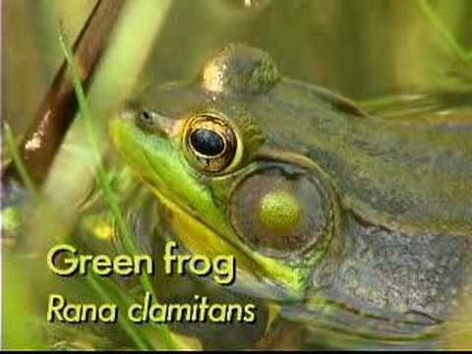
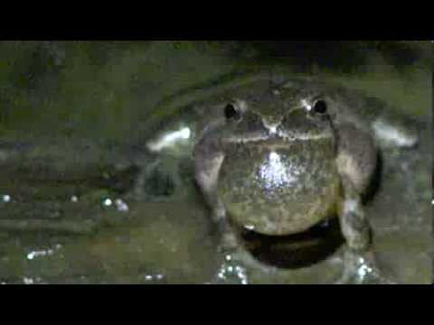
Slide 3
Listen to the green frog.
Bullfrogs (male frogs) croak to attract female frogs as mates, especially in the evenings and at night. In some frog species, the sounds can be heard up to a mile away!
Listen to the spring peepers.

Slide 5
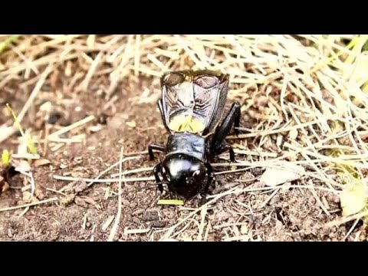
Slide 4
Listen here:
Crickets chirp by rubbing their wings together.
Different species of crickets make different sounds, so each kind of cricket can find the right mate. They also chirp when they are threatened.

Slide 6
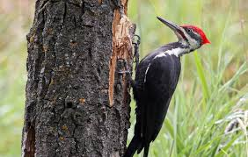
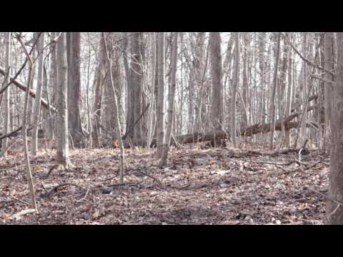
Slide 5
I live here.
Woodpeckers drum on trees and sometimes houses to signal their territory.
Listen here.

Slide 7
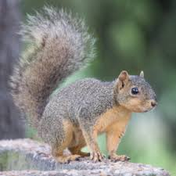
Slide 6
Get out of here!
Listen here:
Many animals, like squirrels, make sounds to communicate to intruders to go away.

Slide 8
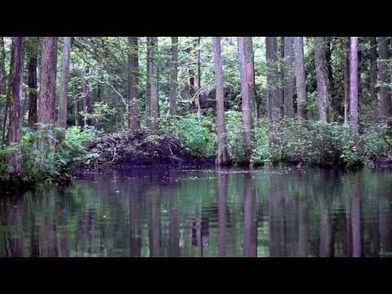
Slide 7
Listen here.
Beavers slap their broad tails on the water. This might sound like a large rock or a tree falling into the water. It warns other beavers about danger and frightens predators. After a beaver slaps its tail, it can listen for the sounds of a predator moving and figure out where that predator is hiding.

Slide 9
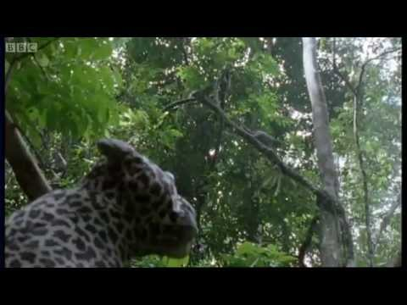
Slide 8
Watch out!
I think there’s trouble!
Listen here.
Many monkeys use different calls to warn about different kinds of predators. These monkeys have spotted a cheetah.

Slide 10
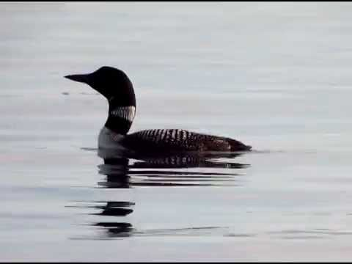
Slide 9
Listen here.
In music, tremolo refers to a wavering or trembling sound. Loons make this special sound when they feel threatened.

Slide 11
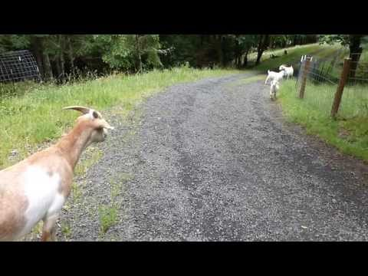
Slide 10
Come this way.
I’m hungry.
Many animal parents and their young use sounds to communicate with each other. Mother and kid goats recognize each other’s voices soon after the babies are born.
Listen here.

Slide 12
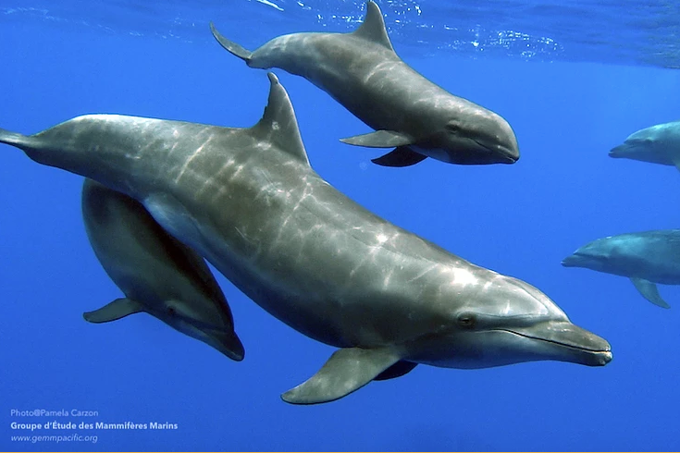
Slide 11
Complicated communication systems
Scientists don’t fully understand all the sounds some animals make or what their sounds mean.
Dolphins use clicks and whistles to find their way through the deep water, to warn about danger, and to relate to each other as group members.
Listen to clicking here:
Listen to squeaking here:
Listen to buzzing clicks here:

Slide 13
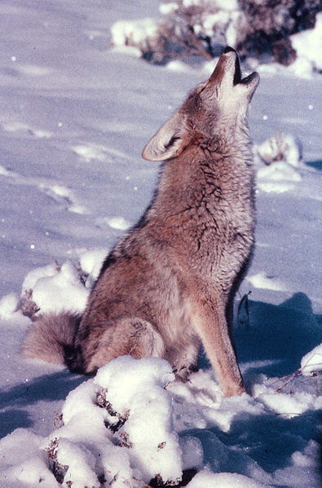
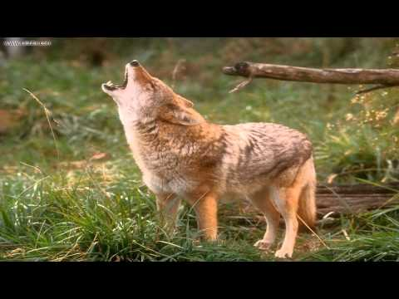
Slide 12
Coyotes are known as sound dogs. They make many different kinds of sounds, for different reasons, although they are most famous for howling. They also growl, huff, woof, bark, bark-howl, whine, yelp, woo-oo-wow.
Listen here:

Slide 14
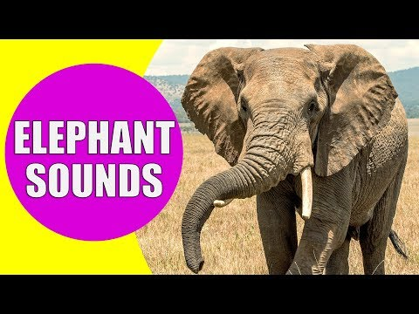
Slide 13
Elephants are also known as good communicators.
Like coyotes and people, elephants use different sounds for different purposes. Elephants use movements along with their sounds to communicate specific messages.
Listen here:

Slide 15
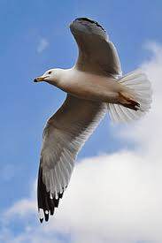
Slide 14
What animal sounds have you heard?

Slide 16
Citations
Written and compiled by Melissa Tonachel, Focus on First, 2019.
Slide 1: https://babygooroo.com/articles/decoding-your-babys-cry
Slide 2: https://gardeningsolutions.ifas.ufl.edu/design/gardening-with-wildlife/cardinals.html; https://www.youtube.com/watch?v=1E91raf-H5c; https://www.youtube.com/watch?v=ZNsF_tyHiUY
Slide 3: https://flypaper.soundfly.com/discover/5-unique-ways-animals-communicate-through-sound/; https://www.youtube.com/watch?v=G0uGjsM_gh4&feature=emb_logo; https://www.youtube.com/watch?time_continue=35&v=lXfmubmx-qw&feature=emb_logo
Slide 4: https://www.youtube.com/watch?v=rjzmutRaKDo&feature=emb_logo
Slide 5: https://www.audubon.org/field-guide/bird/pileated-woodpecker; https://www.youtube.com/watch?time_continue=4&v=hODaq9iplGY&feature=emb_logo
Slide 6: https://audubonportland.org/our-work/rehabilitate-wildlife/having-a-wildlife-problem/urban-squirrels/; https://www.trutechinc.com/services/animal-sounds/squirrel/
Slide 7: https://www.youtube.com/watch?v=zptTKMdYEso; https://www.nhm.ac.uk/discover/news/2019/may/scottish-beavers-are-now-a-protected-species.html
Slide 8: https://www.youtube.com/watch?v=o-bxPLFt1vI
Slide 9: https://www.youtube.com/watch?time_continue=14&v=4UrCRcZ8Pas&feature=emb_logo
Slide 10: https://www.youtube.com/watch?time_continue=12&v=BewGBbCWwDg&feature=emb_logo
Slide 11: https://seaworld.org/animals/all-about/bottlenose-dolphin/communication/; https://www.iucnredlist.org/species/41714/17600466
Slide 12: https://commons.wikimedia.org/wiki/File:Coyote-00063.jpg; https://www.youtube.com/watch?v=zR_g2cHXzQQ
Slide 13: https://www.smithsonianmag.com/smart-news/wildlife-trade-conference-imposes-near-total-ban-sending-wild-african-elephants-zoos-180973015/
Slide 14: https://www.freesoundslibrary.com/fly-noise/; https://en.wikipedia.org/wiki/Gull

