Slide 1
Surprised!
Text Talk Week 3, Day 4

Slide 2
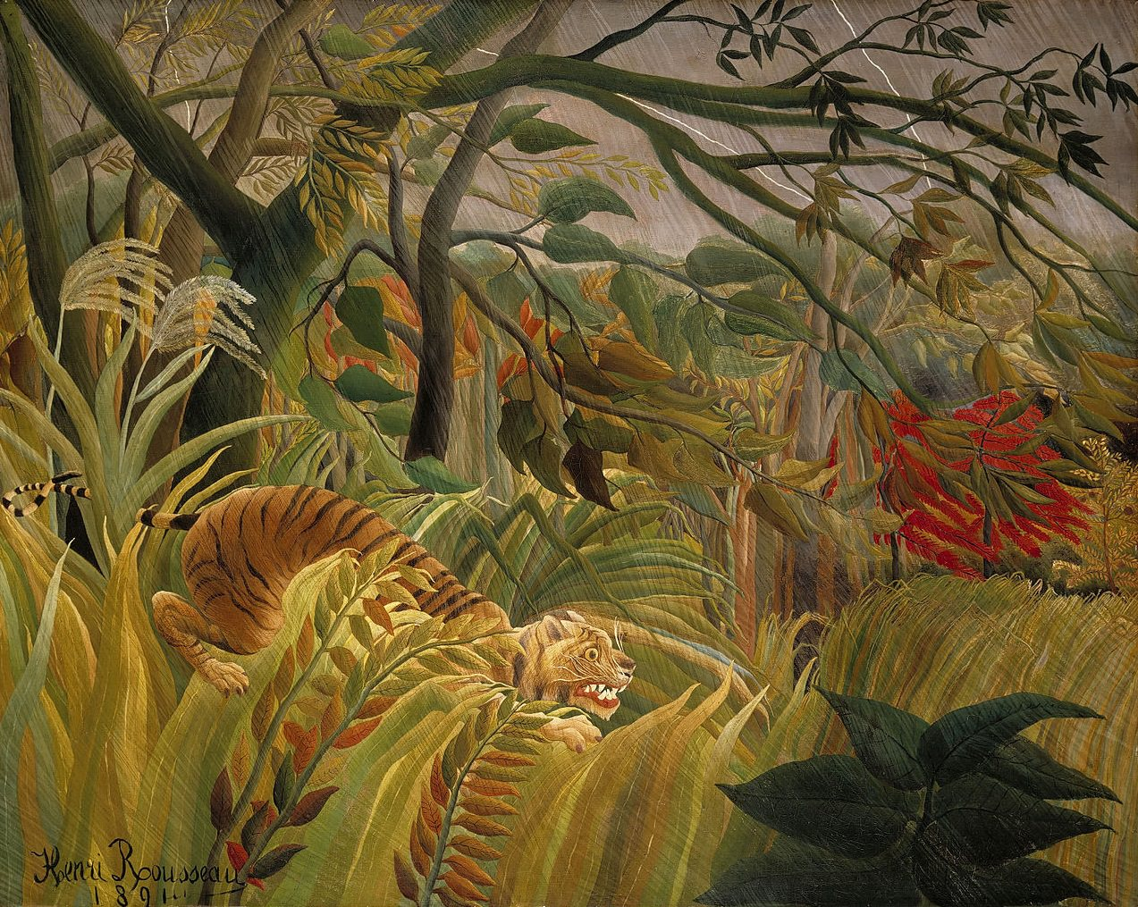
Slide 1

Slide 3
Slide 2
Surprised! (also known as Tiger in a Tropical Storm)

Slide 4
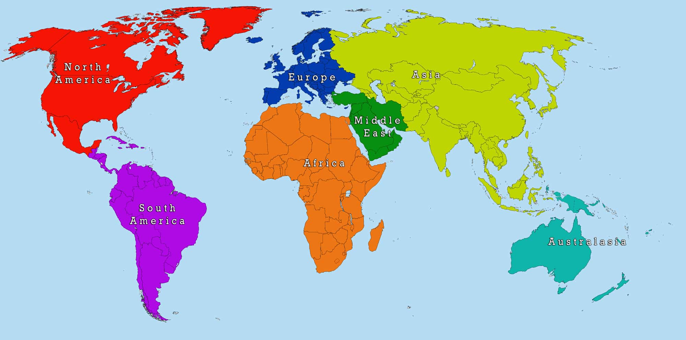
Slide 3
Paris, France
Tiger habitat
Boston

Slide 5
Slide 4

Slide 6
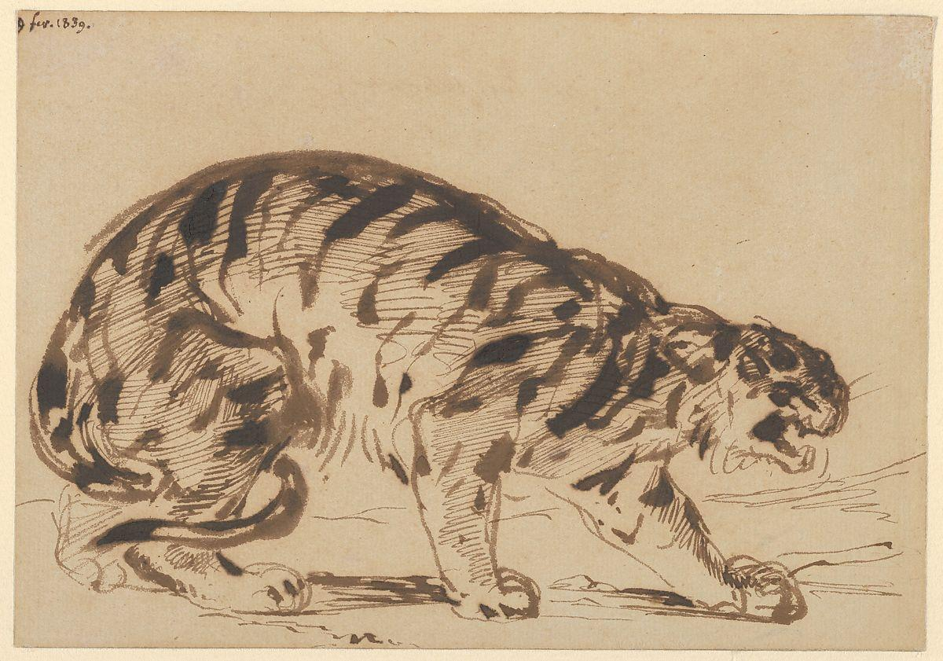
Slide 5
Crouching Tiger, Eugene Delacroix, 1839

Slide 7
Citations
Images:
Slides 1, 2, 4: http://www.henrirousseau.net/surprised.jsp
Slide 3: https://mapofeurope.com/world-map/
Slide 5: https://www.metmuseum.org/art/collection/search/336529
Information:
http://www.bbc.com/culture/story/20151002-henri-rousseau-the-untrained-godfather-of-modern-art
https://www.nationalgallery.org.uk/paintings/henri-rousseau-surprised

