Slide 1
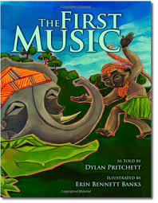

Slide 2
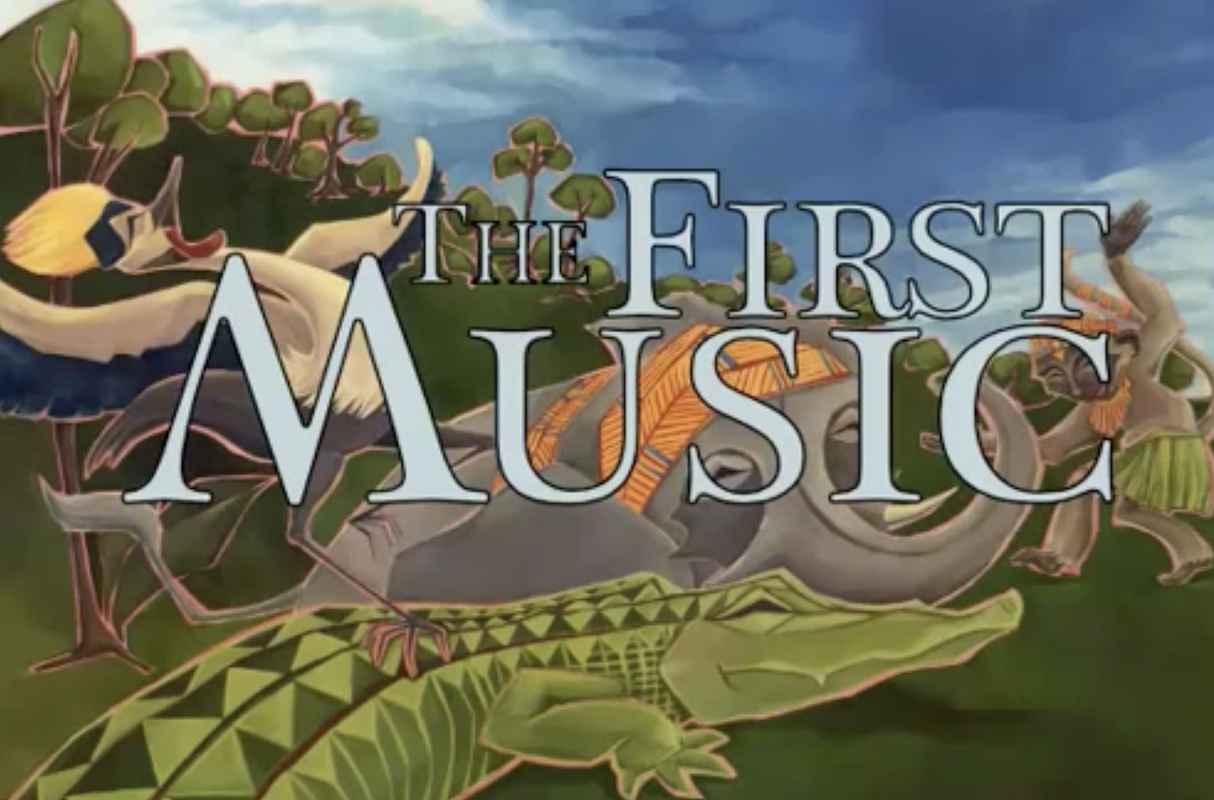
Slide 1
Click on image to play video

Slide 3
Slide 2
“Keep up that beat,” Monkey said to King Frog. “I thought frogs could only watch and listen.”
“Someone’s arms and legs may be too short to play or dance. But they can use their voices, no matter how different they may sound,” said Crane.
“I guess everyone has something to add when it comes to making music,” King Frog croaked.

Slide 4
Slide 3
And that is how the animals learned to make music together. Now King Frog loves to sing so much you can hear him practicing every morning. At night, he sings again, and every animal in the African forest helps keep the music alive. And, oh, how sweet the sound they perform together!

Slide 5
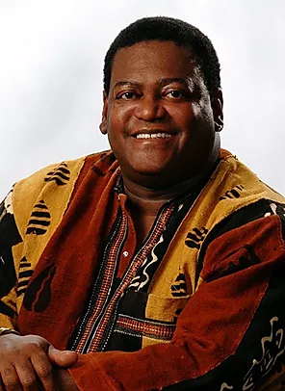
Slide 4
Notes:
Read author’s note

