Slide 1
Where do cocoa beans
come from?
Text Talk Week 3, Day 1

Slide 2
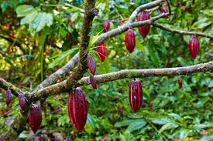
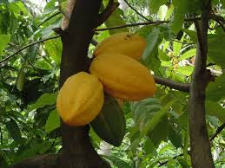
Slide 1
Cocoa grows in forests that are warm and wet, often rainforests. Cacao trees grow in the shade of larger trees.
Where in the world are these forests located?

Slide 3
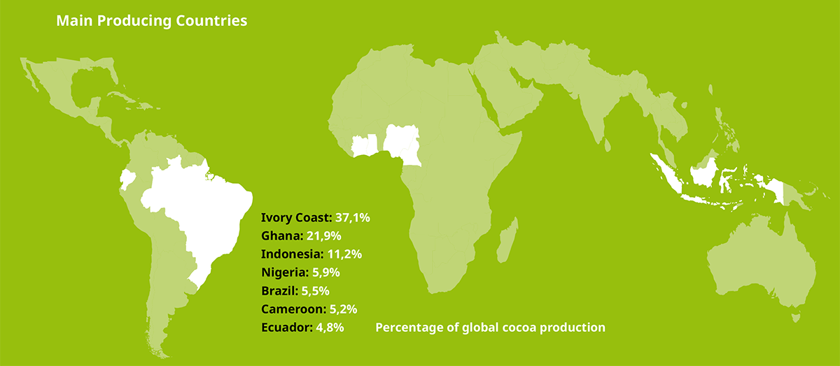
Slide 2
https://makechocolatefair.org/issues/cocoa-production-nutshell

Slide 4
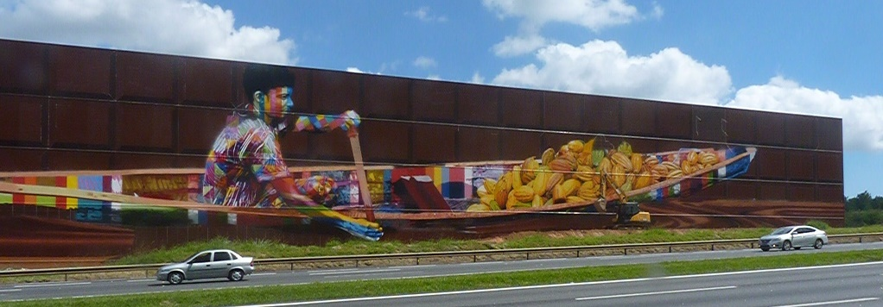
Notes:
http://carapicuibanarede.com.br/regiao-visita-a-fabrica-de-chocolate-e-diversao-pra-criancada-no-feriado-carapicuiba-na-rede-jornalismo-independente/

