Slide 1
Communities We Belong To
Text Talk Week 3, Day 1

Slide 2
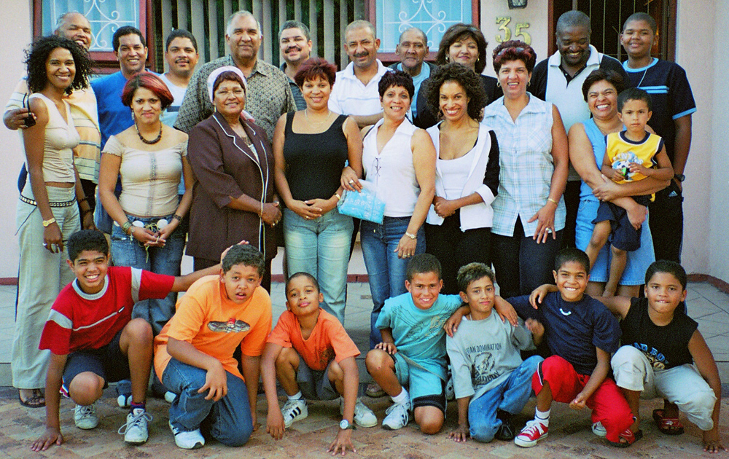
Family Communities
Slide 1
In families, people are close to one another and care about each other.
Many people belong to family communities.

Slide 3
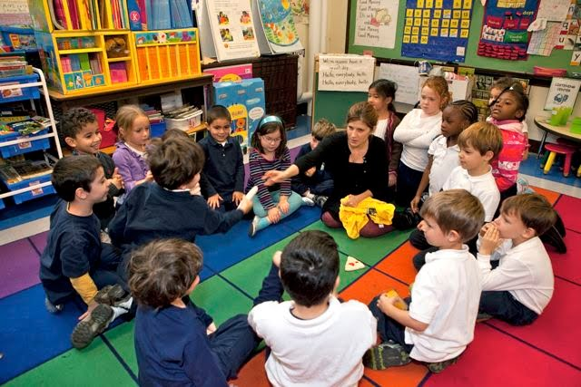
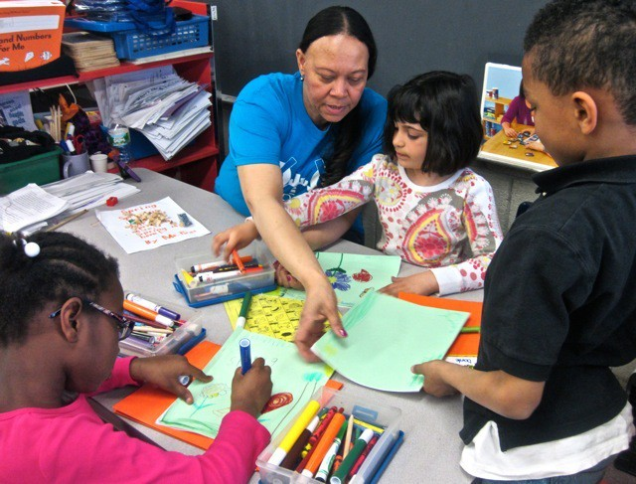
Classroom Communities
Slide 2
Classroom communities include classmates, teachers, and other adults. People work together.
Many people belong to classroom communities.

Slide 4
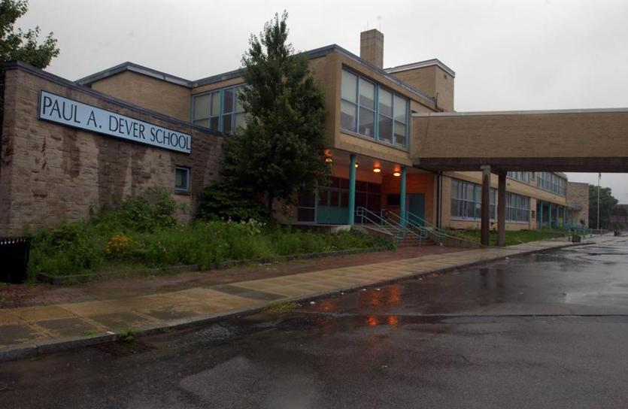
School Communities
Slide 3
People go to school to learn together. School communities include students, families, teachers, custodians, nurses, principals, and other adults.
Many people belong to school communities.

Slide 5
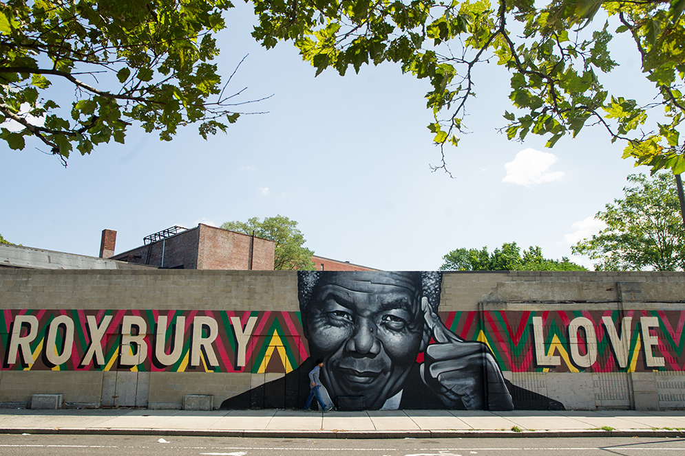
Neighborhood Communities
Slide 4
In neighborhood communities, people live and work close together. People get to know each other in neighborhoods.
Many people belong to neighborhood communities.

Slide 6
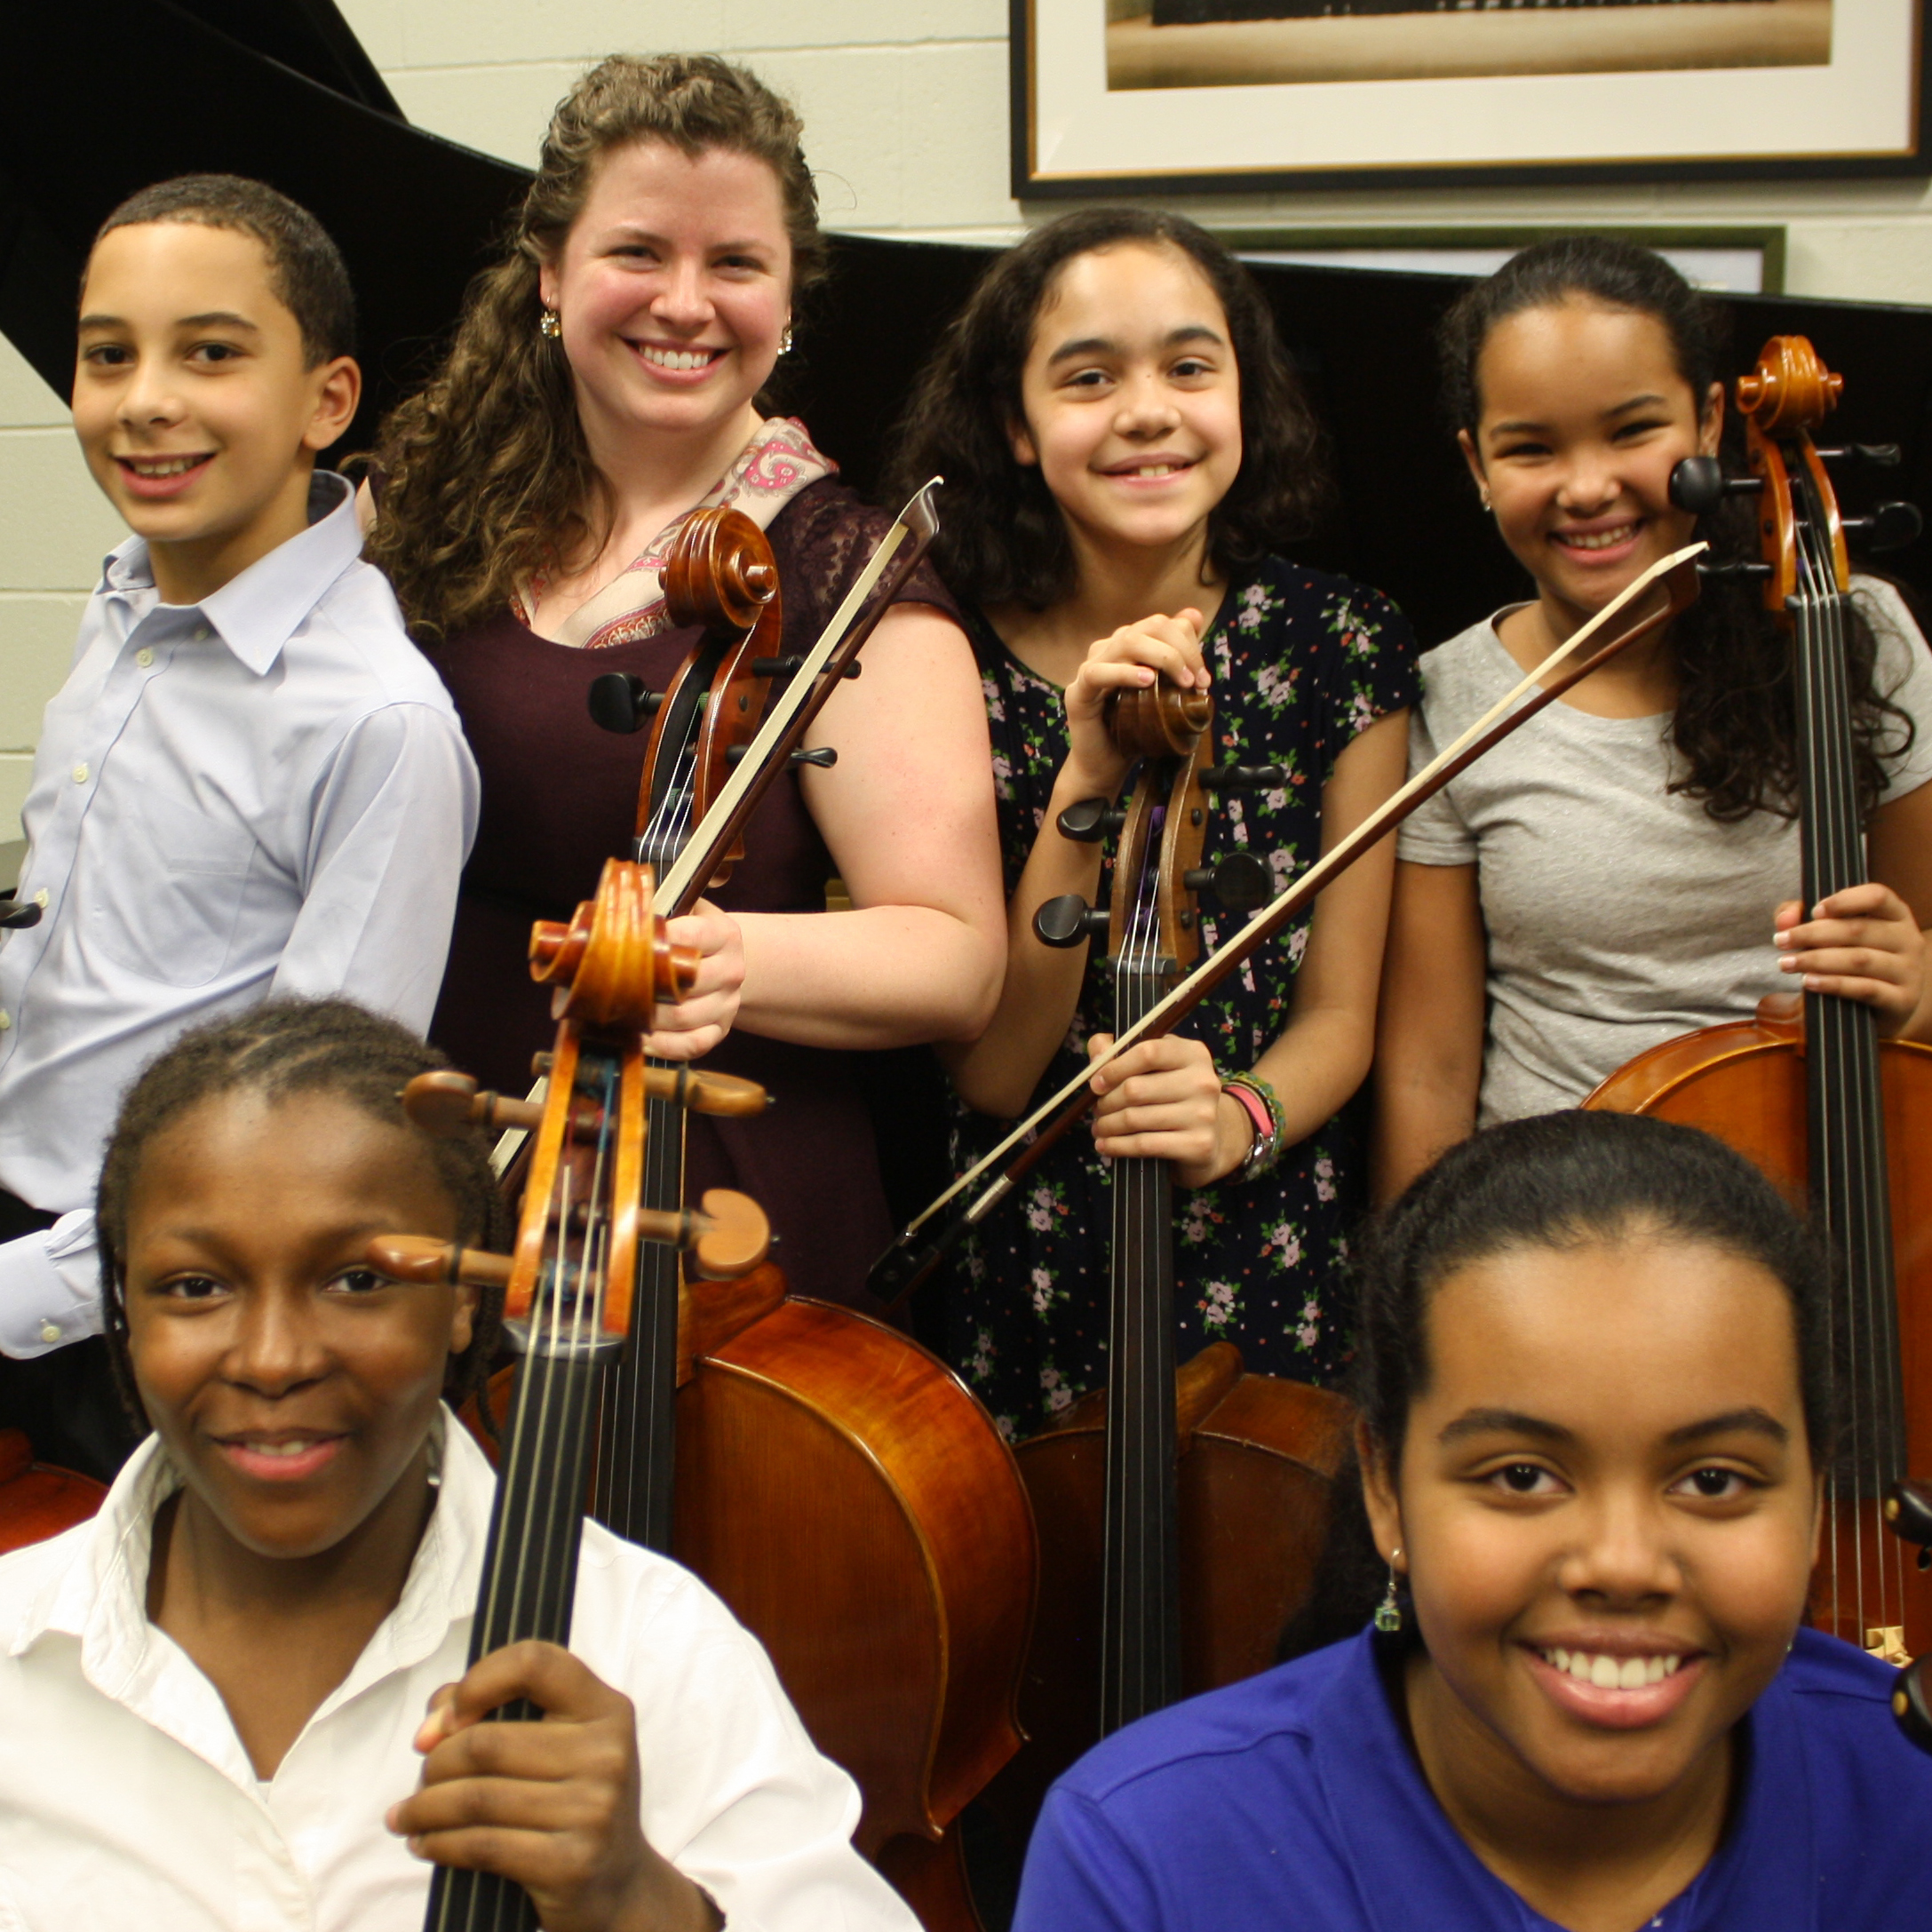
Artistic Communities
Slide 5
Artistic communities include people who want to do something creative together, like play music, make visual art, or dance.
Many people belong to artistic communities.

Slide 7
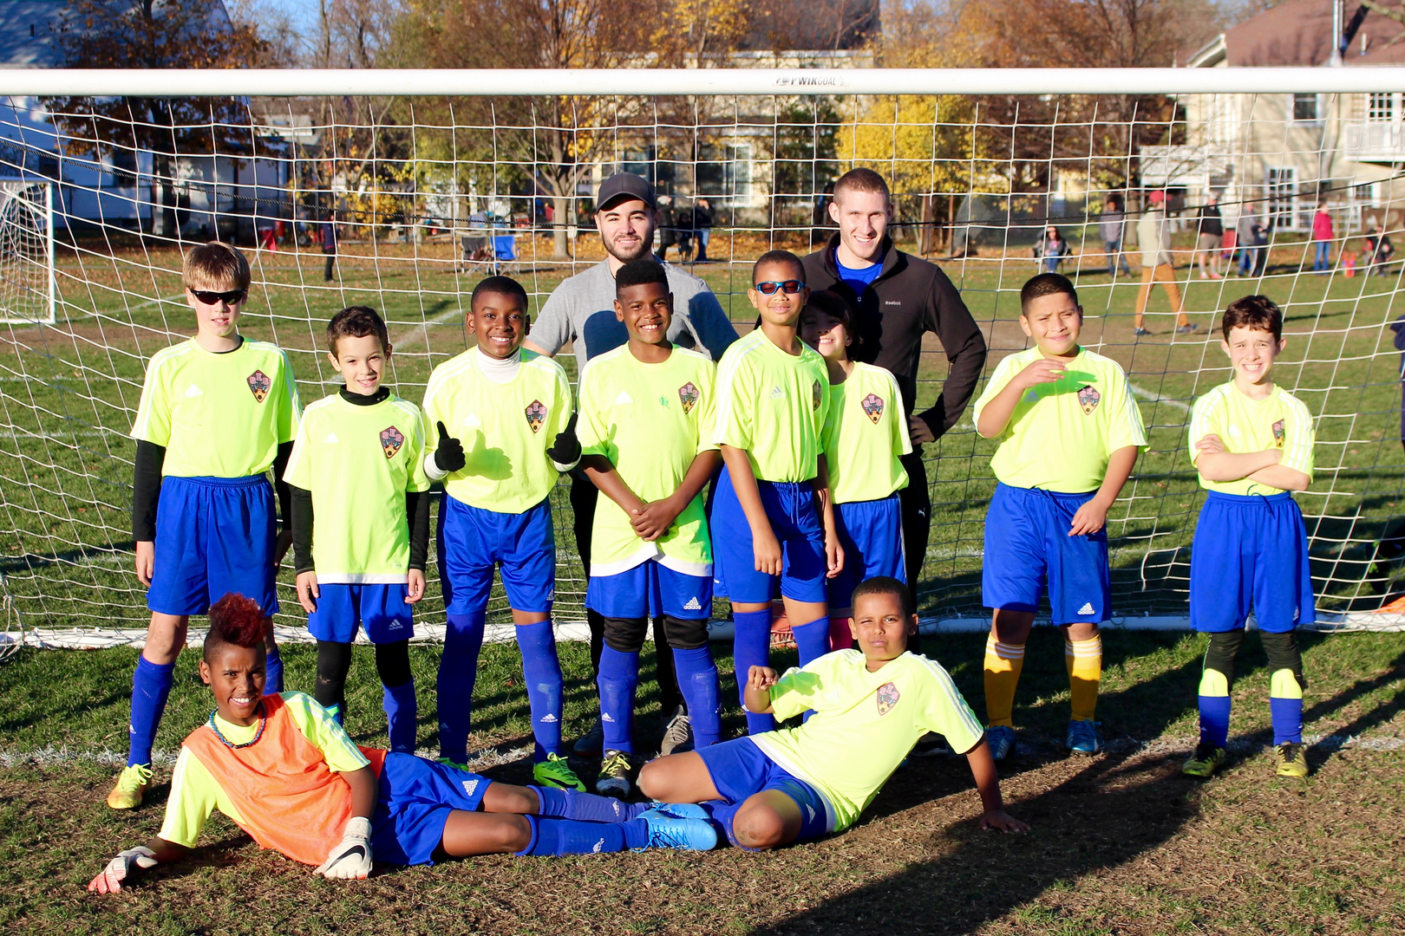
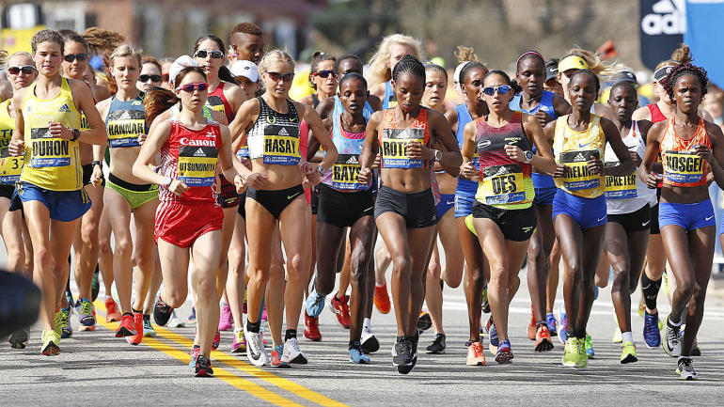
Athletic Communities
Slide 6
People play sports together. Some people are part of a team, like a soccer team. Some people connect with others by doing an activity together, talking about it and being fans, like runners watching the Boston Marathon.
Many people belong to athletic communities.

Slide 8
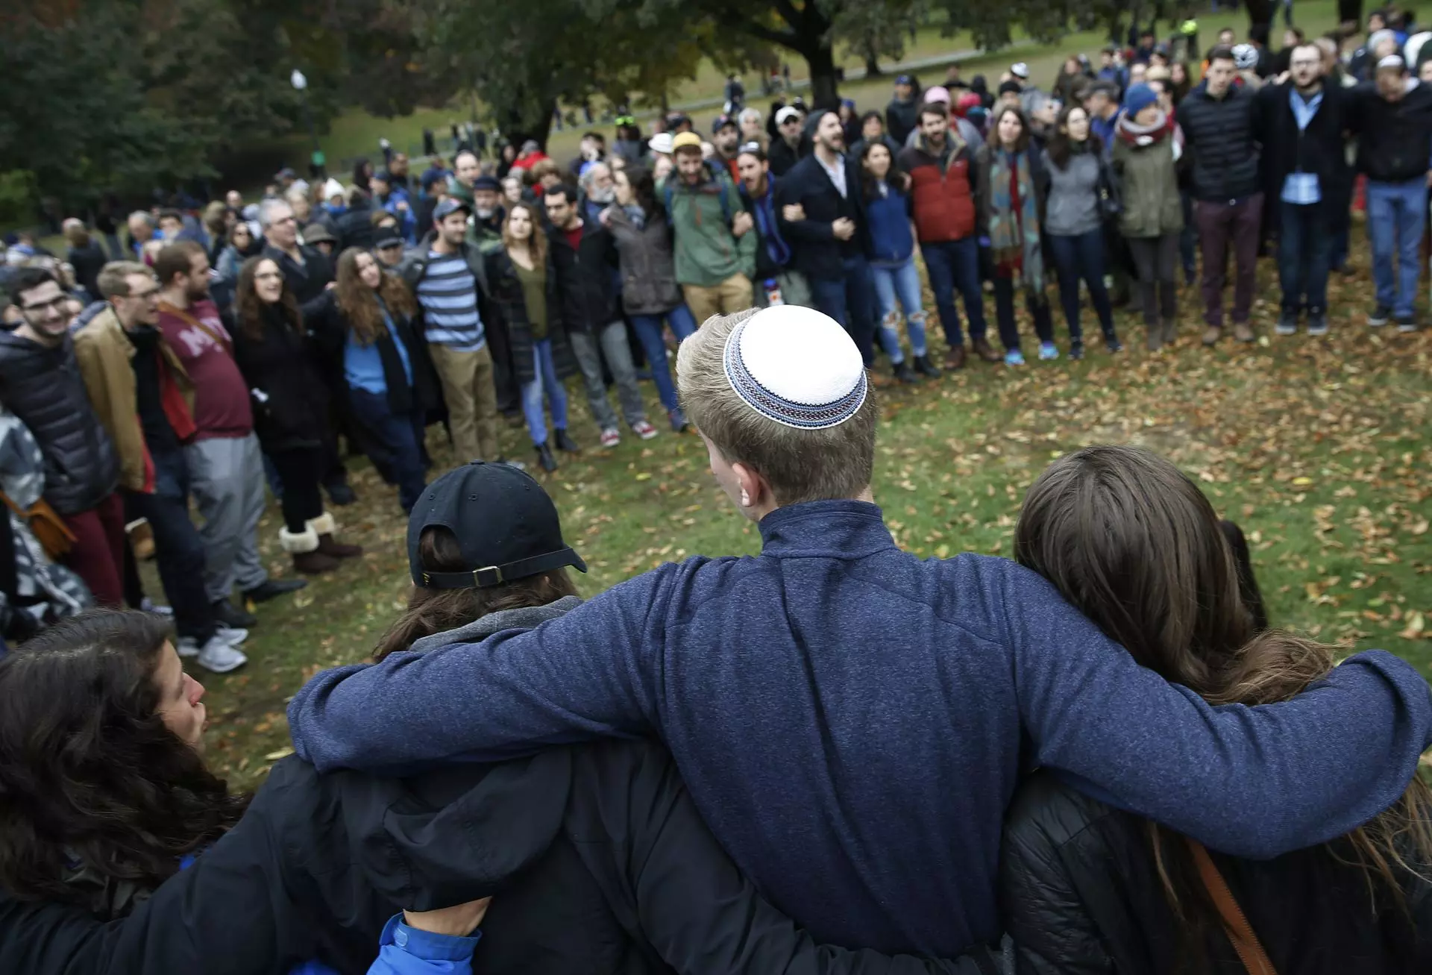
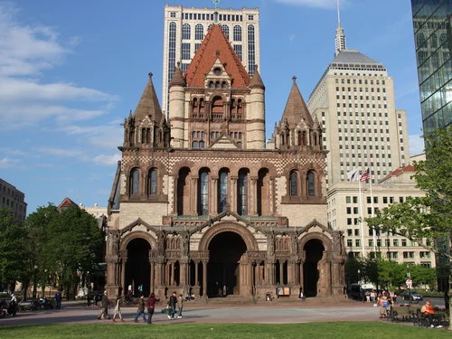
Religious Communities
Slide 7
In religious communities, people share a set of beliefs. People support each other.
Many people belong to religious communities.

Slide 9
Citations
Slide 1: https://en.wikipedia.org/wiki/Family
Slide 2: https://sites.google.com/a/bostonpublicschools.org/history/curriculum-documents/kindergarten, https://btu.org/learning/west-zone-early-learning-center/
Slide 3: http://archive.boston.com/yourtown/specials/gallery/mcas_improved_schools?pg=10
Slide 4: http://www.bu.edu/today/2016/getting-to-know-your-neighborhood-roxbury/
Slide 5: http://projectstep.org/wp/wp-content/uploads/2014/01/MLK-Day-for-Photo-Page.jpg
Slide 6: http://www.southendsoccer.org/our-team.html, https://www.cbssports.com/general/news/boston-marathon-says-trans-women-can-compete-as-women-we-take-people-at-their-word/
Slide 7: https://www.bostonglobe.com/metro/2018/10/28/local-vigils-planned-for-pittsburgh-synagogue-shooting/wgiBf7RtA1XPlkvNIpDV0I/story.html, https://www.skyscanner.com/trip/boston/things-to-do/trinity-church-boston

