Slide 1
Amazing Sounds:
How does this music make us feel?
Text Talk Week 2, Day 5

Slide 2
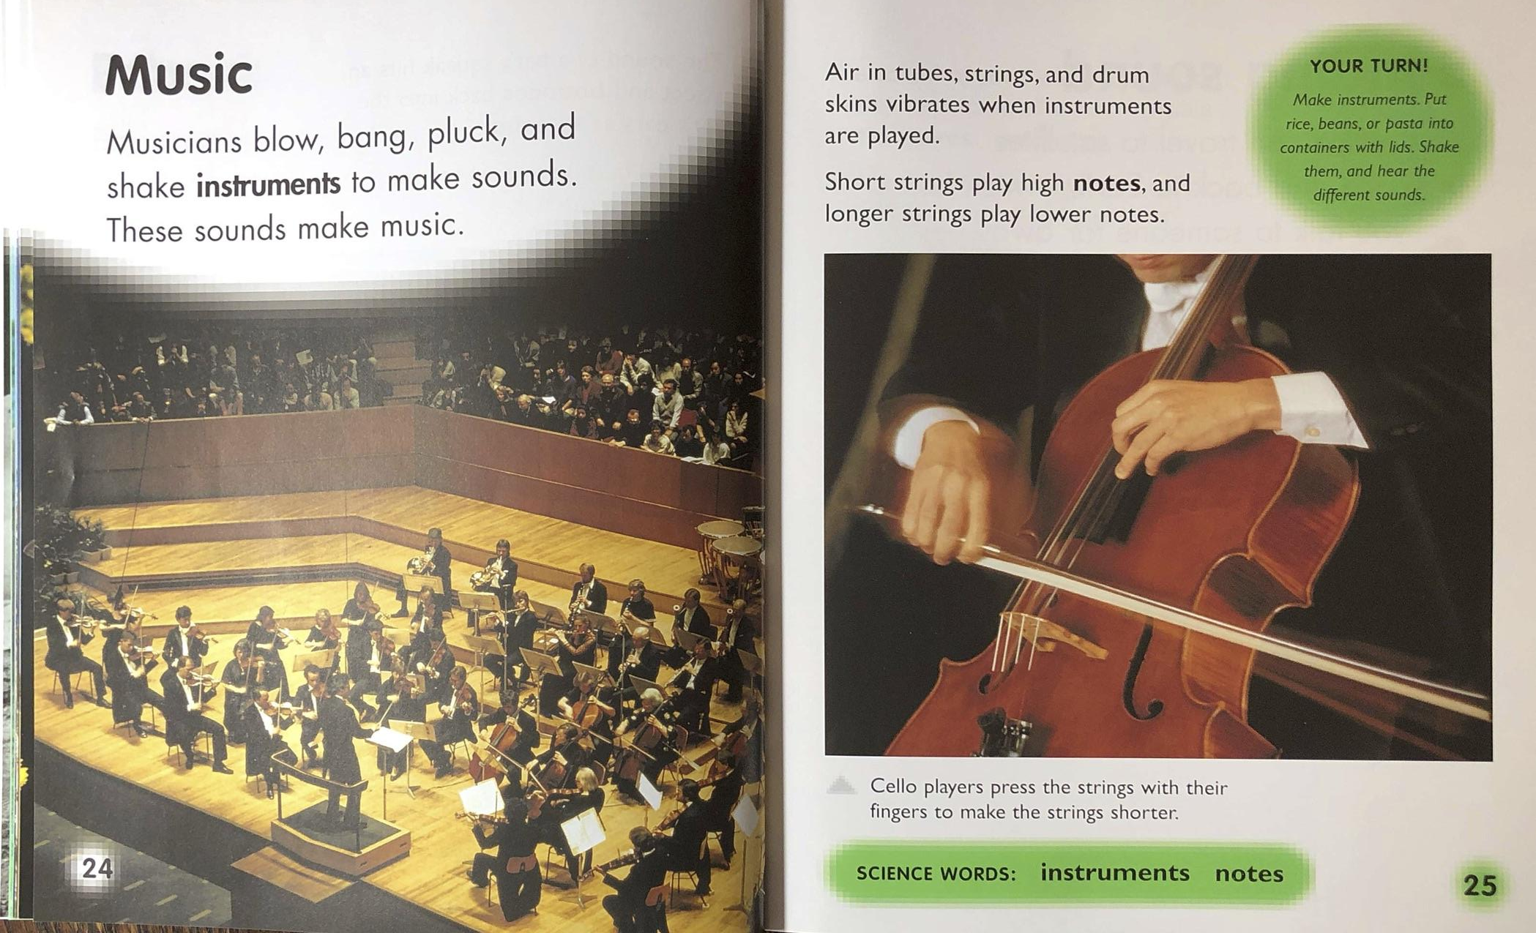

Slide 3
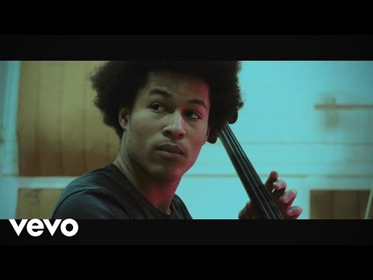
Slide 1

Slide 4
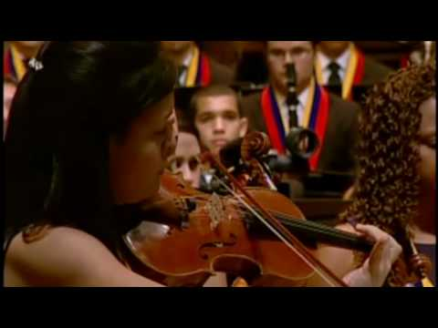
Slide 2
Notes:
Show video and play audio

Slide 5
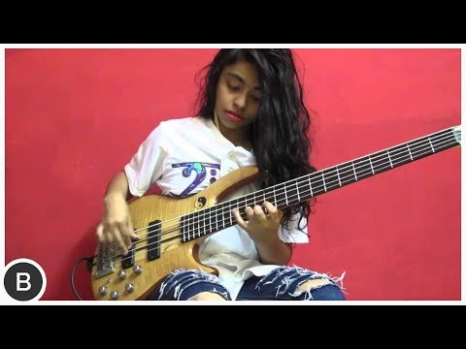
Slide 3
Notes:
https://news.berkeley.edu/2020/01/06/music-evokes-13-emotions/
http://www.gradfree.com/kevin/some_theory_on_musical_keys.htm

Slide 6
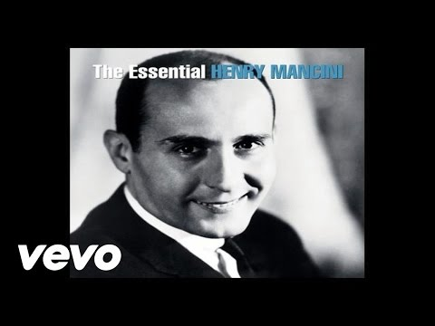
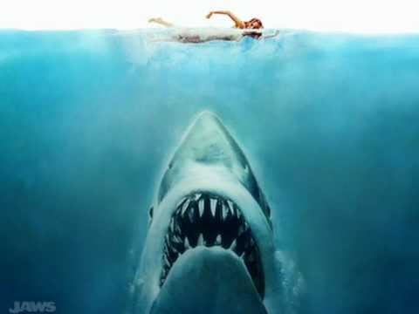
Slide 4
Notes:
Do not see screen for these ones- just listen
https://news.berkeley.edu/2020/01/06/music-evokes-13-emotions/
http://www.gradfree.com/kevin/some_theory_on_musical_keys.htm

Slide 7
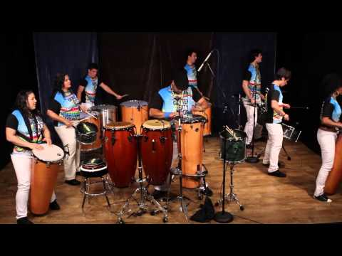
Slide 5
Notes:
https://news.berkeley.edu/2020/01/06/music-evokes-13-emotions/
http://www.gradfree.com/kevin/some_theory_on_musical_keys.htm

Slide 8
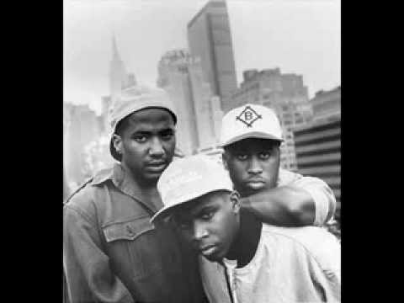
Slide 6

Slide 9
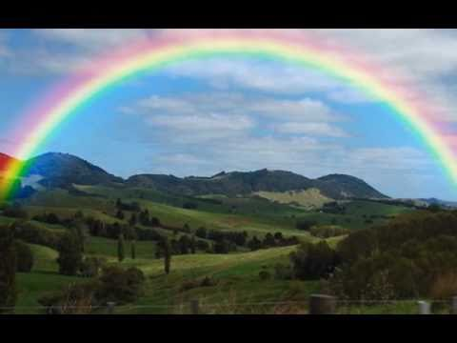
Slide 7

Slide 10
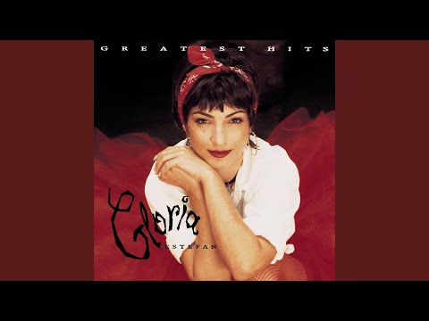
Slide 8

