Slide 1
Market
Text Talk Week 1, Day 2
Notes:
global, map

Slide 2
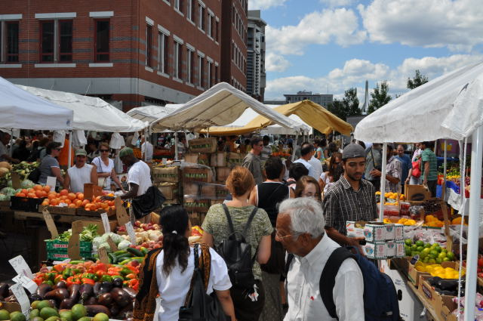
http://keithdalyphoto.blogspot.com/2010/08/haymarket-boston-ma.html

Slide 3
http://keithdalyphoto.blogspot.com/2010/08/haymarket-boston-ma.html
Haymarket is Boston's biggest open-air market.

