Slide 1
Root Words
Vocabulary and Language Week 7, Days 3-4

Slide 2
engineering

Slide 3
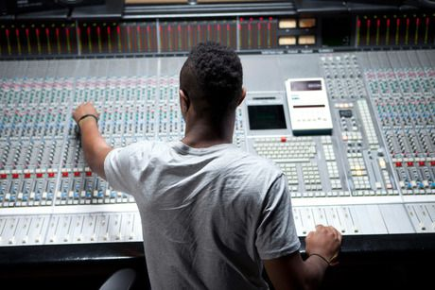
engineer
someone who designs and builds engines, machines, or structures
Notes:
https://www.pinterest.co.uk/pin/477381629243445290/

Slide 4
engineering

Slide 5
innovation

Slide 6
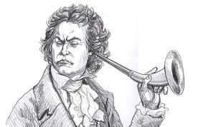
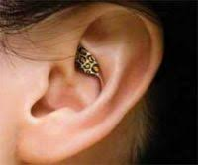
innovate
to make changes in something that already exists
Notes:
eniorplanet.org/not-your-grandpas-a-hearing-aid-history/
https://www.retirementliving.com/hearing-aid-technology

Slide 7
innovation

Slide 8
invention

Slide 9
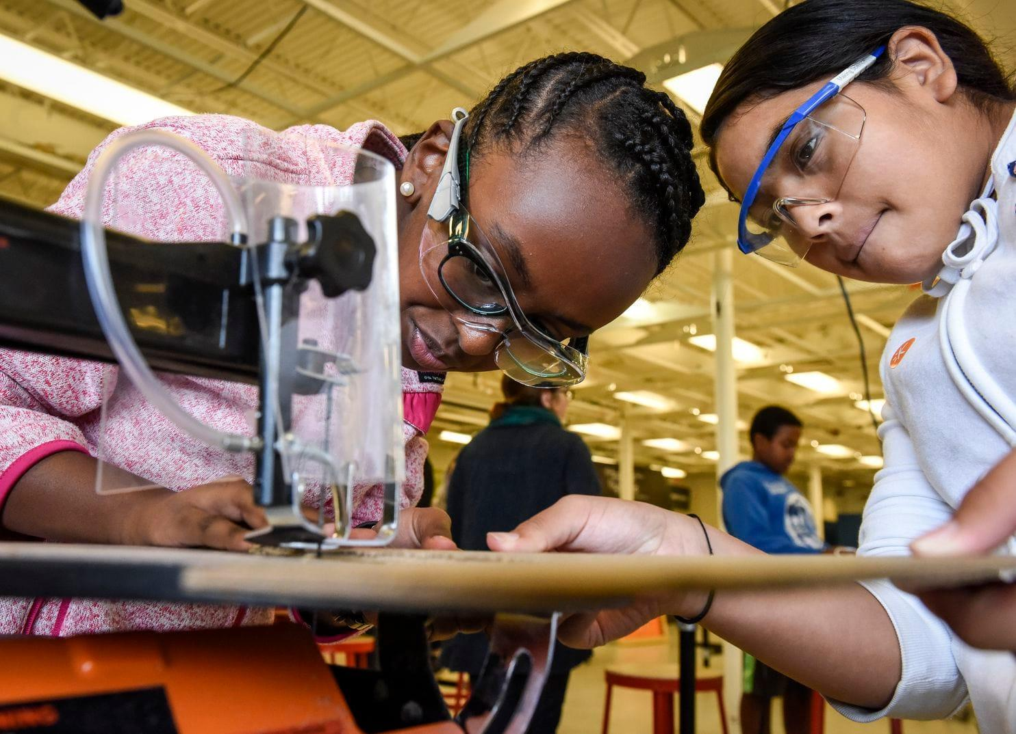
invent
to create or design something that did not exist before
Notes:
invent
Elaboration:
When people invent something, they come up with a plan, build the invention, and make sure that it works as they intended it. The girls in the image are building and testing the motion sensing light-switch they invented.
Think, Pair, Share prompt:
Have you invented something? Do you know anybody who invented something? You might think of a character from a text or someone in real life. Tell your partner about it.
https://www.washingtonpost.com/lifestyle/kidspost/museum-helps-kids-learn-skills-to-invent-the-future/2018/10/29/5c64e4d0-d6e6-11e8-83a2-d1c3da28d6b6_story.html

Slide 10
invention

Slide 11
A new garden would make a big improvement to the school.

Slide 12
improve
to make better
Notes:
https://articles.bplans.com/10-tips-to-improve-business-efficiency/

Slide 13
A new garden would make a big improvement to the school.

Slide 14
They showed perseverance when they completed the hard task.

Slide 15
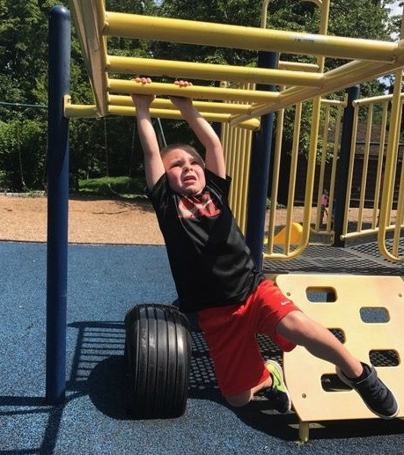
persevere
to keep trying in the face of difficulty
Notes:
https://mystudentvoices.com/how-to-persevere-like-a-4-year-old-adb1e418bde3

Slide 16
They showed perseverance when they completed the hard task.

