Slide 1
Personal Pronouns
Vocabulary and Language Week 7, Day 3

Slide 2
Slide 1
Rosa tried on skates. Rosa tried on dresses. Rosa tried on coats.
Rosa tried on skates. She tried on dresses. She tried on coats.

Slide 3
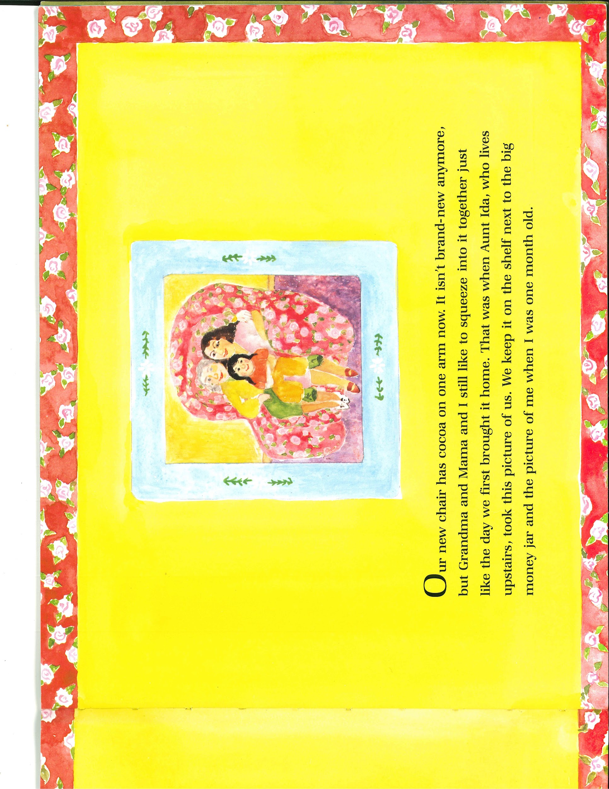
Slide 2

Slide 4
Slide 3
That was when Aunt Ida, who lives upstairs, took this picture of us.

Slide 5
Slide 4
That was when Aunt Ida, who lives upstairs, took this picture of us.
We keep it on the shelf next to the big money jar and the picture of me when I was one month old.

