Slide 1
Describe and Classify Objects
Vocabulary and Language Week 5, Days 3-4

Slide 2
Adjectives
Adjectives describe nouns.
They answer these questions:
How many/much?
What kind?
What like?
Which ones? Whose?

Slide 3
Describe Objects
smooth | bumpy | rough
small | medium | large
opaque | translucent | transparent
This _____ is _____ and _____.

Slide 4
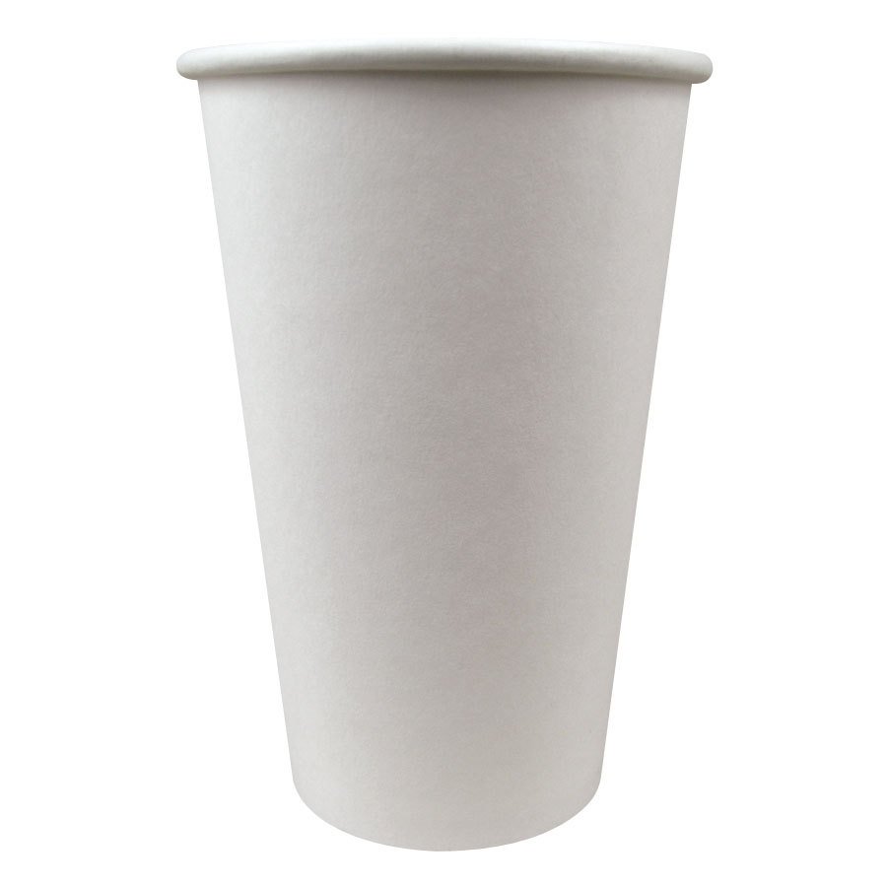
Classify and Describe Objects
A paper cup is a container that _____.

Slide 5
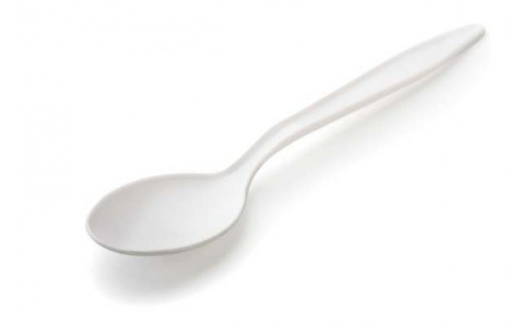
Classify and Describe Objects
A plastic spoon is a _____ that _____.

Slide 6
Classify and Describe Objects
A _____ is a _____ that _____.

