Slide 1
Possessive Nouns
Vocabulary and Language Week 4, Days 3-4

Slide 2
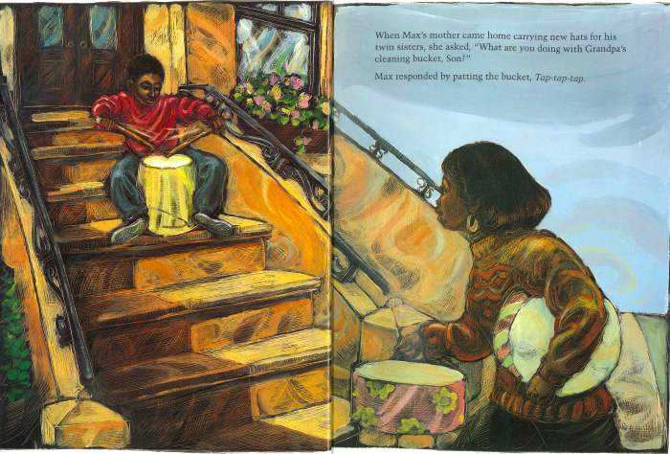
When Max’s mother came home carrying new hats for his twin sisters, she asked, “What are you doing with Grandpa’s cleaning bucket, Son?”

Slide 3
Max’s mother

Slide 4
When Max’s mother came home carrying new hats for his twin sisters, she asked, “What are you doing with Grandpa’s cleaning bucket, Son?”

Slide 5
Grandpa’s cleaning bucket

Slide 6
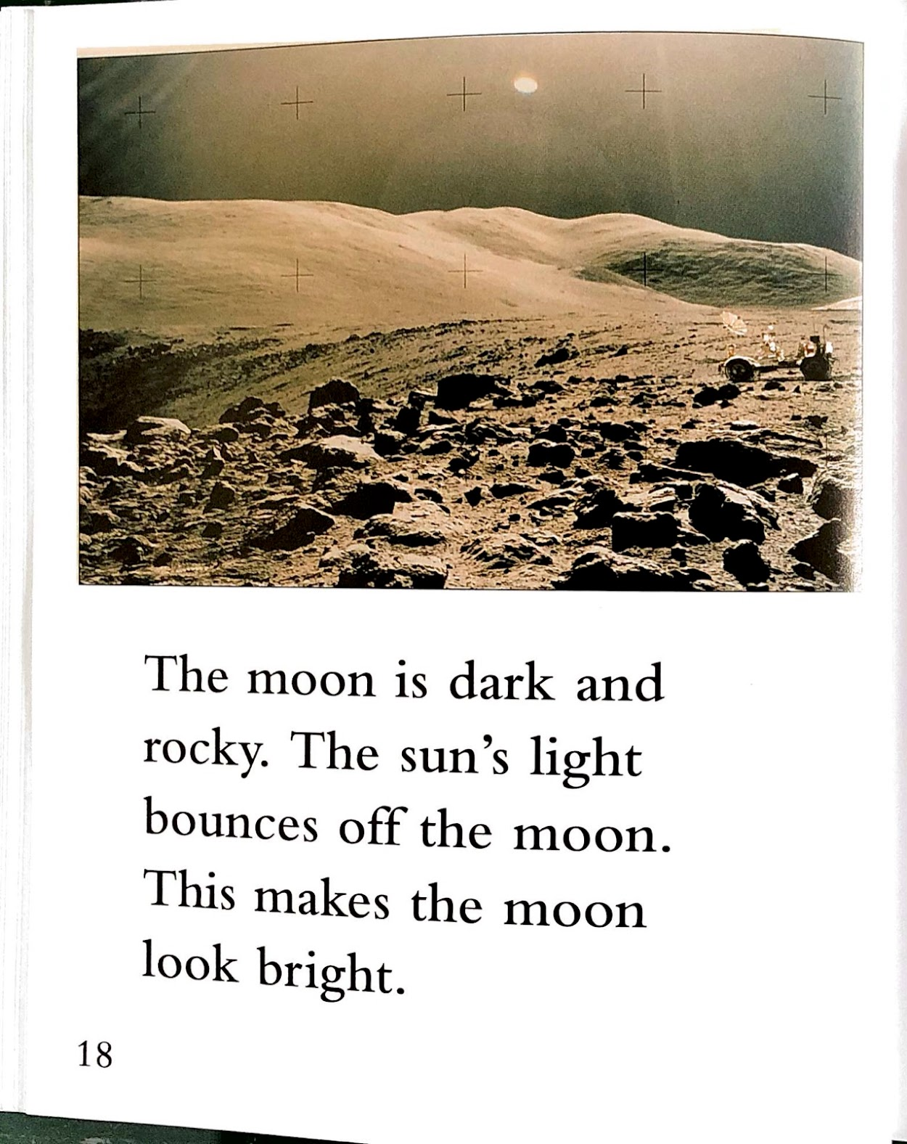

Slide 7
The sun’s light

Slide 8
Your turn!
You will write two sentences that include possessive nouns.
Write a sentence that includes a possessive noun. The possessive could show the relationship between two people or things, or it could show that someone owns something.
Write a second sentence that includes a possessive noun.

