Slide 1
Phrases of Place
Vocabulary and Language Week 3, Days 3-4

Slide 2
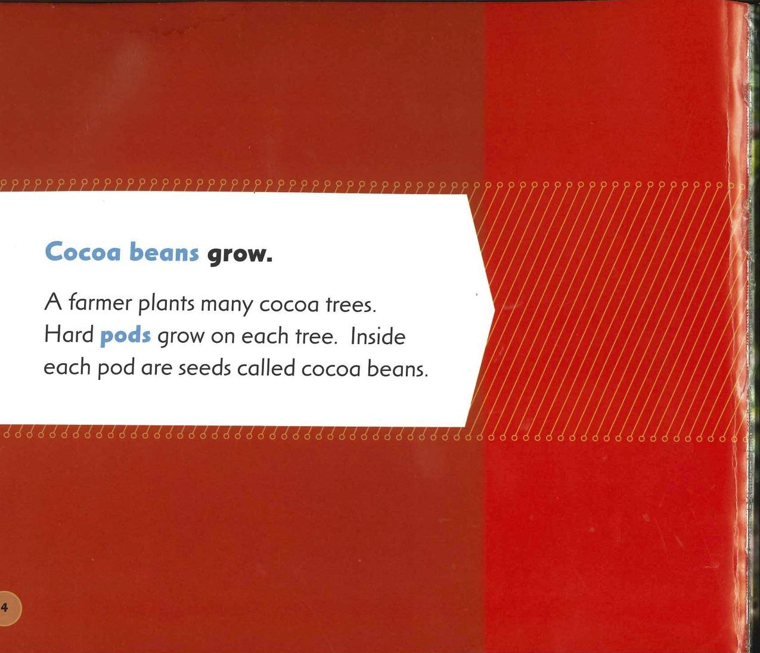
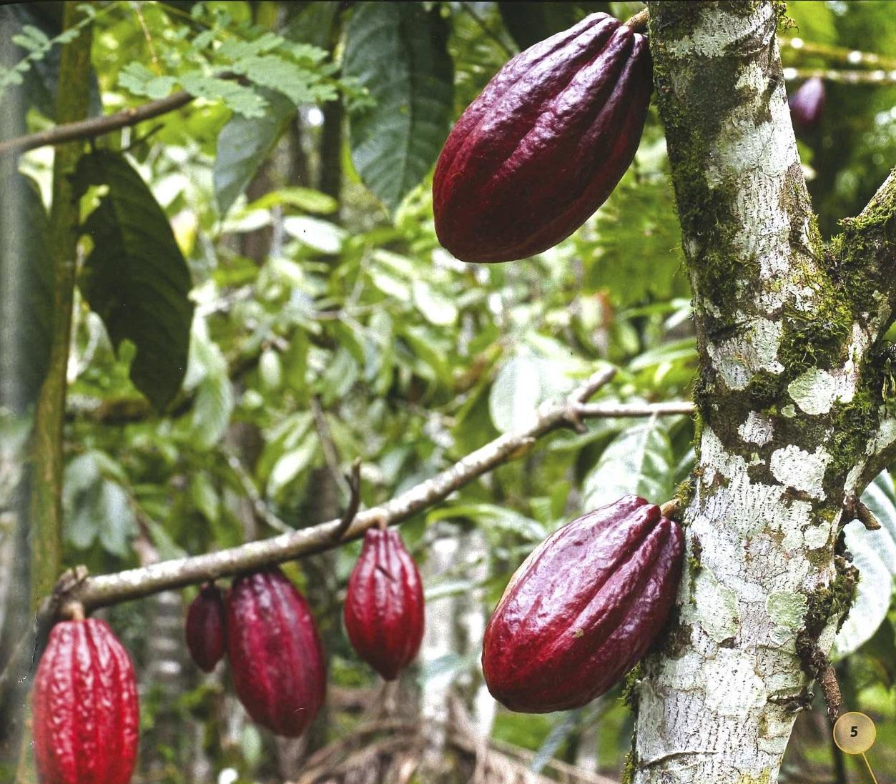
Slide 1

Slide 3
Slide 2
Hard pods grow on each tree.
Hard pods grow on each tree.
Hard pods grow on each tree.

Slide 4
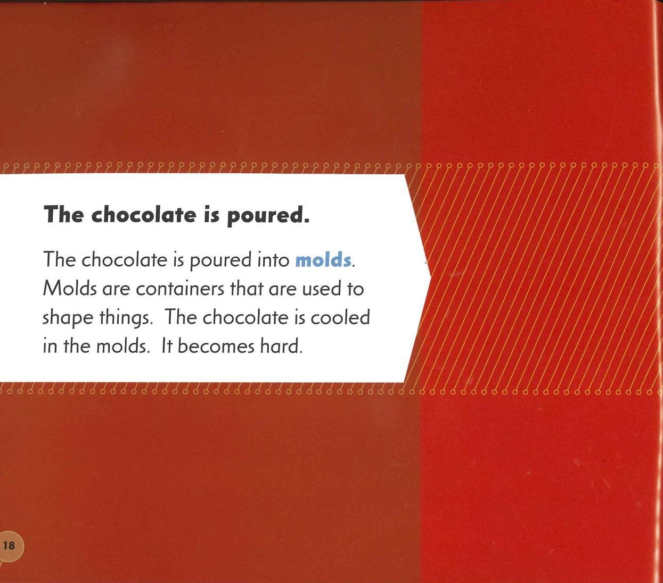
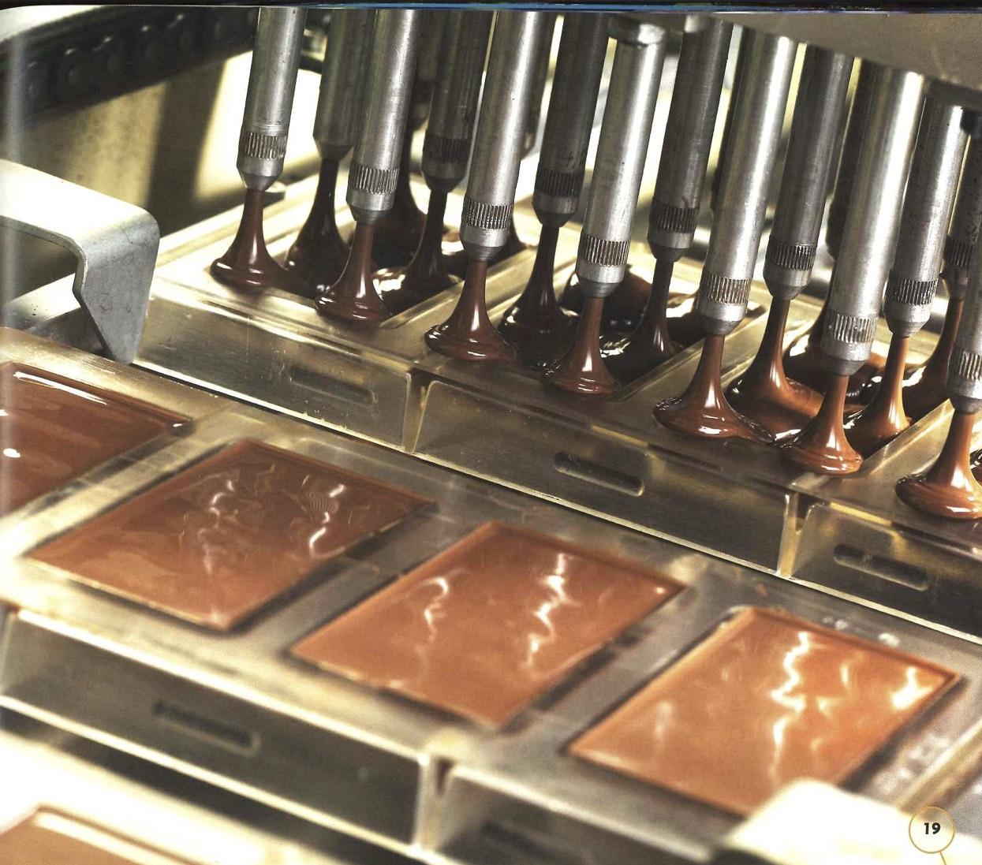
Slide 3

Slide 5
Slide 4
The chocolate is cooled in the molds.
The chocolate is cooled in the molds.
The chocolate is cooled in the molds.

Slide 6
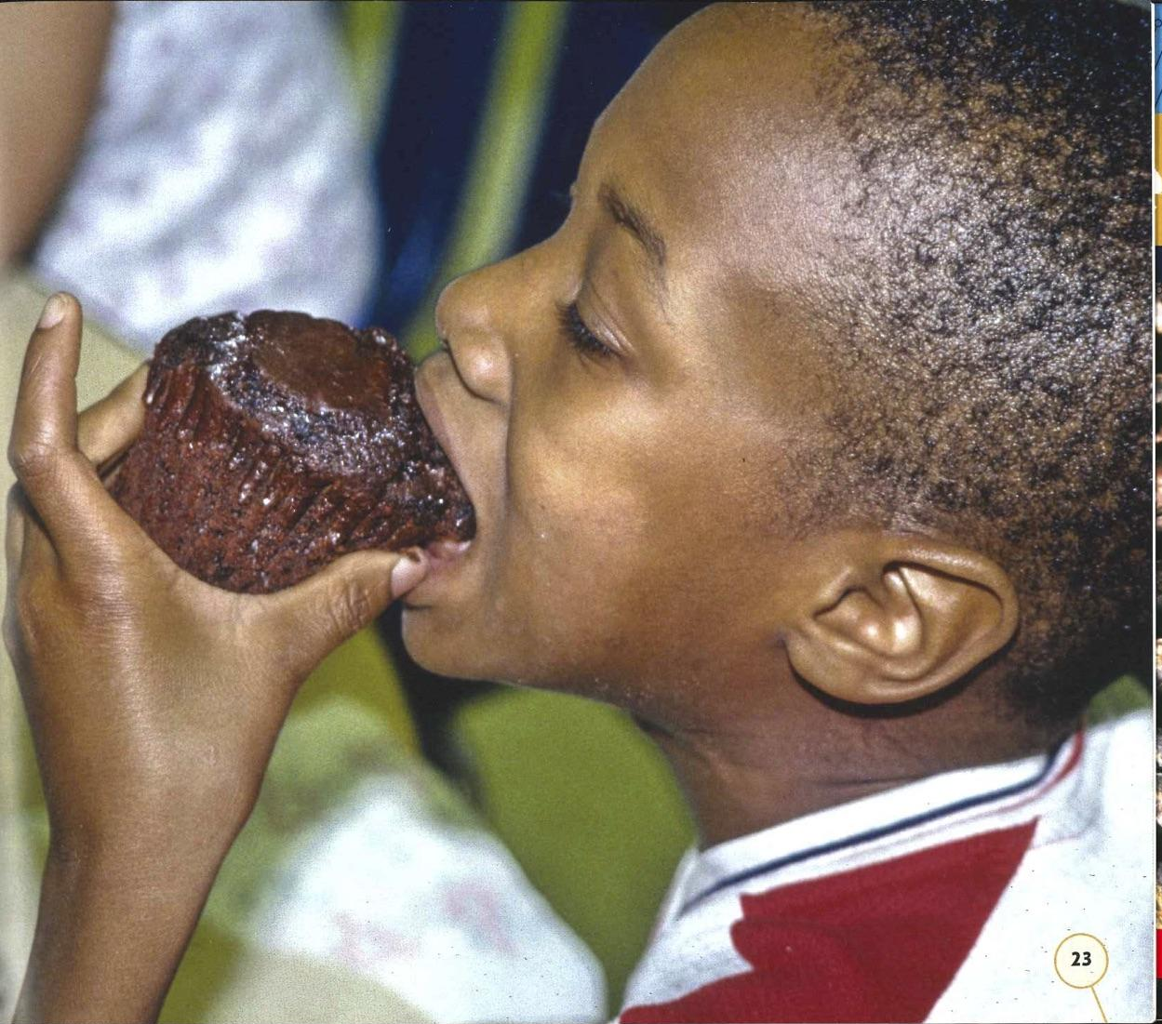
Slide 5
The cupcake is ______________.

Slide 7
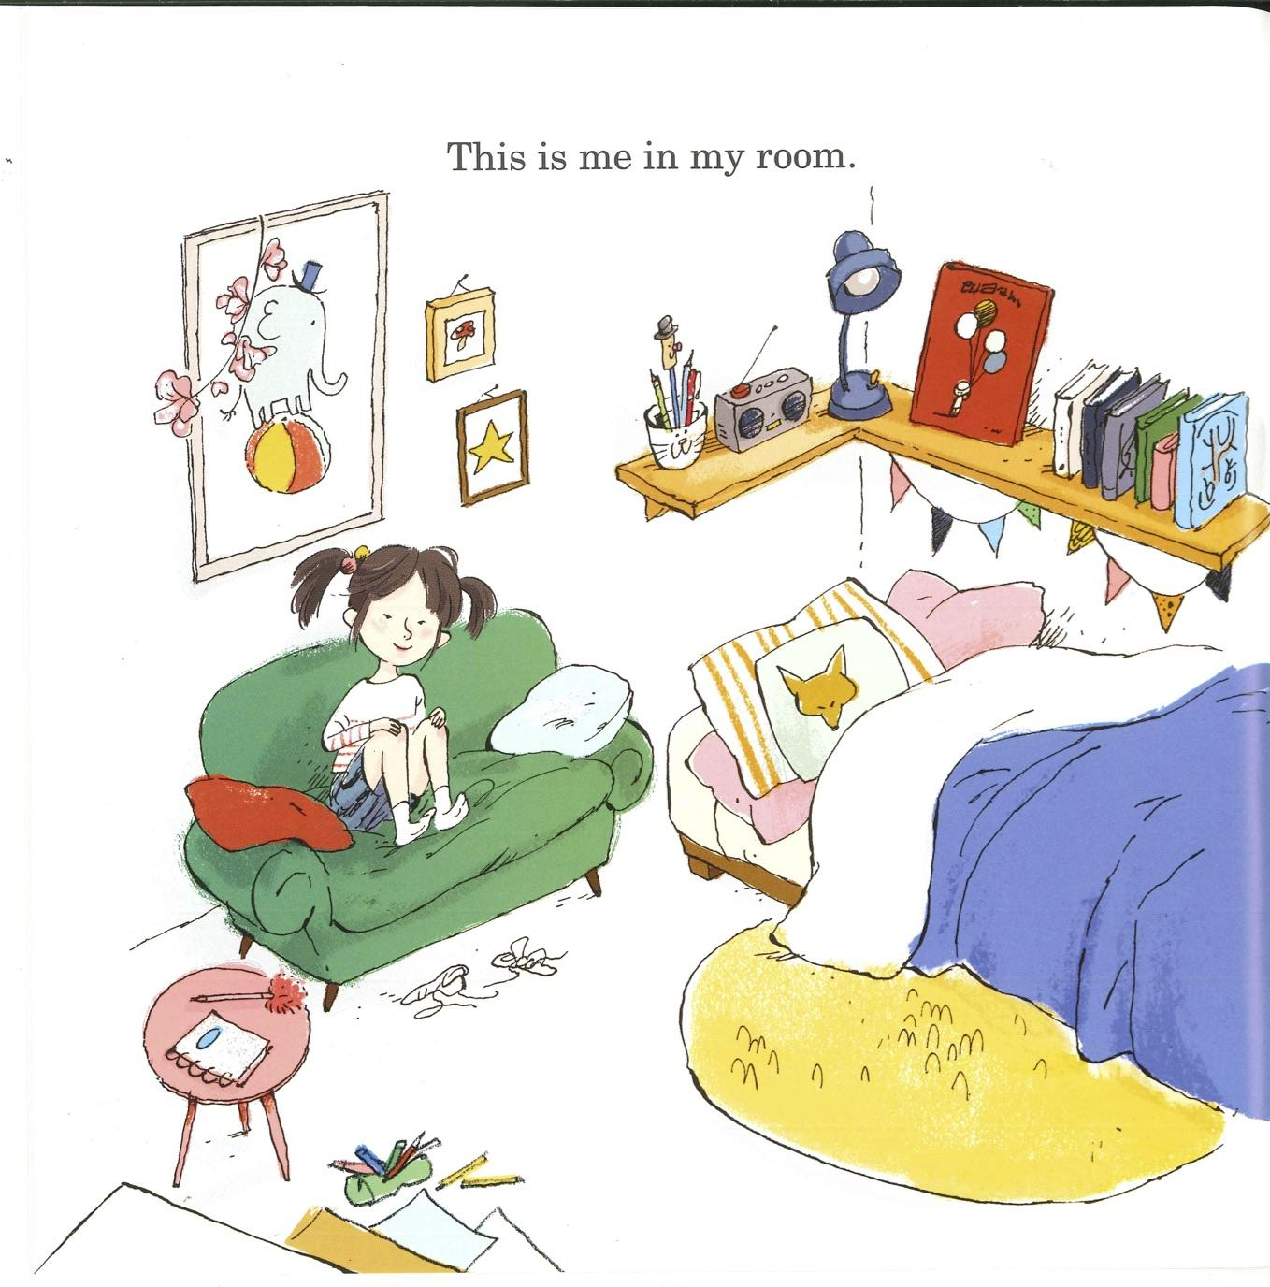
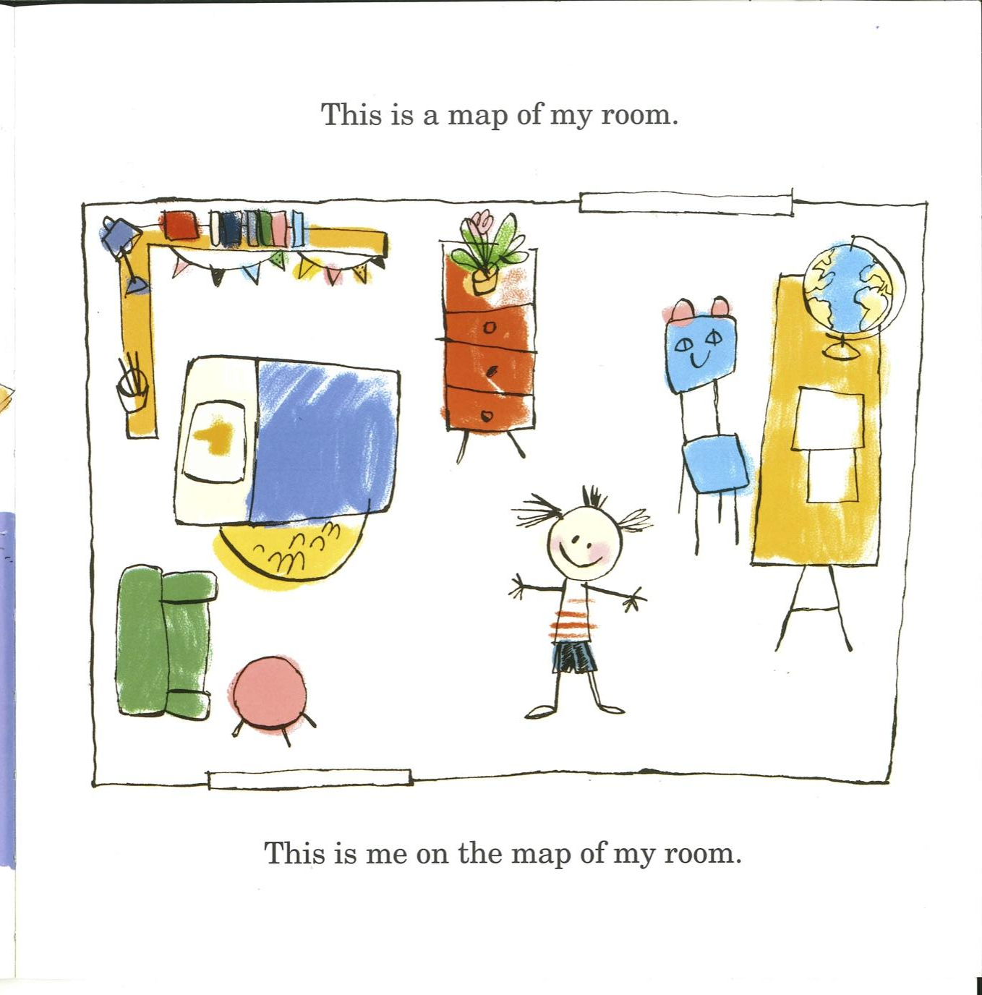
Slide 6

Slide 8
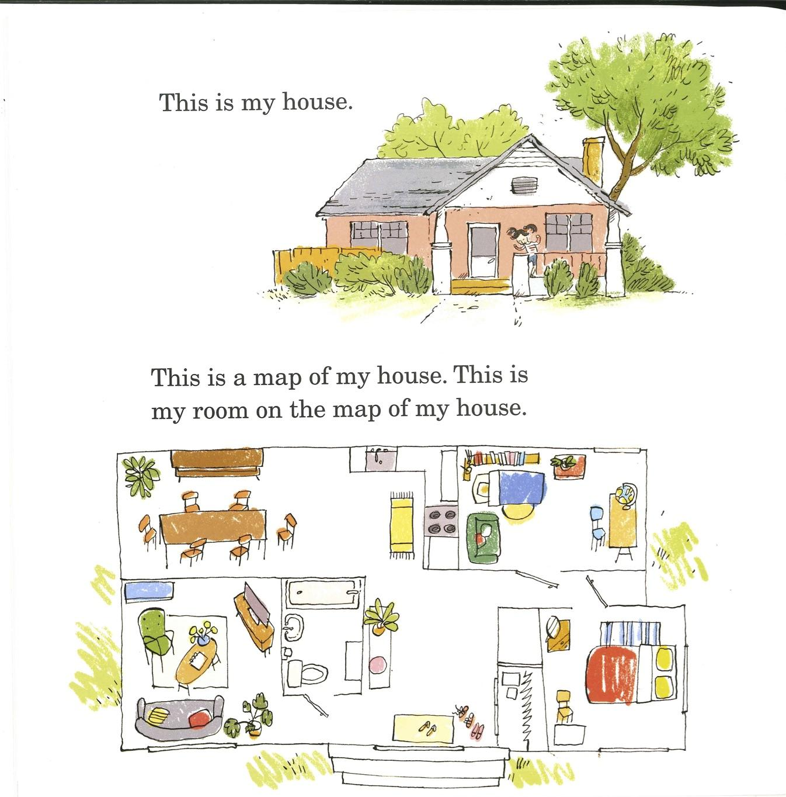
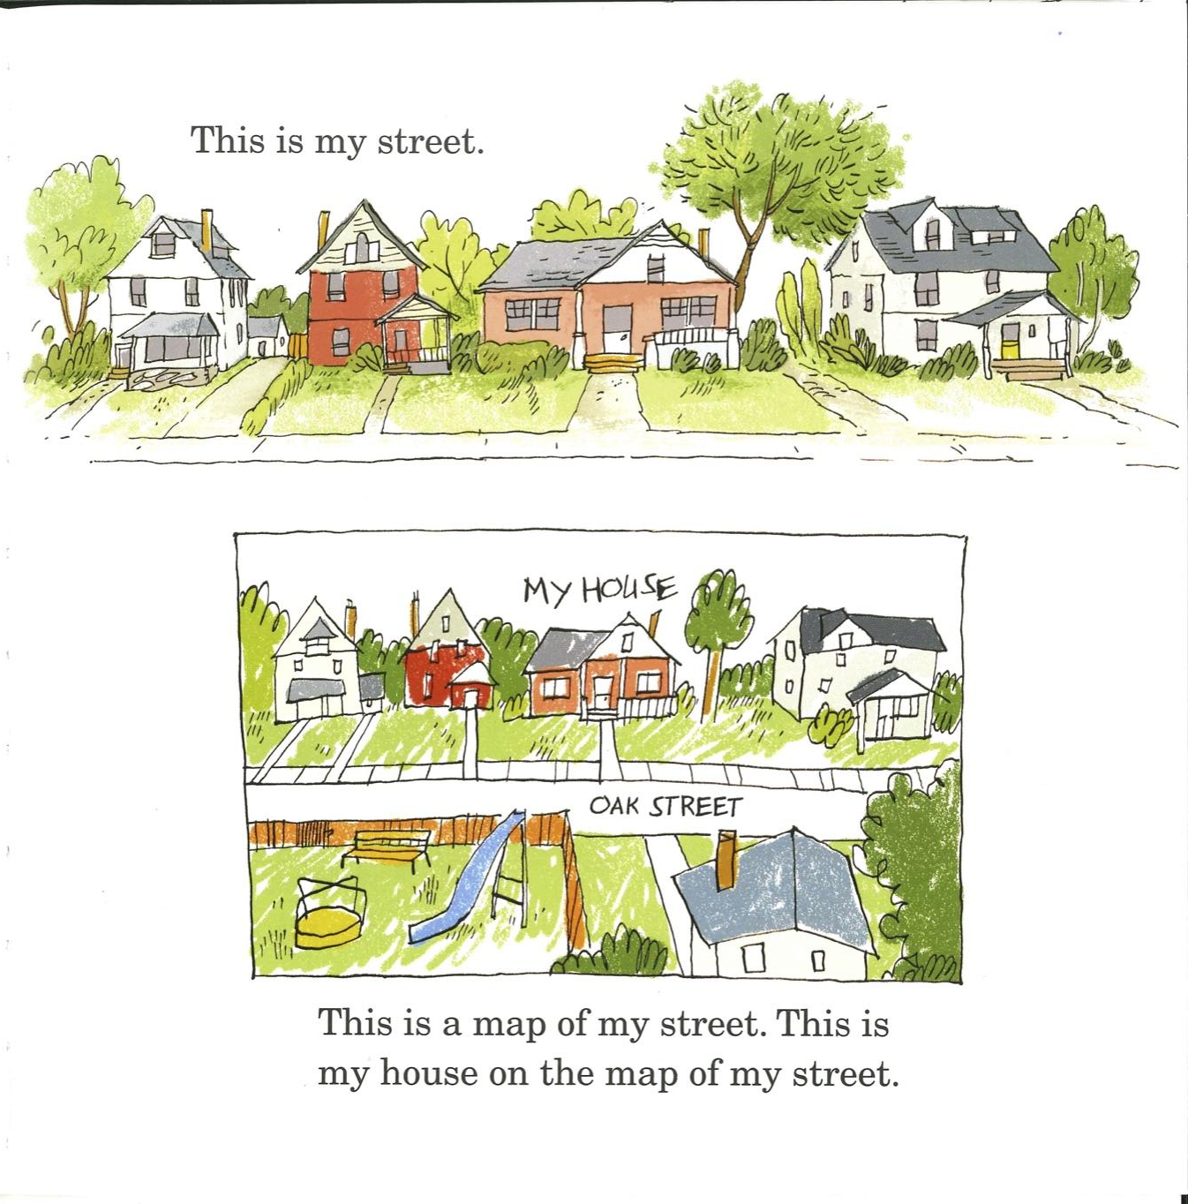
Slide 7

